Slide 1
Week5:Tetris
—— Practice of Programming Language 1——
Shen Shuyin
Spring

Slide 2
Tetris
What is Tetris?
Create Blocks(Tetriminos)
Move Left or Right
Rotate the Blocks
Remove the row

Slide 3
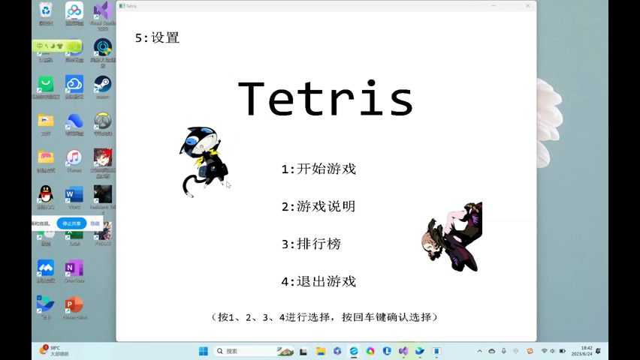
Introduction

Slide 4
Tetris
How to represent blocks?
Array

Slide 5
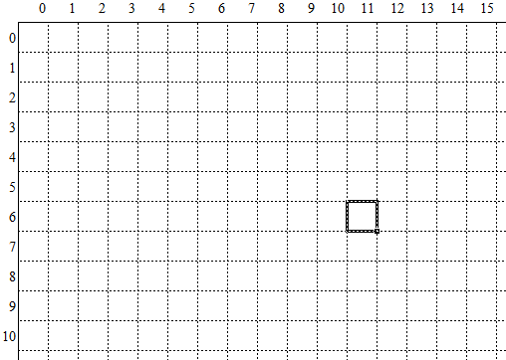
Review Screen Space
(x_{origin}, y_{origin})
(0,0)
x
y
rectangle(left, top,right,bottom);

Slide 6
Screen v.s. Game coordinates space
(x_{origin}, y_{origin})
(0,0)
x
block_width
left = x_orgin+ 11 * block_width
y
top = y_origin + 6 * block_width

Slide 7
How to represent a Tetris block
new int[4,4,2] {
{{0, 0}, {-1, 0}, {1, 0}, {0, -1}},
{{0, 0}, {1, 0}, {1, 0}, {0, -1}},
{{0, 0}, {-1, 0}, {1, 0}, {0, 1}},
{{0, 0}, {-1, 0}, {0, 1}, {0, -1}}
};

Slide 8
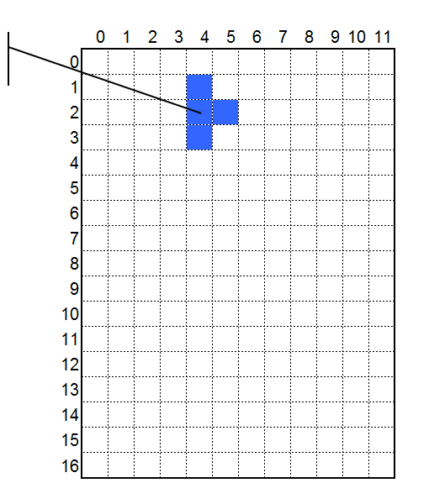
DrawTetrisBlock by using relative coordinates
new int[4,4,2] = {
{{0, 0}, {-1, 0}, {1, 0}, {0, -1}},
{{0, 0}, {1, 0}, {0, 1}, {0, -1}},
{{0, 0}, {-1, 0}, {1, 0}, {0, 1}},
{{0, 0}, {-1, 0}, {0, 1}, {0, -1}}
};
Position of a Tetris block: (4, 2)
Add 4 to each x coord.
Add 2 to each y coord.
{{4, 2}, {5, 2}, {4, 3}, {4, 1}},
Game coordinate of the central Tetris block (4, 2) :
x = 4; y= 2;
left = x_origin + x * block_width;
top = y_origin + y * block_width;

Slide 9
How to represent Tetris blocks
new int[7,4,4,2]{
{
{{0, 0}, {-1, 0}, {1, 0}, {0, -1}},
{{0, 0}, {1, 0}, {0, 1}, {0, -1}},
{{0, 0}, {-1, 0}, {1, 0}, {0, 1}},
{{0, 0}, {-1, 0}, {0, 1}, {0, -1}}
},
{
{{0, 0}, {-1, 0}, {1, 0}, {0, -1}},
{{0, 0}, {1, 0}, {1, 0}, {0, -1}},
{{0, 0}, {-1, 0}, {1, 0}, {0, 1}},
{{0, 0}, {-1, 0}, {0, 1}, {0, -1}}
},
{
{{0, 0}, {-1, 0}, {1, 0}, {0, -1}},
{{0, 0}, {1, 0}, {1, 0}, {0, -1}},
{{0, 0}, {-1, 0}, {1, 0}, {0, 1}},
{{0, 0}, {-1, 0}, {0, 1}, {0, -1}} },……
}

Slide 10
Data
Initialize the Array
7 Types, 4 Rotations,4 Blocks, 2 Dimensions
int blocks[?][?][?][?]=

Slide 11
Practice
Complete the array
int blocks[ ]
Draw Tetris Blocks
Function drawUnitBlock(x, y, color)
Function drawTetrisBlock()

Slide 12
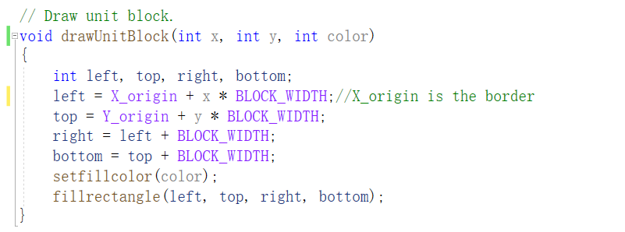
Draw Unit Block

Slide 13
How to draw by type and rotation?
blocks[7][4][4][2]
7 Types, 4 Rotations
4 Blocks, 2 Dimensions

Slide 14
Practice
drawTetrisBlock(...)

Slide 15
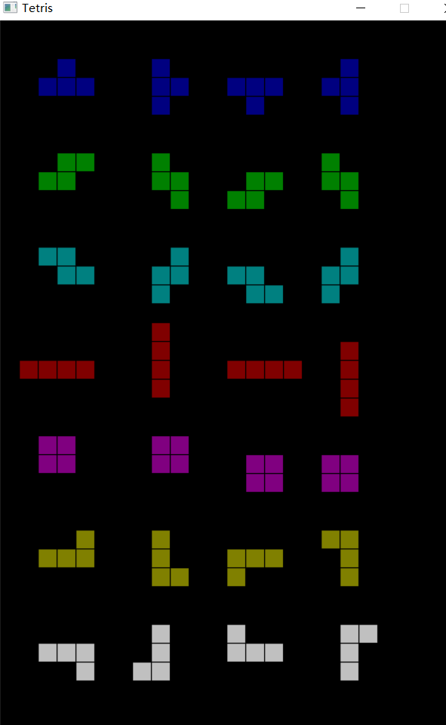
Homework
Complete the function drawTetrisBlock()
You can draw all the Tetris Blocks on one graph.
Or you can generate the iType and iRotation randomly.

Slide 16
Thinking
Design your game view.
Any other functions do we need?

Slide 17
Handle of the window
HWND GetHWnd();
SetWindowText(GetHWnd(), "界面1");

Slide 18
Switch Window
First closegraph();
Then initgraph();

