Slide 1
Week6:Tetris
——Practice of Programming Language 1——
Shen Shuyin
Spring

Slide 2
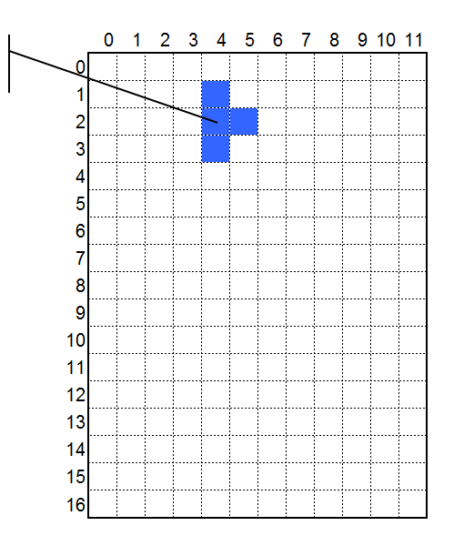
Review
new int[4,4,2] = {
{{0, 0}, {-1, 0}, {1, 0}, {0, -1}},
{{0, 0}, {1, 0}, {0, 1}, {0, -1}},
{{0, 0}, {-1, 0}, {1, 0}, {0, 1}},
{{0, 0}, {-1, 0}, {0, 1}, {0, -1}}
};
Position of a Tetris block: (4, 2)
Add 4 to each x coord.
Add 2 to each y coord.
{{4, 2}, {5, 2}, {4, 3}, {4, 1}},
Positions of 4 subblocks of Tetris block (4, 2) :
x= 4; y= 2;

Slide 3
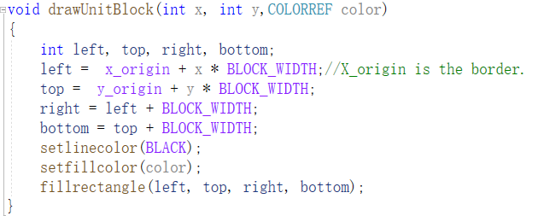
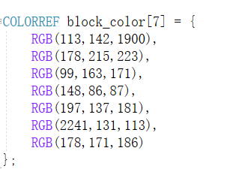
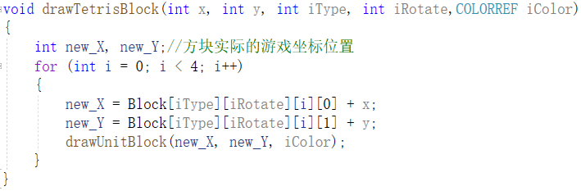
Review

Slide 4
Basic Function
genBlock()
Get the type and rotation state randomly
Initialize the coordinate x and y

Slide 5
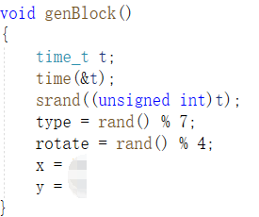
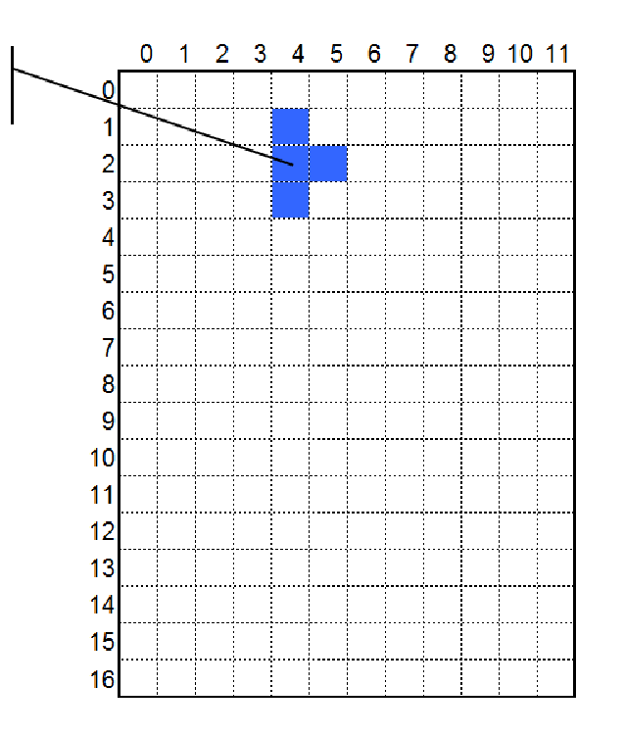
Generate a Tetris block randomly
x=?
y=?
x=4,y=2

Slide 6
Move the Tetris block
Determine which key is input ( a:left, s:down, d:right, w:rotation, q:quit)
Erase the block by using drawTetrisBlock() with background color.
Modifying the positions of coordinate.
Draw the block at new positions.

Slide 7
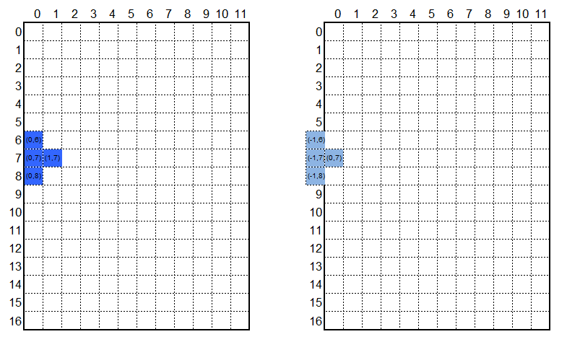
Judge whether the block cross the border
We can move tetris block to where it will go. And then judge whether none of the subblock crosses the border.

Slide 8
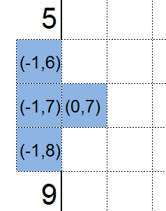
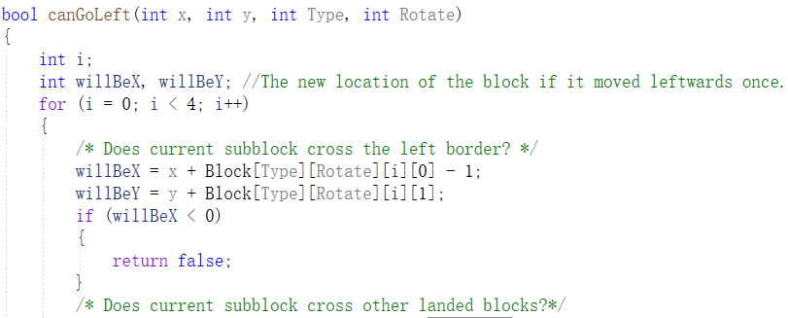
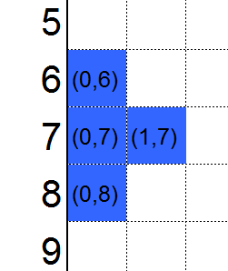
Judge whether the block cross the border
After moving left
Block coord:(-1,7)
Subblock coords:
{{-1,7},{-1,6},{-1,8},{0,7}}
Check each subblock to see whether it cross the border.
Before moving left
Block coord:(0,7)
Subblock coords:
{{0,7},{0,6},{0,8},{1,7}}
Press ‘a’
[left]

Slide 9
Judge whether the block cross the border
Press ‘a’
[left]
Before moving left
{x,y}={0,7}
Coords of subblocks:
{x,y}+Block[Type][Rotate]=
{{0,7},{0,6},{0,8},{1,7}}
Before moving left
Block coord:(0,7)
Subblock coords:
{{0,7},{0,6},{0,8},{1,7}}
Coord of tetris block
Relative coords of subblocks
After moving left
Block coord:{0-1,7}
Subblock coords:
{willBeX,willBeY} =
{{-1,7},{-1,6},{-1,8},{0,7}}

Slide 10
Practice
canGoLeftV1(int x, int y, int Type,int Rotate)
canGoRightV1()

Slide 11
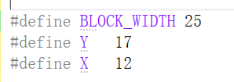
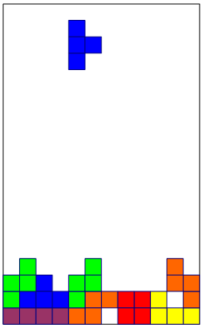
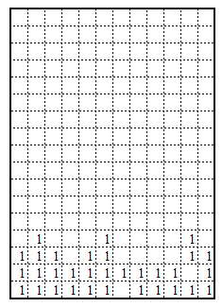
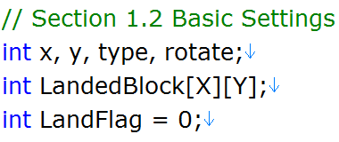
Landed Tetris Blocks

Slide 12
Practice
Modify canGoLeftV1() and canGoRightV1()
Not cross other landed blocks
canFall(int x, int y, int Type, int Rotate )
Not cross the game bottom(Y)
Not cross other landed blocks
LandedBlocks[X][Y]

Slide 13
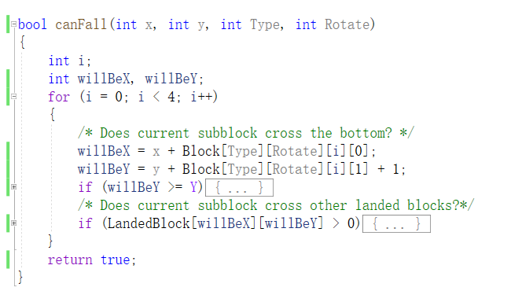
Landing a tetris block

Slide 14
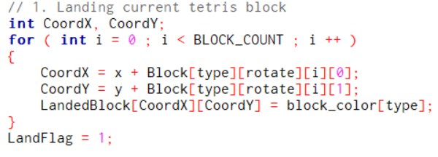
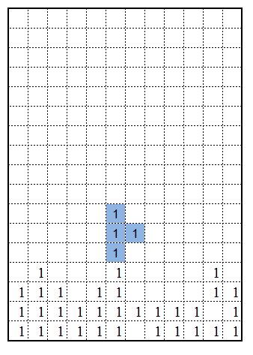
Landing a tetris block
landBlock(int x, int y, int type, int rotate)

Slide 15
Practice
moveBlock()
Determine which key is input ( a:left, s:down, d:right, w:rotation, q:quit)
Check the collision and landing status
Change the coordinate(x, y)
canRotate()
New Rotate state
Cross game border
Cross landed blocks

Slide 16
Homework
Generate a Tetris block that can move and rotate
moveBlock()
canGoLeft(),canGoRight(),canFall(),canRotate()
landBlock()
genBlock()

Slide 17
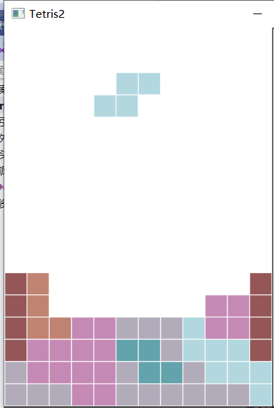
Homework

