Slide 1
Week7:Tetris
——Practice of Programming Language 1——
Shen Shuyin
Spring

Slide 2
Review
moveBlock()
change(x,y)
canGoLeft(),canGoRight(),canFall(),canRotate()
Encapsulation?
landBlock()
LandBlock[CoorX][CoorY]
genBlock()

Slide 3
Remove the blocks
Check if the row is occupied
LandBlock[ ][ ]
A function to check one row
Remove the row
Update LandBlock

Slide 4
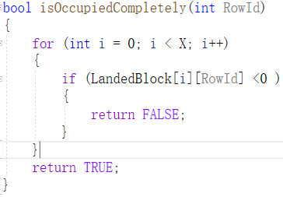
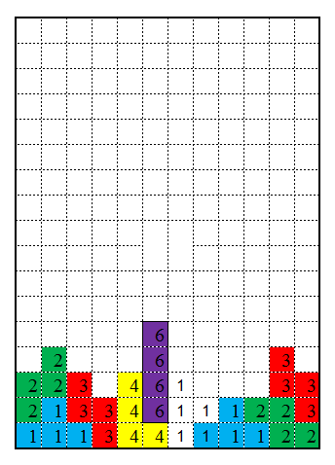
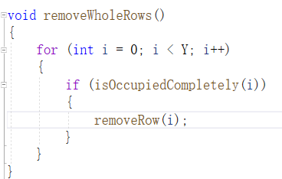
Task: Romove completely occupied rows

Slide 5
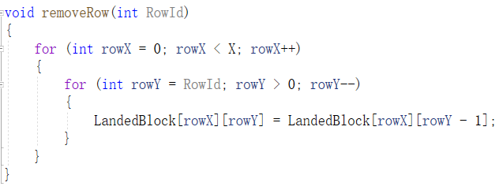
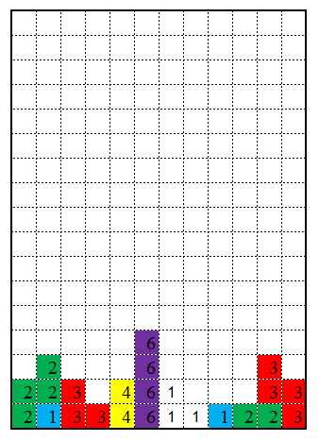
Task: Romove completely occupied rows
RemoveRow(16)

Slide 6
Practice
bool isOccupiedCompletely()
Check status
void removeRow()
Update data:LandBlock[][]

Slide 7
Task: Romove completely occupied rows
Check whole rows
Remove rows
Update Landblocks
Update Game board
Clear gameboard
Draw unit block by color number
Remove this row

Slide 8
Practice
void removeWholeRows()
Check and Update every row
void updateLandedBlock()
Clear game board
Use drawUnitBlock(),and LandBlock[][] to draw new blocks

Slide 9
Design a Flow Chart to Conclude your Code.
N
Y
Start
Press ‘s’?
?
N
1. Draw a border
Press ‘A’?
Y
3.1 Erase blocks
at old position
2. Draw a TBlocks
3.2 Draw blocks at new position
Press ‘Q’?
N
Y
End

Slide 10
Thinking
Auto Fall
While loop
_kbhit()
Sleep()
Similar as hit key ‘s’
Game Over
LandBlock[][]?

Slide 11
Homework
The completely project files.
- Creativity and Functionality: 30%
- Game Mechanics Implementation: 25%
- Graphics and User Interface Design: 20%
- Code Quality and Efficiency: 15%
A small video to show how it works.

Slide 12
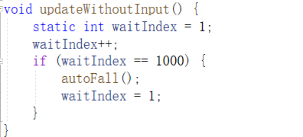
Hint
Data Representation (with Functions)
Life cycle of data
Temporary / local
Object
Global ( cross Process/ Function)
Session
Persistent Object
Eliminates flickering
BeginBatchDraw();
FlushBatchDraw();
EndBatchDraw();
Sleep()

Slide 13
Windows API
Windows application programming interface(API) for desktop and server applications.
Create a traditional Windows Desktop application (C++).

