Slide 1
Week8:Gobang1
—— Practice of Programming Language 1——
Shen Shuyin
Spring

Slide 2
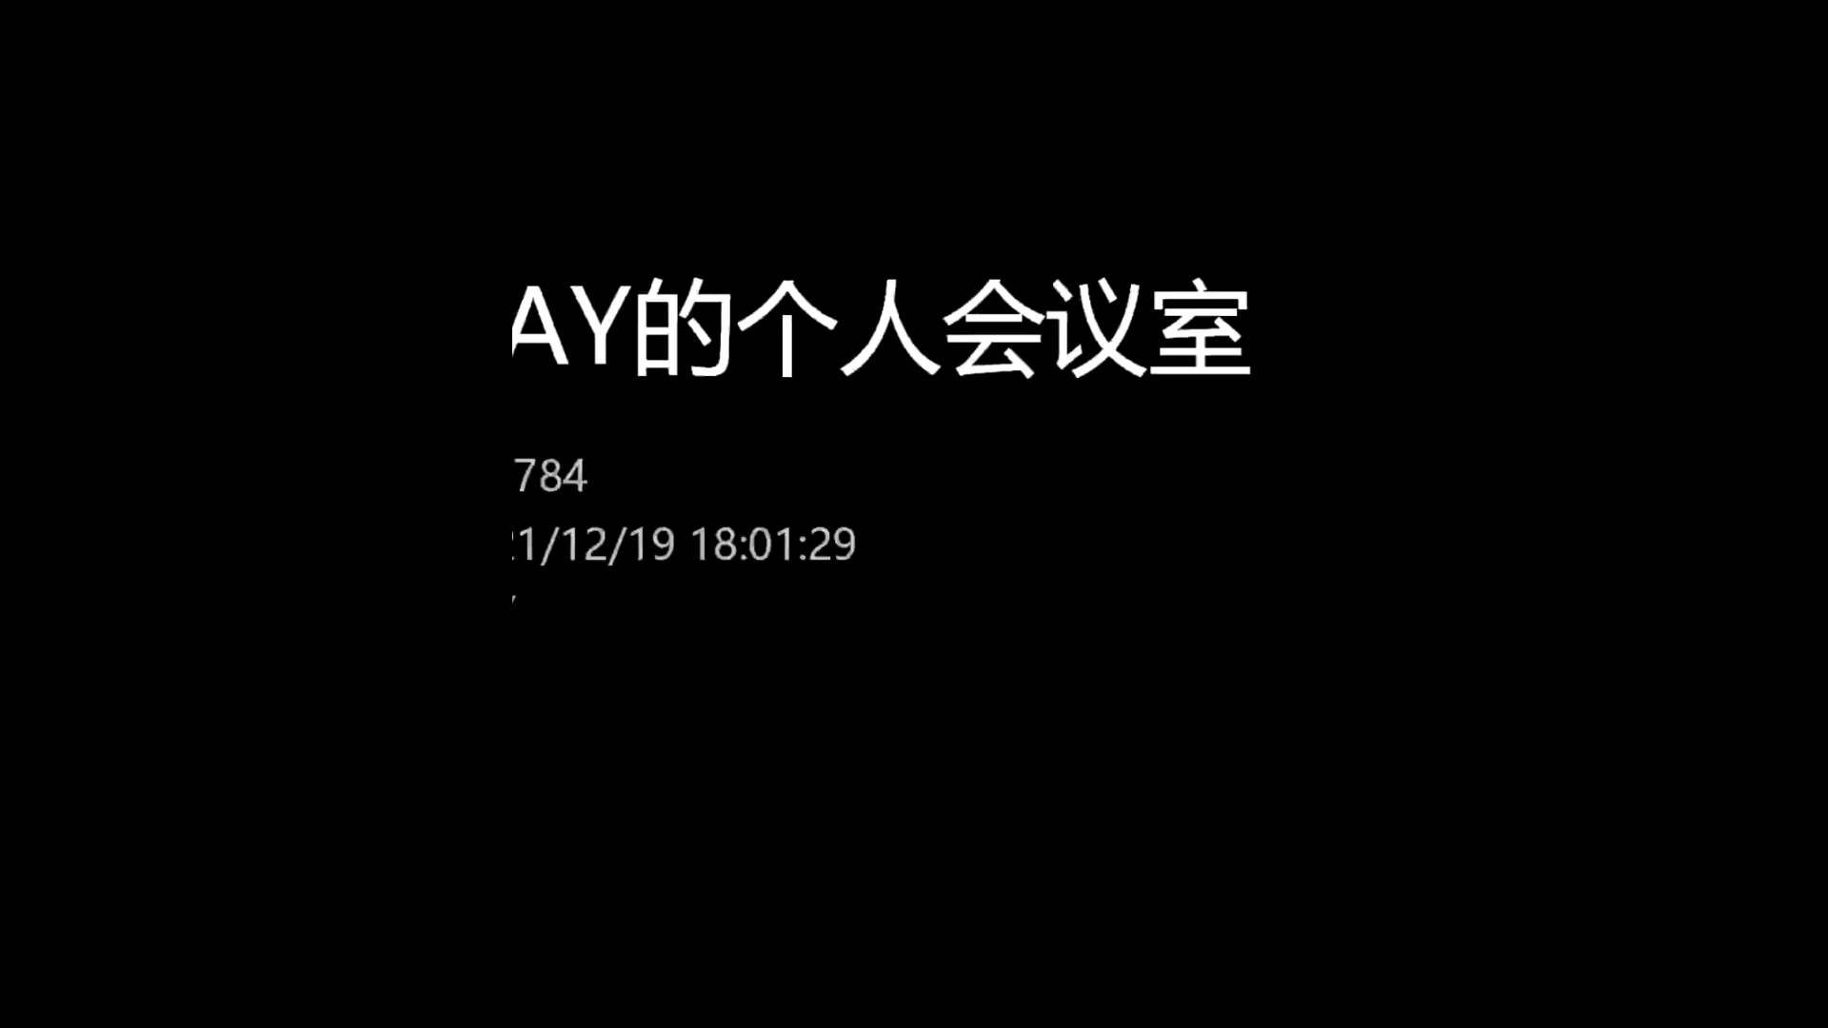
Introduction

Slide 3
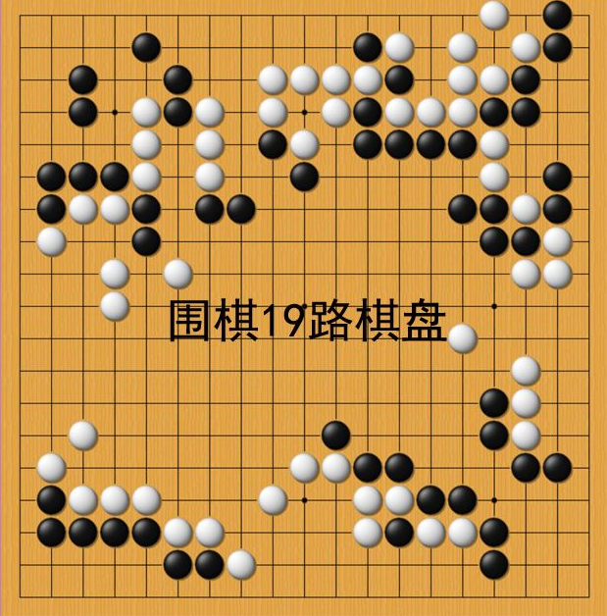
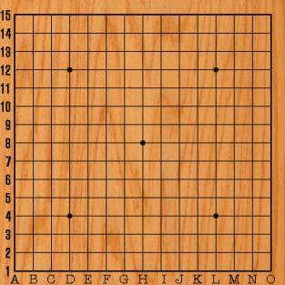
Game Board
15*15 or 19*19
225 points
361 points

Slide 4
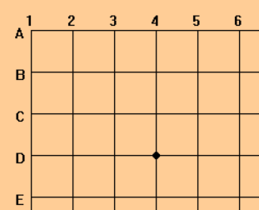
Game Board
Line numbers
margin
Board height =
(N-1) * block_width + margin *2
margin
block_width
N * N Game Board
star or tianyuan
Board width = (N-1) * block_width + margin *2
Right Bottom
( (N-1) * block_width + margin ,
(N-1) * block_width + margin )

Slide 5
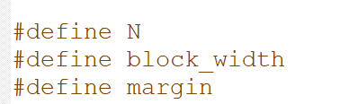
View Design
Draw background
setfillcolor(RGB(255, 205, 150));
solidrectangle(0,0,board_width,board_height)
Draw Line
N, block_width, margin
Text
setbkmode(TRANSPARENT);

Slide 6
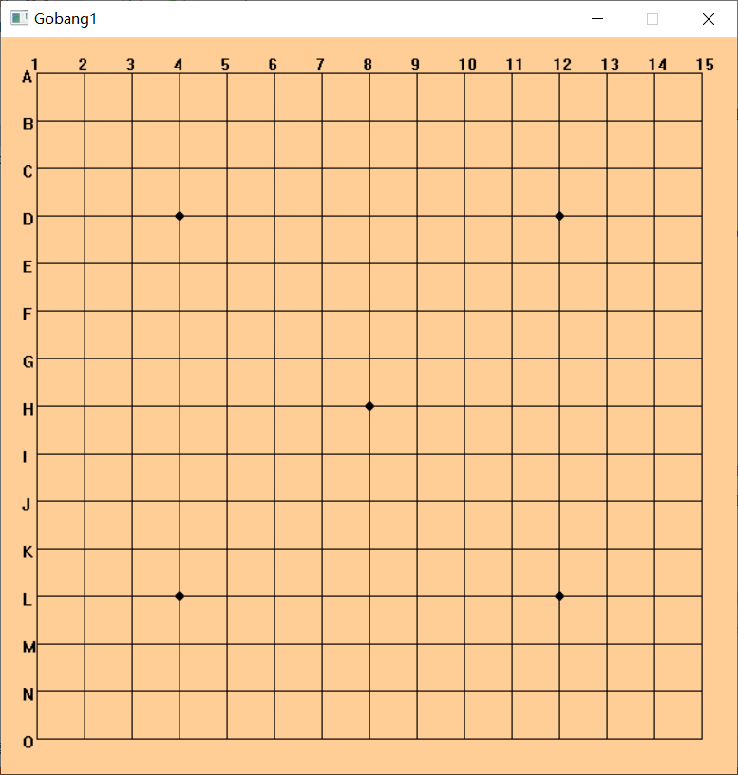
Practice
void drawBoard()
Draw a blank board(yellow or other color)
Draw lines(N*N)
line(x1,y1,x2,y2);
Draw stars and Tianyuan
Draw line numbers text
setbkmode(TRANSPARENT);

Slide 7
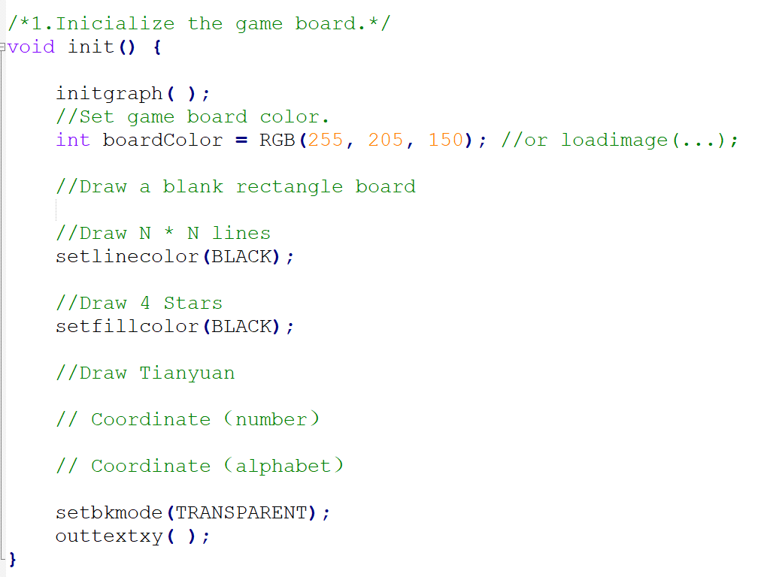
Inicialize the game

Slide 8
Model
2-D Array
int chessBox[N][N]
Initiliaze value is 0
Value is number(1 for black, 2 for white)？

Slide 9
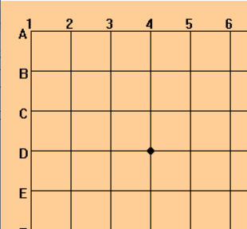
Chess View
margin
chessBox[row][col]
margin
y = margin + row *block_width
solidcircle(x,y,radius)
x = margin + col * block_width

Slide 10
Draw Chess
Coordinate
x= margin + col * block_width
y= margin + row * block_width
Draw circle
x,y
Radius
color

Slide 11
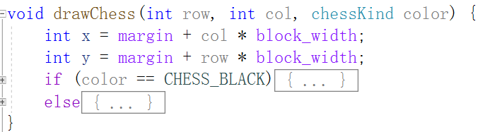
Practice
drawChess(int row, int col, color)
Calculate x, y
Draw(check color)
setfillcolor()
solidcircle()

Slide 12

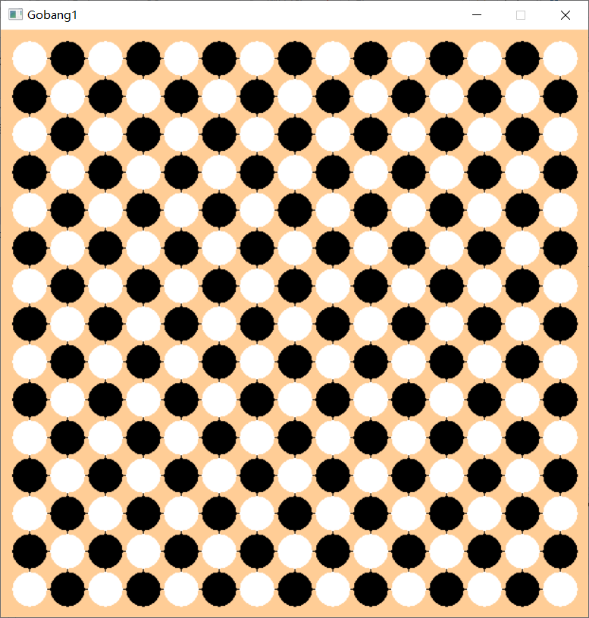
Practice
Test if your drawChess function works
A test() function to draw black and white chesses like the right picture

Slide 13
Mouse Message
https://docs.easyx.cn/zh-cn/mouse-operations
int main() {
drawBoard();//初始化游戏棋盘
while (1) {
ExMessage m;
m = getmessage(EM_MOUSE);
if(m.message == WM_LBUTTONDOWN && checkClick(m)){
player();

Slide 14
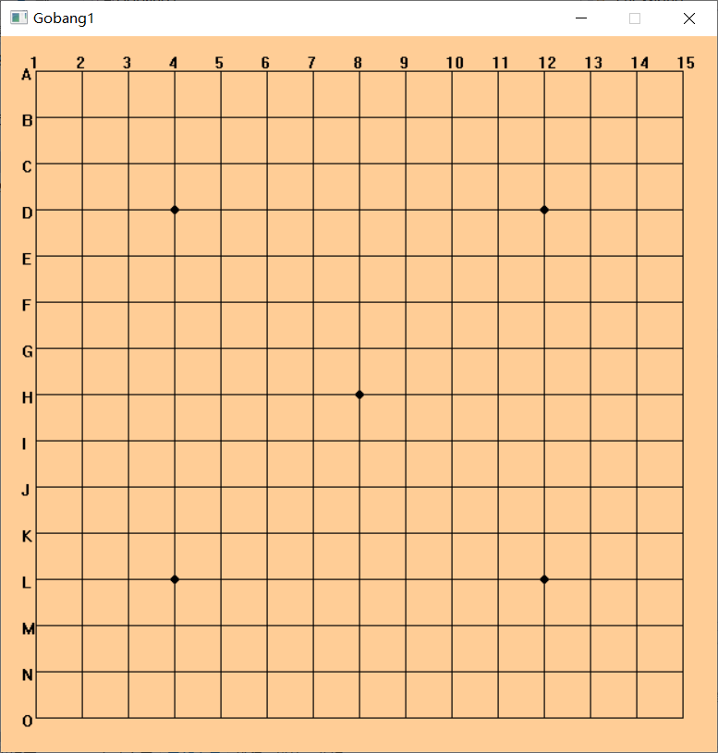
How to check the click location?
Get the row and col of
int col = (x - margin) / block_width;
int row = (y - margin) / block_width;
int leftTopX = margin + col * block_width;
int leftTopY = margin + row * block_width;
y - margin
(leftTopX, leftTopY)
(x, y)
Click here
x - margin

Slide 15
Chess location
(leftTopX+block_width,
leftTopY)
(leftTopX,leftTopY)
Mouse left button click coordinate
(m.x, m.y)
Calculate 4 distances
(leftTopX,
leftTopY+block_width)
(leftTopX+block_width,
leftTopY+block_width)

Slide 16
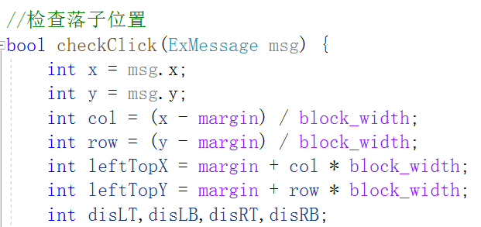

Practice
bool checkClick()
Check if the distance is less than the boundary
Check if the position is empty

Slide 17
Flow Chart
Start
Is the position empty?
Y
N
2.1 Update the chess array
1. Draw a chess Board
Y
2.2 Draw a chess
Click in right position?
N
Left button clicked?
N
Y

Slide 18
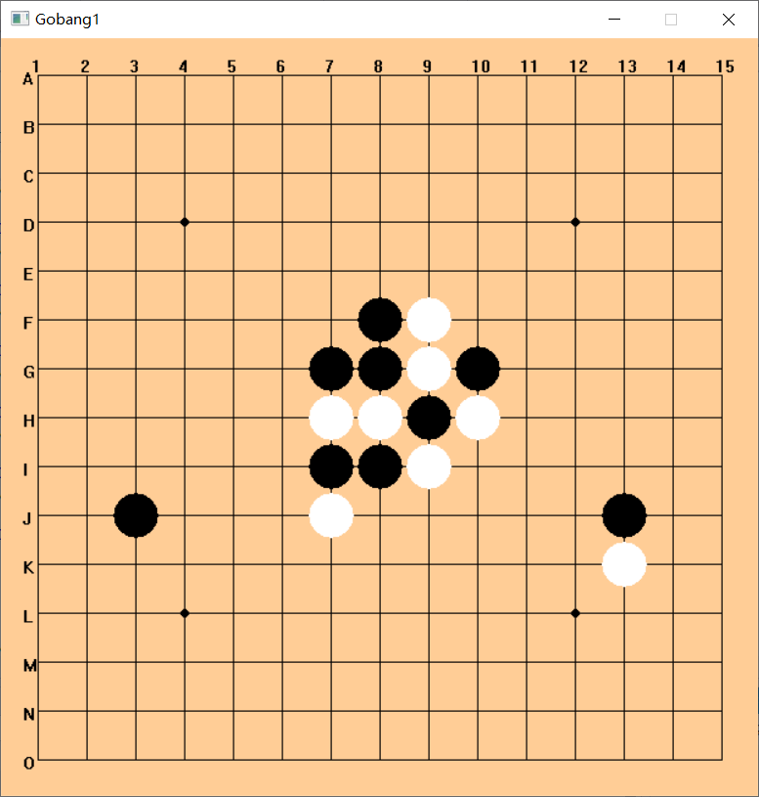
Homework
Complete
drawBoard()
drawChess()
checkClick()
Draw some chesses

