Slide 1
Week9:Gobang2
——Practice of Programming Language 1——
Shen Shuyin
Spring

Slide 2
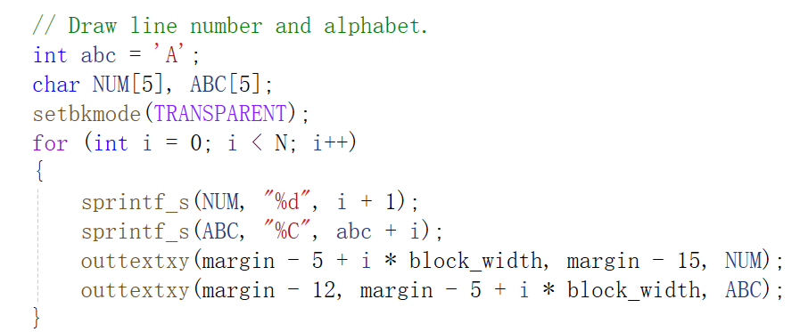
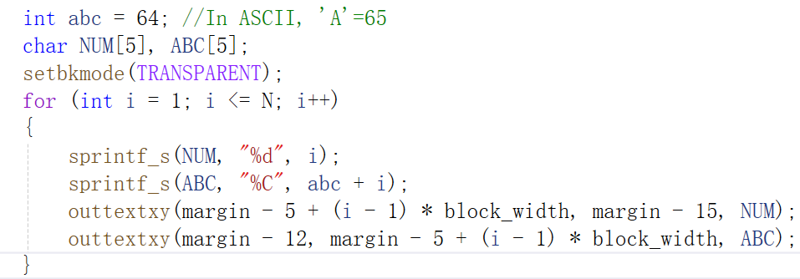
Review
Draw numbers and alphabets

Slide 3
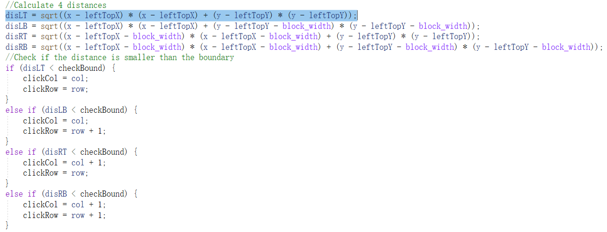
Review
checkClick()

Slide 4
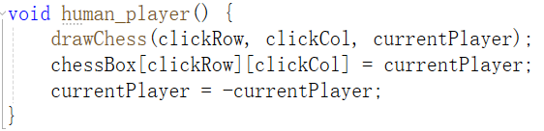
How to play?
drawChess()
Update chessBox[][]
Change player color

Slide 5
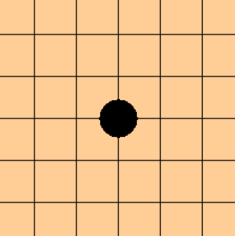
Judge if the player win
4 directions
x
y
y = x
y= -x

Slide 6
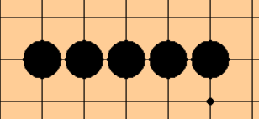
How many chesses need to be check?

Slide 7
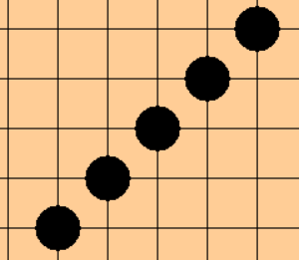
How many chesses need to be check?

Slide 8
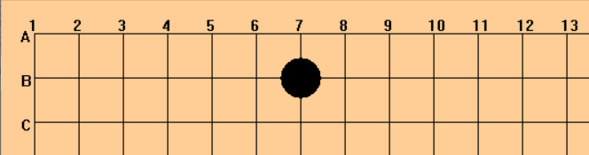
How many chesses need to be check?
4+1+4
Check boundary limit(0~N-1)
For Example :click at (clickRow,clickCol)
x direction
From (clickCol-4) to (clickCol+4)
Check chessBox[][] value

Slide 9
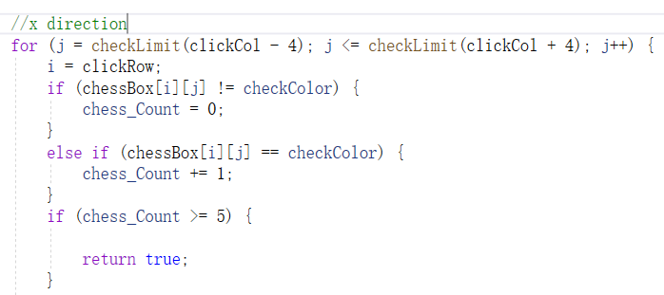
Practice
bool judgeWin()
checkLimit() (0~N-1)
Count the continuous chess with the same color
Check x, y, y=x, y=-x 4 directions

Slide 10
Thinking: if the player regret
Let chessBox[clickRow][clickCol] = 0
How to remove the chess from view?
Cleardevice
Draw board
Draw chessBox
flag

Slide 11
Practice
void regretPlay()
chessBox[clickRow][clickCol] = 0;
drawboard();
For loop drawChess() with chessBox[N][N]

Slide 12

GetHWnd();
Returns the handle of the graphics window.
HWND hwnd = GetHWnd();
MoveWindow(hwnd, coord_x, coord_y, width, height,TRUE);//set window position
SetWindowText(hwnd, L"五子棋对战"); //set window name

Slide 13
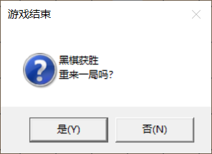
MessageBox()
int MessageBox(
HWND hWnd, // handle to owner window
LPCTSTR lpText, // text in message box
LPCTSTR lpCaption, // message box title
UINT uType // message box style
);
Example:
HWND wnd = GetHWnd();
int ret = 0;
ret = MessageBox(hwnd, L"黑棋获胜\n重来一局吗？", L"游戏结束", MB_YESNO|MB_ICONQUESTION);
if (ret == IDYES)

Slide 14
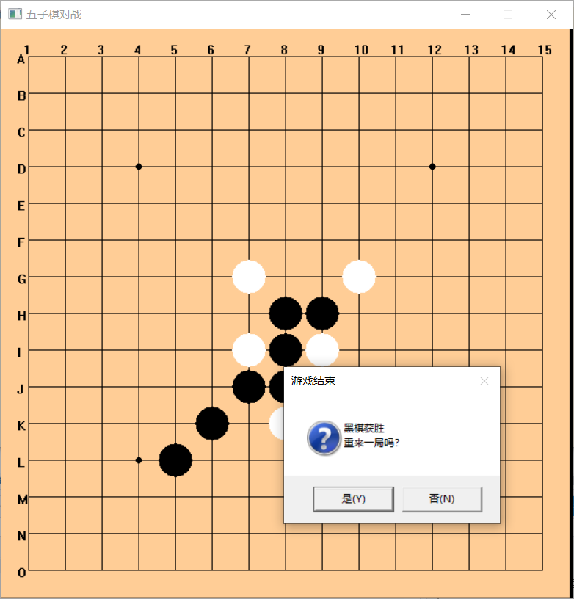
Homework
Complete judgeWin()
checkLimit()
Complete person vs person game

Slide 15
禁手规则
1.三三禁手
由于黑方落一子，同时形成二个或二个以上黑方活三的局面
2.四四禁手
由于黑方落一子，同时形成二个或二个以上黑方四（活四或者冲四）的局面
3.长连禁手
由于黑方落一子，形成六个或者六个以上的同色连续棋子

Slide 16
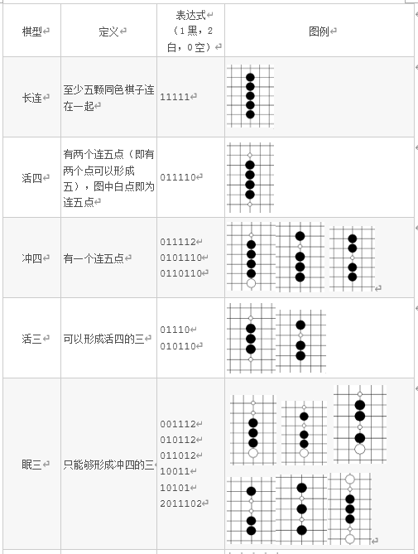
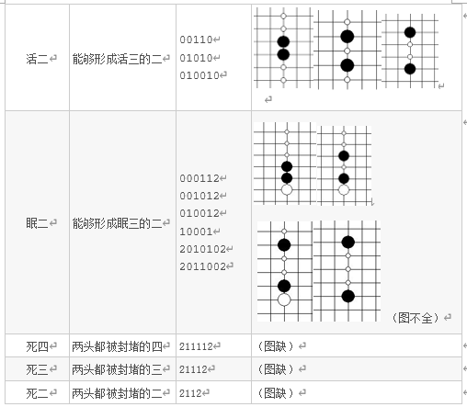

Slide 17
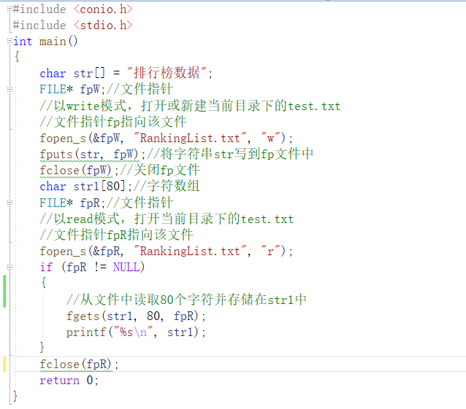
File Read and Write

