Slide 1
Transformations of Objects
南开大学软件学院
王 靖
<number>/43

Slide 2
Goals
Affine Transformation 2D and 3D
Transforming coordinate frames
OpenGL functions
<number>/43

Slide 3
Object versus Coordinate Transformations
Object Transformation
  Changes the objects positions
  Fixes the underlying coordinate system
Coordinate transformations
  Defines a new coordinate system
  Represents the objects in the new system
<number>/43

Slide 4
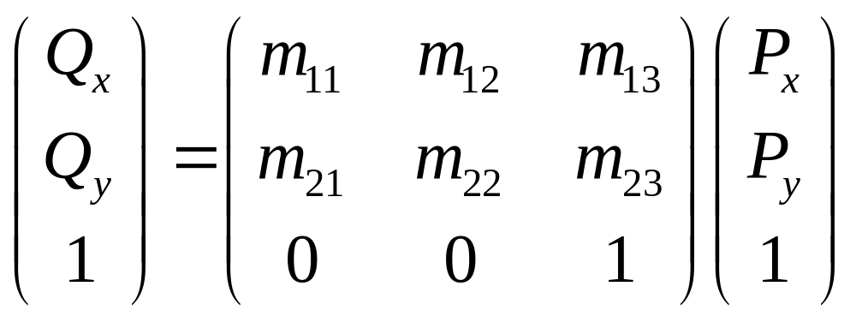
Affine Transformation
<number>/43

Slide 5
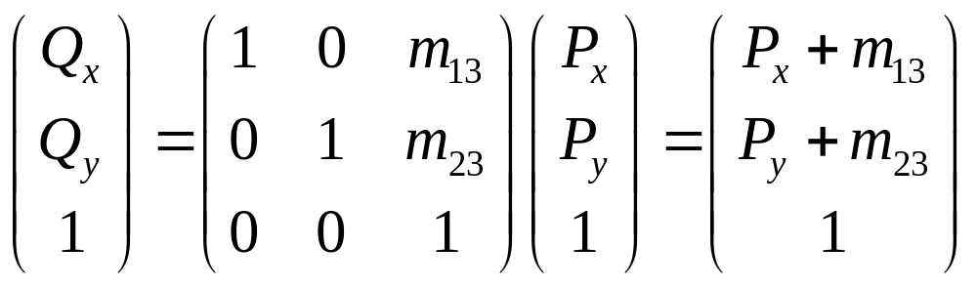
Affine Transformation-Translation
<number>/43

Slide 6
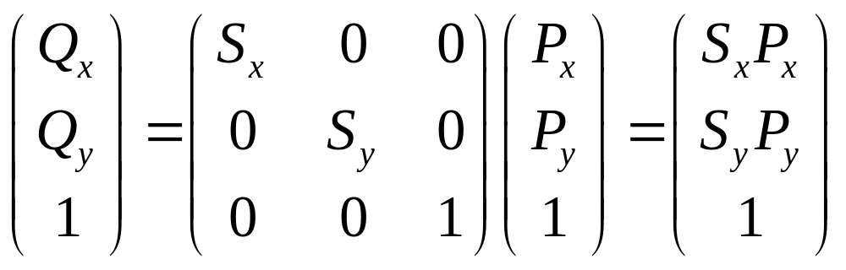
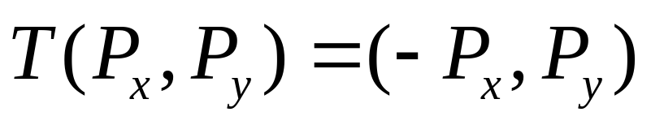
Affine Transformation-Scaling
<number>/43

Slide 7
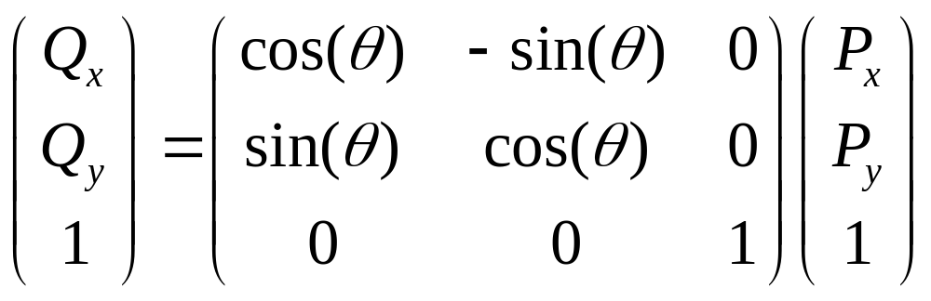
Affine Transformation-Rotation
<number>/43

Slide 8
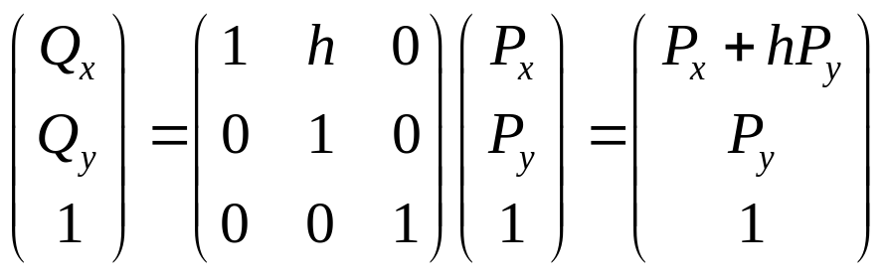
Affine Transformation-Shearing
<number>/43

Slide 9
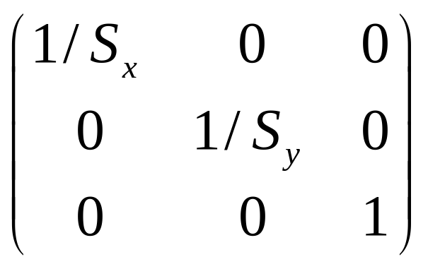
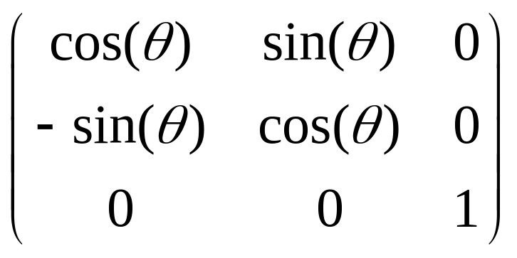
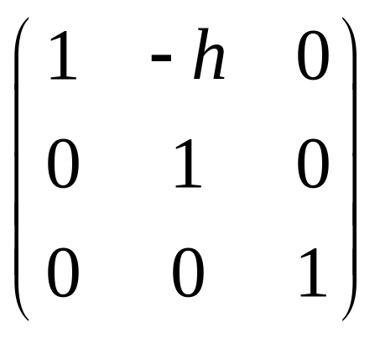
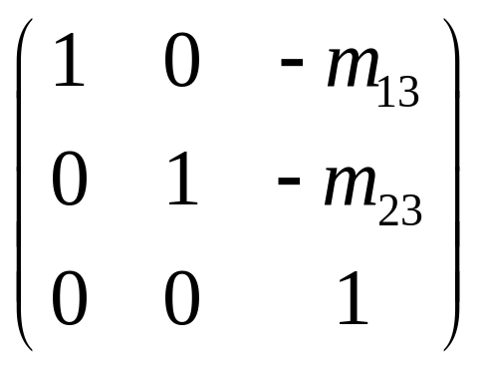
Inverse of an Affine Transformation
Scaling
Rotation
Shearing
Translations
<number>/43

Slide 10
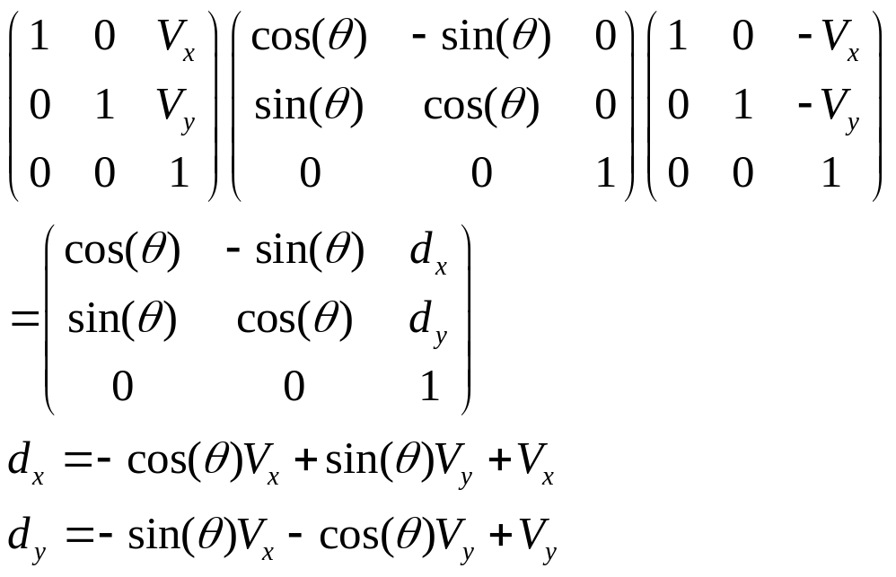
Composing 2D Transformation
Translate point P through vector v
Rotate about the origin through angle θ
Translate P back through v
Q
θ
P
Q’
θ
V
P’
<number>/43

Slide 11
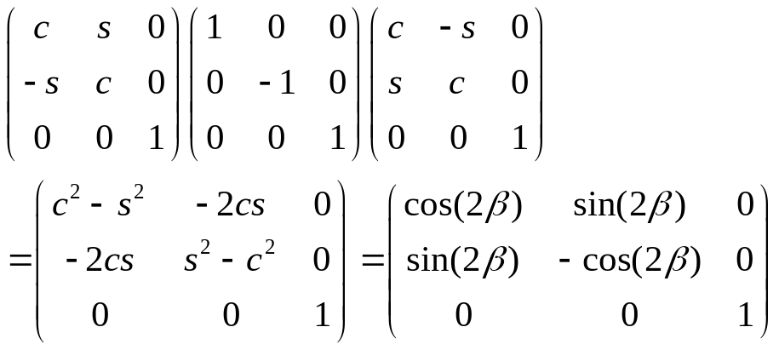

Composing 2D Transformation
Rotate through the angle β
A reflection about the x-axis
A rotation back through the angle β
axis of reflection
β
<number>/43

Slide 12
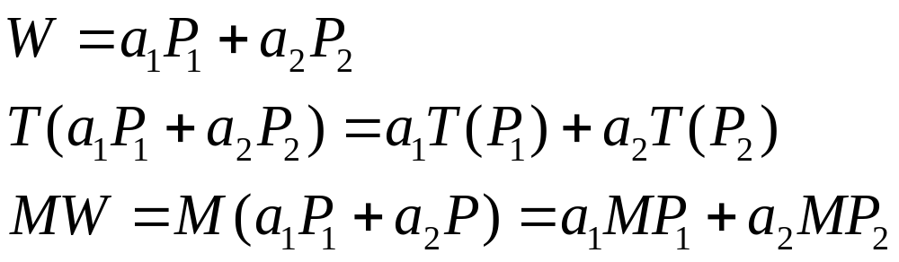
Properties of Affine Transformations
Preserve affine combinations of points
<number>/43

Slide 13
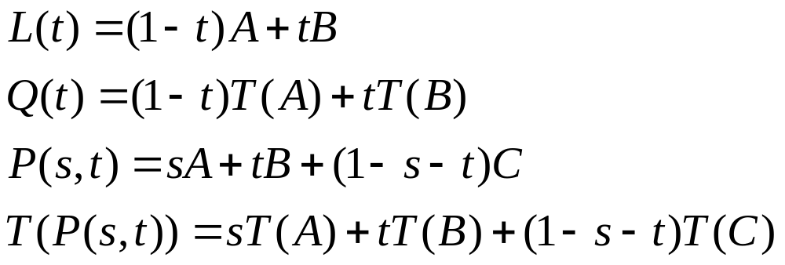
Properties of Affine Transformations
Preserve Lines and Planes
  Image of a straight is another straight line
  Plane is transformed into another plane
<number>/43

Slide 14
Properties of Affine Transformations
Parallelism of lines and planes is preserved
  If two lines or planes are parallel, their images under an affine transformation are also parallel.
The direction doesn’t depend on the points A
<number>/43

Slide 15
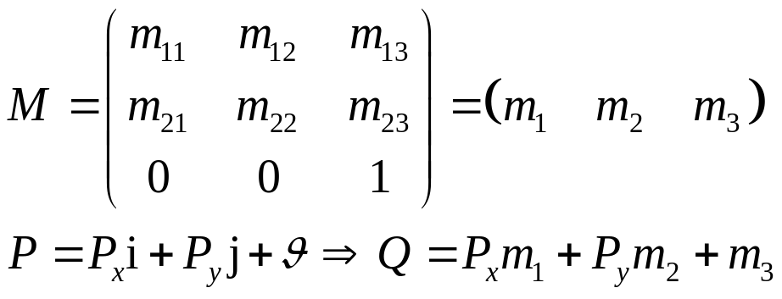

Properties of Affine Transformations
m2
m1
m3
j
i
<number>/43

Slide 16
Properties of Affine Transformations
Relative Ratios are Preserved
B
1-t
t
P
A
t
1-t
T(A)
T(P)
T(B)
<number>/43

Slide 17
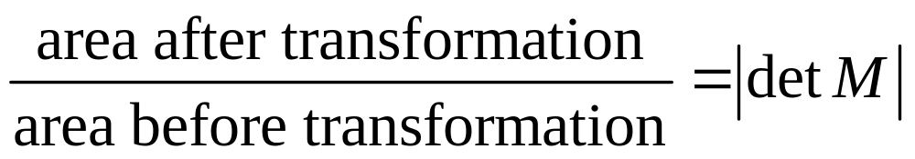
Properties of Affine Transformations
Effect of Transformations on the areas of figures
The area of an ellipse?
<number>/43

Slide 18
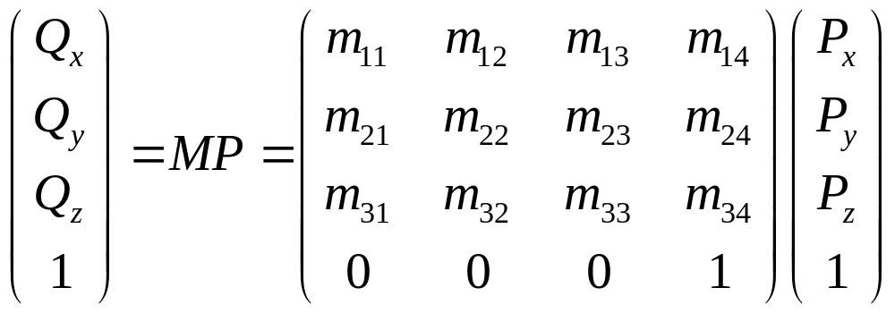
3D Affine transformations
<number>/43

Slide 19
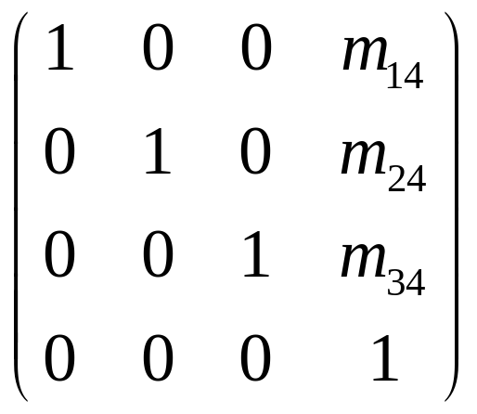
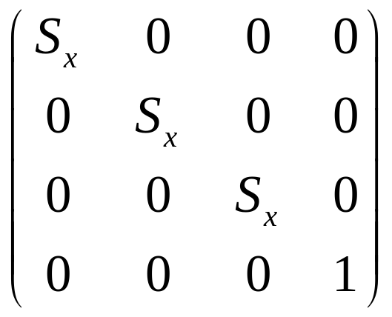
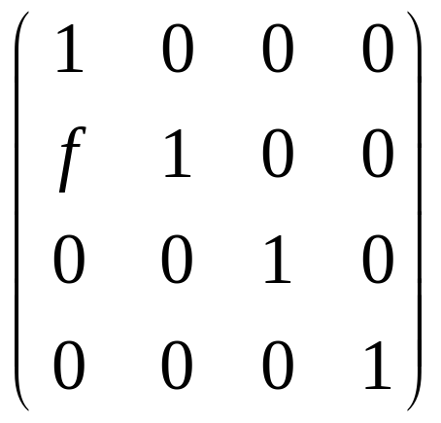
The elementary 3D Transformations
Translation
Scaling
Shearing
<number>/43

Slide 20
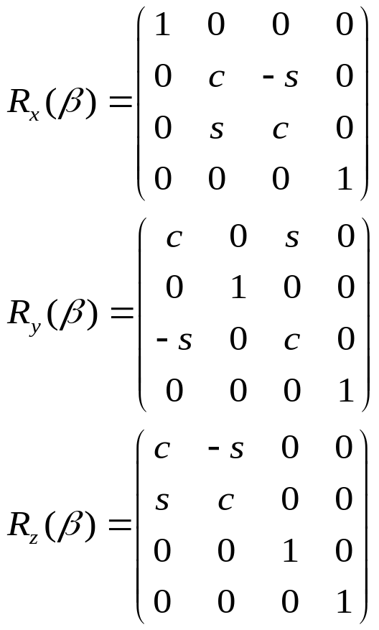
The elementary 3D Transformations
X-roll
y
Y-roll
Z-roll
z
x
Rotations
Why y-roll different from the other two?
<number>/43

Slide 21
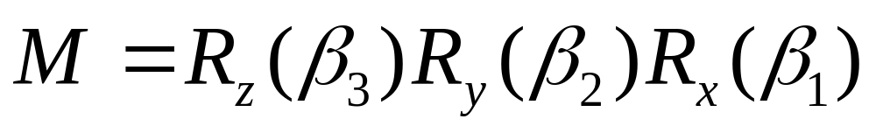
Combining Rotations
Any 3D rotation can be obtained by three rolls about the x-,y- and z-axes
<number>/43

Slide 22



Combining Rotations
Rotations about an Arbitrary Axis
y
u
Perform two rotations so that u becomes
aligned with x-axes
2. Do a x-roll through the angle β.
3. Undo the two alignment rotations to
restore u to its original direction.
Q
P
z
x
<number>/43

Slide 23
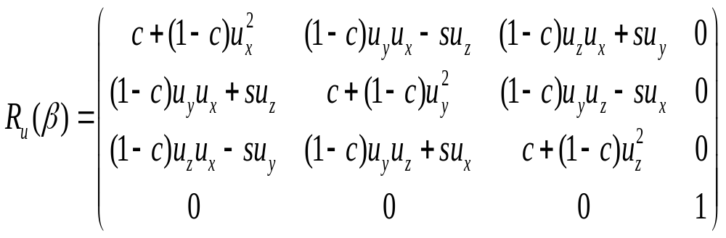

Combining Rotations
b
Q
y
a’
u
β
Q
P
a
h
β
a’
a
P
p
z
x
<number>/43

Slide 24
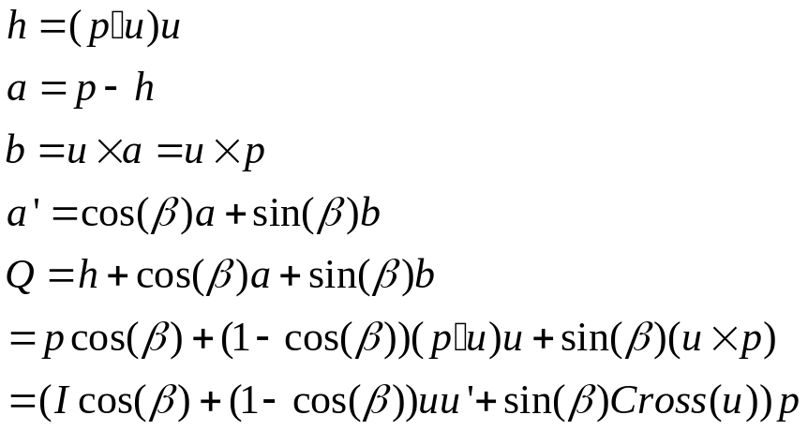
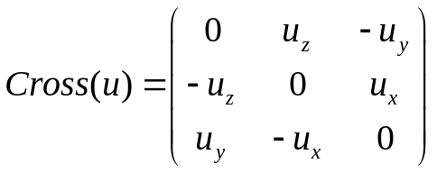
Combining Rotations
y
u
b
Q
h
Q
a’
a
β
a’
β
P
p
P
a
z
x
<number>/43

Slide 25
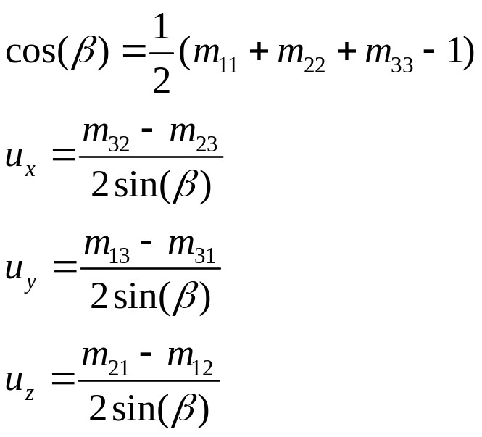

Combining Rotations
Finding the axis and angle of rotation
<number>/43

Slide 26
Properties of 3D affine transformations
Preserve affine combinations of points
Preserve lines and planes
Parallelism of lines and planes is preserved
The columns of the Matrix reveal the transformed coordinate frame
Relative ratios are preserved
Effect on volumes: V → |detM|V
Every affine transformations is composed of elementary operations
<number>/43

Slide 27
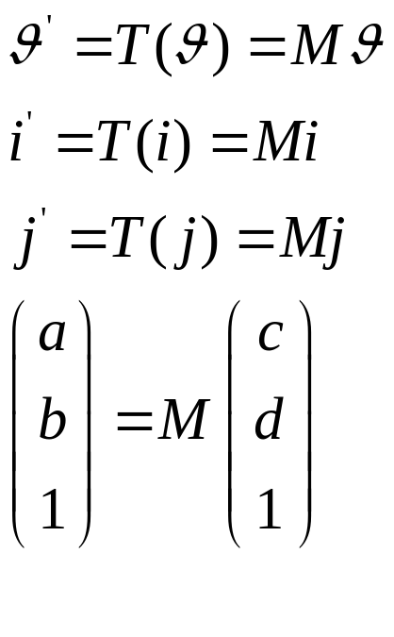

Change Coordinate Systems
b
P
d
j’
c
i’
j
i
a
<number>/43

Slide 28
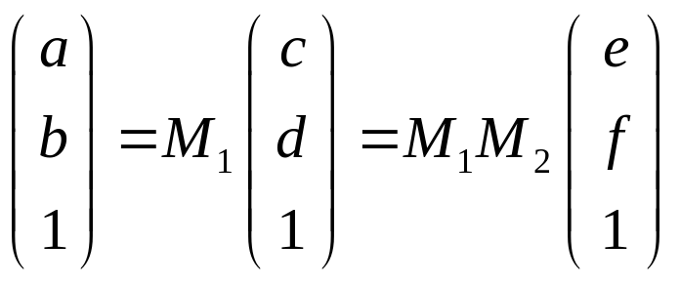
Successive Changes of Coordinate Frames
b
P
f
system#3
d
e
j’
c
system#2
i’
j
i
a
system#1
<number>/43

Slide 29
Successive Changes of Coordinate Frames
Transforming Points
  To apply a sequence of transformations T1(), T2(),T3() to a point P, form the matrix:
  M=M3*M2*M1 (Premultiply by Mi)
Transforming the Coordinate System
  To apply a sequence of transformations T1(), T2(),T3() to the coordinate system, form the matrix:
  M=M1*M2*M3
  P in the transformed system has coordinates MP in the original system. (Postmultiply by Mi)
<number>/43

Slide 30
Using affine transformations in a program-2D
y
viewport
Current
Transform
CT
Window-to
-viewport
transformation
V
Q
S
Sy
V
y
Q
Sx
x
x
world window
<number>/43

Slide 31
Using affine transformations in a program-2D
CT=CT*M
  glScaled(sx.sy.1.0)
  glTranslated(dx,dy,0);
  glRotated(angle,0,0,1);
  glMatrixMode(GL_MODELVIEW);
  glLoadIdentity();
<number>/43

Slide 32
Using affine transformations in a program-2D
glMatrixMode(GL_MODEVIEW)
glLoadIdentity();
House();
glTranslated(32,25,0)
glRotated(-30,0,0,1.0)
House();
<number>/43

Slide 33
Saving the CT for later use
After glPushMatrix()
After glRotated()
CT3*Rot
before
After glPopMatrix()
CT2
CT2
CT4=CT4*Rot
=CT3*Rot
CT4=CT3
CT2
CT2
CT3
CT3
CT3
CT3
CT1
CT1
CT1
CT1
<number>/43

Slide 34
Saving the CT for later use
glPushMatrix()
glTranslated(W,H);
for (row=0;row<3;row++){
{ glPushMatrix()
for(col=0;col<3;col++)
{ smile();
glTranslated(L,0);
}
glPopMatrix();
glTranslated(0,D);}
glPopmatrix();
D
H
W
L
<number>/43

Slide 35
Drawing 3D scenes with OpenGL
An overview of the viewing process and the graphics pipeline
y
viewport
z
x
near plane
window
far plane
<number>/43

Slide 36
Drawing 3D scenes with OpenGL
Camera view volume
View plane
Near
plane
Image produced
Far plane
<number>/43

Slide 37
The OpenGL pipeline
VM
P
Clip
Vp
Modelview
matrix
Projection
matrix
Viewport
matrix
<number>/43

Slide 38
The OpenGL pipeline
block
block
M
V
Effect of modelview Matrix in the graphics pipeline
<number>/43

Slide 39
The OpenGL pipeline
P
1
1
1
Effect of the projection matrix
<number>/43

Slide 40
The OpenGL pipeline
Normalized Device Coordinates
Vp
1
depth
1
1
Effect of the viewport transformation
<number>/43

Slide 41
Some OpenGL Tools for MV
To modify the modelview matrix (First made “current” by executing: glMatrixMode(GL_MODELVIEW)
  glScaled(sx,sy,sz):
  glTranslated(dx,dy,dz)
  glRotated(angle,ux,uy,uz)
All postmultiply the current matrix
<number>/43

Slide 42
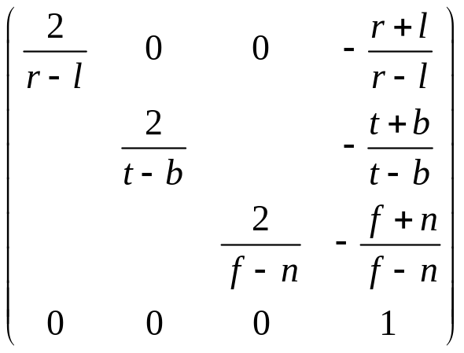
Setting the camera in OpenGL(for a parallel projection)
Set Up a Projection Matrix
glMatrixMode(GL_PROJECTION)
glLoadIdenity();
glOrtho(left,right,botom,top,near,far)
<number>/43

Slide 43
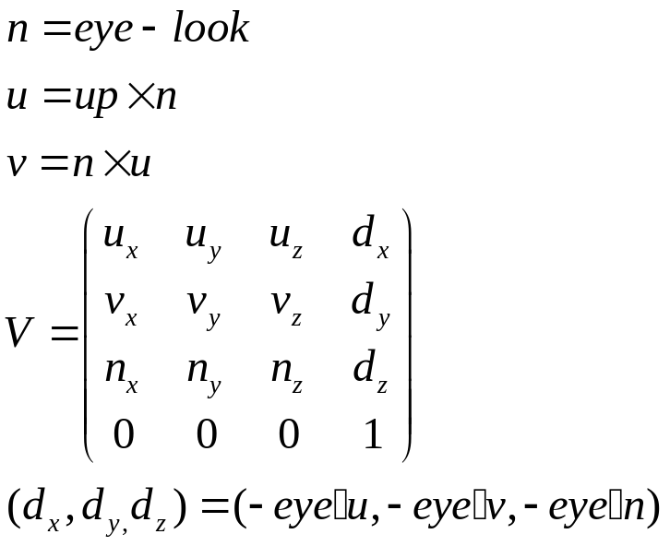
Setting the camera in OpenGL(for a parallel projection)
Position and aiming the camera
gluLookAt(eye.x,eye.y,eye.z,look.x,look.y,look.z,
Up.x,up.y,up.z)
up
v
n
u
eye
look
<number>/43

