Slide 1
计算机图形学
南开大学软件学院
王 靖
jingwang@nankai.edu.cn

Slide 2
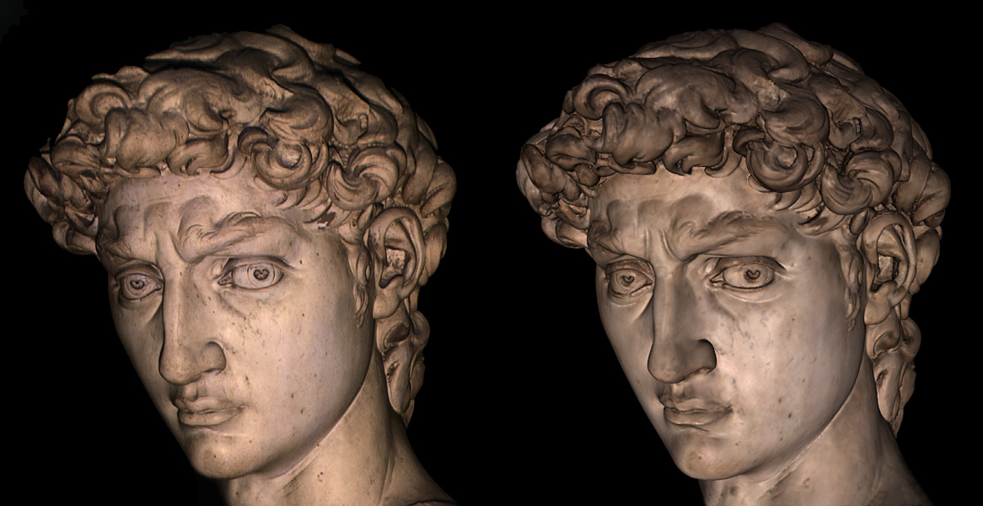
Introduction

Slide 3
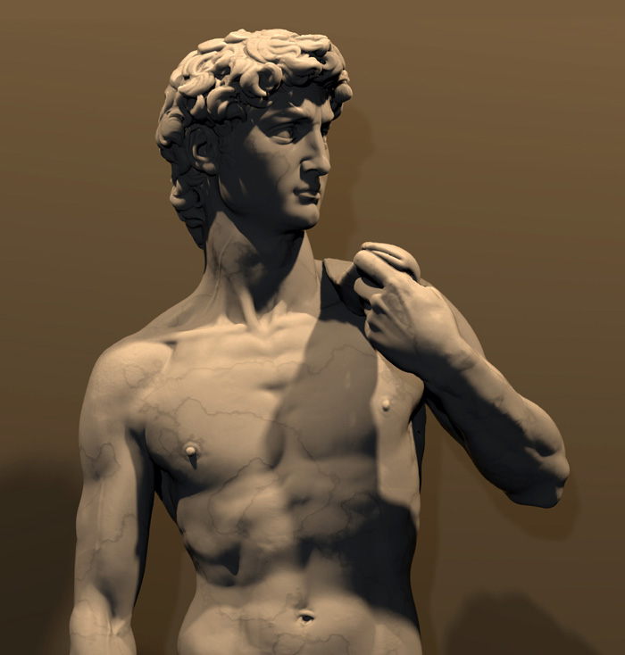
Introduction

Slide 4
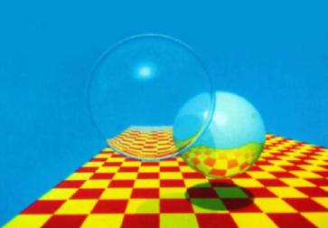
Introduction

Slide 5
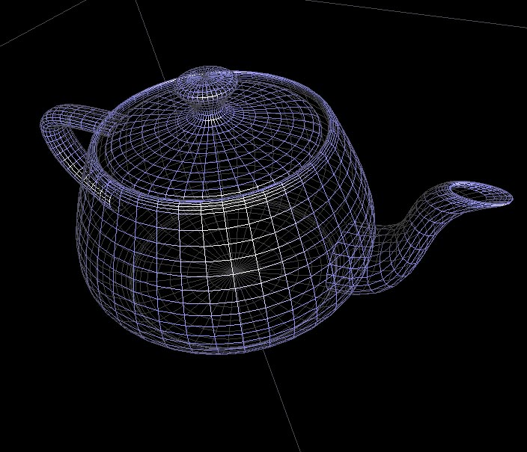
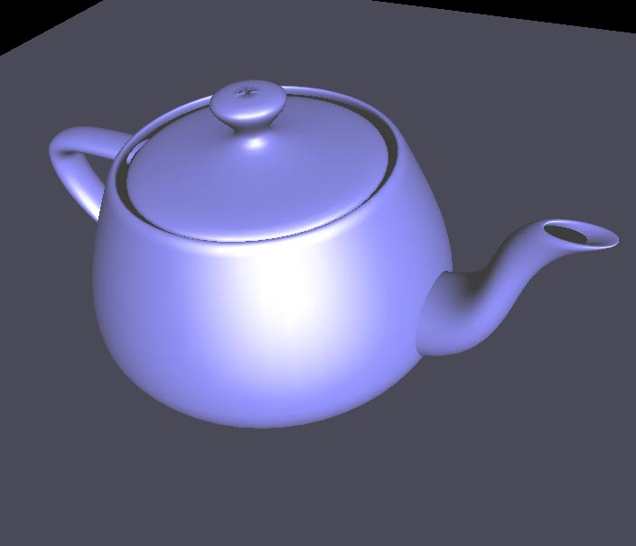
Introduction-objects
How to describe the objects?
Rendering Primitive: points, lines, triangles.
A objects is thus an approximation by a number of such primitives.

Slide 6
Introduction-objects
Are these (points, lines, triangles) enough?
Light sources
Material properties
Textures

Slide 7
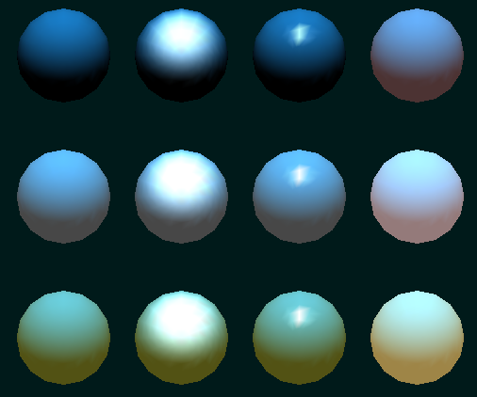
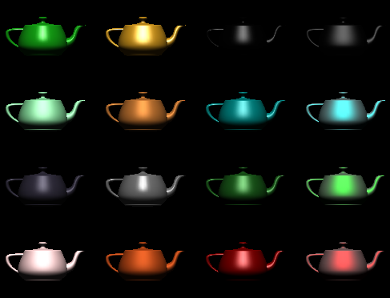
Introduction
Refection with different material properties

Slide 8
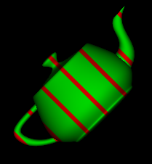
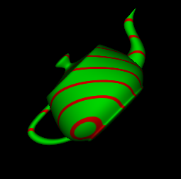
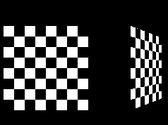
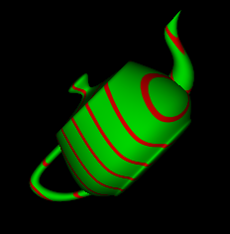
Introduction-Texture

Slide 9
Introduction-Steps to get the picture
Create a scene
  Geometry (triangles, lines, points, and more)
  Light sources
  Material properties of geometry
  Textures (images to glue onto the geometry)
Put a virtual camera
Take a picture

Slide 10
Introduction
How to create the scene with multiple objects?
Originally, an object is in ”model space”
Move, orient, and transform geometrical objects into ”world space”
For example, a sphere is defined with origin at (0,0,0) with radius 1
  Translate, rotate, scale to make it appear elsewhere
Done per vertex with a 4x4 matrix multiplication!
The user can apply different matrices over time to animate objects

Slide 11
Introduction
model space
world space

Slide 12
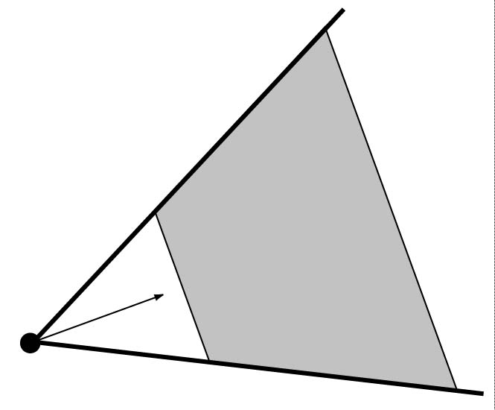
Introduction-Virtual Camera
dir
far
point
fov
(angle)
near

Slide 13
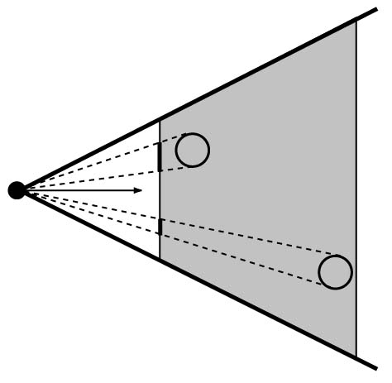
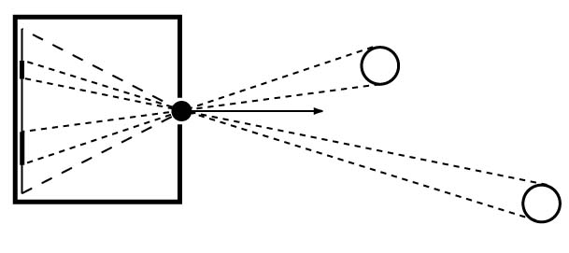
Introduction-Virtual Camera
Pinhole Camera

Slide 14
Introduction-lighting
light
blue
Geometry
red
green

Slide 15
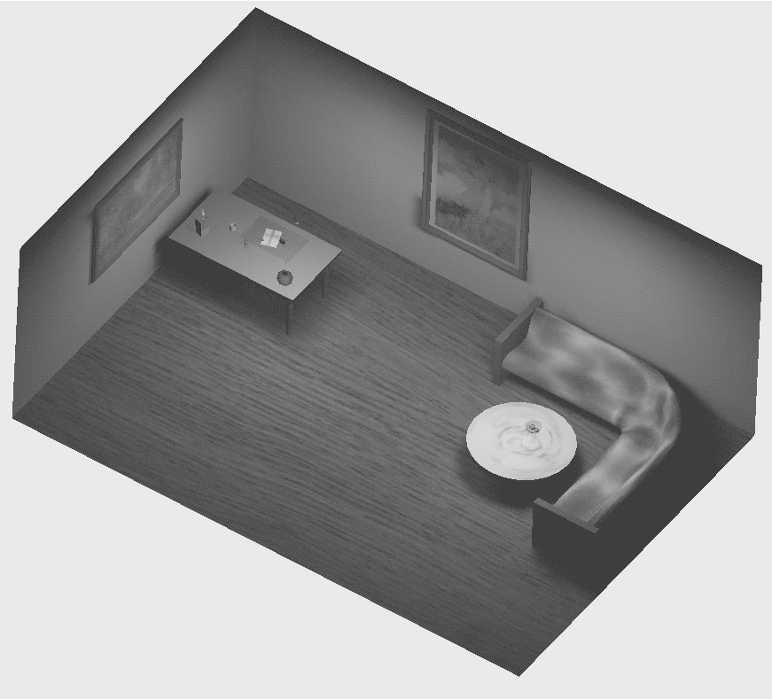
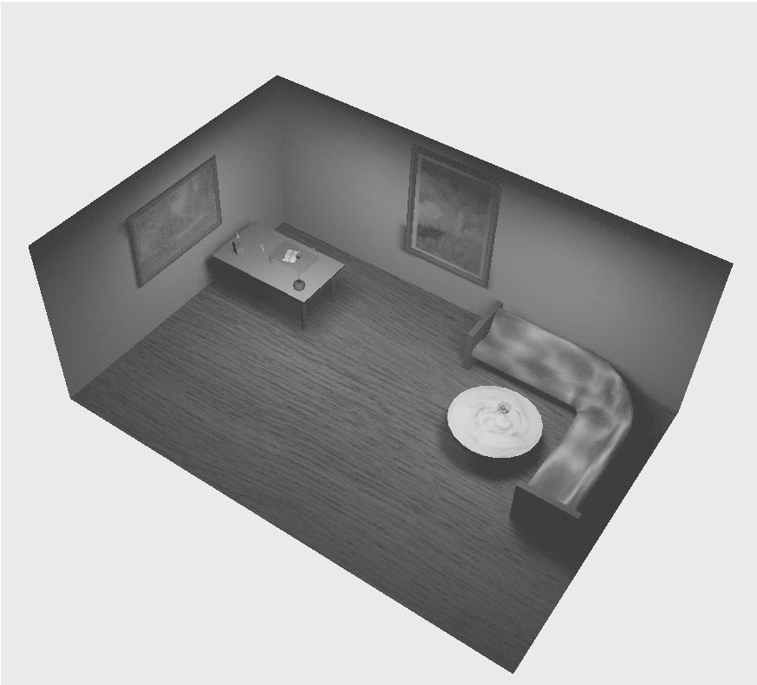
Introduction-Virtual Camera
Projections
  Orthogonal (useful in few applications)
  Perspective (most often used)
    Mimics how humans perceive the world, i.e., objects’ apparent size decreases with distance

Slide 16
Introduction-Clipping

Slide 17
Introduction-Virtual Camera
model space
world space
world space
camera space
map to screen
compute lighting
projection
clip

Slide 18
Introduction
The geometry is described by vertices, However we see the pictures, so how to fill the gap!
Remember, the computer screen only have finite resolution, so basically we can only have limit discrete pixels.
Also we need to remove occluded objects.
Rasterizer! Equavelent to take a digital image.

Slide 19
Rasterizer
Scan-conversion
  Find out which pixels are inside the primitive
Texturing
  Put images on triangles
Interpolation over triangle
Z-buffering
  Make sure that what is visible from the camera really is displayed
Double buffering

Slide 20
Rasterizer-Scan Conversion
Triangle vertices from GEOMETRY is input
Find pixels inside the triangle
  Or on a line, or on a point
Do per-pixel operations on these pixels:
  Interpolation
  Texturing
  Z-buffering

Slide 21
Rasterizer-Scan Conversion

Slide 22
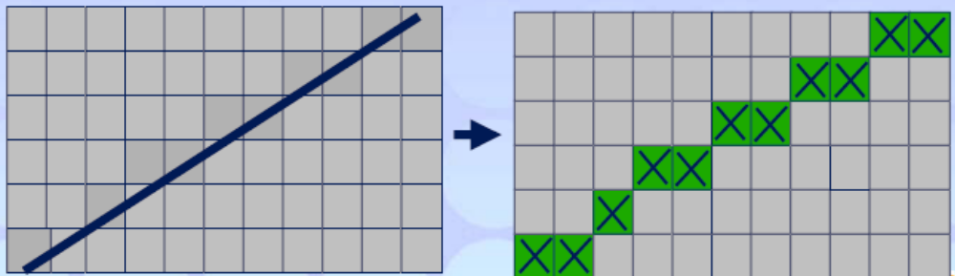
Rasterizer-Aliasing
Turn screen space vertex coordinates into pixels that make lines

Slide 23
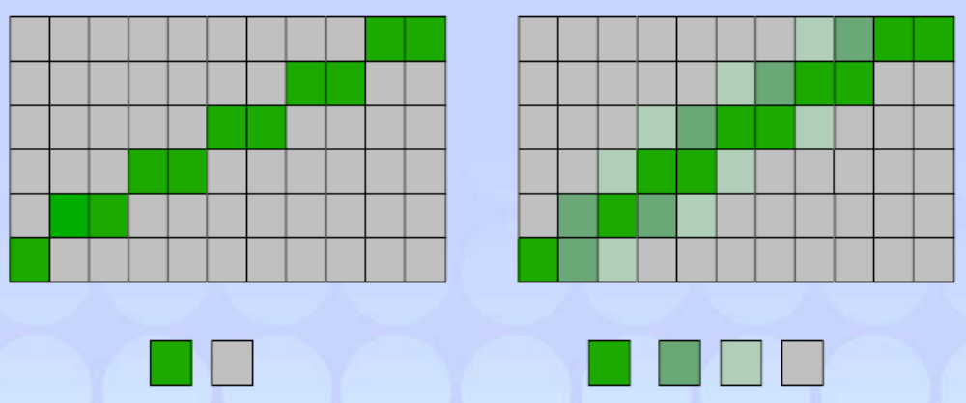
Rasterizer-Antialiasing

Slide 24
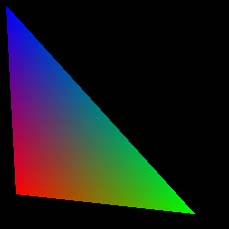
Rasterizer-Interpolation
Interpolate colors over the triangle
  Called Gouraud interpolation
blue
red
green

Slide 25

Rasterizer-Texture
Texturing: ”glue” images onto geometrical object
+
=

Slide 26
Rasterizer-Z-buffer
The graphics hardware is pretty stupid
  It ”just” draws triangles
However, a triangle that is covered by a more closely located triangle should not be visible
Assume two equally large triangles at different depths
incorrect
correct
Triangle 1
Triangle 2
Draw 1 then 2
Draw 2 then 1

Slide 27
Rasterizer-Z-buffer
Would be nice to avoid sorting…
The Z-buffer (aka depth buffer) solves this
Idea:
  Store z (depth) at each pixel
  When scan-converting a triangle, compute z at each pixel on triangle
  Compare triangle’s z to Z-buffer z-value
  If triangle’s z is smaller, then replace Z-buffer and color buffer
  Else do nothing
Can render in any order

Slide 28
Rasterizer-Double Buffering
The monitor displays one image at a time
So if we render the next image to screen, then rendered primitives pop up
And even worse, we often clear the screen before generating a new image
A better solution is ”double buffering”

Slide 29
Rasterizer-Double Buffering
Use two buffers: one front and one back
The front buffer is displayed
The back buffer is rendered to
When new image has been created in back buffer, swap front and back

Slide 30
Introduction-Summary
Three stages:
  Application
  Geometry- per-vertex operation
  Rasterizer- per-pixel operation
Application
Geometry
Rasterizer
Image
output
3D
scene
input

Slide 31
Introduction-GPU
Programmable shading has become a hot topic
  Vertex shaders
  Pixel shaders
  Adds more control and much more possibilities for the programmer
HARDWARE
Application
Geometry
Rasterizer
Vertex shader
program
Pixel shader
program

Slide 32
Course textbook
计算机图形学 (OpenGL版)
  Computer Graphics Using OpenGL, Second Edition. F.S.Hill.JR. 著. 科学出版社
  ISBN: 7-03-012499-5
  计算机图形学(OpenGL版)(第3版) 翻译版
  出版社: 清华大学出版社
  Francis S Hill.Jr. (作者), Stephen M Kelley (作者), 胡事民 (译者), 刘利刚 (译者), 刘永进 (译者), 张松海 (译者）
  http://product.dangdang.com/product.aspx?product_id=20496217
OpenGL 编程指南 (第四版)
  OpenGL Programming Guide Fourth Edition
  The Official Guide to Learning OpenGL. Version 1.4

Slide 33
Topics
OpenGL and GLUT introduction
Basic drawing tools
Vectors and basic operation
3D Geometric transformation
Modeling complicated mesh objects
3D viewing
Realistic Rendering
Curves and Surfaces Design
Ray tracing

