Slide 1
Polygonal Meshes
南开大学软件学院
王 靖

Slide 2
Goals
Develop tools for working with objects in 3D space
To represent solid objects using polygonal meshes
To draw simple wire-frame views of mesh objects

Slide 3
Solid modeling with polygonal meshes
Polygonal meshes are simply collections of polygons of “faces”.
Vertex Normals Versus Face Normals
V3
V1
V2
V4
V2
n
n1
F1
F2
n2
V5
V1

Slide 4
Defining a Polygonal Mesh
y
n1
Vertex list
Normal list
3
n2
Vertex x y z
0 0 0 0
1 1 0 0
2 1 1 0
3 0.5 1.5 0
4 0 1 0
5 0 0 1
6 1 0 1
7 1 1 1
8 0.5 1.5 1
9 0 1 1
Normal nx ny nz
0 -1 0 0
1 -0.7 0.7 0
2 0.7 0.7 0
3 1 0 0
4 0 -1 0
5 0 0 1
6 0 0 -1
8
4
2
9
n0
n6
7
n5
1
5
n3
z
x
n4
6
A polygonal mesh is a collection of polygons, along with a normal
vector associated with each vertex of each polygon.

Slide 5
Defining a Polygonal Mesh
y
n1
3
n2
Face vertices associated normal
0(left) 0,5,9,4 0,0,0,0
1(roof left) 3,4,9,8 1,1,1,1
2(roof right) 2,3,8,7 2,2,2,2
3(right) 1,2,7,6 3,3,3,3
4(bottom) 0,1,6,5 4,4,4,4
5(front) 5,6,7,8,9 5,5,5,5,5
6(back) 0,4,3,2,1 6,6,6,6,6
8
4
2
9
n0
n6
7
n5
1
5
n3
z
x
n4
6
Traverse the polygon countercockwise as seen from outside the object

Slide 6
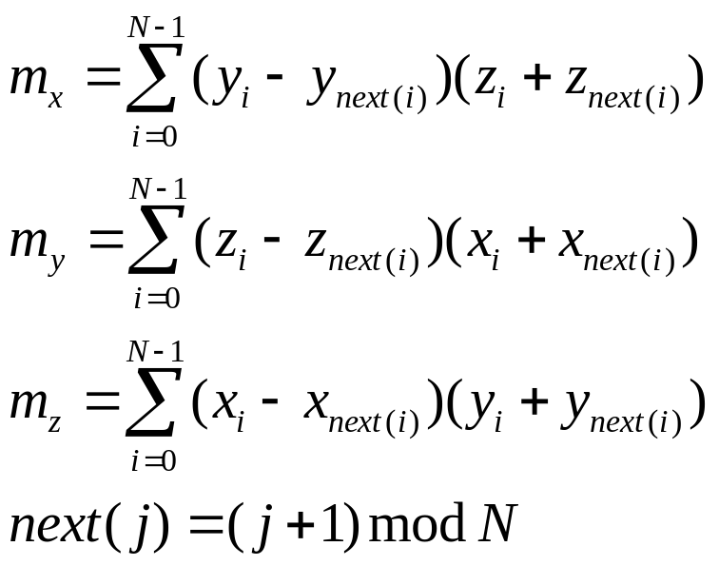
Finding the Normal Vectors

Slide 7
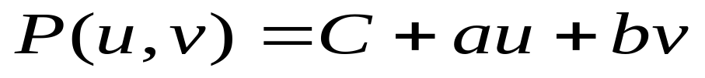
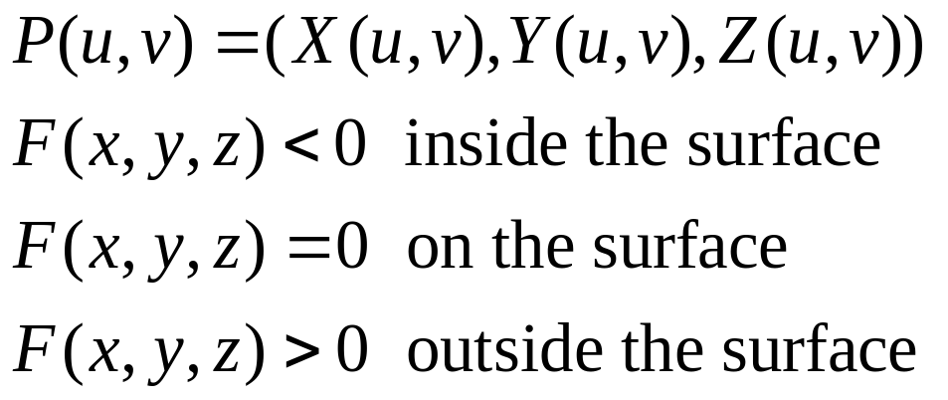
Mesh Approximation to smooth objects
The planar patch

Slide 8
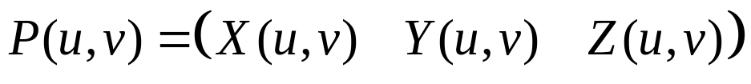
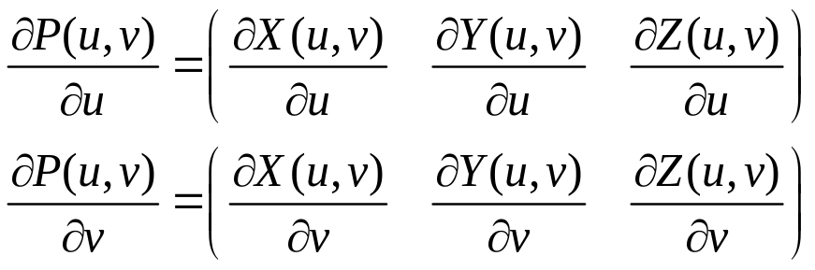
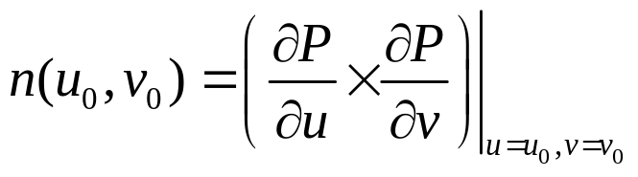

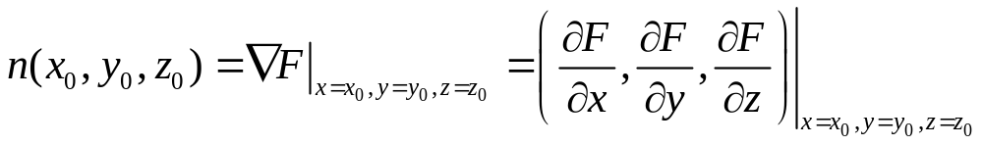
The normal vector to a surface
The Normal Vector for a surface given parametrically

Slide 9
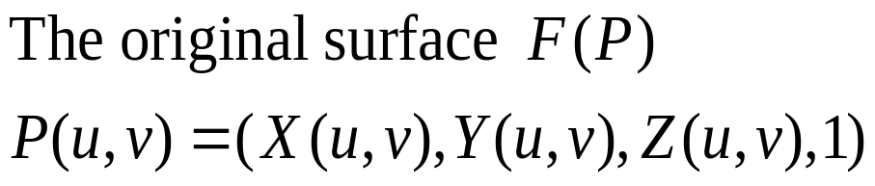
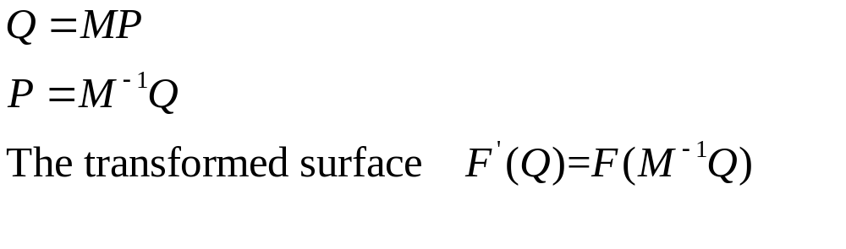
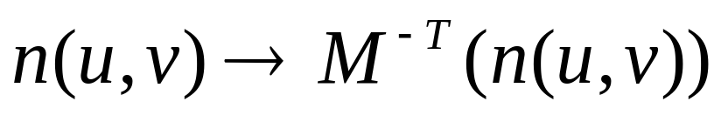
The normal vector to a surface
The Effect of an affine transform

