Slide 1
Rendering Faces for Visual Realism
南开大学软件学院
王 靖

Slide 2
Goals
Add Realism to drawings of 3D scene
How light reflects off of surface
Render polygonal meshes bathed in light
How to make a mesh object appear smooth
Remove hidden surfaces by depth buffer
Texture Mapping

Slide 3
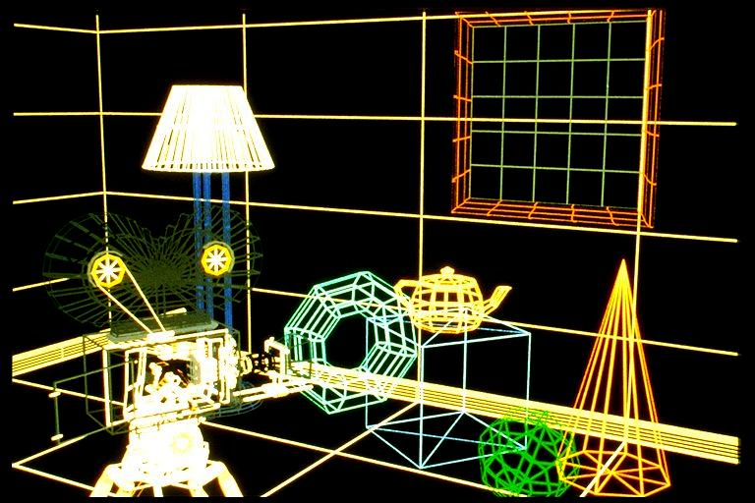
Introduction-Wire Frame

Slide 4
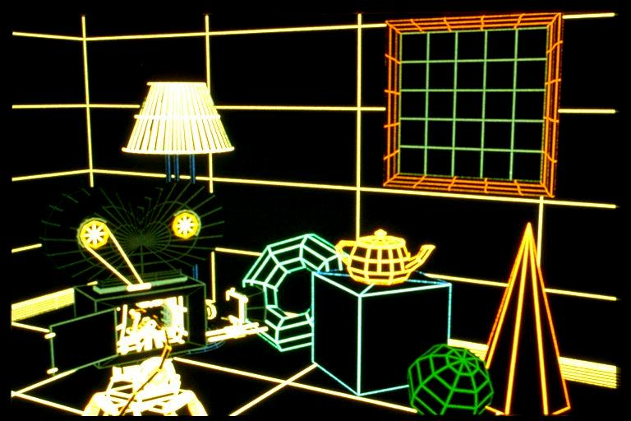
Introduction-Wire Frame (Hidden Lines)

Slide 5
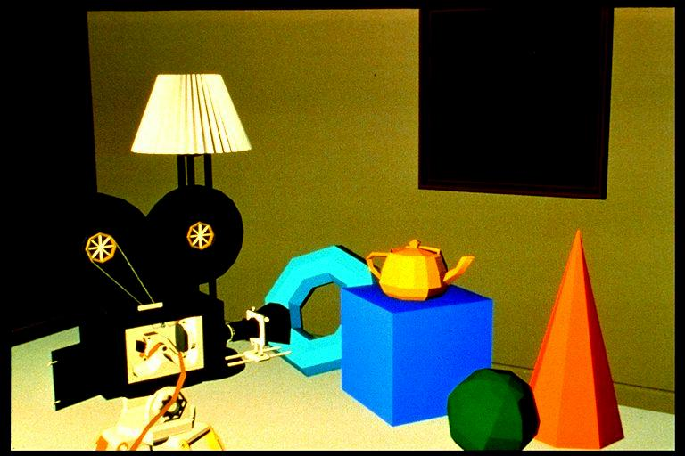
Introduction-Flat Shading

Slide 6
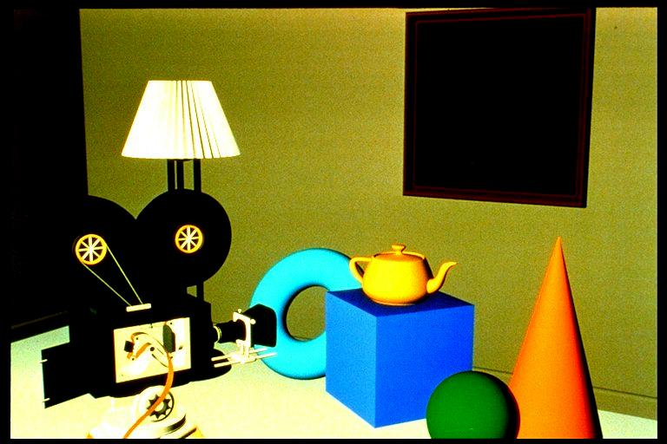
Introduction-Gouraud Shading

Slide 7
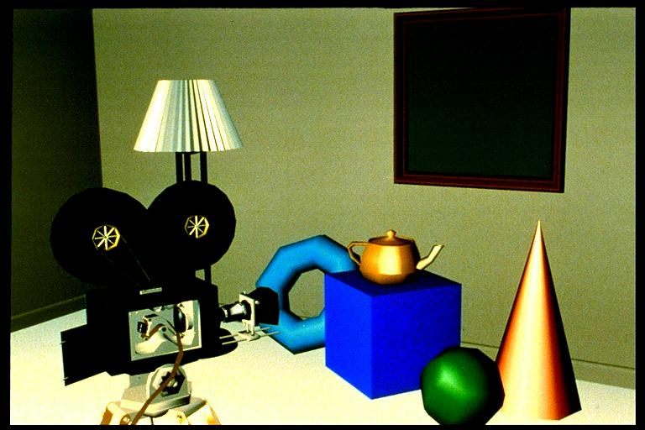
Introduction-Gouraud Shading( Specular Highlights)

Slide 8
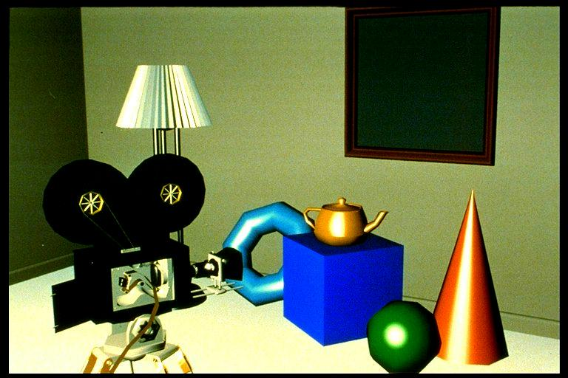
Introduction-Phone Shading( Specular Highlights)

Slide 9
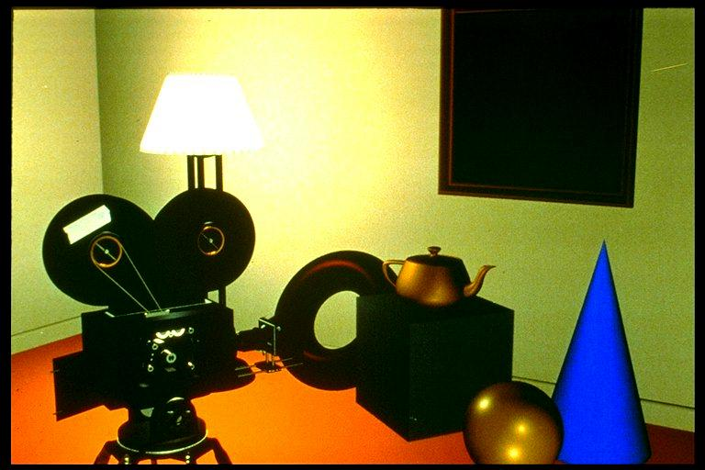
Introduction-Advanced Illumination Model

Slide 10
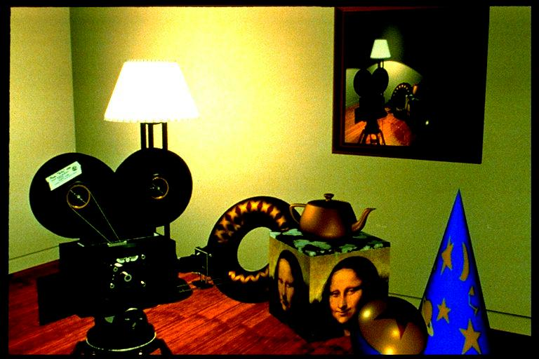
Introduction-texture mapping

Slide 11
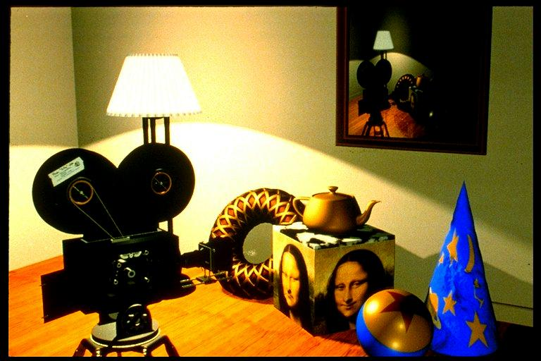
Introduction-Bump Mapping

Slide 12
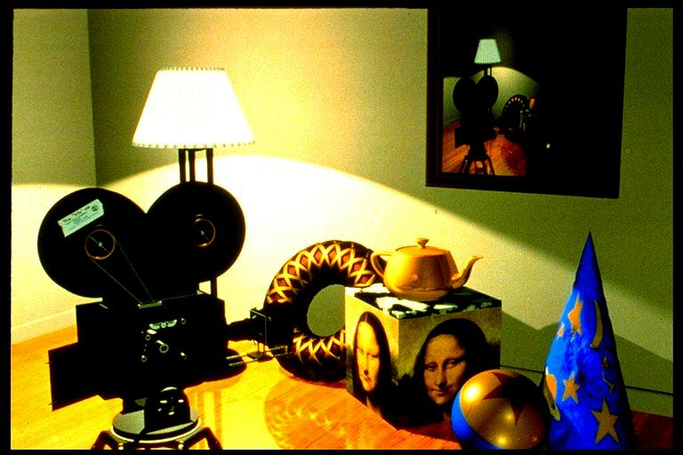
Introduction-Reflection Mapping

Slide 13
Shading Models
Point light source and ambient light
Some is absorbed by he surface and is converted to heat
Some is reflected from the surface
Some is transmitted into the interior of the object,
as in the case of a piece of glass
Diffuse scattering: light is re-radiated uniformly
in all directions
Specular reflections: more mirrorlike and are highly
directional

Slide 14
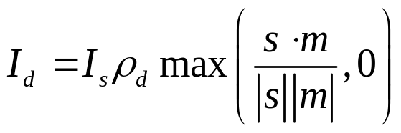
Shading Models-Diffuse Reflection
s
Normal
m
light
m
S
m
s
eye
v
θ
P
S
S
The normal vector m to the surface at P
The vector v from P to the viewer’s eye
The vector s from P to the light source.
Scattering is uniform in all directions.

Slide 15
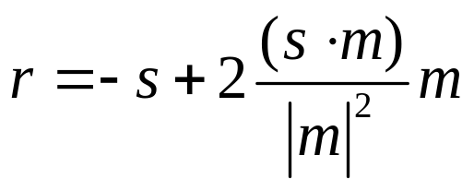
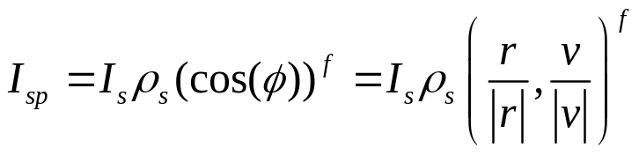
Shading Models-Specular Reflection
r
S
S
m
r
Φ
v
P
P
Phone Model:

Slide 16
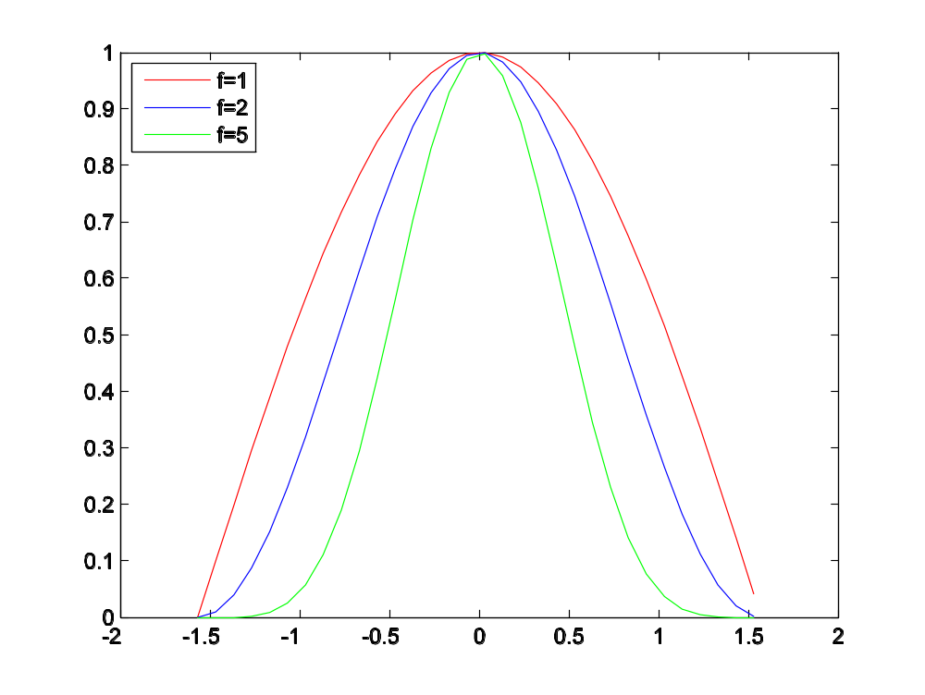
Shading Models-Specular Reflection
Cos(α)
α
π/2

Slide 17
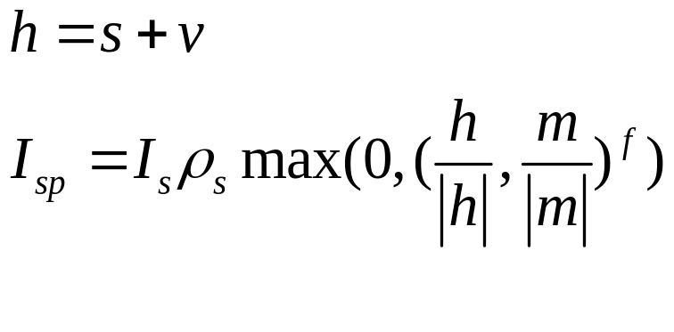
Shading Models-Specular Reflection
m
β
h
s
v
(adjusted specular term)

Slide 18

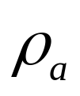
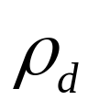
Shading Models-Ambient Reflection
“Uniform background glow” called ambient light
Ambient reflect reflection coefficient
(often it is the same as the diffuse reflection coefficient

Slide 19
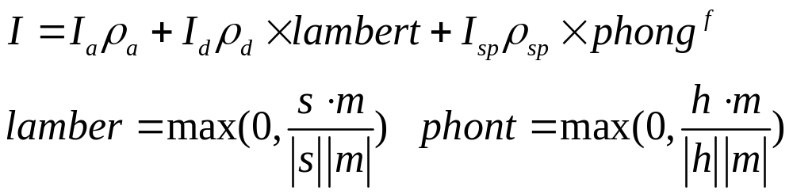
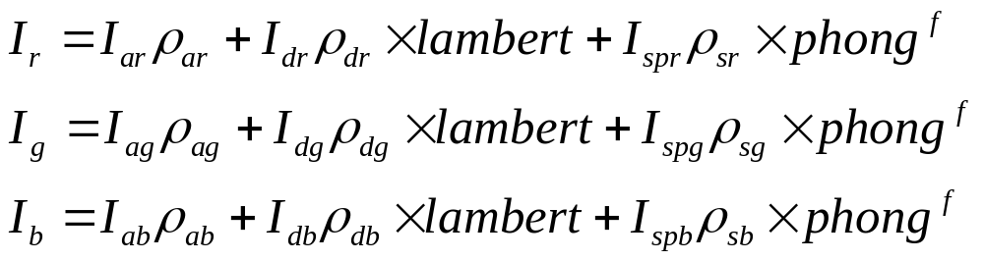
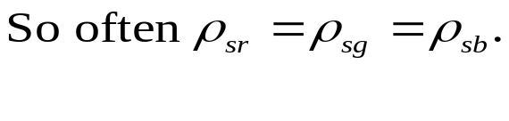
Combining light contributions
Usually, the diffuse and specular light are the same.
The ambient and diffuse reflection coefficients are based on
the color of the surface. The specular component is often the same
as that of the light source.

Slide 20
Shading and the graphics pipeline
V1,m1
V2,m2
Projection
Matrix
Viewport
matrix
VM
Clip
V0,M0
Shading is applied here

Slide 21
Light Sources in OpenGl
GLfloat myLightPosition[]={30, 6.0, 5.0,1.0)
glLightfv(GL_LIGHT0, GL_POSITION, myLightPosition)
glEnable(GL_LIGHTING); //enable
glEnable(GL_LIGHT0); //enable this particular source
(x,y,z,1): a local light source at the position (x,y,z)
(x,y,z,0): a vector to an infinitely remote light source in the direction(x,y,z)
Glfloat am0[]=(0.2, 0.4,0.6,1.0)
GLfloat diff0[]=(0.8,0.80.5,1.0)
GLfloat spec0[]=(1.0,0.8,1.0,1.0)
glLightfv(GL_LIGHT0, GL_AMBIENT, amb0);
glLightfv(GL_LIGHT0, GL_DIFFUSE, diff0);
glLightfv(GL_LIGHT0, GL_SPECULAR, spec0);
Default ambient=(0,0,0,1) diffuse=(1,1,1,1) specular=(1,1,1,1)

Slide 22

Light Sources in OpenGl
Spotlights
α
d
β
P
glLightf(GL_LIGHT0, GL_SPOT_CUTOFF,45.0)
//a cutoff angle of 45
glLightf(GL_LIGHT0, GL_SPOT_EXPONENT,4.0);
//ε=4.0
GLfloat dir[]={2.0,1.0,-4.0}
glLightfv(GL_LIGHT0,GL_SPOT_DIRECTION,dir);
The default values are d=(0,0,-1) α=180, ε=0 which makes
a source an omniirectional point source.

Slide 23
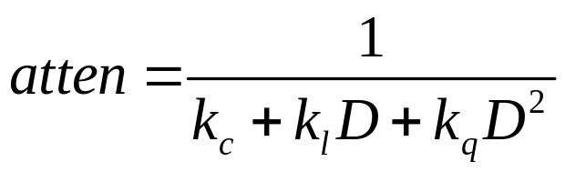
Light Sources in OpenGl
Attenuation of light with distance
Kc,kl, kq are coefficients and D is the distance between the position of
The light and the vertex in question.
glLightf(GL_LIGHT0 GL_CONSTANT_ATTENUATION,2.0)
Also for GL_LINEAR_ATTENUATION, and GL_QUADRATIC_ATTENUATION

Slide 24
Light Sources in OpenGl
Global Ambient light:
GLfloat amb[]={0.2,0.3,0.1,0.1}
glLightModelfv(GL_LIGHT_MODEL_AMBIENT,amb)
Make the viewpoint local
glLighModeli(GL_LIGHT_MODEL_LOCAL_VIEW,GL_TRUE);
Front and back face
glLightModeli(GL_LIGHT_MODEL_TWO_SIDE, GL_TRUE);

Slide 25
Moving Light Source
Void display()
{ GLfloat position[]={2,1,3,1}
glMatrixMode(GL_MODELVIEW);
glLoadIdentity();
glPushMatrix();
glRotated();
glTranslated();
glLightf(GL_LIGHT0,GL_POSITION,
position);
glPopMatrix();
glulookat();
//draw the object
glutSwapBuffers();
}
Independently move the camera
GLfloat pos[]={0,0,0,1};
glMatrixMode(GL_MODELVIEW);
glLoadIdenity();
glLightf(GL_LIGHT0,GL_POSITION,
position); //light at (0,0,0)
gluLookat(…);
//move the light and the camera
//draw the object
The code establishes the light to
be positioned at the eye, and the
Light moves with the camera.

Slide 26
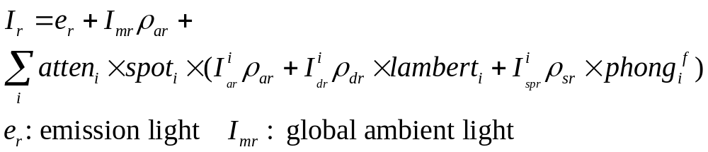
Working with Material Properties
gLfloat mydiffuse[]={0.8,0.2,0.0,1.0};
glMaterialfv(GL_FRONT, GL_DIFFUSE, mydiffuse);
GL_FRONT, GL_BACK, GL_FRONT_AND_BACK
GL_AMBIENT, GL_DIFFUSE, GL_SPECULAR,
GL_AMBIENT_AND_DIFFUSE,GL_EMISSION

Slide 27
Flat Shading and Smooth Shading
color3
ytop
For (int y=bott, y<=ytop; y++)
{
find xleft and xright;
for (int x=xleft, x<=xright,; x++)
{
find the color c for this pixel
put x into the pixel at (x,y)
}
}
glShadeModel(GL_FLAT);
y4
color4
color2
ys
ybot
color1
xleft
xright
Lerp(G,H,f)=G+(H-G)f

Slide 28
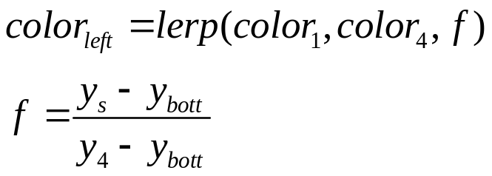
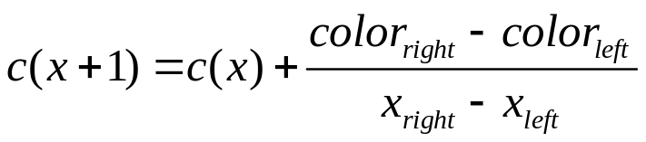
Smooth Shading-Gouraud Shading
Pixel interpolation
color3
ytop
y4
color4
For (int y=bott, y<=ytop; y++)
{
find xleft and xright;
find color(left) and color(right)
color(inc)=(color(right)-color(left))/(x(right)-x(left);
for (int x=xleft, x<=xright,; x++, c+=color(inc)
{
put c into the pixel at (x,y)
}
}
color2
ys
ybot
color1
xleft
xright
Lerp(G,H,f)=G+(H-G)f

Slide 29
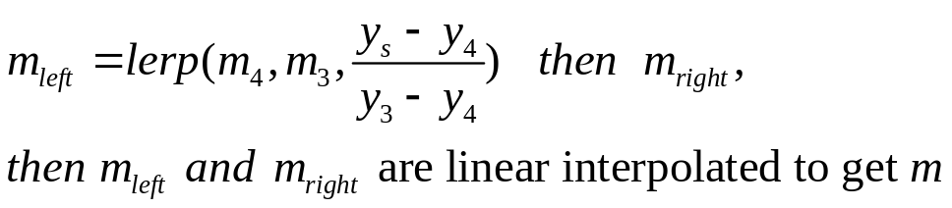
Smooth Shading-Phone Shading
y
m3
y3
m left
m2
mright
ys
m4
y4
m1
x
x

Slide 30
Hidden surface removal
y
For (int y=bott, y<=ytop; y++)
{
find xleft and xright;
find dleft, dright, dinc, colorleft, colorright
and colorinc
for (int x=xleft, c=colorleft, d=dleft, x<=xright,; x++, c+=colorinc,d+=dinc)
{ if(d<d[x][y])
put c into the pixel at (x,y)
d[x][y]=d; //update the closeet depth
}
}
y3
d4
dl
d3
ys
dr
y4
d1
d2
x
x

Slide 31
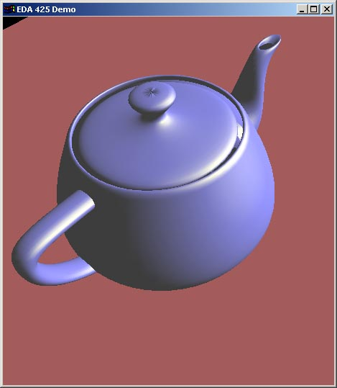
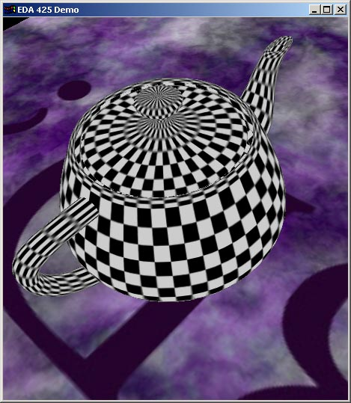

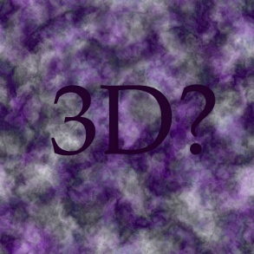
Texturing
+
=

Slide 32
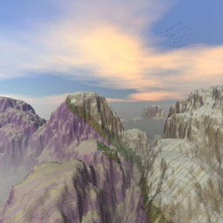
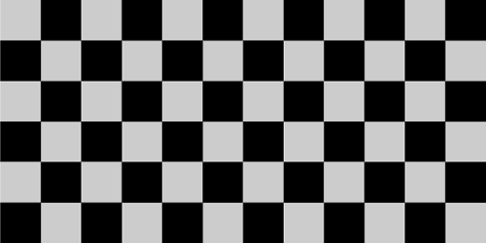
Texturing
t
Bitmap Textures
Procedural Textures
1.0
1.0
s
t
1.0
1.0
s

Slide 33

Texturing
(0,1)
(1,1)
(u₁,v₁)
(u₂,v₂)
(0,0)
(1,0)
(u₀,v₀)
(u,v) in [0,1]
What if (u,v) >1.0 or <0.0 ?
To repeat textures, use just the fractional part
  Example: 5.3 -> 0.3
Repeat, mirror, clamp, border:
(2,2)
(-1,-1)

Slide 34
Rendering the texture
Texture Space
World Space
Screen Space
y
y
1
z
x
y
eye
1
x_{left}
y_{left}
x
P(x_{s},y_{s})
(S*,t*)

Slide 35
Rendering the texture
F
(s0,t0)
closer to
the eye
Farther to
the eye
y_{top}
(s1,t1)
(s3,t3)
F’
y_{s}
y_{bot}
(s2,t2)
170
equispaced
x_{left}
x_{right}

Slide 36
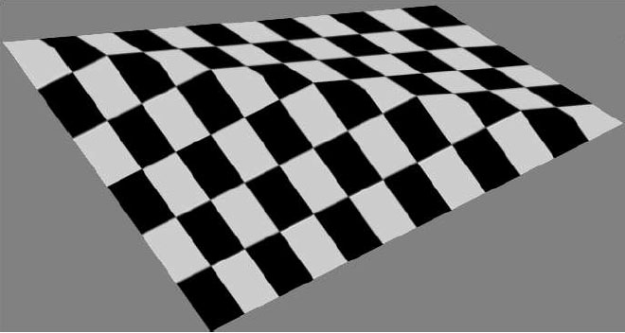
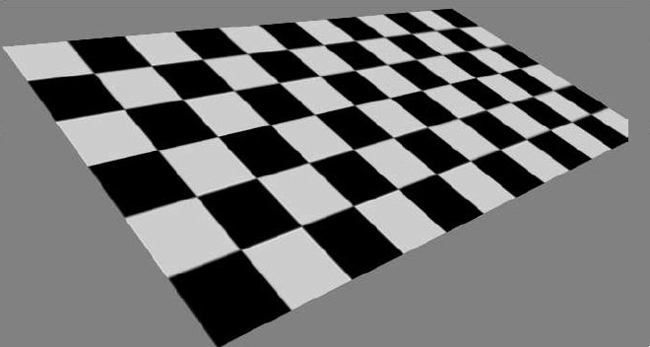
Rendering the texture
Linear interpolation
Perspective-correct interpolation

Slide 37
Rendering the texture
Texture space
Eye space
Screen space
Le
Ls
Lt

Slide 38
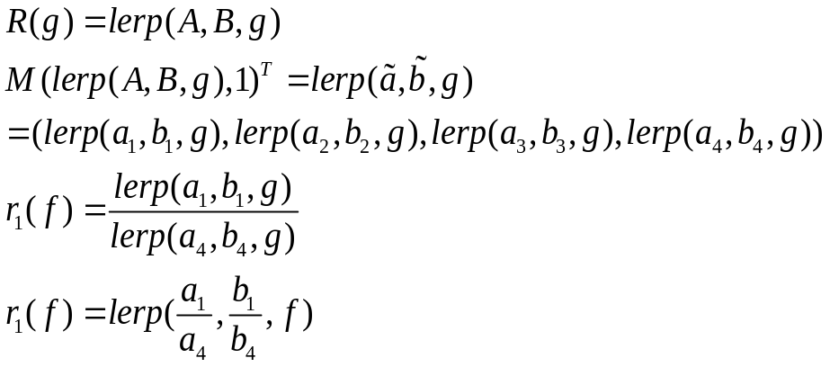
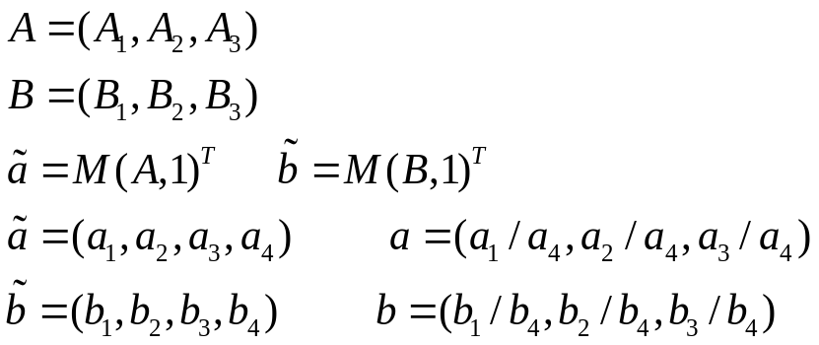
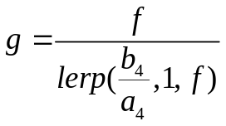
Rendering the texture
A
r(f)
b
R(g)
M
a
B

Slide 39
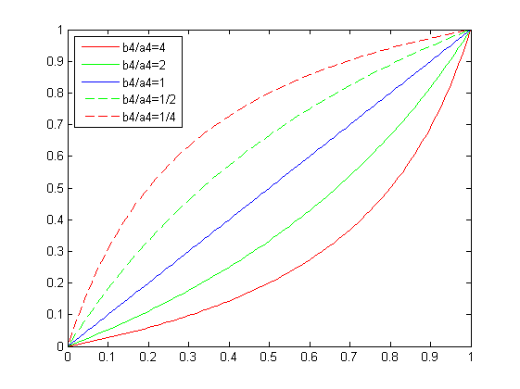
Rendering the texture
g
f

Slide 40
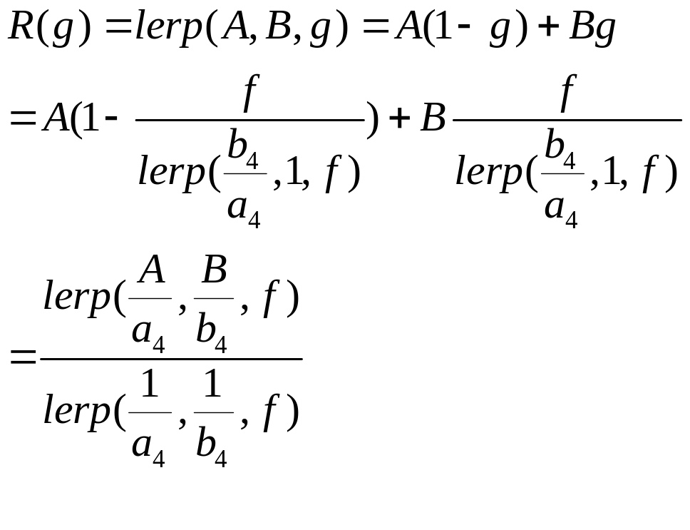
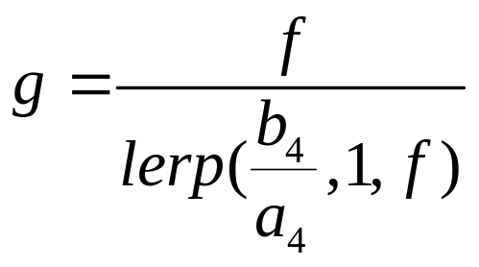
Rendering the texture
The transformation is affine
The transformation is the perspective transformation
Fact:
If M is affine, equal steps along the line ab do correspond to equal steps
along the line AB.

Slide 41
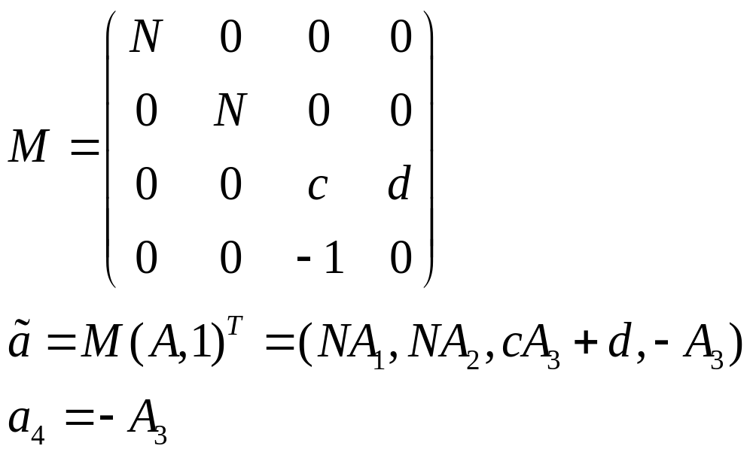
Rendering the texture
Spacing increases
A
B
a
b
screen
The depth of the point in front of the eye.

Slide 42
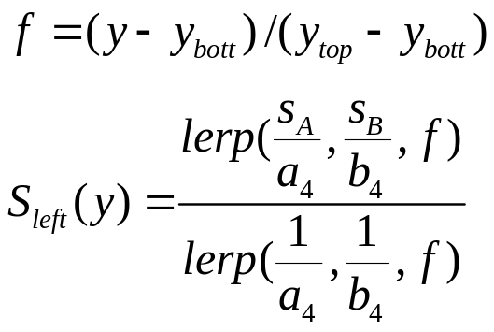
Rendering the texture
y
(S_{B}, T_{B})
B
y_{top}
b
b’
y
a’
y_{bott}
a
A
(S_{A},T_{A})
x_{left}
x_{right}
x
For each x from x_{left} to x_{right},
how to find the value s and t?

Slide 43


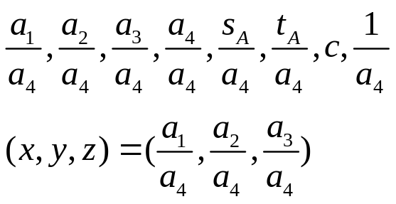
Implication for the Graphics Pipeline
V,s,t,n
A, s_{A}, t_{A}, n’
A, s_{A}, t_{A}, c
, s_{A}, t_{A}, c
Model
View
Shade
Perspective
transformation
clip
Perspective
division
viewport
screen

Slide 44
What does the texture modulate?
Creating a glowing object
I=texture(s,t)
glTexEnvf(GL_TEXTURE_ENV, GL_TEXTURE_ENV_MODE,
GL_REPLACE);
Painting the texture by modeulating the reflection coefficient
glTexEnvf(GL_TEXTURE_ENV, GL_TEXTURE_ENV_MODE,
GL_MODULATE);

Slide 45
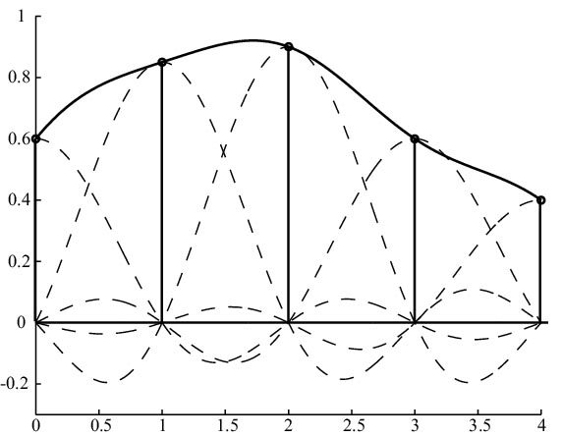
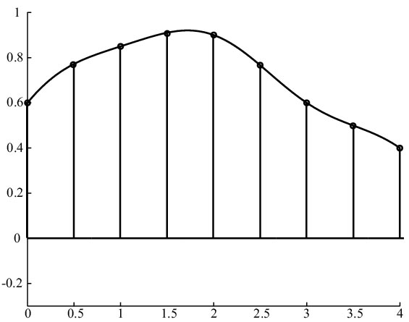
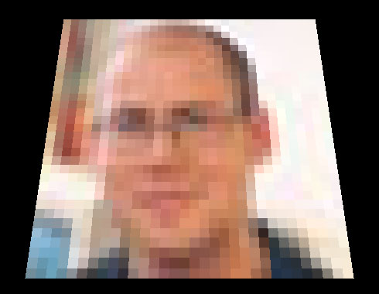
Filtering- Texture magnification
sinc(x) is not feasible in real time
Nearest-neighbor
filtering

Slide 46
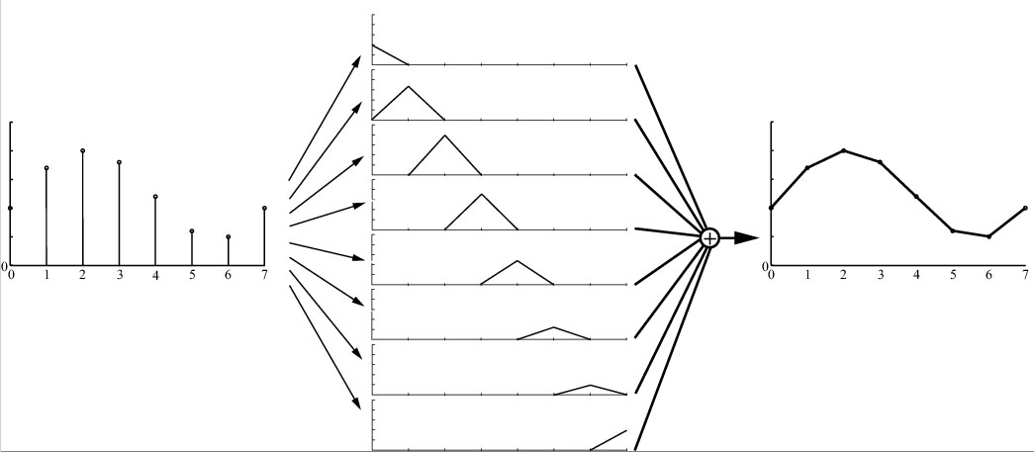

Filtering- Texture magnification
1D linear interpolation

Slide 47
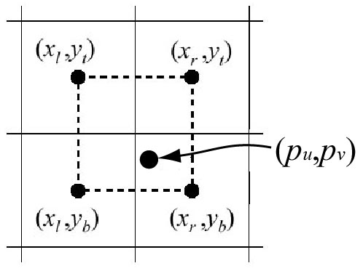
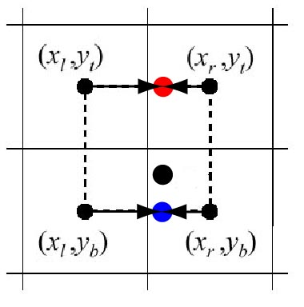
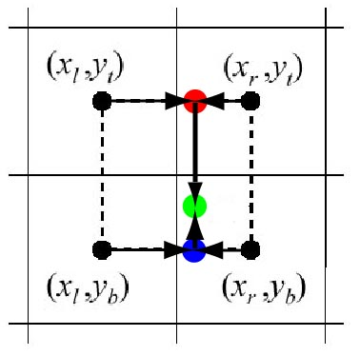
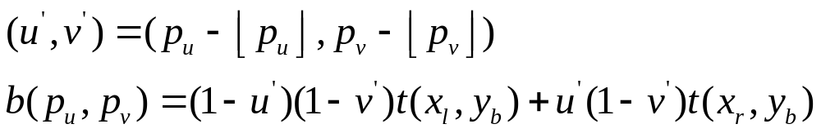
Filtering- Texture magnification
Bilinear interpolation

Slide 48
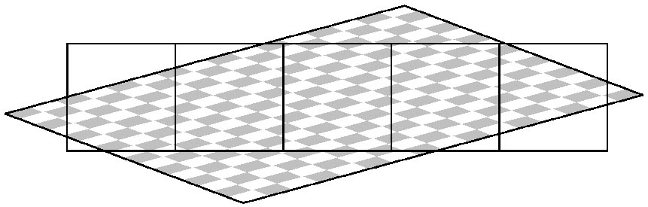
Filtering- Texture minification
Nead to average a texel inside a pixel!

Slide 49

Mipmapping
Image pyramid
Half width and height when going upwards
Average over 4 ”parent texels” to form ”child texel
Depending on amount of minification, determine which image to fetch from
Compute d first, gives two images
  -Bilinear interpolation in each
d
v
u

Slide 50


Mipmapping
No mipmapping
Mipmapping

Slide 51
Mipmapping
Interpolate between those bilinear values
  Gives trilinear interpolation
Level n+1
(u₀,v₀,d₀)
d
Level n
v
u
Constant time filtering: 8 texel accesses
How to compute d?

Slide 52

Mipmapping
texel
pixel projected
to texture space
Approximate quad with square
Memory requirement?
Gives overblur!
Even better: anisotropic texture filtering
  Approximate quad with several smaller mipmap samples

Slide 53


Anisotropic texture filtering
16 samples

Slide 54

Projection of images onto geometry
Simulating a slide projector
Fast Shadows and Lighting Effects Using Texture Mapping Siggraph 92

Slide 55


Projection of images onto geometry
Viewing a projected texture
Objects geometry in the light
and clip coordinate systems

Slide 56




Projection of images onto geometry
Clip coordinate:
Screen Coordinates:
Objects geometry in the light
and clip coordinate systems

Slide 57


Projection of images onto geometry
Objects geometry in the light
and clip coordinate systems

Slide 58
Projection of images onto geometry
Pass 1: if z<z_{p} Then z_{p}=z (hidden surface removal)
Pass 2: if z_{p}==z , then c_{p}= c_{p} +c_{τ} (illumination)
Pass 3: Set c_{p} =c* c_{p}(final rendering)
Associated with each screen point is a color c and z-value z
Associated with each corresponding texture point is a color c_{τ} and z-value z_{τ}
These values are used to modify corresponding values in a framebuffer of
pixels. Each pixel denoted as p, also has an associated color c_{p} and z-value z_{p}

Slide 59

Texture Map Shape
For each point in the object, how to associate a pixel in the texture map?
( Map shape and Map entity )

Slide 60

Texture Map Shape
Throw away one component of (x,y,z) for planar map shape.

Slide 61

Texture Map Shape-Planar

Slide 62

Texture Map Shape-Planar

Slide 63

Texture Map Shape- Cylinder
X,Y,Z is converted to r, theta, height
Theta -> x, Height->y

Slide 64

Texture Map Shape- Cylinder

Slide 65
Texture Map Shape- Cylinder

Slide 66

Texture Map Shape- Sphere
X,y,z -> (latitude, longitude) ->(u,v)

Slide 67

Texture Map Shape- Sphere
Stretches the square near the equator, and squeezes the squares
near the pole.

Slide 68

Texture Map Shape- Sphere

Slide 69

Texture Map Shape- Box
Six planar texture map

Slide 70


Texture Map Shape- Box

Slide 71


Texture Map Shape- Box

Slide 72

Texture Map Entity
Map shape determine the conversion from (x,y,z) to (u,v)
Map entity determine definition of (x,y,z)

Slide 73

Texture Map Entity
Interaction between map shape and entity, what is
this shape?

Slide 74

Texture Map Entity
cylindrical map shape

Slide 75

Texture Map Entity
Sphere map shape

Slide 76

Texture Map Entity
What is this shape?

Slide 77


Texture Mapping-Surface Parameterization

Slide 78

Texture Mapping-Surface Parameterization

Slide 79


Texture Mapping-Linear and Nonlinear effects

Slide 80


Texture Mapping- Layered Texture

