Slide 1
Three-Dimensional Viewing
南开大学软件学院
王 靖

Slide 2
Goals
Tools to create and manipulate a camera
How to “fly” a camera through a scene
Learn the mathematics for perspective projections
OpenGL graphics pipeline
Clipping algorithms for 3D objects

Slide 3
Camera Setting
θ
y
z
Far plane
N
Near plane
F
glMatixMode(GL_PROJECTION)
glLoadIdentity();
gluPerspective(viewAngle,aspectRatio,
N,F);
N
x
F

Slide 4
Positioning and Pointing the camera
v
glMatrixMode(GL_MODEVIEW);
glLoadIdentity();
gluLookAt(eye.x,eye.y,eye.z,
look.x,look.y,look.z,up.x,up.y,up.z);
n
y
eye
x
How to rotate the camera around
u,v,n and how to slide the
Camera?
-n
z
u
Attatching a coordinate system
To the camera

Slide 5
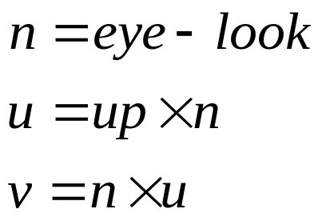
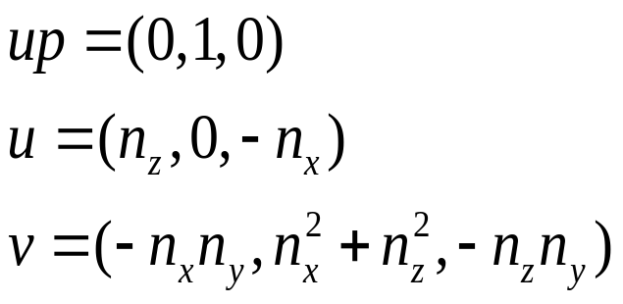
Positioning and Pointing the camera
v
up
up
n
eye
look
eye
look
u
U,V,N all needs to be normalized

Slide 6
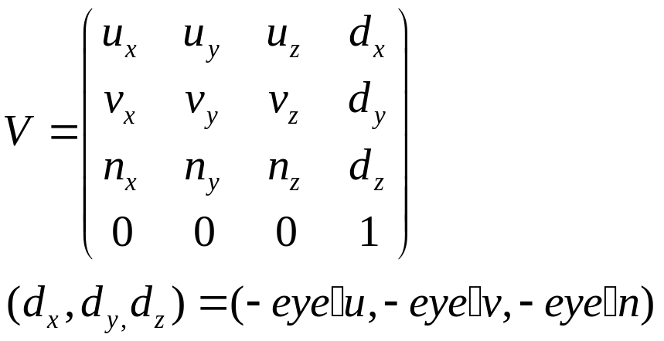
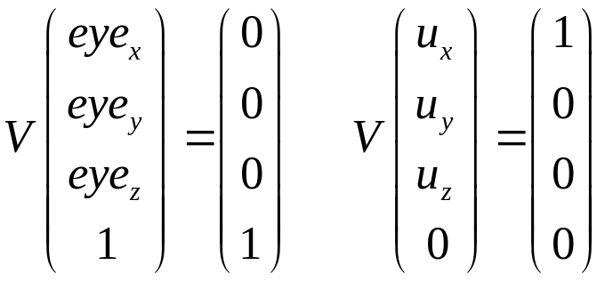
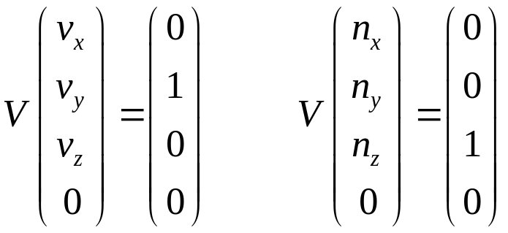
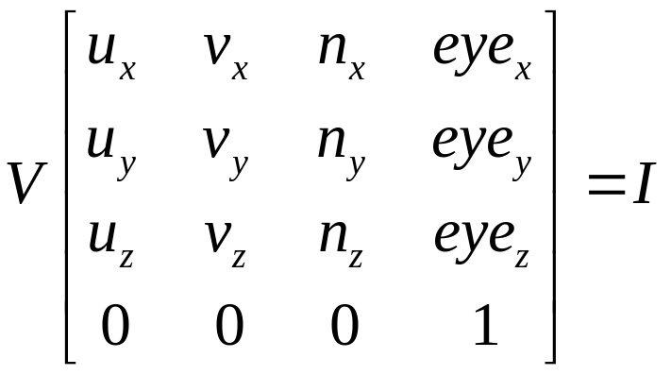
Positioning and Pointing the camera
Convert world coordinates to camera coordinates

Slide 7
Building a camera in a program
Cam.set(eye,look.up);
cam.slide(-1,0,-2);
cam.roll(30);
cam.yaw(20);
Class camera{
private:
Point3 eye;
Vector u,v,n
double viewAngle, aspect, nearDist, farDist; //view volume shape
void setModelViewMatrix(); //tell openGL where the camera is
public:
Camera(); // default construct
void set(Point3 eye, Point3 look, Vector3 up); // like gluLookAt
void roll(float angle);
void pitch(float angle);
void yaw(float angle);
void slide(float delu, float delv, float delN);
void setShape(float vAng, float asp, float nearD, float farD);
}

Slide 8
Building a camera in a program
Void Camera:: setModelViewMatrix(void)
{ //load modelview matrix with existing camera values
float m[16];
Vector3 eVec(eye.x, eye.y, eye.z);
m[0]=u.x; m[4]=u.y; m[8]=u.z; m[12]=-eVec.dot(u);
m[1]=v.x; m[5]=v.y; m[9]=v.z; m[13]=-eVec.dot(v);
m[2]=n.x; m[6]=n.y; m[10]=n.z; m[14]=-eVec.dot(n);
m[3]=0; m[7]=0; m[11]=0; m[15]=1.0;
glMatrixMode(GL_MODELVIEW);
glLoadMatrix(M); //load OpenGL’s modelview matrix
}
Void Camera:: set(Point3 Eye, Point3 look, Vector3 up)
{ // create a model view matrix and set it to opengl
eye.set(Eye);
n.set(eye.x-look.x, eye.y-look.y, eye.z-look.z); // make n
u.set(up.cross(n)); //make u=upxn
n.normalize(); u.normalize(); //make then unit length
v.set(n.cross(u)); //make v=nxu
setModelViewMatrix(); //tell openGL
}

Slide 9
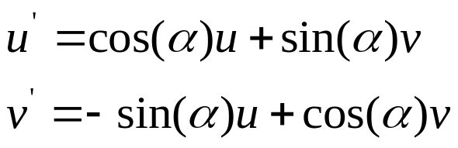
Flying the camera
Sliding the camera:
Void Camera::slide(float delu, float delv, float delN)
{
eye.x+=delU*u.x+delV*v.x+delN*n.x;
eye.y+=delU*u.y+deuV*v.y+delN*n.y;
eye.z+=delU*u.z+deuV*v.z+delN*n.z;
setModelViewMatrix();
}
v
v’
u’
u

Slide 10
Perspective Projection of 3D Objects
eye coordinates
Clip coordinates
Normalized
Device coordinates
V1,V2,…
VM
P
clip
Modelview
matrix
Projection
matrix
Perspective
divisions
Window coordinates
Vp
Viewport
matrix

Slide 11
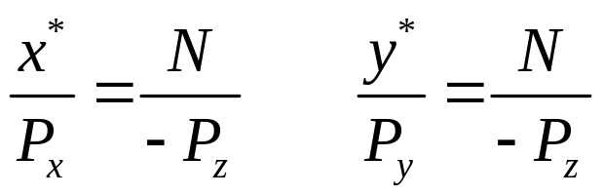
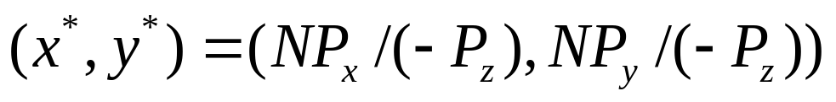
Perspective Projection of 3D Objects
y
y*
Pz
x*
x
N

Slide 12
Perspective Projection of 3D Objects
Perspective foreshortening
Points on the z=0 plane -> clipping
Points behind the eye -> clipping
Effect of the near-plane distance N is simply to scale the picture
Straight lines project to straight lines

Slide 13
Perspective Projection of 3D Objects
y
0.5,1.5,0
View #1 eye at (0,0,2) look down the –z
With u=(1,0,0) n=(0,0,1)
Near plane at a distance of unity from the
Eye.
0.5,1.5,1
1,1,0
y
1.5
1,0,0
1.0
0,0,1
z
x
0.5
1,0,1
0.5
1
x

Slide 14
Perspective Projection of 3D Objects
y
View #2 eye=(0.5,0,2), u and n are the
same as in view #1
0.5,1.5,0
y
0.5,1.5,1
1,1,0
1.5
1.0
1,0,0
0,0,1
z
x
1,0,1
0.25
0.5
x

Slide 15
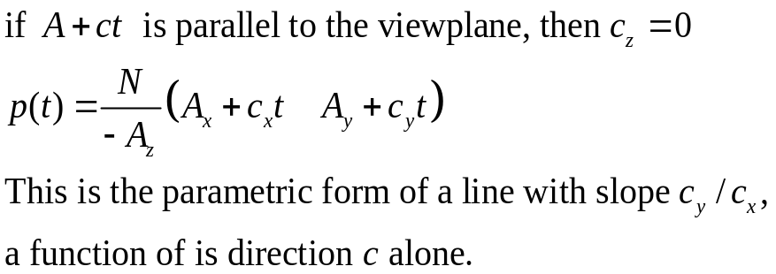
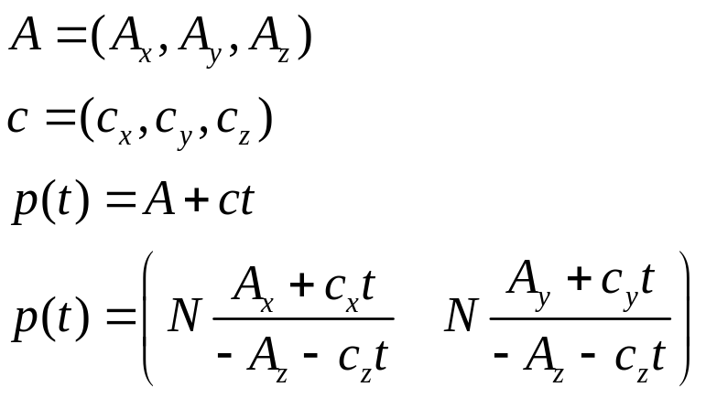
Perspective Projection of a Line
Lines are parallel in 3D object to lines, but the two are not necessarily parallel. If they are not parallel, they meet at some “vanishing point”
If two lines in 3D are parallel to each
Other and the view plane, they project
to parallel lines.

Slide 16
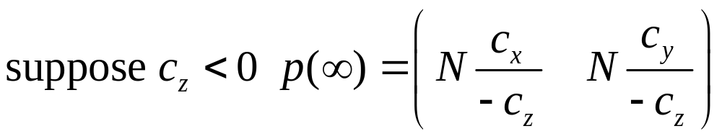
Perspective Projection of a Line
Vp
Is this a line equation?

Slide 17
Perspective Projection of a Line
B
A
B’
viewplane
A’
VP
x
z
The geometry of a vanishing point

Slide 18
Perspective Projection of a Line
A
B’
A’
C’
viewplane
C
x
B
z
Projection the line segment AB, with B “behind the eye”

Slide 19
Perspective Projection of a Line
Consider eye at (0,1,0) . n=(0,0,1) up=(0,1,0)
The grid lines of constant x have the parametric form (i,-1,-t) in eye coordinate
i from –M to M, t from zero to infinity.
So the i-th line projects to (i/t,-1/t), as t goes to infinity, the vanish point is (0,0)
The grid lines of constant z are given by (t,-1,-i), where i=1,2,…N and t varies
from negative infinity to infinity. These grid lines project to (t/i, -1/i)
The more remove ones lie closer together. The horizon consists of all the
Contours such that z is very large and negative. It is positioned at y=0.

Slide 20
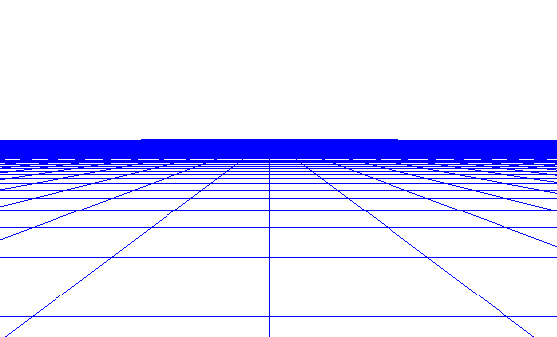
Perspective Projection of a Line

Slide 21
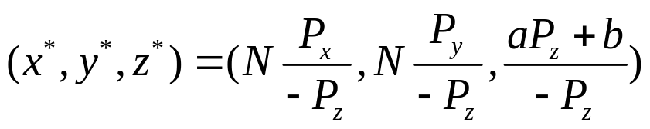
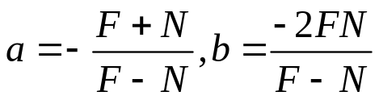
Incorporating Perspective into the Graphics Pipeline
(x*,y*)
P1
P2
1
N
F
-1
-Pz

Slide 22
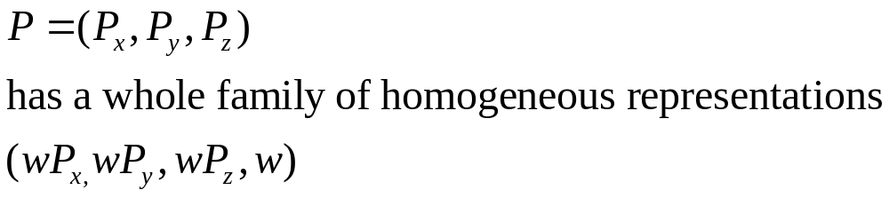
Using Homogeneous Coordinates
To convert a point from ordinary coordinates to homogeneous
coordinates, append a 1.
To convert a point from homogeneous coordinates to ordinary
coordinates, divide all of the components by the last component, and
discard the fourth component.

Slide 23
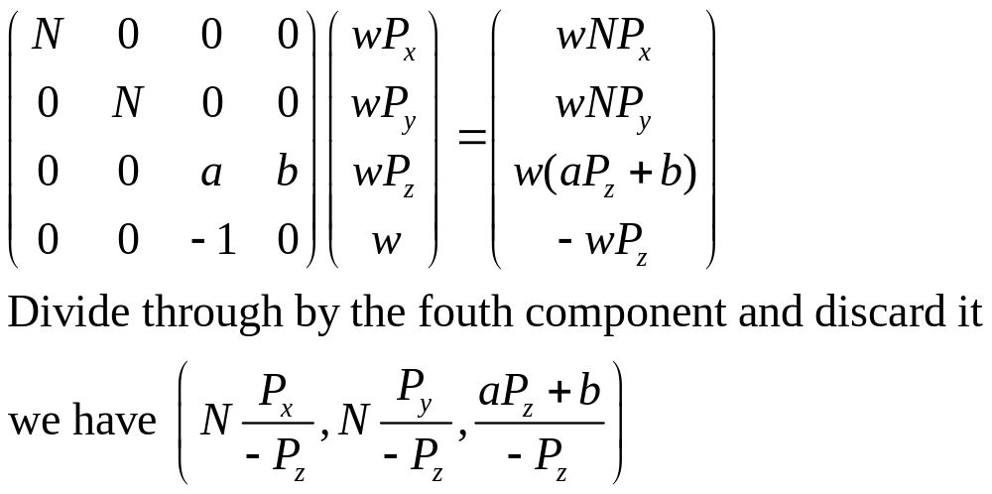
Using Homogeneous Coordinates
Suppose the viewing plane is given in camera coordinates by the
equation Ax+By+Cz=D, what is the point on the plane P projects to?

Slide 24
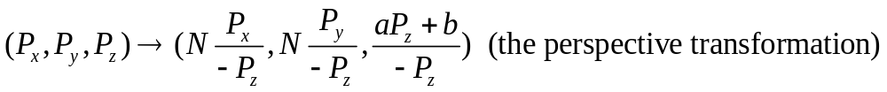
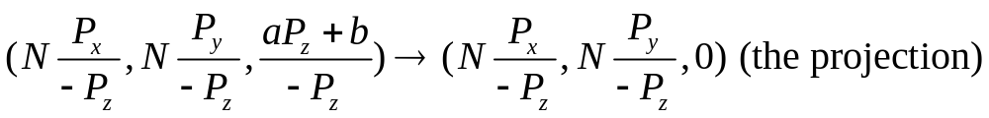
Using Homogeneous Coordinates
(perspective projection)=
(perspective transformation)+ (orthographic projection)

Slide 25
The geometric Nature of the Perspective Transformation
y
y
T
W
W’
T’
-1
1
z
z
S’
S
Lines through the eye map into lines parallel to the z-axis.
Lines perpendicular to the z-axis map into lines perpendicular to the z-axis.

Slide 26
The geometric Nature of the Perspective Transformation
y
2
2
1
1
z
The perspective transformation “warps” objects so that, when viewed with
An orthographic projections, they appear the same as the original objects
do when viewed with a perspective projections.

Slide 27
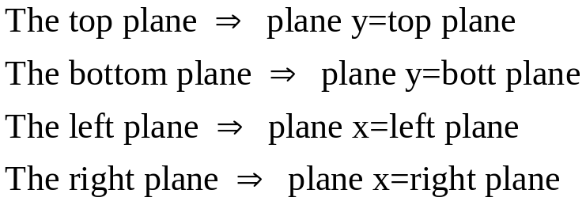
The geometric Nature of the Perspective Transformation
y
(left, top,-N)
y
1
z
1
1
z
x
x

Slide 28
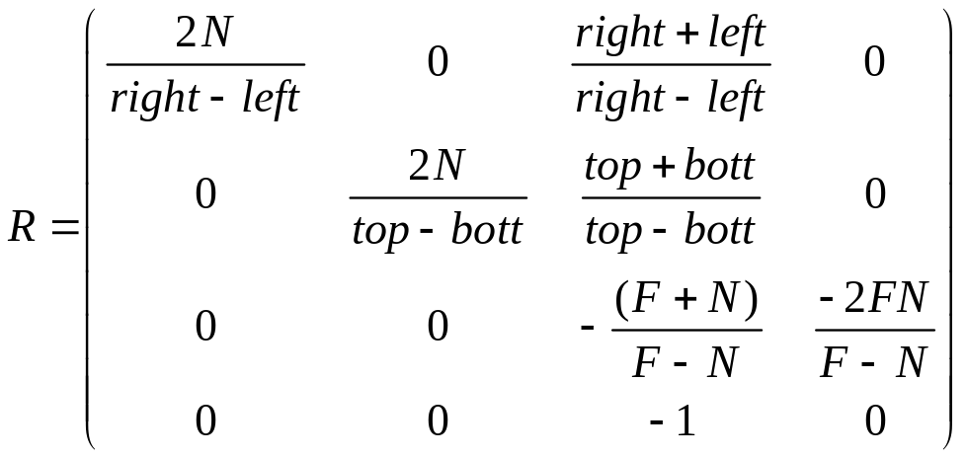
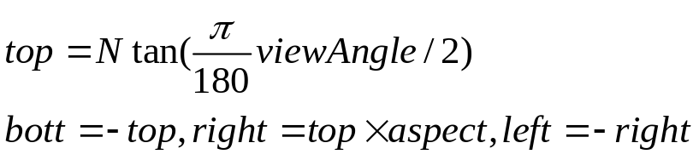
The geometric Nature of the Perspective Transformation
Shift by –(right+left)/2
In x, and by
–(top+bott)/2 in y
Scale by 2/(right-left)
In x and by 2/(top-bott)
In y
Try to verify R.
glFrustum(left, right,bott,top,N,F)
gluPerspective(viewAngle, aspect, N,F)

Slide 29
Clipping Faces against the View Volume
CVV:
canonical view volume
y
y
C
V3
b
I
a
V1
V2
A
x
x
z
z

Slide 30
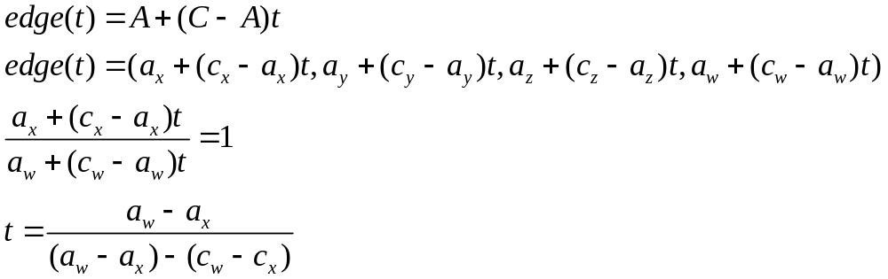
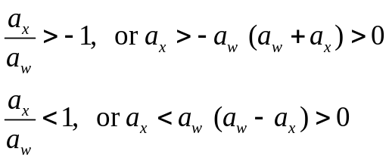
Clipping Faces against the View Volume
y
C
Boundary coordinate homogeneous value clip plane
BC0 w+x x=-1
BC1 w-x x=1
BC2 w+y y=-1
BC3 w-y y=1
BC4 w+z z=-1
BC5 w-z z=1
I
A
x
z

Slide 31
Clipping Faces against the View Volume
Int clipEdge(Point4& A, Point4& C)
{
double tIn=0, tOut=1.0, tHit;
double aBC[6], cBC[6];
int aOutcode=0, cOutcode=0;
….find BC’s for A and C..
….form outcodes for A and C..
if((aOutcode & cOutcode)!=0) return 0; //trivial reject
if((aOutcode | cOutcode)==0) return 1; //trivial accept
for (int i=0;i<6;i++) //clip against each plane
{
if(cBC[i]<0) //exists: C is outside
{
tHit=aBC[i]/(aBC[i]-cBC[i]); tOut=MIN(tOut,tHit);
}
else if(aBC[i]<0) //enters: A is outside
{
tHit=aBC[i]/(aBC[i]-cBC[i]); tIn=MAX(tIn, tHit);
}
if (tIn>tOut) return 0; //CI is empty: early out
Update the end points as necessary }
Bit i of A’s outcode holds
0 if aBC[i]>0
(A is inside the ith Wall)
1 otherwise

Slide 32
Clipping Faces against the View Volume
Why did we clip against the canonical view volume
  The CCV is parameter free: it only uses the values -1 and 1
  The planes of the CCV are aligned with the coordinate axes

Slide 33
The Viewport Transformation
y
CVV
x
z
viewport
Aspect ratio 1.5
Aspect ratio 1.0
glViewport(x,y,wid,ht):
viewport lower left corner (x,y) wid pixel wide, ht pixel high.
spec ratio wid/ht. also map pseudodepth from [-1 1] into [0 1]

Slide 34
Summary
eye coordinates
Clip coordinates
Normalized
Device coordinates
V1,V2,…
VM
P
clip
Modelview
matrix
Projection
matrix
Perspective
divisions
Window coordinates
Vp
Viewport
matrix

Slide 35
Summary
V is extended to a homogeneous quadruple by appending a 1
The quadruple is multiplied by the modelview matrix, producing a quadruple giving the position in eye coordinates
The point is then multiplied by the projection matrix, producing a quadruple in clip coordinates
The edge having the projected point as an endpoint is clipped
Perspective division is performed, returning an ordered triple
The viewport transformation multiplied the proceeding triple by a matrix, the result, (sx,sy,sz), is used for drawing and depth calculations. The point(sx,sy) is displayed in screen coordinate; dz is a measure of the depth of the original point from the eye of the camera.

