Slide 1
Nature of Software – Defining Software
Software is:
Instructions (computer programs) that when executed provide desired features, function, and performance;
Data structures that enable the programs to adequately
manipulate information.
Documentation that describes the operation and use of the
programs.

Slide 2
What is Software?
Software is developed or engineered it is not manufactured in the
classical sense.
Software doesn't "wear out“ but is does deteriorate.
Although the industry is moving toward component-based
construction, most software continues to be custom-built.

Slide 3
Software Application Domains
System software.
Application software.
Engineering/Scientific software.
Embedded software.
Product-line software.
Web/Mobile applications.
AI software (robotics, neural nets, game playing).

Slide 4
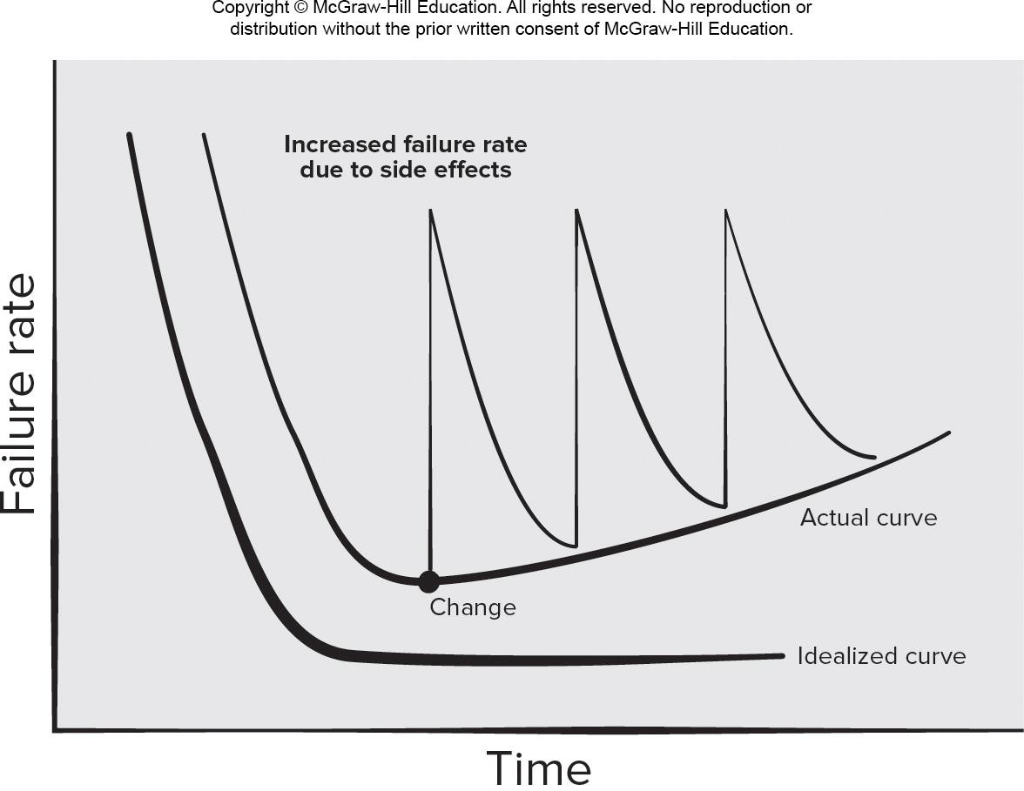
Wear versus Deterioration
Access the text alternative for slide images.

Slide 5
Process Framework Activities
Communication.
Planning. Modeling.
Analysis of requirements.
Design.
Construction:
Code generation.
Testing.
Deployment.

Slide 6
Hooker’s General Principles
for software engineering practice
The Reason It All Exists – provide value to users.
KISS (Keep It Simple, Stupid!) – design simple as it can be.
Maintain the Vision – clear vision is essential.
What You Produce, Others Will Consume.
Be Open to the Future - do not design yourself into a corner.
Plan Ahead for Reuse – reduces cost and increases value.
Think! – placing thought before action produce results.

Slide 7
Identifying a Task Set
A task set defines the actual work to be done to accomplish the
objectives of a software engineering action.
A task set is defined by creating several lists:
A list of the tasks to be accomplished.
A list of the work products to be produced.
A list of the quality assurance filters to be applied.

Slide 8
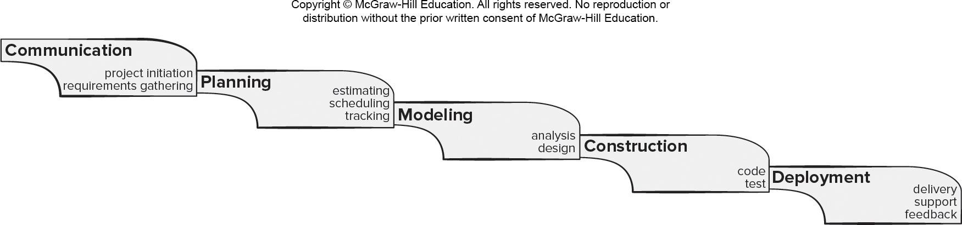
Waterfall Process Model
Pros
It is easy to understand and plan.
It works for well-understood small projects.
Analysis and testing are straightforward.
Cons
It does not accommodate change well.
Testing occurs late in the process.
Customer approval is at the end.
Access the text alternative for slide images.

Slide 9
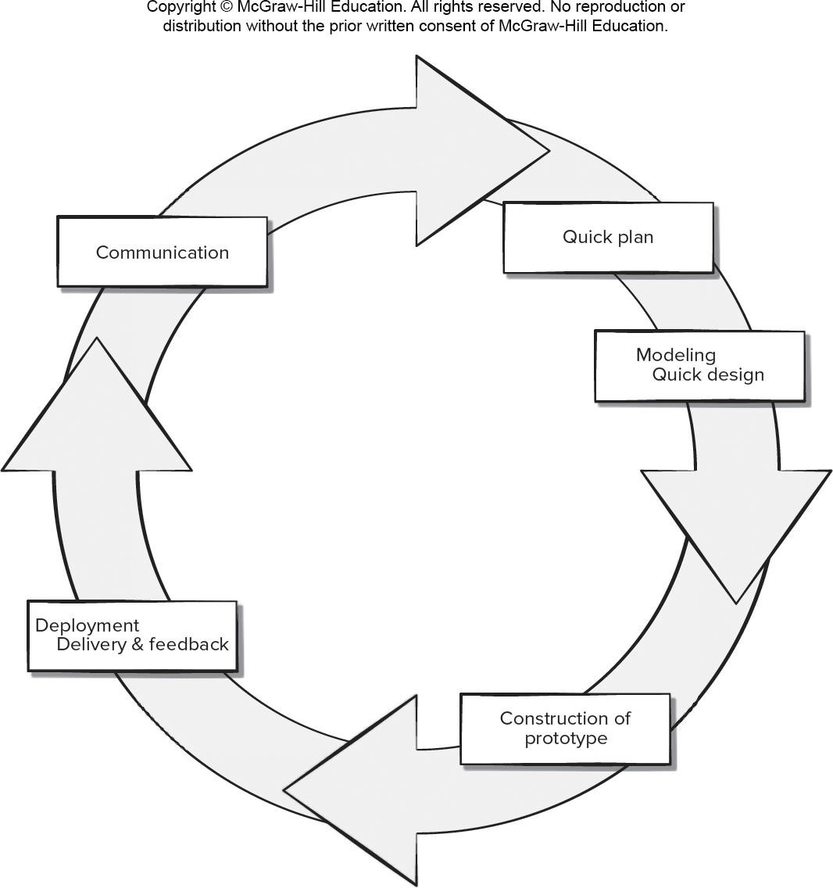
Prototyping Process Model
Pros
Reduced impact of requirement changes.
Customer is involved early and often.
Works well for small projects.
Reduced likelihood of product rejection.
Cons
Customer involvement may cause delays.
Temptation to “ship” a prototype.
Work lost in a throwaway prototype.
Hard to plan and manage.
Access the text alternative for slide images.

Slide 10
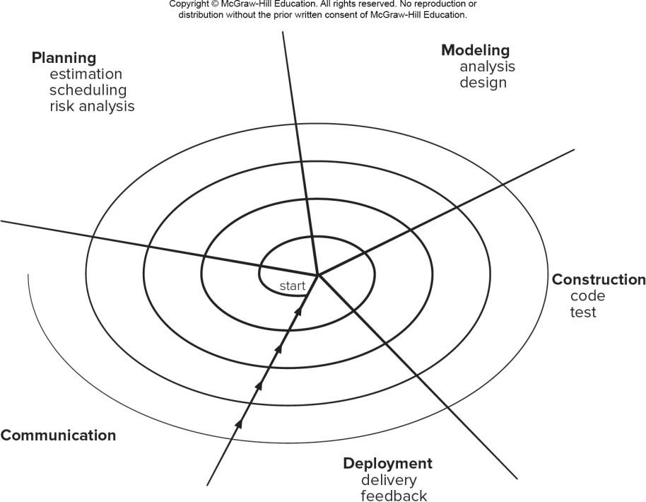
Spiral Process Model
Pros
Continuous customer involvement.
Development risks are managed.
Suitable for large, complex projects.
It works well for extensible products.
Cons
Risk analysis failures can doom the project.
Project may be hard to manage.
Requires an expert development team.
Access the text alternative for slide images.

Slide 11
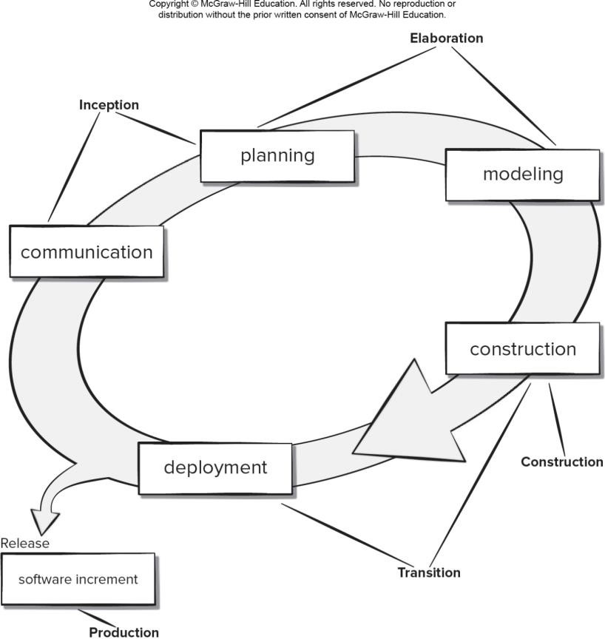
Unified Process Model
Pros
Quality documentation emphasized.
Continuous customer involvement.
Accommodates requirements changes.
Works well for maintenance projects.
Cons
Use cases are not always precise.
Tricky software increment integration.
Overlapping phases can cause problems.
Requires expert development team.
Access the text alternative for slide images.

Slide 12
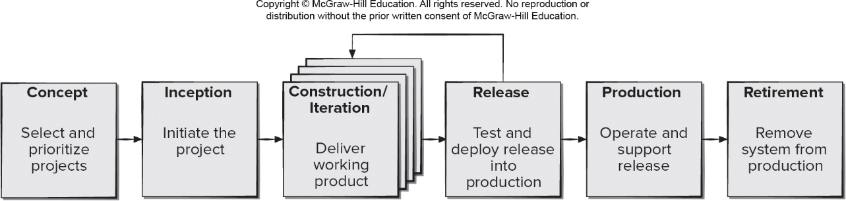
Prototype Evolution Process Model
Access the text alternative for slide images.
Notes:
【逻辑】 在开始讨论软件支持策略之前，我们首先要理解软件是如何从一个概念逐步演化成为最终产品并最终退役的。原型演化过程模型提供了一个清晰的框架，帮助我们理解软件从诞生到退出的全过程。
【内容解释】 原型演化过程模型描述了软件从概念提出到最终退役的完整生命周期，主要包括以下几个阶段：
概念阶段：选择和确定产品方向，明确优先级。
起始阶段：项目正式启动，明确目标和范围。
构建/迭代阶段：通过多次迭代交付可工作的产品，逐步完善功能。
发布阶段：对软件进行测试并部署到生产环境。
生产阶段：系统正式运行并提供支持。
退役阶段：系统最终停止使用并退出生产环境。
这个模型强调迭代与反馈，允许在构建过程中根据实际情况返回前一阶段进行调整。例如，在发布后发现问题，可以返回构建阶段进行修复，再重新发布。

Slide 13
What is Agility?
Effective (rapid and adaptive) response to change.
Effective communication among all stakeholders.
Drawing the customer onto the team.
Organizing a team so that it is in control of the work performed.
Rapid, incremental delivery of software.

Slide 14
What is an Agile Process?
Driven by customer descriptions of what is required (scenarios).
Customer feedback is frequent and acted on.
Recognizes that plans are short-lived.
Develops software iteratively with a heavy emphasis on construction activities.
Delivers multiple ‘software increments’ as executable prototypes.
Adapts as project or technical changes occur.

Slide 15
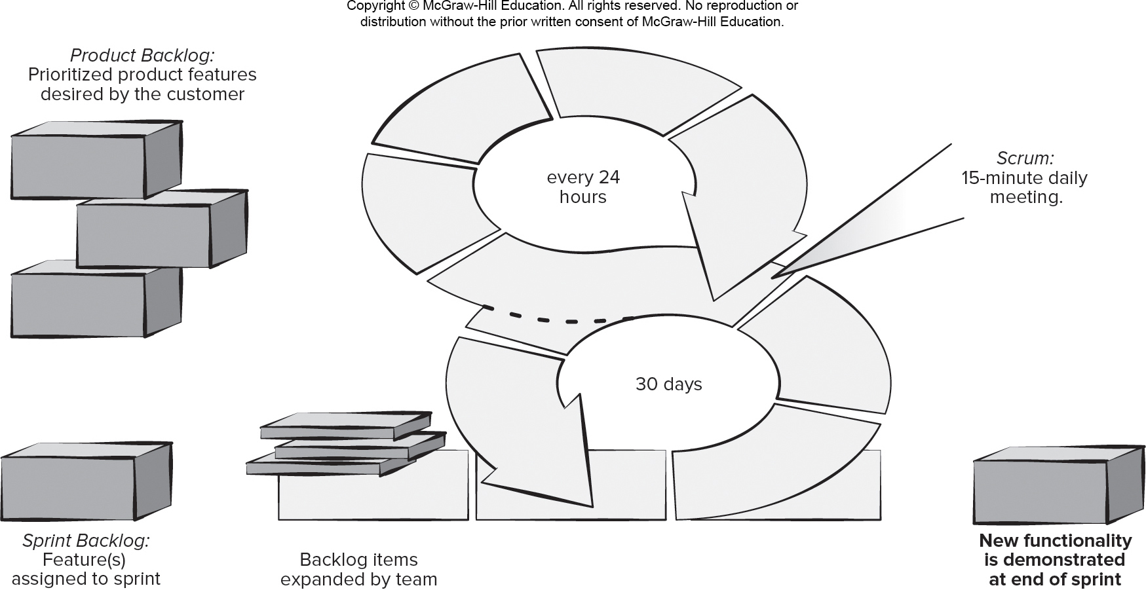
Scrum Framework
Access the text alternative for slide images.

Slide 16
Scrum Details
Backlog Refinement Meeting Developers work with stakeholders to create product backlog.
Sprint Planning Meeting Backlog partitioned into “sprints” derived from backlog and next sprint defined.
Daily Scrum Meeting Team members synchronize their activities and plan work day (15 minutes max).
Sprint Review Prototype “demos” are delivered to the stakeholders for approval or rejection.
Sprint Retrospective After sprint is complete, team considers what went well and what needs improvement.
Pros
Product owner sets priorities.
Team owns decision making.
Documentation is lightweight.
Supports frequent updating.
Cons
Difficult to control the cost of changes.
May not be suitable for large teams.
Requires expert team members.

Slide 17
Agile Teams
Stress individual competency coupled with group collaboration as critical success factors.
People trump process and politics can trump people.
Agile teams as self-organizing and have many structures.
Adaptive team structures.
Significant autonomy.
Communication among developers and stakeholders is important (consider adding customer rep to team).
Planning is kept to a minimum and constrained only by business requirements and organizational standards.

Slide 18
Agile Teams
Team members must have trust in one another.
The distribution of skills must be appropriate to the problem.
Mavericks may have to be excluded from the team, if team cohesiveness is to be maintained.
Team is “self-organizing.”
An adaptive team structure.
Planning is kept to a minimum.
Team select its own approach constrained by business requirements and organizational standards.
Notes:
【逻辑】 为了避免传统团队容易出现的僵化和毒性问题，许多现代软件项目转向了敏捷开发模式。那么，一个敏捷团队的核心特征是什么？它与传统团队有何不同？
【内容解释】 敏捷团队强调适应性、协作和快速响应变化，其核心特征包括：
成员间高度信任：这是协作的基础，信任能促进知识共享和风险共担。
技能分布合理：团队成员技能互补，能够共同应对问题，而不是依赖个别“英雄”。
排除不合群的成员：为了保持团队凝聚力和协作效率，有时不得不让难以协作的“独行者”离开。
自组织性：团队不是被动接受指令，而是主动规划任务、解决问题，具有很高的自主权。
适应性结构：团队结构能随项目需求灵活调整，而非一成不变。
最小化计划：不做冗长的前期计划，而是通过短周期迭代来逐步明确方向。
自主选择工作方式：在业务要求和组织标准的大框架下，团队可以选择最适合自己的具体方法和工具。
例如，在一个敏捷团队中，可能会每天进行站会同步进度和问题，并根据每轮迭代的回顾来调整下一个周期的工作方式。

Slide 19
Traits of Successful Software Engineers
Sense of individual responsibility.
Acutely aware of the needs of team members and stakeholders.
Brutally honest about design flaws and offers constructive criticism.
Resilient under pressure.
Heightened sense of fairness.
Attention to detail.
Pragmatic adapting software engineering practices based on the circumstances at hand.

Slide 20
Effective Software Team Attributes
Sense of purpose.
Sense of involvement.
Sense of trust.
Sense of improvement.
Diversity of team member skill sets.

Slide 21
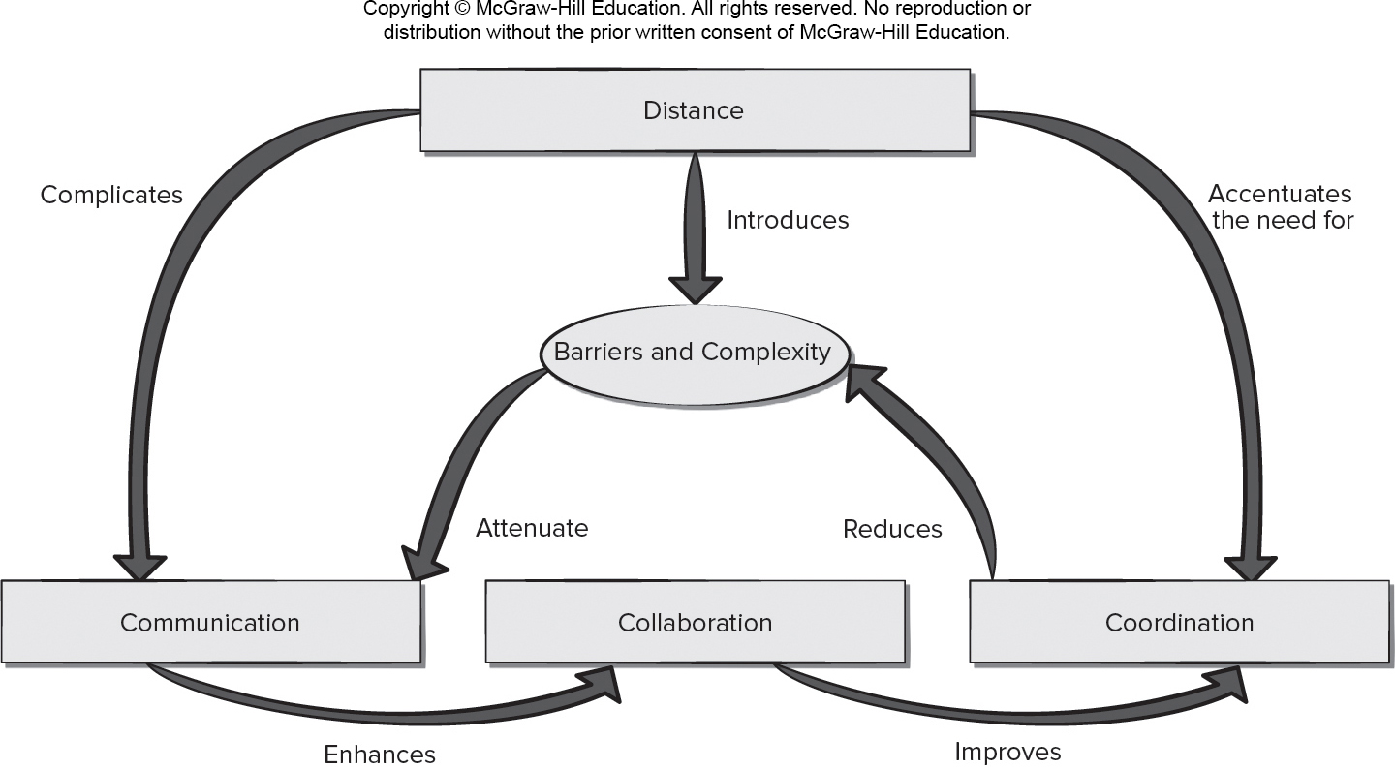
Factors Affecting Global Software Development Teams
Access the text alternative for slide images.

Slide 22
Factors Affecting Software Team Structure
Difficulty of the problem to be solved.
Size of the resultant program(s) in lines of code or function points.
Team lifetimes - time that the team will stay together.
Degree to which the problem can be modularized.
Required quality and reliability of the system to be built.
Rigidity of the delivery date.
Communication (degree of sociability) required.
Notes:
【逻辑】 了解了团队领导的重要性后，我们自然会问：一个团队应该如何组建？团队的结构并不是随意决定的，而是受到多种因素影响。这一页我们就来分析这些关键因素。
【内容解释】 软件团队的构建需要考虑多个维度，主要包括：
问题难度：技术挑战越大，可能需要更多资深专家或更专业的角色分工。
项目规模：通常用代码行数或功能点来衡量。规模越大，团队可能需要更细的分工和更多的沟通机制。
团队存续时间：短期项目可能强调快速协作，长期团队则更注重结构稳定性和知识积累。
问题模块化程度：如果系统能高度模块化，团队可以按模块分工，并行开发。
质量与可靠性要求：对安全性、稳定性要求高的系统，可能需要更严格的流程和更多的测试人员。
交付期限的严格程度：时间越紧，团队可能需要更敏捷的结构和更集中的决策机制。
沟通需求：团队是否需要高频率、高互动的沟通，也会影响是否采用集中办公或远程协作工具。
例如，一个开发高可靠性医疗软件的团队，往往会比一个开发内部工具的小团队更强调流程和角色分工。

Slide 23
Team Toxicity Factors
Frenzied work atmosphere team members waste energy and lose focus on work objectives.
High frustration caused by personal, business, or technological factors causing team member friction.
Fragmented or poorly coordinated procedures poorly defined or improperly chosen process model.
Unclear definition of roles resulting in lack of accountability and resultant finger-pointing.
Continuous and repeated exposure to failure leads to a loss of confidence and a lowering of morale.
Notes:
【逻辑】 组建了团队，并不意味着就能顺利工作。在项目过程中，一些负面因素可能悄悄侵蚀团队的效率和士气。识别这些“毒性因素”是防患于未然的关键。
【内容解释】 这一页列出了几种对团队健康极为有害的因素：
狂热的工作氛围：看似大家都很忙，但实际上可能忙于救火或重复劳动，失去了对核心目标的专注。
高度挫折感：可能源于技术瓶颈、资源不足或人际冲突，导致成员相互埋怨、协作破裂。
零散或协调不佳的流程：如果流程选择不当或定义不清，团队成员会无所适从，效率低下。
角色定义模糊：谁该负责什么不清晰，导致出了问题互相推诿，无人负责。
持续遭遇失败：如果项目接连受挫，团队会丧失信心，士气低迷，形成恶性循环。
例如，一个项目如果频繁变更需求且没有妥善管理，就很容易导致“持续遭遇失败”和“高度挫折感”，进而引发团队毒性。

Slide 24
Agile Modeling Principles 1
Principle #1. The primary goal of the software team is to build software not create models.
Principle #2. Travel light – don’t create more models than you need.
Principle #3. Strive to produce the simplest model that will describe the problem or the software.
Principle #4. Build models in a way that makes them amenable to change.
Principle #5. Be able to state an explicit purpose for each model that is created.

Slide 25
Agile Modeling Principles 2
Principle #6. Adapt the models you create to the system at hand.
Principle #7. Try to build useful models, forget abut building perfect models.
Principle #8. Don’t become dogmatic about model syntax. Successful communication is key.
Principle #9. If your instincts tell you a paper model isn’t working you may have a reason to be concerned.
Principle #10. Get feedback as soon as you can.

Slide 26
Agile Testing Principles 1
Principle #1. All tests should be traceable to customer requirements.
Principle #2. Tests should be planned long before testing begins.
Testing is a process of executing a program with intent of finding an error,
A good test case is one that has a high probability of finding an as-yet-undiscovered error.
A successful test is one that uncovers an as-yet-undiscovered error.
Principle #3. The Pareto principle applies to software testing.

Slide 27
Agile Testing Principles 2
Principle #4. Testing should begin “in the small” and progress toward testing “in the large.”
Principle #5. Exhaustive testing is not possible.
Principle #6. Testing effort for each system module commensurate to expected fault density.
Principle #7. Static testing can yield high results.
Principle #8. Track defects and look for patterns in defects uncovered by testing.
Principle #9. Include test cases that demonstrate software is behaving correctly.

Slide 28
Requirements Engineering 1
Inception - establish a basic understanding of the problem, the people who want a solution, and the nature of the solution that is desired, important to establish effective customer and developer communication.
Elicitation - elicit requirements and business goals from all stakeholders.
Elaboration - focuses on developing a refined requirements model that identifies aspects of software function, behavior, and information.

Slide 29
Requirements Engineering 2
Negotiation—agree on the scope of a deliverable system that is realistic for developers and customers.
Specification—can be any or all of the following: written documents, graphical models, mathematical models, usage scenarios, prototypes.
Validation—Requirements engineering work products produced during requirements engineering are assessed for quality and consistency.
Requirements management – set of traceability activities to help the project team identify, control, and track requirements and their changes to requirements as the project proceeds.

Slide 30
Validating Requirements 1
Is each requirement consistent with the overall objective for the system/product?
Have all requirements been specified at the proper level of abstraction? That is, do some requirements provide a level of technical detail that is inappropriate at this stage?
Is the requirement really necessary or does it represent an add-on feature that may not be essential to the objective of the system?
Is each requirement bounded and unambiguous?
Does each requirement have attribution? That is, is a source (generally, a specific individual) noted for each requirement?
Do any requirements conflict with other requirements?

Slide 31
Validating Requirements 2
Is each requirement achievable in the technical environment that will house the system or product?
Is each requirement testable, once implemented?
Does the requirements model properly reflect the information, function and behavior of system to be built?
Has the requirements model been “partitioned” in a way that exposes progressively more detailed information about the system?
Have requirements patterns been used to simplify the requirements model. Have all patterns been properly validated? Are all patterns consistent with customer requirements?

Slide 32
Non-functional Requirements
Non-Functional Requirement (N F R) – quality attribute, performance attribute, security attribute, or general system constraint.
A two-phase process is used to determine which N F R’s are compatible:
The first phase is to create a matrix using each N F R as a column heading and the system S E guidelines a row labels.
The second phase is for the team to prioritize each N F R using a set of decision rules to decide which to implement by classifying each N F R and guideline pair as complementary, overlapping, conflicting, or independent.

Slide 33
Software Engineering Design
Data/Class design – transforms analysis classes into implementation classes and data structures.
Architectural design – defines relationships among the major software structural elements.
Interface design – defines how software elements, hardware elements, and end-users communicate.
Component-level design – transforms structural elements into procedural descriptions of software components.

Slide 34
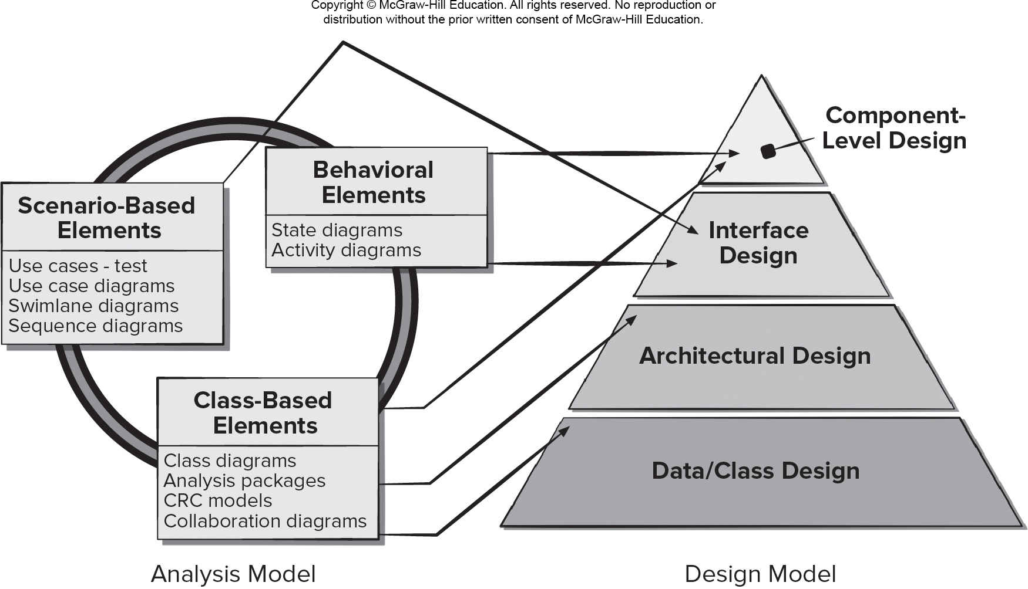
Mapping Requirements Model to Design Model
Access the text alternative for slide images.

Slide 35
Design Concepts 1
Abstraction – data (named collection of data describing data object), procedural (name sequence of instructions with specific and limited function).
Architecture - overall structure or organization of software components, ways components interact, and structure of data used by components.
Design Patterns - describe a design structure that solves a well-defined design problem within a specific context.
Separation of concerns - any complex problem can be more easily handled if it is subdivided into pieces.
Modularity—compartmentalization of data and function.

Slide 36
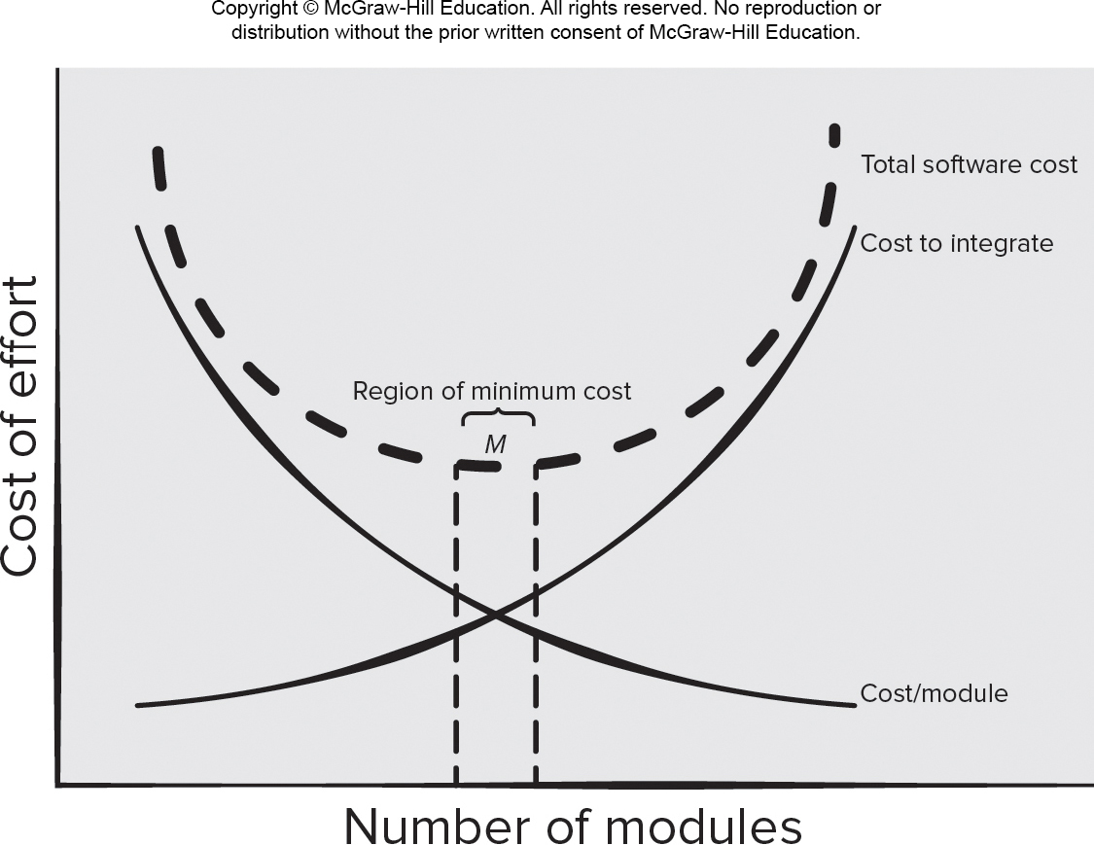
Modularity and Software Cost
Access the text alternative for slide images.

Slide 37
Design Concepts 2
Information Hiding - controlled interfaces which define and enforces access to component procedural detail and any local data structure used by the component.
Functional independence - single-minded (high cohesion) components with aversion to excessive interaction with other components (low coupling).
Stepwise Refinement – incremental elaboration of detail for all abstractions.
Refactoring—a reorganization technique that simplifies the design without changing functionality.
Design Classes—provide design detail that will enable analysis classes to be implemented.

Slide 38
What is Software Architecture?
The architecture is not the operational software, it is a representation that enables a software engineer to:
Analyze the effectiveness of the design in meeting its stated requirements,
Consider architectural alternatives at a stage when making design changes is still relatively easy, and
Reduce the risks associated with the construction of the software.

Slide 39
Why is Software Architecture Important?
Software architecture provides a representation that facilitates communication among all stakeholders interested in the development of a computer-based system.
Architecture highlights early design decisions that will have a profound impact on all software engineering work that follows.
Architecture constitutes a relatively small, intellectually graspable mode of how the system is structured and how its components work together.

Slide 40
Basic Component Design Principles
Open-Closed Principle (O C P). “A module [component] should be open for extension but closed for modification.
Liskov Substitution Principle (L S P). “Subclasses should be substitutable for their base classes.
Dependency Inversion Principle (D I P). “Depend on abstractions. Do not depend on concretions.”
Interface Segregation Principle (I S P). “Many client-specific interfaces are better than one general purpose interface.
Release Reuse Equivalency Principle (R E P). “The granule of reuse is the granule of release.”
Common Closure Principle (C C P). “Classes that change together belong together.”
Common Reuse Principle (C R P). “Classes that aren’t reused together should not be grouped together.”

Slide 41
Component-Level Design Guidelines
Components - Naming conventions should be established for components that are specified as part of the architectural model and then refined and elaborated as part of the component-level model.
Interfaces - provide important information about communication and collaboration (as well as helping us to achieve the O P C).
Dependencies and Inheritance – For readability, it is a good idea to model dependencies from left to right and inheritance from bottom (derived classes) to top (base classes).

Slide 42
Cohesion
Traditional view - the “single-mindedness” of a module.
Object-Oriented view - cohesion implies that a component encapsulates only attributes and operations that are closely related to one another and the component itself.
Levels of cohesion:
Functional - module performs one and only one computation.
Layer - occurs when a higher layer accesses the services of a lower layer, but lower layers do not access higher layers.
Communicational - All operations that access the same data are defined within one class.

Slide 43
Coupling
Traditional view - degree to which a component is connected to other components and to the external world.
Object-Oriented view - qualitative measure of the degree to which classes are connected to one another.
Levels of coupling.
Content - occurs when one component “surreptitiously modifies data that is internal to another component.
Control – occurs when control flags a passed to components to requests alternate behaviors when invoked.
External - occurs when a component communicates or collaborates with infrastructure components.

Slide 44
User Experience Design Elements 1
User experience design tries to ensure that no aspect of your software appears the final product without the explicit decision of stakeholders to include it.
Strategy. Identifies user needs and customer business goals that form the basis for all U X design work.
Scope. Includes both the functional and content requirements needed to realize a feature set consistent with the project strategy.
Structure. Consists of the interaction design [For example, how the system reacts in response to user action] and information architecture.
Skeleton. Comprised of three components: information design, interface design, navigation design.
Surface. Presents visual design or the appearance of the finished project to its users.

Slide 45
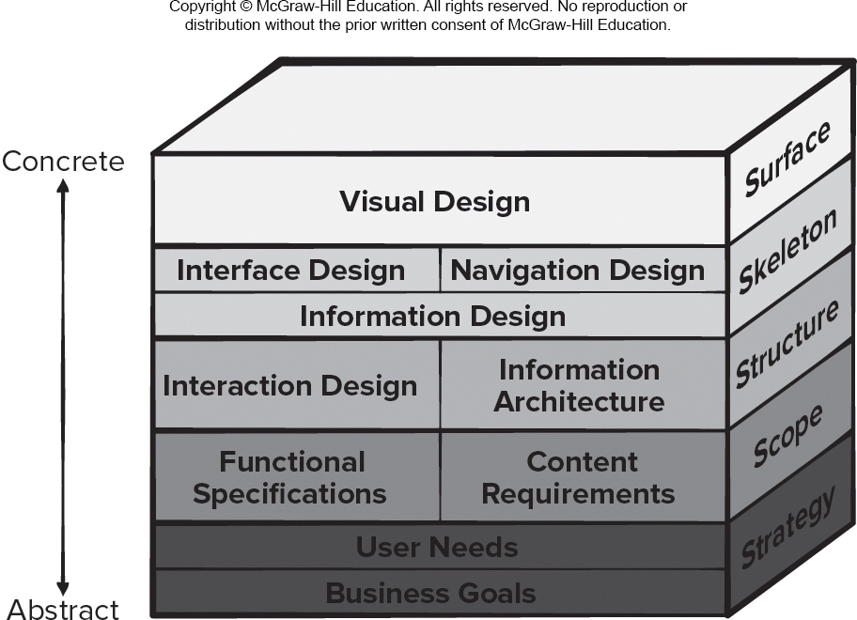
User Experience Design Elements 2
Access the text alternative for slide images.

Slide 46
Golden Rule 1: Place User in Control
Define interaction modes in a way that does not force a user into unnecessary or undesired actions.
Provide for flexible interaction.
Allow user interaction to be interruptible and undoable.
Streamline interaction as skill levels advance and allow the interaction to be customized.
Hide technical internals from the casual user.
Design for direct interaction with screen objects.

Slide 47
Golden Rule 2: Reduce User’s Memory Load
Reduce demand on short-term memory.
Establish meaningful defaults.
Define shortcuts that are intuitive.
The visual layout of the interface should be based on a real-world metaphor.
Disclose information in a progressive fashion.

Slide 48
Golden Rule 3: Make Interface Consistent
Allow the user to put the current task into a meaningful context.
Maintain consistency across a family of applications.
If past interactive models have created user expectations, do not make changes unless there is a compelling reason to do so.

Slide 49
Context-Aware Apps
Context allows the creation of apps based on the location of the mobile device and the device functionality to be delivered.
Context helps tailor personal computer apps for mobile devices.
Mobile computing merges real and virtual worlds by allowing devices to be aware of other objects and its surroundings.
Device must detect the presence and identity of a user, as well as the attributes of the context that are relevant for that user.
Extracting relevant context information from several sensors is challenging (for example: noise, miscalibration, wear and tear, weather).
Event-based communication is preferable to the management of continuous streams of high-abstraction-level data in context-aware applications.
Notes:
情境允许创建基于移动设备位置和设备功能来交付的应用。 情境有助于为移动设备量身定制个人计算机应用。 移动计算通过让设备感知其他对象及其周围环境，将现实世界和虚拟世界融合。 设备必须检测用户的存在和身份，以及与该用户相关的上下文属性。 从多个传感器中提取相关的情境信息具有挑战性（例如：噪声、校准错误、磨损、天气）。 在情境感知应用中，基于事件的通信优于管理连续的高抽象级别数据流。
核心主题： 深入探讨了情境感知这一移动应用的核心特性及其技术挑战。
要点：
定义与价值： 情境感知使应用能够根据环境（如位置、时间、周围设备）、用户（如身份、活动）和设备自身状态来提供动态、个性化的服务和信息。它是移动应用智能化的关键。
融合虚实： 通过感知现实世界（如通过扫描二维码连接物理物品和数字信息），移动设备成为连接物理世界和数字世界的桥梁。
技术挑战：
数据质量： 传感器数据可能不准确、不可靠或被干扰。
信息提取： 如何从原始、嘈杂的数据中识别出有意义的“情境”是一项复杂任务。
设计建议： 采用事件驱动架构。即当特定情境事件发生时（如用户进入某个区域），才触发相应的处理，而不是持续不断地监控和传输所有传感器数据，这有助于节省设备资源和电量。

Slide 50
Reviews
What are they?
A meeting conducted by technical people.
A technical assessment of a work product created during the software engineering process.
A software quality assurance mechanism.
A training ground.
What they are not!
A project summary or progress assessment.
A meeting intended solely to impart information.
A mechanism for political or personal reprisal!
Notes:
【逻辑】 在开始具体内容之前，我们首先需要明确“评审”到底是什么。很多同学可能听说过评审，但容易误解它的真正目的。这一页将澄清评审的定义，区分它是什么和不是什么。
【内容翻译及略微解释】
What are they?（评审是什么？）
由技术人员参与的会议。
对软件工程过程中产生的工作产品进行技术评估。
一种软件质量保证机制。
一个培训平台（团队成员通过评审学习最佳实践）。
What they are not!（评审不是什么？）
不是项目总结或进度评估会议。
不是单纯的信息传达会议。
不是政治或个人报复的工具！
解释：评审是技术性的、以质量为中心的协作活动，目的是早期发现问题，而不是管理进度或解决人际问题。
【本页总结】 评审是一种结构化的技术评估活动，旨在提升产品质量和团队能力，而非用于项目管理或个人目的。理解这一点是有效实施评审的基础。

Slide 51
Formal Technical Reviews
The objectives of an F T R (walkthrough or inspection) are:
To uncover errors in function, logic, or implementation for any representation of the software.
To verify that the software under review meets its requirements.
To ensure that the software has been represented according to predefined standards.
To achieve software that is developed in a uniform manner.
To make projects more manageable.
Notes:
【逻辑】 了解了灵活的非正式评审后，我们再把目光转向更为严格和系统的正式技术评审。当项目进入关键阶段，或者工作产品复杂度高、影响大时，就需要启动这种形式的评审。
【内容翻译】
正式技术评审的目标是：
发现软件任何表现形式中的功能、逻辑或实现错误。
验证被评审的软件是否满足其需求。
确保软件的开发符合预定义的标准。
以统一的方式开发软件。
使项目更易于管理。
【解释】 正式技术评审，有时也叫“走查”或“审查”，是软件工程中的一道重质量关卡。它不仅仅是为了“找bug”，而是一个多目标的、系统性的质量保障活动。
目标1和2是它的核心检测功能，确保软件做“对”了事。
目标3和4是它的过程规范功能，确保大家以“正确”的方式做事，保证项目的一致性和可维护性。
最终，所有这些都汇集成目标5：提升项目的可控性，通过提前暴露风险，让项目经理对项目的健康状况有更清晰的了解。
【核心主题】 阐述正式技术评审的多个核心目标，说明其超越“找错误”的更深层价值。
【要点】
FTR旨在发现错误、验证需求、保证符合标准。
它促进开发的统一性，增强项目的可管理性。
FTR是系统性的质量保障活动，而非简单的找bug。

Slide 52
Review Guidelines
Review the product, not the producer.
Set an agenda and maintain it.
Limit debate and rebuttal.
Enunciate problem areas, but don’t try to solve every problem noted.
Take written notes.
Limit the number of participants and insist upon advance preparation.
Develop a checklist for each product that is likely to be reviewed.
Allocate resources and schedule time for F T Rs.
Conduct meaningful training for all reviewers.
Review your early reviews.
Notes:
【逻辑】 除了流程和角色，评审要成功，所有参与者还需要遵守一些重要的行为准则。这些指南是确保评审在积极、专业、高效的氛围中进行的软性保障。
【内容翻译】
评审产品，而非评审生产者。
设定议程并遵循它。
限制争论和反驳。
指明问题区域，但不要试图解决每一个被注意到的问题。
做好书面记录。
限制参与者人数并坚持会前准备。
为每个可能被评审的产品制定检查表。
为正式技术评审分配资源和安排时间。
为所有评审员开展有意义的培训。
评审你早期的评审（持续改进）。
【解释】 这些指南是评审文化的精髓。
“评审产品，不评审人” 是最重要的原则，旨在营造安全的心理环境，让生产者不怕暴露错误。
“限制争论和反驳” 和 “不现场解决问题” 是为了保持会议聚焦于“发现问题”，而不是陷入技术辩论或解决方案设计中，这能极大提高会议效率。
“使用检查表” 和 “进行培训” 是提升评审效果的专业做法。
最后，“为评审分配资源” 意味着评审不是可有可无的活动，而是项目计划中必须包含的任务。
【核心主题】 列出成功实施评审所需遵循的关键行为准则和最佳实践，强调文化和纪律的重要性。
【要点】
核心文化：对事不对人，保持建设性。
效率关键：聚焦发现問題、限制争论、遵守议程。
成功保障：做好准备、使用检查表、分配资源、持续改进。

Slide 53
Elements of S Q A
Standards.
Reviews and Audits.
Testing.
Error/defect collection and analysis.
Change management.
Education.
Vendor management.
Security management.
Safety.
Risk management.
Notes:
【逻辑过渡】 那么，如何将质量管理的理念落地呢？答案就是建立系统化的软件质量保证（SQA） 体系。接下来我们看看，这个体系具体由哪些核心要素构成。
【内容讲解】
软件质量保证：SQA是一套贯穿整个软件生命周期的活动体系，目的是为最终产品的质量提供过程和体系上的保障。
标准：这是SQA的基础，它规定了开发中必须遵循的统一规范，确保工作的一致性和可衡量性。
评审与审计：评审是检查工作产品（如文档、代码）的缺陷；审计是检查开发过程是否遵守了流程。它们是重要的质量检查手段。
测试：通过执行软件来发现代码中的缺陷，是验证产品功能的直接活动。
错误/缺陷收集与分析：系统性地收集、分析缺陷，找出根本原因，目的是预防其再次发生。
变更管理：对任何修改进行严格控制、评估和记录，防止变更引入新的风险。
教育：确保团队成员都具备必要的技能和知识，并理解质量流程。人是质量的核心。
供应商管理：确保外部供应商提供的组件或服务也符合项目的质量要求。
安全管理：专门关注如何保护软件免受恶意攻击，确保数据的机密性、完整性和可用性。
安全：这里的“安全”通常指功能性安全，即防止软件故障对人员、设备或环境造成危害。
风险管理：主动识别、评估和控制项目中可能影响质量的各种风险，做到防患于未然。
【本页总结】 我们可以看到，软件质量保证远不止是“测试”。它是一个多维度、全过程的防护网。从建立规则（标准），到进行检查（评审、测试），再到管理变化（变更、风险）和人员（教育、供应商），所有这些要素协同工作，系统地保障最终软件产品的质量。

Slide 54
Role of S Q A Group 1
Prepares an S Q A plan for a project which identifies:
Evaluations to be performed.
Audits and reviews to be performed.
Standards that are applicable to the project.
Procedures for error reporting and tracking.
Documents to be produced by the S Q A group.
Amount of feedback provided to the software project team.
Participates in the development of the project’s software process description.
Reviews the process description for compliance with organizational policy, internal software standards, externally imposed standards (for example, I S O-9001), and other parts of the software project plan.
Notes:
【逻辑过渡】 体系和方法明确了，那么在一个项目中，具体由谁来推动和执行这些工作呢？答案是SQA小组。他们的职责可以分为两大块，我们先看第一块：他们在项目前期和规划期的角色。
【内容讲解】
制定SQA计划：这是SQA小组的“立法”职能。他们为项目制定一份全面的质量计划，明确需要执行的评价、审计、评审、适用的标准、错误跟踪流程、产出文档及反馈机制，为整个项目的质量活动设定“游戏规则”。
参与制定流程描述：SQA小组需要参与到项目开发流程的制定中，确保这个流程本身是可执行、可监控的。
评审流程合规性：他们负责评审制定好的流程，确保其符合组织政策、内外部标准（如ISO-9001）。这体现了“合规性检查”角色，从源头上保证项目的规范性。
【本页总结】 总结来说，SQA小组在项目前期的角色是 “规则的制定者”和“基础的奠定者” 。他们通过制定计划和评审流程，为项目“一开始就做正确的事”提供了框架和保障。

Slide 55
Role of S Q A Group 2
Reviews software engineering activities to verify compliance with the defined software process.
Identifies, documents, and tracks deviations from the process and verifies that corrections have been made.
Audits designated software work products to verify compliance with those defined as part of the software process.
Reviews selected work products; identifies, documents, and tracks deviations; verifies that corrections have been made.
Periodically reports the results of its work to the project manager.
Ensures that deviations in software work and work products are documented and handled according to a documented procedure.
Records any noncompliance and reports to senior management.
Noncompliance items are tracked until they are resolved.
Notes:
【逻辑过渡】 规则制定好后，在执行过程中谁来监督大家是否遵守了规则呢？这就是SQA小组的第二项主要职责：在项目执行与监控阶段的角色。
【内容讲解】
过程审计：他们像“监理”一样，评审软件工程活动，验证其是否遵守已定义的流程。
跟踪与验证：对于发现的流程偏差，他们负责识别、记录、跟踪，并验证纠正措施已执行，确保问题形成闭环。
产品审计：他们审计指定的软件工作产品（如代码、文档），验证其是否符合既定要求，关注“工作成果”本身的质量。
报告与沟通：他们定期向项目经理汇报结果，保证质量状况的透明度；对于严重的不合规项，有权直接向高级管理层报告，这体现了其独立性和权威性。
【本页总结】 所以，SQA小组在执行阶段的角色是 “独立的监督者”和“严格的审计官” 。他们通过持续的审计、跟踪和报告，确保项目“始终正确地做事”，维护了质量体系的严肃性。

Slide 56
Strategic Approach to Testing
You should conduct effective technical reviews this can eliminate many errors before testing begins.
Testing begins at the component level and works "outward" toward the integration of the entire system.
Different testing techniques are appropriate for different software engineering approaches and at different points in time.
Testing is conducted by the developer of the software and (for large projects) an independent test group.
Testing and debugging are different activities, but debugging must be accommodated in any testing strategy.
Notes:
【逻辑】 开始测试之前，我们首先要建立一个战略性的、系统的测试方法。不能盲目地测试，而应该有计划、有步骤地进行。
【内容解释】 这一页概述了一个有效的软件测试策略所应包含的几个核心原则：
技术评审先行：在测试开始之前，进行有效的技术评审（如代码审查、设计评审）可以提前发现并消除大量错误，这比通过测试发现错误的成本要低得多。
“由内向外”的测试进程：测试从组件级（单元测试）开始，然后逐步“向外”推进到集成测试（检验组件如何协作）和系统测试（检验整个系统）。
灵活运用测试技术：不同的软件开发方法（如结构化开发、面向对象开发）和不同的时间点，需要采用不同的测试技术。
测试的执行者：测试由软件开发人员和（对于大型项目）独立的测试小组共同完成。开发者最了解组件的细节，而独立测试组则能提供更客观、无偏见的视角。
测试与调试的区别：
测试的目的是发现错误的存在。
调试的目的是定位并修复已发现的错误。
两者是不同的活动，但任何测试策略都必须为调试活动预留时间和资源。

Slide 57
Testing the Big Picture
Unit testing begins at the center of the spiral and concentrates on each unit (for example, component, class, or content object) as they are implemented in source code.
Testing progresses to integration testing, where the focus is on design and the construction of the software architecture. Taking another turn outward on the spiral.
Validation testing, is where requirements established as part of requirements modeling are validated against the software that has been constructed.
In system testing, the software and other system elements are tested as a whole.
Notes:
【逻辑】 对应于测试策略的螺旋模型，测试的执行步骤也遵循着一个自底向上的顺序。这张图展示了测试如何从代码层一步步上升到需求层。
【内容解释】 这张图将软件测试步骤描绘成一个金字塔或层次结构：
底层（基础）：
测试方向：自底向上。
对应活动：单元测试。直接针对代码进行测试，确保每个基础单元牢固。
中间层：
对应活动：集成测试。针对设计，将测试好的单元逐步组装并测试其接口和协作。
顶层：
对应活动：高阶测试（包括确认测试和系统测试）。针对需求，验证整个系统是否满足用户的要求和业务目标。
这个结构的寓意是：下层是上层的基础。如果单元测试不充分，集成测试就会困难重重；如果集成测试不充分，高阶测试几乎肯定会失败。它强调了打好基础的重要性。

Slide 58
White Box Testing
Using white-box testing methods, you can derive test cases that:
Guarantee that all independent paths within a module have been exercised at least once.
Exercise all logical decisions on their true and false sides.
Execute all loops at their boundaries and within their operational bounds.
Exercise internal data structures to ensure their validity.
Notes:
【逻辑】 设计测试用例有两种基本思路：一种关注程序的内部结构，另一种关注程序的外部功能。我们先来看关注内部的“白盒测试”。
【内容解释】 白盒测试，又称结构测试或玻璃盒测试，它要求测试者清楚了解程序的内部逻辑结构。
使用白盒测试方法，可以设计出能保证测试覆盖率的测试用例，其目标主要包括：
保证所有独立路径都至少被执行一次。
对所有逻辑判断（真和假两个分支）都进行测试。
在循环的边界和运行界限内执行循环体。
测试内部数据结构以确保其有效性。
核心价值：白盒测试能发现代码层面的逻辑错误、条件判断错误、循环错误等问题，非常适合由开发者在单元测试阶段实施。

Slide 59
Black Box Testing 1
Black-box (functional) testing attempts to find errors in the following categories:
Incorrect or missing functions.
Interface errors.
Errors in data structures or external database access.
Behavior or performance errors.
Initialization and termination errors.
Unlike white-box testing, which is performed early in the testing process, black-box testing tends to be applied during later stages of testing.
Notes:
【逻辑】 与关注程序内部结构的白盒测试相反，现在我们转向另一种重要的测试方法——黑盒测试。它把程序看作一个打不开的黑盒子。
【内容解释】 这一页介绍了黑盒测试的核心概念及其目标：
黑盒测试，也称为功能测试，它不关心程序的内部逻辑结构，只关注程序的输入和输出行为是否符合规格说明。
黑盒测试旨在发现以下类型的错误：
不正确或缺失的功能：软件没有实现应该实现的功能，或者实现有误。
接口错误：模块之间或系统与外部环境之间交互出现问题。
数据结构或外部数据库访问错误：数据存储、读取或修改不正确。
行为或性能错误：软件未达到预期的性能指标（如速度、资源消耗）。
初始化和终止错误：程序启动或关闭时发生问题。
测试阶段的应用：
白盒测试通常用于早期的单元测试。
黑盒测试则更常用于后期的集成测试、确认测试和系统测试，因为它需要从整体功能上来验证系统。

Slide 60
Black Box Testing 2
Black-box test cases are created to answer questions like:
How is functional validity tested?
How are system behavior and performance tested?
What classes of input will make good test cases?
Is the system particularly sensitive to certain input values?
How are the boundaries of a data class isolated?
What data rates and data volume can the system tolerate?
What effect will specific combinations of data have on system operation?
Notes:
【逻辑】 那么，具体如何设计黑盒测试的用例呢？我们需要通过一系列关键问题来引导我们的思考。
【内容解释】 这一页通过一系列问题，引导我们设计出有效的黑盒测试用例：
设计测试用例时，应尝试回答以下问题：
如何测试功能的正确性？ （基本功能验证）
如何测试系统的行为和性能？ （非功能需求验证）
哪些输入类可以构成好的测试用例？ （等价类划分）
系统是否对某些特定输入值特别敏感？ （错误猜测和边界值分析）
如何确定一个数据类的边界？ （边界值分析）
系统能够承受的数据速率和数据量是多少？ （压力测试和容量测试）
特定的数据组合会对系统运行产生什么影响？ （组合测试）
这些问题就像一个检查清单，确保我们的测试能够覆盖功能的正确性、鲁棒性、性能以及各种输入场景，从而发现更深层次的缺陷。

Slide 61
Role of Scaffolding
Components are not stand-alone program some type of scaffolding is required to create a testing framework.
As part of this framework, driver and/or stub software must often be developed for each unit test.
A driver is nothing more than a “main program” that accepts test-case data, passes such data to the component (to be tested), and prints relevant results.
Stubs (dummy subprogram) serve to replace modules invoked by the component to be tested.
A stub uses the module’s interface, may do minimal data manipulation, prints verification of entry, and returns control to the module undergoing testing.
Notes:
【逻辑】 在测试单个组件时，一个常见的难题是：这个组件并不是一个能独立运行的程序。那么，我们该如何测试它呢？这就需要搭建“脚手架”。
【内容解释】 这一页介绍了在单元测试中构建测试框架所需的辅助代码：
脚手架：指的是为了测试某个组件而临时编写的支撑代码/环境。它不是一个真正的产品部件，而是测试的“道具”。
驱动：
作用：模拟一个调用者或主程序。
功能：它接收测试用例数据，将其传递给待测试的组件，然后接收并打印或验证返回的结果。
例子：要测试一个计算器模块的加法函数，你需要一个驱动程序来调用这个函数，并传入测试参数（如2和3），然后检查返回值是否为5。
桩：
作用：模拟待测试组件所依赖的下级模块。
功能：它实现被替代模块的接口，通常会进行最少量的数据操作，打印一条日志表明自己被调用了，然后返回一个预定义的、简单的控制权给待测试模块。
例子：测试一个“用户登录”模块，该模块需要调用一个“数据库查询”模块来验证密码。在单元测试时，我们还不关心数据库本身，就可以写一个“桩”来模拟数据库查询，直接返回“密码正确”或“密码错误”。
总结：驱动和桩让我们能够将被测组件隔离出来，在一个受控的环境中进行精确测试。

Slide 62
Reactive Risk Management
Project team reacts to risks when they occur.
Mitigation—plan for additional resources in anticipation of fire fighting.
Fix on failure—resource are found and applied when the risk strikes.
Crisis management—failure does not respond to applied resources and project is in jeopardy.
Notes:
【逻辑】 同学们，在项目管理中，风险是无法完全避免的。我们首先来看一种常见的应对方式——反应式风险管理。这种方式是在风险发生后才采取行动，是一种“被动应对”的模式。
【内容解释】 反应式风险管理指的是项目团队在风险实际发生后才做出反应。它主要包括三种处理方式：
Mitigation（缓解）：提前预留额外资源，为可能出现的“救火”情况做准备。比如，预见到某个模块可能延期，就提前安排更多人力和时间缓冲。
Fix on failure（故障后修复）：风险真正发生时才调动资源应对。例如，系统上线后出现性能问题，再紧急组织优化。
Crisis management（危机管理）：当风险严重到无法通过常规资源解决、项目面临失败危险时采取的紧急应对措施。比如关键人员突然离职且项目无人接手，可能导致项目停滞。
这种方式的缺点是“事后补救”，往往成本高、压力大，适用于无法预知或概率极低的风险。

Slide 63
Proactive Risk Management
Potential risks are identified, their probability and impact are assessed, and they are ranked by importance.
Software team establishes a plan for managing risk.
Primary objective is to avoid risk, but because not all risks can be avoided.
Team works to develop a contingency plans that will enable it to respond in a controlled and effective manner.
Proactive risk management is a software engineering tools that can be used to reduce technical debt.
Notes:
【逻辑】 为了更有效地控制风险，我们更推荐另一种方式——主动式风险管理。这种方式强调“预防胜于治疗”，在风险发生前就进行识别与规划。
【内容解释】 主动式风险管理是指在项目开始前或进行中，就主动识别潜在风险，评估其发生概率和影响程度，并按重要性排序。
软件团队会制定明确的风险管理计划，
其核心目标是尽量避免风险发生，同时也为无法避免的风险制定应急预案。
例如，在项目启动阶段，团队可以列出可能遇到的技术难题、人员变动、需求变更等风险，并为每一种风险制定应对策略。
这样不仅能减少项目中断的可能性，还能控制“技术债务”的积累，提升项目整体可控性。

