Slide 1
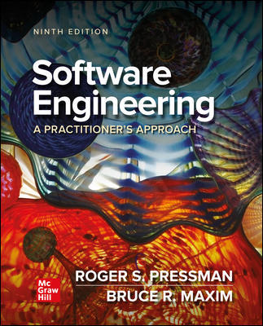
Chapter 1
Software and Software Engineering
Introduction

Slide 2
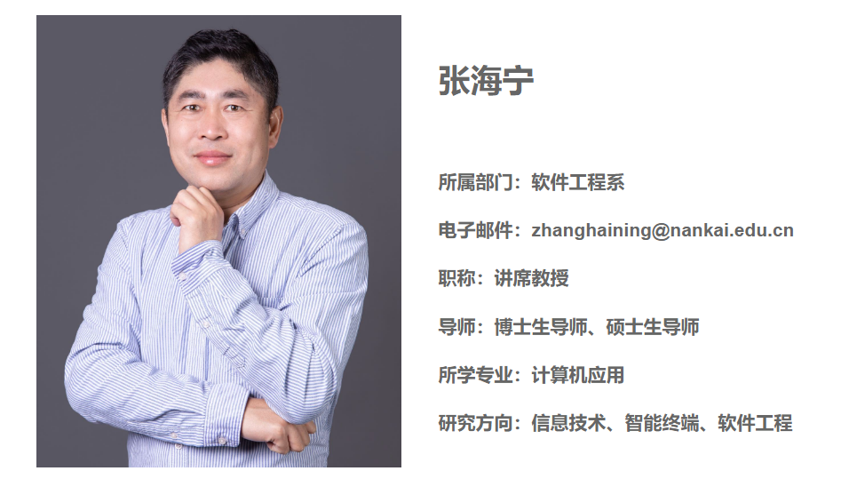
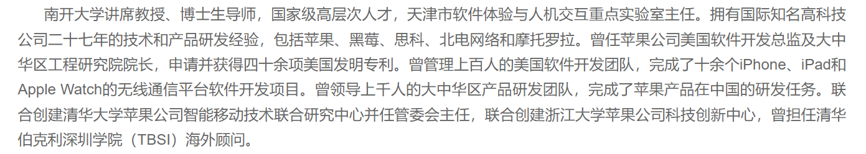
Lecturer

Slide 3
Grading Policy
Type | Component | Weight | Details
Individual | Final Examination | 50% | A comprehensive exam assessing understanding of core software engineering principles, methodologies, and theoretical knowledge covered throughout the course.
Group | Group Project (动感地带AI高校创智计划) | 35% | A hands-on project evaluating the entire software lifecycle: requirement elicitation, system design, implementation, testing, and deployment. Key focus on teamwork, tool usage, and creating a functional, valuable product.
 | Conference-Style Paper | 10% | A complete academic paper formatted for a target conference. Must include abstract, introduction, methodology, results, discussion, and conclusions. Evaluates ability to communicate research and technical work formally.
Individual | Class Participation & Quizzes | 5% | Based on active contribution to lectures, in-class exercises. Attendance is a prerequisite for earning these points.

Slide 4

https://www.migufun.com/5gcampus/?pageId=102003

Slide 5
Nature of Software – Defining Software
Software is:
Instructions (computer programs) that when executed provide desired features, function, and performance;
Data structures that enable the programs to adequately manipulate information.
Documentation that describes the operation and use of the programs.

Slide 6
What is Software?
Software is developed or engineered it is not manufactured in the classical sense.
Software doesn't "wear out“ but it does deteriorate.
Although the industry is moving toward component-based construction, most software continues to be custom-built.

Slide 7
Software Application Domains
System software.
Application software.
Engineering/Scientific software.
Embedded software.
Product-line software.
Web/Mobile applications.
AI software (robotics, neural nets, game playing).

Slide 8
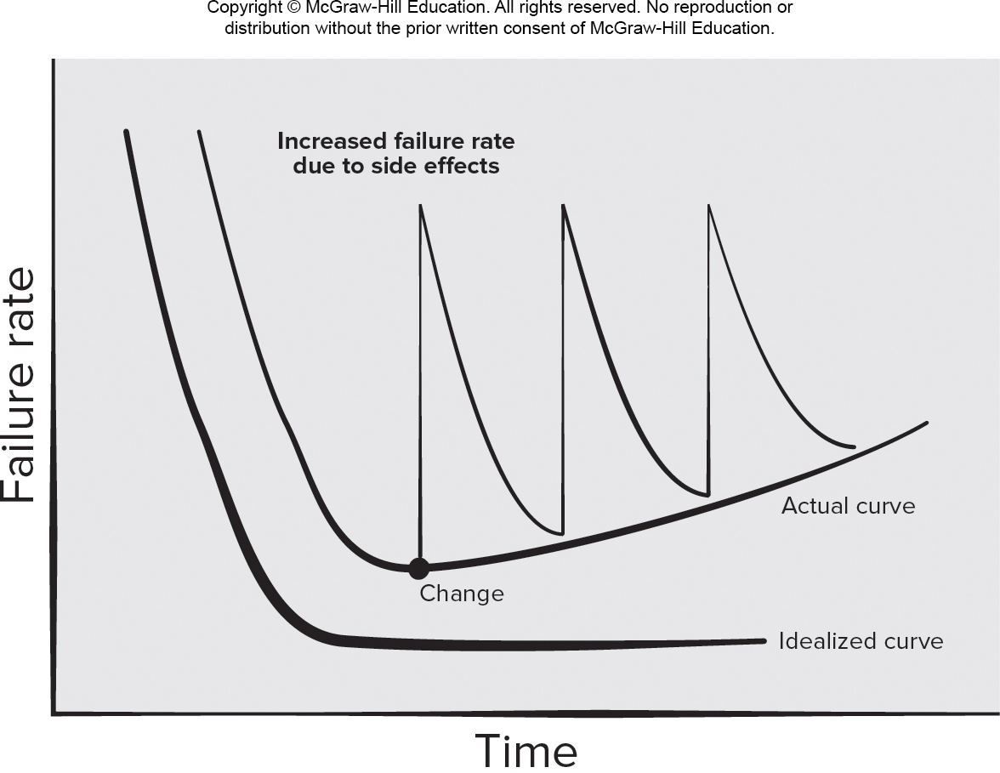
Wear versus Deterioration
Access the text alternative for slide images.

Slide 9
Legacy Software
Why must software change?
Software must be adapted to meet the needs of new computing environments or technology, e.g. cloud computing
Software must be enhanced to implement new business requirements, e.g. e-commerce
Software must be extended to make it interoperable with other more modern systems or databases, e.g. AI framework
Software must be re-architected to make it viable within a network environment, e.g. data center virtualization

Slide 10
Defining the Discipline
The IEEE definition:
Software Engineering:
The application of a systematic, disciplined, quantifiable approach to the development, operation, and maintenance of software; that is, the application of engineering to software.
The study of approaches as in (1).

Slide 11
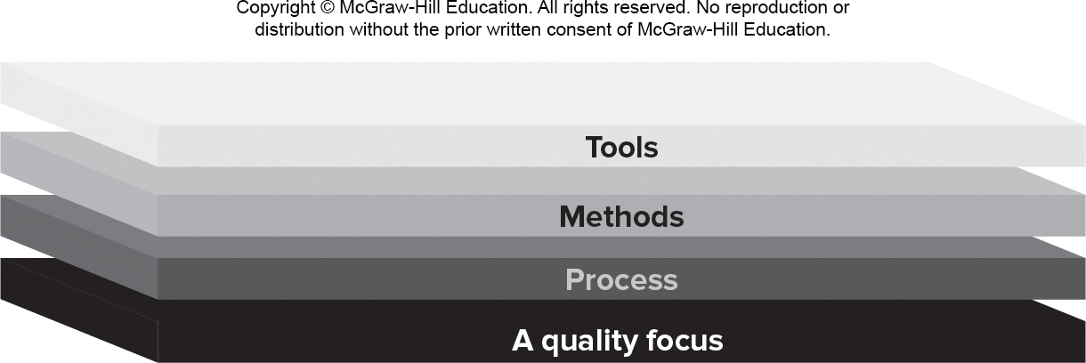
Software Engineering Layers

Slide 12
Process Framework Activities
Communication – Understand the problem.
Planning – Tasks, Dependencies, Schedule, Resources
Modeling.
Analysis of requirements.
Design.
Construction:
Code generation.
Testing.
Deployment.

Slide 13
Umbrella Activities
Umbrella activities help a software team manage and control the process, quality, change and risk.
Software project tracking and control.
Risk management.
Software quality assurance.
Technical reviews.
Measurement – KPIs (Key Performance Indicators).
Software configuration management.
Reusability management.
Work product preparation and production.

Slide 14
Process Difference Requiring Adaptation
Overall flow of activities, actions, and tasks and the interdependencies among them.
Degree to which actions and tasks are defined within each framework activity.
Degree to which work products are identified and required.
Manner which quality assurance activities are applied.
Manner in which project tracking and control activities are applied.
Overall degree of detail and rigor with which the process is described.
Degree to which the customer and other stakeholders are involved with the project.
Level of autonomy given to the software team.
Degree to which team organization and roles are prescribed.

Slide 15
Essence of Software Engineering Practice
Polya suggests:
Understand the problem (communication and analysis).
Plan a solution (modeling and software design).
Carry out the plan (code generation).
Examine result for accuracy (testing & quality assurance).

Slide 16
Understand the Problem
Who has a stake in the solution to the problem?
That is, who are the stakeholders?
What are the unknowns?
What data, functions, and features are required to properly solve the problem?
Can the problem be compartmentalized?
Is it possible to represent smaller problems that may be easier to understand?
Can the problem be represented graphically?
Can an analysis model be created?

Slide 17
Plan a Solution
Have you seen similar problems before?
Are there patterns that are recognizable in a potential solution? Is there existing software that implements the data, functions, and features that are required?
Has a similar problem been solved?
If so, are elements of the solution reusable?
Can subproblems be defined?
If so, are solutions readily apparent for the subproblems?
Can you represent a solution in a manner that leads to effective implementation?
Can a design model be created?

Slide 18
Carryout the Plan
Does the solution conform to the plan?
Is source code traceable to the design model?
Is each component part of the solution provably correct?
Has the design and code been reviewed, or better, have correctness proofs been applied to algorithm?

Slide 19
Examine the Result
Is it possible to test each component part of the solution?
Has a reasonable testing strategy been implemented?
Does the solution produce results, that conform to the data, functions, and features that are required?
Has the software been validated against all stakeholder requirements?

Slide 20
Hooker’s General Principles
The Reason It All Exists – provide value to users.
K I S S (Keep It Simple, Stupid!) – design simple as it can be.
Maintain the Vision – clear vision is essential.
What You Produce, Others Will Consume.
Be Open to the Future - do not design yourself into a corner.
Plan Ahead for Reuse – reduces cost and increases value.
Think! – placing thought before action produce results.

Slide 21
How it all Starts – SafeHome Begins
Every software project is precipitated by some business need—
The need to correct a defect in an existing application;
The need to the need to adapt a ‘legacy system’ to a changing business environment;
The need to extend the functions and features of an existing application, or
The need to create a new product, service, or system.

Slide 22
Question 1
A key difference between software and physical products, like hardware, is that software doesn't "wear out." What does this mean in practice?
Software never fails and has a zero failure rate over its entire lifespan.
Software failures are primarily not due to aging components but from undiscovered bugs or changes in its environment.
Software requires no maintenance once it is deployed to the customer.
The cost of maintaining and evolving software is always lower than the initial development cost.
Notes:
答案 C) 定义为实现软件工程活动目标所需完成的具体工作。
其他选项解析： A) 保证最终软件产品能按时、按预算交付。错误原因： 定义任务集是规划工作，但它本身无法保证结果。项目成功还取决于众多其他因素（如风险、技术变化、团队能力等）。
B) 提供一个团队必须遵循的、不可更改的刚性计划以确保纪律。错误原因： 过程模型（如螺旋、UP）都强调适应性和变化，任务集应能根据项目反馈进行调整，而非僵化不变。
D) 取代质量保证和风险管理等 umbrella activities。 错误原因： 任务集和 umbrella activities（ umbrella activities）是互补共存的关系。任务集定义“做什么”，而 umbrella activities 是“如何保障”整个过程的质量和管理。

Slide 23
Question 2
According to the prescriptive model characteristics, what is the primary purpose of defining a "task set" within a software process?
To guarantee that the final software product will be delivered on time and under budget.
To provide a rigid, unchangeable plan that the team must follow to ensure discipline.
To define the actual work to be done to accomplish the objectives of a software engineering action.
To replace the need for umbrella activities like quality assurance and risk management.
Notes:
答案：B) 软件失效主要不是由于部件老化，而是由于未发现的缺陷或其环境的变化。
A) 软件永远不会失败，在其整个生命周期内的失败率为零。错误原因： 软件当然会失败（有缺陷），但失败率不会像硬件一样随着时间推移而必然上升；曲线可能保持平稳或因变更而波动。
C) 软件一旦部署给客户，就完全不需要维护。错误原因： 正相反，软件正是因为会“退化”（需求变化、环境变化、发现新缺陷）而需要大量的维护工作来使其保持价值。
D) 软件维护和演化的成本总是低于其初始开发成本。错误原因： 对于大多数长期使用的软件系统来说，维护和演化的总成本通常会远远超过其初始开发成本。

Slide 24
Why did you choose Software Engineering?
Job Security?
High Salary?
To Build Things?
Passion for Technology?
Notes:
核心问题 ：我们为什么在这里？
下方小字
好找工作？
兴趣驱动？
改变世界？
...还是？
（此页目的：引发学生对自己学习动机的初始思考）

Slide 25
The New Reality
What happens when we have ChatGPT?
...when GitHub Copilot writes code for us?
...when AI can generate an entire app in seconds?
Does our "golden ticket" still exist?
Notes:
时代的浪潮：一个新的疑问
核心问题：
- 当我们有了ChatGPT...
- 当GitHub Copilot能自动补全代码...
- 当AI能在秒级内创建一个完整项目...
最终问题:
- 我们今天的努力，还有意义吗？
-我们手中的“金饭碗”，还牢靠吗？

Slide 26
End of Main Content

Slide 27
Accessibility Content: Text Alternatives for Images

Slide 28
Wear versus Deterioration – Text Alternative
Return to parent-slide containing images.
A graph showing wear versus deterioration is plotted for failure rate versus time. An idealized curve shows that failure-rate reduces as time increases. The displayed curve has a hyperbolic shape which falls from a high y-value to a near constant y-value as x increases. The actual curve shows that failure-rate reduces and reaches a minimum but rises again with a reduced slope as time increases. When a change is implemented there is sudden spike in the curve resulting in higher failure rate which then falls back towards the actual curve as time increases. The failure rate increases due to side-effects.
Return to parent-slide containing images.

