Slide 1


Slide 2
Geo-Fence Searchable Inventory….
You can Find your required Products and directions to the location of that store nearby (Shortest distance) on maps in just few Clicks through our website application.
Members
Muhammad Umer
Asfa Akhter
Izma Khalid Qureshi
Asad Raza

Slide 3
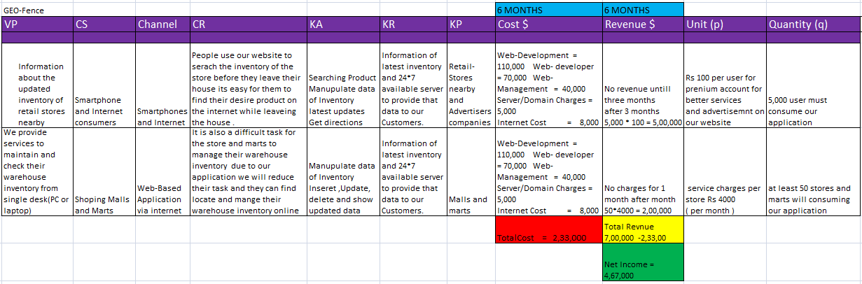
Business model canvas

Slide 4
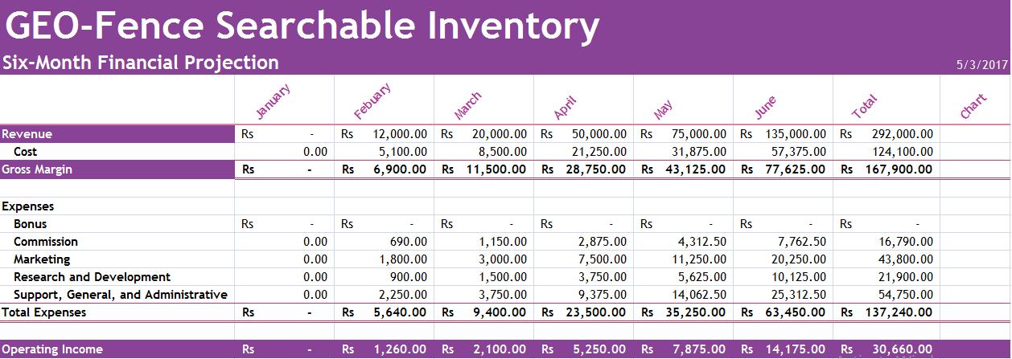
Financial Projection
Notes:
What-If Assumptions
Bonus 20,000.00
Commission 5.75%
Margin 57.50%
Marketing 15.00%
Research and Development 7.50%
Sales Revenue for Bonus 350,000.00
Support, General, and Administrative 18.75%

Slide 5
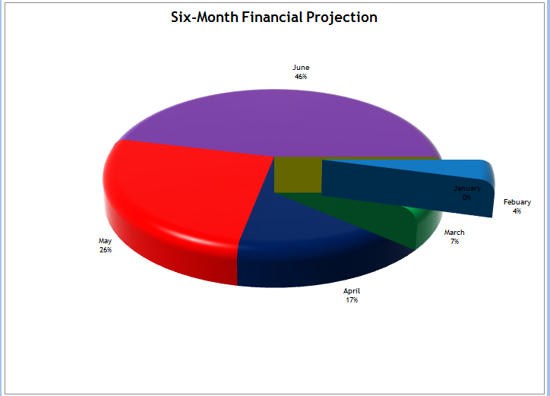
Financial Projection Cont…

Slide 6
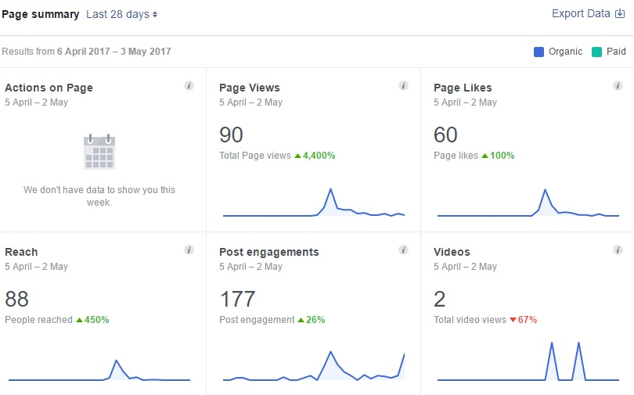
Social Media Response

Slide 7
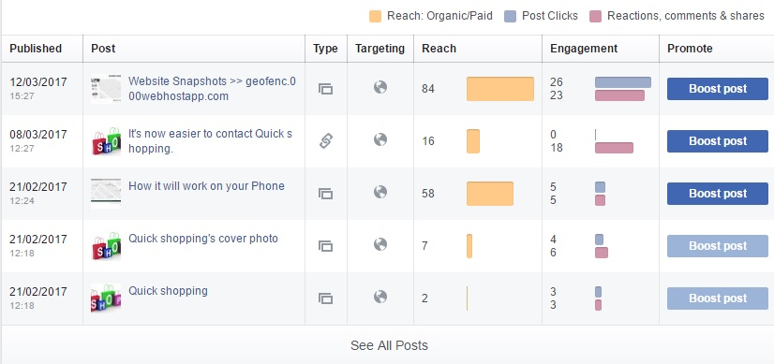
Cont…

Slide 8
Learning Outcomes
First we developed a website & when we presented that, some of the forms and design having errors were highlighted, meanwhile in development process we integrated social media response with our website and we obtain huge amount of interest towards our website. We get a talk with some of famous superstores and marts' Manager later on with their Owner, most of the time we got rejected and mistreated by them but its was also a experience how to entertain our customer and satisfy with our Product..

Slide 9
Future Plan
As we know that technology is increasing day by day so there is no way that technology involved apps or service will fail the best example is Uber and careem we are working on the site to make it better and after that we have plans for IOS and ANDROID app for that Project

Slide 10
Thank YOU…

