Slide 1
Faisal Alidu
Web Tech Fall 2024 Final Exams

Slide 2
Faisal Alidu is developing an attendance management system to help faculty (Lecturers and FI’s) keep proper track of their students’ attendance while creating a platform for convenient communication regarding absenteeism on the part of students and making announcements.

Slide 3




Project Title
ddd
Students need to properly keep track of their attendance to class to avoid failing
Students sometimes fail their courses due to poor attendance. Eduventure attendance system (my attendance management will help improve communication between lecturer and student concerning attendance)
A platform for FI and lecturers to keep attendance.
When attendance is good, it brings about improved performance in school

Slide 4
User / Customer
The target users or customers are faculty (Lecturers and FI’s) and students of a particular class. It was not only designed to help keep the attendance log of students but to provide a platform where students can easily send a request to be absent from class and receive prompt responses.
The Lecturer will create a class and enroll the students in the class. He or she is the only user who has this privilege.
The FI can take attendance. After the lecturer creates the class, the FI can access the page for taking attendance and record students attendance.
The students can view their attendance logs when they log into the system. The system captures the attendance of students per date collectively. If you visit view attendance, you can see the dates, when you click on the dates, you will the attendance status of all the students in the class

Slide 5
Main Functions of the Website
1. Create function: to create the class of students whose attendance will be tracked and recorded
2. Update functionality to update the name of students
3. Delete functionality to delete the remove students who o longer belong to the class.
4. View/ Read functionality to view attendance and its related information.

Slide 6
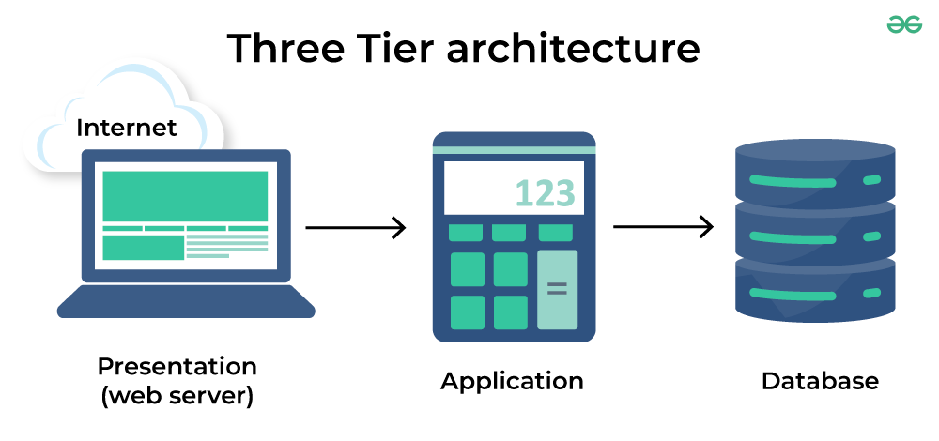
Architecture
The presentation layer uses HTML, CSS and JavaScript to create a beautiful front end
The Application layer uses PHP for the back-end codes (logic tier) to add, delete, or modify data in the database.
The data tier is where the information that is processed by the application is stored and managed. I used SQL Database

