Slide 1

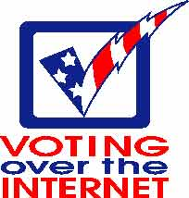
Internet Voting

Slide 2
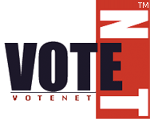
What is Internet Voting?
Internet voting is: an election process whereby people can cast their votes over the Internet, most likely through a web browser, from the comfort of their home, or possibly any other location where they can get Internet access

Slide 3
The 2 types of internet voting:
1. internet voting at traditional polling sites
  Computers that have sufficient security, are then connected to the internet
  This would speed the tabulation and reporting of votes
  Election officials would remain at the voting sites
    Some supporters of internet voting say this type of balloting undermines a main benefit of the internet voting which is the ability to vote from anywhere.

Slide 4
2. Internet voting from any location:
  Voters could cast ballots from anywhere, including their own homes.
  Because no election officials would be present, this type of voting would require a new way to ensure each voters identity
    This type of internet voting would probably be used in addition to voting at traditional polling sites as opposed to as a replacement.

Slide 5
Electronic voting
  This type of voting in no way uses the internet.
  You simply replace voting machines and paper ballots with computers.
  Election officials would still be present at voting sites to prevent voter fraud.
  The key benefit of this type of voting would be an end to the paper ballot problems.
    For example, the kind that plagued Florida in the 2000 elections

Slide 6
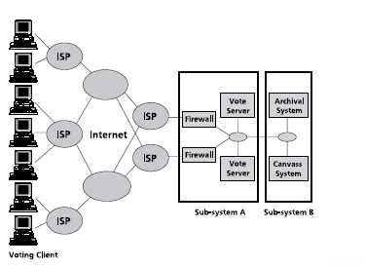
How does Internet Voting Actually work?

Slide 7
The Positive Side of Internet voting
How would internet voting help people?

Slide 8
It has worked before…
France 2003
  French citizens living in the United States used internet voting to elect their representatives to the Assembly of French Citizens.
  Over 60% of voters chose to use internet voting over paper.
  The occurrence was deemed a success and recommended for future use.

Slide 9
Other countries planning to take advantage of internet voting
Netherlands: in the parliamentary elections of 2007 people will be using the RIES internet voting system in order to cast their votes.
Switzerland: several cantons have been developing and attempting to use internet voting systems.

Slide 10
Progress…
EU Cyber-vote Project
  In 2000 the European Commission launched the Cyber-Vote project
  The aim of the project is to demonstrate “fully verifiable online elections guaranteeing absolute privacy of the votes and using fixed mobile internet terminals”
  Trials have been performed in Sweden, France, and Germany

Slide 11
Positives of Internet Voting
Attract a younger generation of voters
Make absentee ballots much easier to submit
Would save money in the long run
Faster and more accurate counting of votes
Much more convenient for voters
  Will increase voter numbers

Slide 12
More positives…
Makes voting easier for those who do not speak English
Will allow voters will disabilities to more easily cast their votes
Would help make voting easier for the elderly
It would be easier for those in remote locations to vote, for example places in Alaska or the mountains
Members of the military or anyone overseas could easily cast their votes

Slide 13

More positives…
Would allow those with unexpected circumstances to cast their votes, such as sudden business trips, or lack of transportation.

Slide 14

Here is a small sample of how internet voting can go wrong…
internet voting clip

Slide 15

Problems with Internet Voting
Discrimination
Minorities and the elderly
Security
viruses, trojans, identity theft, hackers

Slide 16
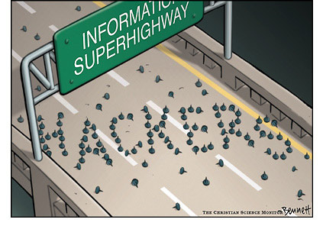
Problems continued…
System Administrator Attacks
Coercion
voting from home, or any other place
Privacy
Solicitation
Paper Trail

Slide 17

Problems continued…
Vote selling
Vote registration
who will pay?
Trust

Slide 18
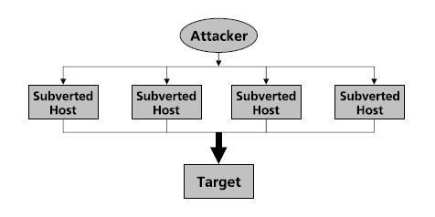
Most significant risk?
Denial of Service

Slide 19
Examples of internet voting problems
In 2000, Arizona became the first state to try online voting during primary elections. Several thousand voters tried to participate, but a series of Y2K-related glitches interfered on its first day
Switzerland was another country that tried to implement internet voting. Officials there found that the most popular method of voting was still postal ballots and more that 90 percent used that method over internet voting.

Slide 20
What now?
  For now, the long term implications of internet voting for democracy is unclear
  Until security measures can be put in place to prevent fraud, it is unlikely that internet voting will be widely accepted.
  Experiments in internet voting will continue for the next several years as officials at all levels of government familiarize themselves with the important issues involved in internet voting.
  As experimentation continues, election officials may grow more confident in and more willing to adopt internet voting

Slide 21

How does this apply to you?
“The future of our country, and the free world for that matter, rests on public confidence that the people have the power to elect their own government. Any process that has the potential to threaten the integrity of the system, or even the perceived integrity of the system, should be treated with the utmost caution and suspicion” (Rubin).
The Bottom-line: more advanced technology = more secure internet voting

