Slide 1
STEGANOGRAPHY: Hiding text in image
CAPSTONE PROJECT
Presented By:
Student Name : ASFAND AHMAD JAMALEE
College Name & Department : Integral University, Lucknow
B.Tech - CSE

Slide 2
OUTLINE
Problem Statement
Technology used
Wow factor
End users
Result
Conclusion
Git-hub Link
Future scope

Slide 3
Problem Statement
With the rise of digital communication, ensuring data privacy has become a major concern. Traditional encryption methods can attract unwanted attention, making secure information transmission challenging. Steganography provides a solution by concealing secret messages within digital images, allowing covert communication without raising suspicion. This project aims to develop a steganographic system using image processing techniques to embed and extract hidden messages securely while maintaining the original image quality.

Slide 4
Technology used
The programming language used was Python
Some of the libraries used are:
OpenCV
NumPy
OS

Slide 5
Wow factors
Some of the unique features are:
Password protected encryption
Multiple image format support
Dynamic message length handling
Robust extraction with error handling

Slide 6
End users
The end users are:
Cybersecurity professionals
Journalists
Digital Forensics Experts
Privacy conscious individuals

Slide 7
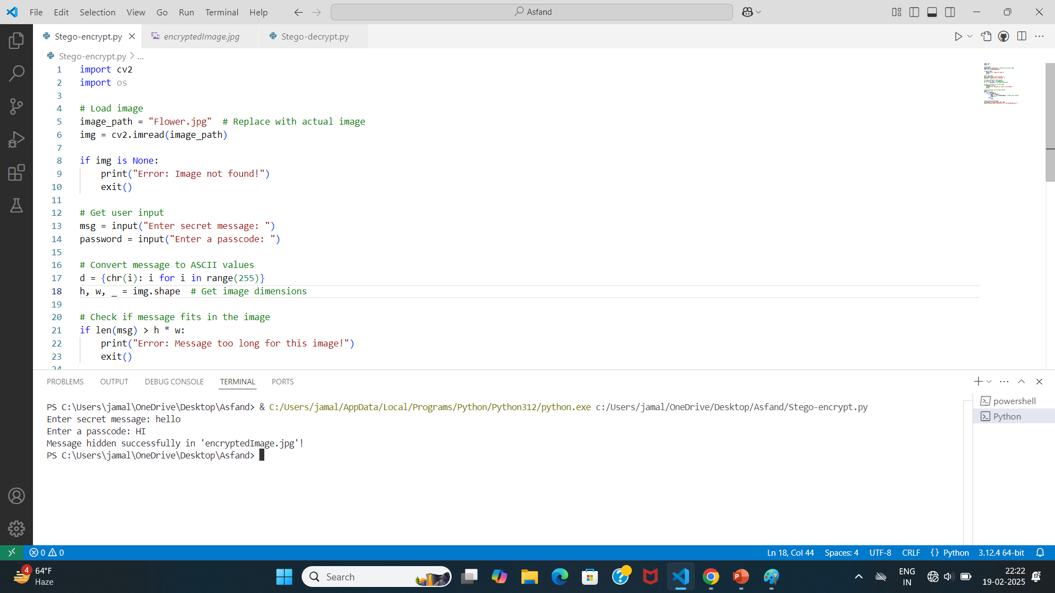
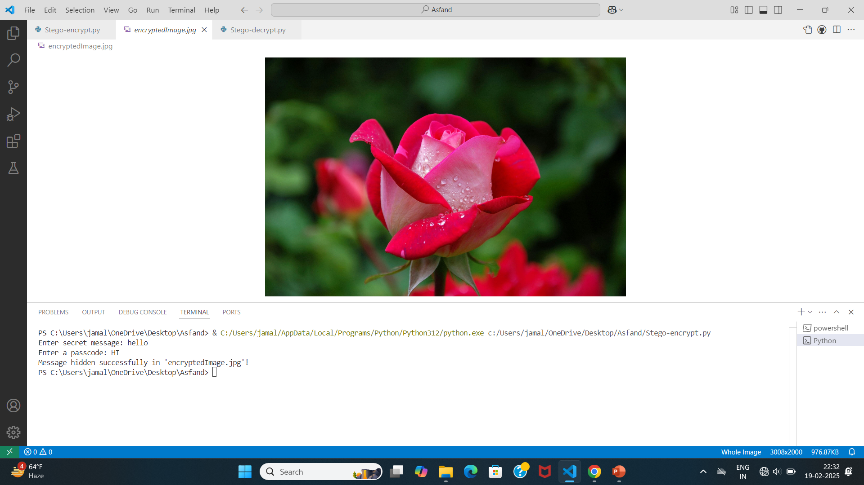
RESULTS

Slide 8
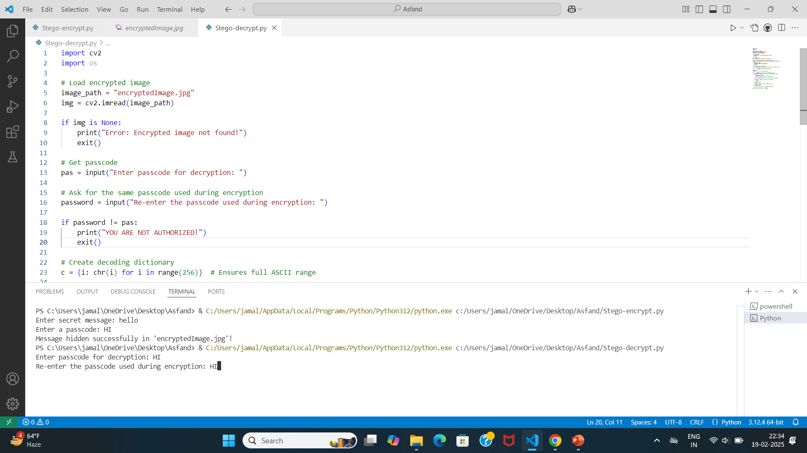
results

Slide 9
Conclusion
This steganography project offers a secure way to hide messages in images, ensuring privacy and confidentiality. It can be used for secure communication, data protection, and cybersecurity. With encryption and efficient embedding, it enhances security while remaining user friendly

Slide 10
GitHub Link
https://github.com/Asfand26/Steganography.git

Slide 11
Future scope(optional)

Slide 12
THANK YOU

