Slide 1

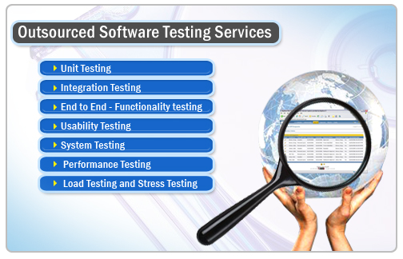
The University of Lahore
A “W4” Category University
CHAPTER 2
Testing Throughout the Software Life Cycle

Slide 2
The University of Lahore
A “W4” Category University
Test Scenario
“It is a test procedure which specifies sequence of action for the execution of a test.”
Test scenario is broken down into one or more
test cases.
Example:
verifying that a user is able to manage his e-mail inbox such as view all messages, send a message, manage folders, logout..etc with a valid user login and password

Slide 3
The University of Lahore
A “W4” Category University
Test Scenario- Example Solution
Test Cases:
is e-mail login page is displaying
is the user able to login using his login ID and password
is he able to view his inbox
is he able to delete unwanted -mails.

Slide 4
The University of Lahore
A “W4” Category University
Test Levels-Component Testing
Component Testing
“The testing of individual software components is called component testing.”
It searches for defects and verifies the functioning of the software (e.g. modules, programs, objects classes etc.)

Slide 5
The University of Lahore
A “W4” Category University
Test Levels-Component Testing
Component Testing is classified into 3 types:
1- Execution Testing
2- Operation Testing
3- Mutation Testing

Slide 6
The University of Lahore
A “W4” Category University
Execution Testing
Verifying the logic of the program.(statement coverage,
loop coverage, conditional coverage, program technique
coverages etc.)

Slide 7
The University of Lahore
A “W4” Category University
Test Levels-Component Testing (Execution Testing Example 1)
Example
READ A
READ B
C = A + 2 * B
IF C>50 THEN
PRINT “LARGE C”
ENDIF
TEST SET 1
Test 1_1: A = 2, B = 3
Test 1_2: A = 0, B = 25
Test 1_3: A = 47, B = 1
Test 1_4: A = 20, B = 25 (100% coverage)

Slide 8
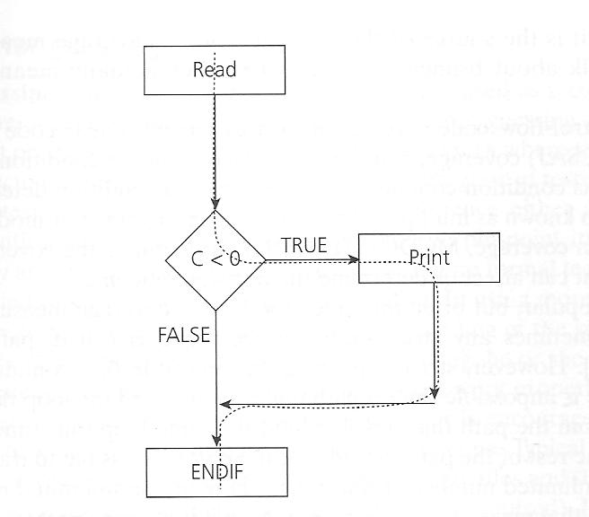
The University of Lahore
A “W4” Category University
Test Levels-Component Testing (Execution Testing Example)
Example
READ A
READ B
C = A - 2 * B
IF C<0 THEN
PRINT “C negative”
ENDIF
TEST SET 2
Test 2_1: A = 20, B = 15
Test 2_2: A = 10, B = 2

Slide 9
The University of Lahore
A “W4” Category University
Test Levels-Component Testing
2- Operation Testing
Checking whether the program is running on the customer expected platform(i.e. OS, Compilers, Browser etc.)
3- Mutation Testing
To check whether the program is responding to the changes or not.

Slide 10
The University of Lahore
A “W4” Category University
Test Levels-Component Testing
Approach of Component Testing
Extreme Programming (XP)
Test-First Approach OR Test-Driven Development
To prepare test cases before coding.
OR
A way of developing software where the test cases are developed before the software is developed to run those test cases.

Slide 11
The University of Lahore
A “W4” Category University
Test Levels-Component Testing
Component testing may include testing of:
1- Functionality Requirements
2- Non-functionality Requirements
3- Robustness Testing
Robustness
to which a component or system can function correctly in the presence of invalid inputs.
Robustness testing
is to determine the robustness of the software product.

Slide 12
The University of Lahore
A “W4” Category University
Test Levels-Integrated Testing
Integration
The process of combining components into larger assemblies.
Integrated Testing
“All individual units are integrated/combined and tested is called integrated testing.”
Once Unit testing is completed those tested units (program) are integrated and
we call it as a module. Then those modules are tested to validate that after integrating all the programs that module is functioning properly or not and we also call this as Component testing. Once all the modules are tested then those modules are again integrated to check
those interconnections are working properly or not

Slide 13
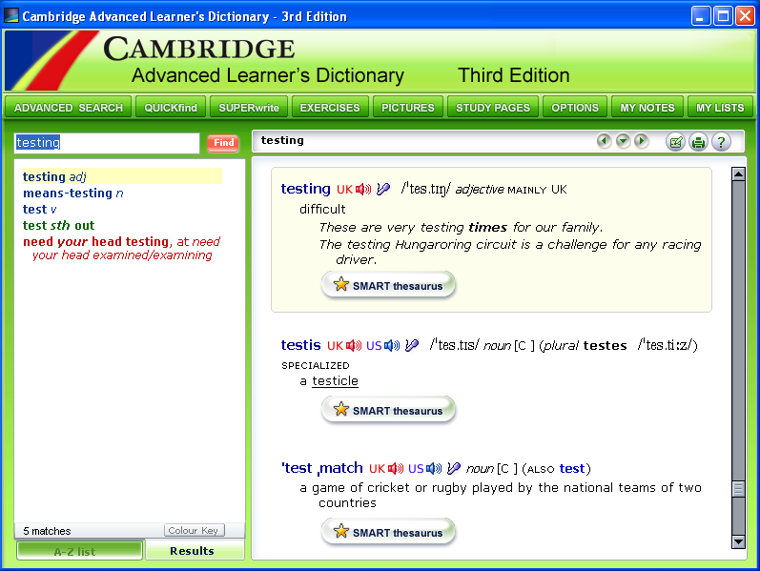
The University of Lahore
A “W4” Category University
Test Levels-Integrated Testing

Slide 14
The University of Lahore
A “W4” Category University
Test Levels-Integrated Testing
Other Levels of Integration Testing
Component Integration Testing
Tests the interactions between software components and is done after component testing.
System Integration Testing
Tests the interactions between different systems i.e. systems that can even run on different platforms.
Big-bang Integration Testing (First Extreme)
All components are integrated simultaneously, after which everything is tested as a whole.

Slide 15
The University of Lahore
A “W4” Category University
Test Levels-Integrated Testing
Advantages of Big-bang Integration Testing
No need to simulate parts, often called stubs.
Stubs
A stub is a piece of software which performs functionality of a not yet constructed/under- constructed component.
OR
while integrating in top down approach any compulsory module are missed replaced with temporary programs known as stubs.

Slide 16
The University of Lahore
A “W4” Category University
Test Levels-Integrated Testing
Disadvantages of Big-bang Integration Testing
1- It is time consuming.
2- Difficult to trace the cause of failures because of late integration.
3- Difficult to check the functionality of components.

Slide 17
The University of Lahore
A “W4” Category University
Test Levels-Integrated Testing
Second Extreme
All components are integrated one by one and tests are carried out after every step, this is called Incremental Testing.

Slide 18
The University of Lahore
A “W4” Category University
Test Levels-Integrated Testing
Advantages of Incremental Testing
1- Defects are found early
2- Easy to detect Defects
Disadvantage of Incremental Testing
1- It is time consuming as stubs and drivers have to be developed and used in the test.

Slide 19
The University of Lahore
A “W4” Category University
Test Levels-Integrated Testing
Other Possibilities in Incremental Testing
1- Top-down testing:
Takes place from top to bottom, following the control flow.
2- Bottom-up testing:
Takes place from the bottom of the control flow upwards.

Slide 20
The University of Lahore
A “W4” Category University
Test Levels-Integrated Testing
Example of Yahoo Mail (Top-down Approach)
Creating an account
Logging into account
Clicking on Compose
Typing email and do formatting
Clicking on options
Clicking on send

Slide 21
The University of Lahore
A “W4” Category University
Test Levels-Integrated Testing
Software engineer/testers are responsible to perform the following testing
GUI software testing
Compatibility testing
Error handling testing
Load testing
Volume testing
Stress testing
User help testing
Capacity testing
usability testing
functionality testing
non-functionality testing
performance testing
security testing

Slide 22
The University of Lahore
A “W4” Category University
Requirement
A condition or capability needed by a user to solve a problem or achieve an objective that must be met.

Slide 23
The University of Lahore
A “W4” Category University
Test Levels-System Testing
System Testing
“The process of testing an integrated system to verify that it meets specified requirements.”
It concerned with the behavior of the whole system.
It is most often the final test to verify that the system to be delivered meets the specification.
Its purpose is to find as many defects as possible.

Slide 24
The University of Lahore
A “W4” Category University
Test Levels-System Testing
System testing should investigate:
Functional Requirements
A requirement that a component or system must perform i.e interoperability, security, accuracy and compliance.
Non-Functional Requirements
Requirement that does not relate the functionality, but to attributes of such as:
Reliability
Efficiency
Usability
Portability etc

Slide 25
The University of Lahore
A “W4” Category University
Test Levels-Acceptance Testing
“Its an activity of testing whether the software is acceptable and fulfilling the user requirements or not.”
Two main test types in business-supporting system
1- User Acceptance Test
It focuses the fitness-for-use (validation) by the business users performed by the users and application managers.
2- Operational Acceptance Test
It focuses on check of backup & recovery, disaster, maintenance tasks and security shortly before the system is released.

Slide 26
The University of Lahore
A “W4” Category University
Test Levels-Acceptance Testing
Other types of acceptance testing
Compliance Acceptance Testing OR Regulation Acceptance Testing
The capability of the software product to strictly firm to Governmental standards, regulations in laws and safety.
Commercial-Off-The-Shelf (COTS) software acceptance testing
1- Alpha Testing:
This takes place at the developer’s site. A cross-section of users and member’s of the developer’s organization are invited to use the system.
2- Beta Testing
Beta Testing is last stage of testing where a product is sent outside the company or customer’s site or offer the product for free trial download.

Slide 27
The University of Lahore
A “W4” Category University
Test Types-The targets of Testing
“A group of test activities aimed at testing a component or system focused on a specific test objective. A test type may take place on one or more test levels.”
Functional Testing (What it does?)-1st Target of Testing
Black-box testing
Functionality Testing
Interoperability Testing
Security Testing

Slide 28
The University of Lahore
A “W4” Category University
Test Types-The targets of Testing
Black Box Testing
“It is testing without knowledge of the internal workings of the item being tested.”
For example, when black box testing is applied to software engineering, the tester would only know the "legal" inputs and what the expected outputs should be, but not how the program actually arrives at those outputs. It is because of this that black box testing can be considered testing with respect to the specifications, no other knowledge of the program is necessary.

Slide 29
The University of Lahore
A “W4” Category University
Test Types-The targets of Testing
Functionality Testing
“The process of testing to determine the functionality of the software.”
e.g. Does the system produce what we require?
Does the system is generating the employee’s salaries per month?
Does the system is doing the bank’s transactions properly?
Interoperability Testing
“The process of testing to determine the interoperability of a software product.” e.g. the one component is effectively interacting or communicating with the other component.

Slide 30
The University of Lahore
A “W4” Category University
Test Types-The targets of Testing
Security Testing
“Testing to determine the security of the software product.” e.g. to test that user name and password belong to an authentic user.

Slide 31
The University of Lahore
A “W4” Category University
Test Types-The targets of Testing
HOME Reading
Non-Functional Testing (2nd Target of Testing)
1- Load Testing
2- Performance Testing
3- Stress Testing
4- Reliability Testing
5- Usability Testing
6- Portability Testing
7- Efficiency Testing

Slide 32
The University of Lahore
A “W4” Category University
Test Types-The targets of Testing
Structural Testing (3rd Target of Testing)
1-White-Box or Glass-box or Clear-box or Open-box Testing
“The white box test is basic knowledge on internal logic of a particular application code.” Because we are interesting what is happening inside the box (Detail knowledge of the code)
2- Code Coverage
“An analysis method to determine which parts of the software have been executed or tested and which parts have not been executed yet.”

Slide 33
The University of Lahore
A “W4” Category University
Testing Related to Change-Final Target
Confirmation Testing (Re-testing)
“Testing that runs test cases that failed the last time they were run, in order to verify the success of corrective action.”
Regression Testing
Testing of a previously tested program following modification to ensure that defects have not been introduced in unchanged areas of the software as a result of the change made.”

Slide 34
The University of Lahore
A “W4” Category University
Maintenance Testing
Maintenance Testing
Modification of a software after delivery to correct defects and to improve performance.
Maintainability
The ease with which a software product can be modified to meet new requirements, modified to make future maintenance easier.
Maintainability Testing
The process of testing to determine the maintainability of a software product.

Slide 35
The University of Lahore
A “W4” Category University
Test Oracle
“A source to determine expected results to compare with the actual results of the software under test. An oracle may be a requirements specification, the existing system, a user manual, or an individual specialized knowledge.”

