Slide 1

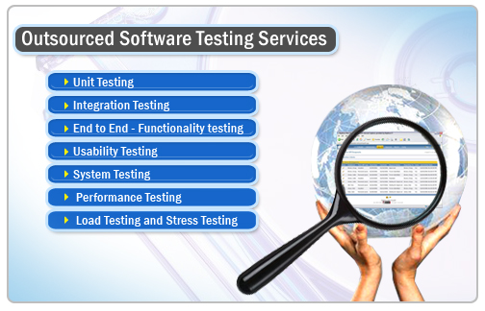
The University of Lahore
A “W4” Category University
CHAPTER 2
Testing Throughout the Software Life Cycle

Slide 2
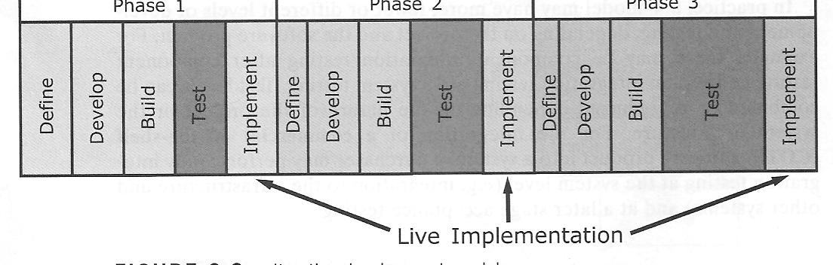
The University of Lahore
A “W4” Category University
Iterative OR Incremental Life Cycle
A development life cycle where a project is broken into a series of increments , each of which delivers a portion of the functionality in the overall project requirements.
The requirements are prioritized and deliver in priority order .
Each subproject follows a mini V-Model with its own design, coding and testing phase

Slide 3
The University of Lahore
A “W4” Category University
Advantages
Simpler to manage
Validation testing is carried out at each increment
Giving early feedback on the fitness for use
Generates working software quickly and early
More flexible – less costly to change the scope or requirements
Easier to test and debug during a smaller iteration

Slide 4
The University of Lahore
A “W4” Category University
Disadvantages
Needs technical expertise
Model is poorly understood by non-technical management, hence not so widely used.
Complicated model, needs competent professional management. High administrative overhead.

Slide 5
The University of Lahore
A “W4” Category University
Rapid Application Development (RAD) Model
Codes are used to implement the software and it does not disappear together with the product.
We can re-use the code all over again in another software.
We just make a little change in the interface to fit the requirement of the client and we have a brand new program.
Code generators. No need to create complicated codes, we just run the system through our preferences and we have a fully functional program.

Slide 6
The University of Lahore
A “W4” Category University
Instead of creating original coding, developers use other tools such as software development kits and other graphic user interfaces to create programs.
RAD also relies on the available codes and reuses it.
RAD uses GUI, development kits and existing codes, software development will be faster.

Slide 7
The University of Lahore
A “W4” Category University
The idea of reusing codes and tools is what defines another form of Software Development Life Cycle called Rapid Application Development, or RAD
If the requirements are well understood and defines, RAD enables a development team to create a fully functional system within very short time period.

Slide 8
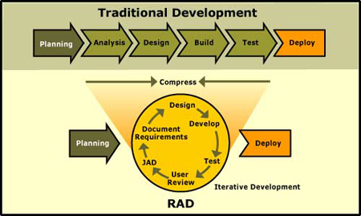
The University of Lahore
A “W4” Category University
Rapid Application Development (RAD) Model
RAD is a methodology for compressing the analysis, design, build, and test phases into a series of short, iterative development cycles.

Slide 9
The University of Lahore
A “W4” Category University
Rapid Application Development (RAD) Model
When do we use RAD?
Experienced programmers
Speed up application development
The participation of the users will be greater since they will work in double time to check if the software is up with the standards.
Quick solution for a business problem

Slide 10
The University of Lahore
A “W4” Category University
Advantages
Quickly give the customer something to see and use.
RAD development encourages active customer feedback regarding requirements.
Rapid change and development is possible.
Validation with the RAD development process is an early and major activity.

Slide 11
The University of Lahore
A “W4” Category University
Conclusion:
Instead of using codes, developers use different tools and software development kits and bring them all together to create a software.
Developers who are time challenged could use this application development.
Users’ feedbacks are important in this development cycle since they will suggest whether the program will fit to their specifications and needs.

Slide 12
The University of Lahore
A “W4” Category University
Characteristics of good testing
For every development activity there is a testing activity.
Each test level has test objectives specific to that level.
The analysis and design of tests for a given test level should begin during the development activity.
Testers should involve in reviewing documents as soon as drafts are available in the development cycle.

Slide 13
The University of Lahore
A “W4” Category University
Re-Cap (Lecture)
Waterfall Model
Problems/disadvantages of waterfall model
Advantages of waterfall model
Three levels of V-MODEL
4 test levels organized in V-model
Waterfall Vs V-model
Iterative or incremental model
Advantages of iterative model
Disadvantages of iterative model
RAD model
Advantages of RAD model
When to use RAD model?
Characteristics of good tester

Slide 14
The University of Lahore
A “W4” Category University
Re-Cap (Lecture)
Waterfall Model
Problems/disadvantages of waterfall model
Advantages of waterfall model
Three levels of V-MODEL
4 test levels organized in V-model
Waterfall Vs V-model
Iterative or incremental model
Advantages of iterative model
Disadvantages of iterative model
RAD model
Advantages of RAD model
When to use RAD model?
Characteristics of good tester

Slide 15
The University of Lahore
A “W4” Category University
Test Case
“A set of input values, execution pre-conditions, expected results and execution post conditions, developed for a particular test condition.”
“Test case is a document which specifies set of input data and expected result which is used to test the application for the intension of finding bugs.”

Slide 16
The University of Lahore
A “W4” Category University
Test Case – Example 1
We have old password, new password, confirmed password followed by submit button. what are the test cases written for that?

Slide 17
The University of Lahore
A “W4” Category University
Old Password
Verify that old password field should allow existing password only.
It should not allow blank.
New Password
New Password field should not allow blank.
New Password field should allow password based on client req.
Confirm Password
Confirm password should be matched with New Password.
Confirm Password should not be blank.
Submit Button
Submit button should be enabled in all cases.

Slide 18
The University of Lahore
A “W4” Category University
Test Case – General Format
General format for test case
Test case ID Test case Description Test case purpose/objective Pre-conditions Input Criteria Expected Result Status (pass/fail) Remarks

Slide 19
The University of Lahore
A “W4” Category University
Test Case – Example 2
Write the test cases for a login page
Test_case id: TC_01 Description: Enter the valid user name and password Purpose: To check login page open successfully Pre condition: Application must accept the user name and password Input Criteria: username: binus, Password: **** Expected Result: Login user page should open with all its contents Status: Pass Remarks: Done

Slide 20
The University of Lahore
A “W4” Category University
Test Case - Types
Positive Test Case
Negative Test Case
“Positive test cases are designed to prove that the system accepts the valid inputs and then process them correctly.”
“The negative test cases are designed to prove that the system rejects invalid inputs and does not process them. “

Slide 21
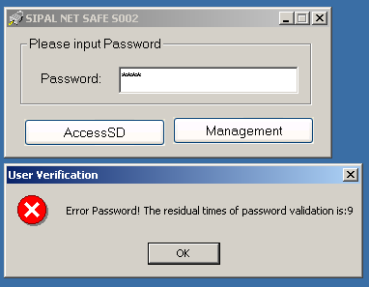
The University of Lahore
A “W4” Category University
Test Case – Types Examples

Slide 22
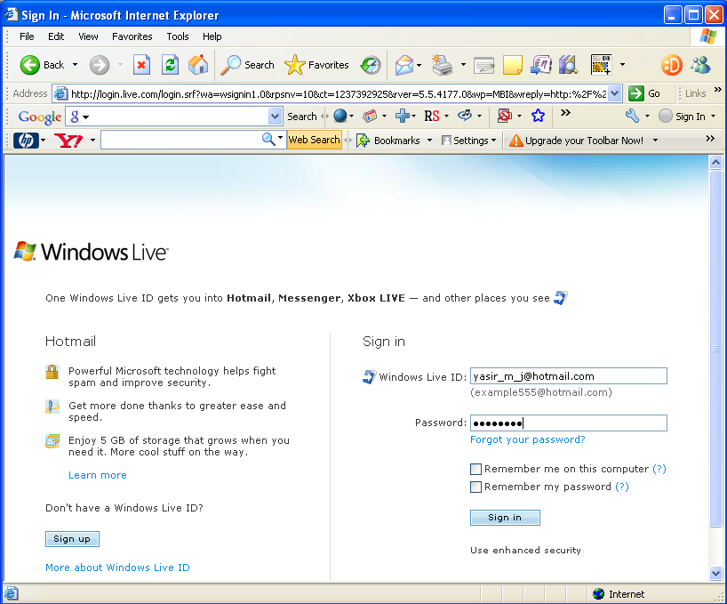
The University of Lahore
A “W4” Category University
Test Case – Types Examples

Slide 23
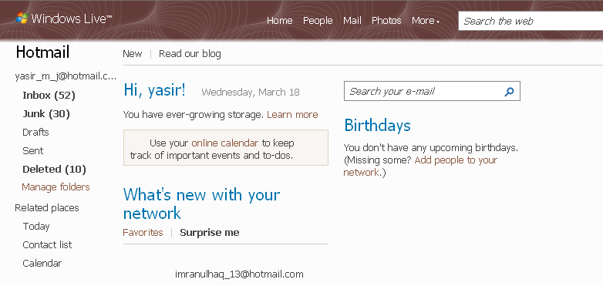
The University of Lahore
A “W4” Category University

Slide 24
The University of Lahore
A “W4” Category University
Test Case – Class Assignment 1
There is a window with 6 to 7 fields like Student ID, First Name, Last Name, Address, Contact Number etc. What are the -ve test cases for such fields.

Slide 25
The University of Lahore
A “W4” Category University
Test Case – Class Assignment 1 Solution
First name & Last name fields shouldn't accept numbers, special characters.
First name & Last name fields should have validation like it can't accept more than 10-15 characters (Depends on the requirement).
The contact number field shouldn't accept alphabets, special characters (Except +sign for the country code).
The contact number field shouldn't accept more than 10 digits.

Slide 26
The University of Lahore
A “W4” Category University
Test Case – Class Assignment 2
Write Negative Test Cases on "Edit" Button, "Cancel" Button ?

Slide 27
The University of Lahore
A “W4” Category University
Test Case – Class Assignment 2 Solution
It should not accept any key other than mouse click.
OR
Enter key or a specific combination of key (e.g. Alt-E or
Alt-C)

Slide 28
The University of Lahore
A “W4” Category University
Test Case – Class Assignment 3
Write down the positive test cases of uploading files (uploading size limit is 10MB).

Slide 29
The University of Lahore
A “W4” Category University
Test Case – Class Assignment 3 SOLUTION
Check for uploading a file within maximum MB (size allowed to upload) expected result : should upload.
2. Check for uploading a file equal to maximum MB (size allowed to upload) expected result : should upload

Slide 30
The University of Lahore
A “W4” Category University
Test Case – Class Assignment 4
Write down the negative test cases of uploading files (uploading size limit is 10MB).

Slide 31
The University of Lahore
A “W4” Category University
Test Case – Class Assignment 4 SOLUTION
1. Check for uploading a file greater than maximum MB .
expected result :should display a message "exceeds the limit“
2. Check for uploading a file which is insecure to send
expected result : should display " cant send these file for
security reason"

Slide 32
The University of Lahore
A “W4” Category University
Test Case – Class Assignment 5
Write down the test cases of uploading files within 10 MB by using proper test case format.

Slide 33
The University of Lahore
A “W4” Category University
Test Case – Class Assignment 5 SOLUTION
Test_case id
TC_ UF
Description
Uploading files within allowed size of 10 MB
Purpose
To check file is uploaded within the allowed size
Pre condition
Application must accept to upload a file
Input Criteria
File of size within the allowed size
Expected Result
File should be uploaded
Status
Pass
Remarks
Done

