Slide 1
Cryptographic Tools
Lecture 8

Slide 2
Message Authentication
protects against attacks
verifies received message is authentic
contents unaltered
from authentic source
timely and in correct sequence
can use conventional encryption
only sender & receiver have key needed
or separate authentication mechanisms
append authentication tag to cleartext message
Notes:
Encryption protects against passive attack (eavesdropping). Message authentication protects against active attacks (falsification of data and transactions), by verifying that received messages are authentic, that is that the contents of the message have not been altered and that the source is authentic. We may also wish to verify a message's timeliness and sequence relative to other messages flowing between two parties.
It is possible to perform authentication simply by the use of conventional encryption. If we assume that only the sender and receiver share a key (which is as it should be), then only the genuine sender would be able to encrypt a message successfully for the other participant. Furthermore, if the message includes an error-detection code and a sequence number, the receiver is assured that no alterations have been made and that sequencing is proper. If the message also includes a timestamp, the receiver is assured that the message has not been delayed beyond that normally expected for network transit.
Alternatively there are several approaches to message authentication that do not rely on encryption. In all of these approaches, an authentication tag is generated and appended to each message for transmission. The message itself is not encrypted and can be read at the destination independent of the authentication function at the destination.

Slide 3
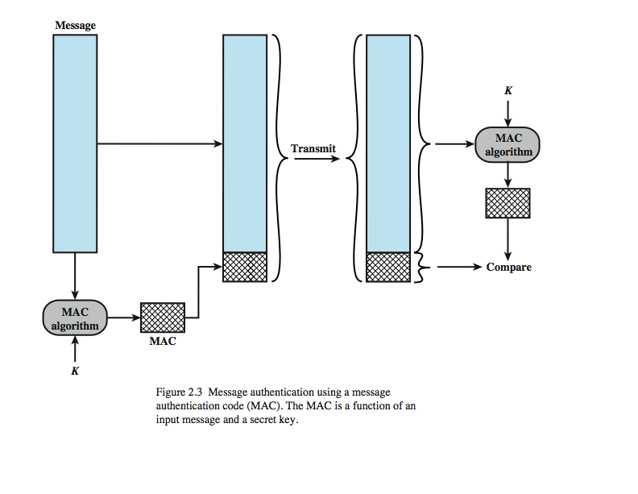
Message Authentication Codes
Notes:
One authentication technique involves the use of a secret key to generate a small block of data, known as a message authentication code, that is appended to the message. This technique assumes that two communicating parties, say A and B, share a common secret key K_{AB}. When A has a message to send to B, it calculates the message authentication code as a function of the message and the key: MAC_{M} = F(K_{AB}, M). The message plus code are transmitted to the intended recipient. The recipient performs the same calculation on the received message, using the same secret key, to generate a new message authentication code. The received code is compared to the calculated code, as shown here in Figure 2.4 from the text. If we assume that only the receiver and the sender know the identity of the secret key, and if the received code matches the calculated code, then:
The receiver is assured that the message has not been altered.
The receiver is assured that the message is from the alleged sender.
If the message includes a sequence number, then the receiver can be assured of the proper sequence.
A number of algorithms could be used to generate the code. The NIST specification, FIPS PUB 113, recommends the use of DES. DES is used to generate an encrypted version of the message, and the last number of bits of ciphertext are used as the code. A 16- or 32-bit code is typical.

Slide 4
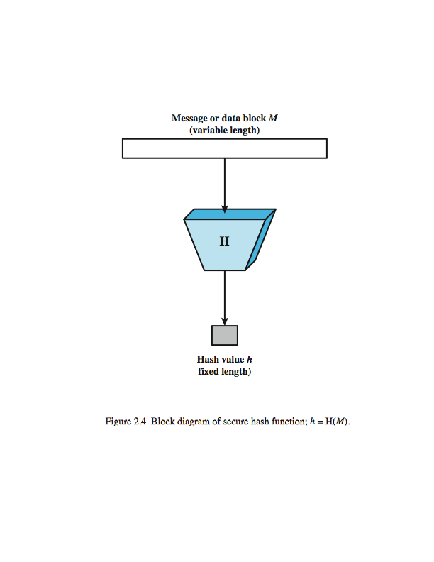
Secure Hash Functions
Notes:
An alternative to the message authentication code is the one-way hash function. As with the message authentication code, a hash function accepts a variable-size message M as input and produces a fixed-size message digest H(M) as output (Figure 2.5). Unlike the MAC, a hash function does not also take a secret key as input. To authenticate a message, the message digest is sent with the message in such a way that the message digest is authentic.

Slide 5
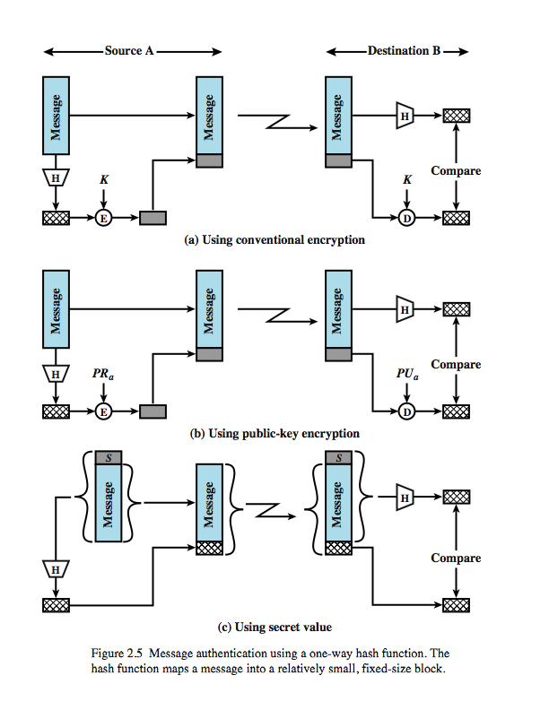
Message Authentication
Notes:
Figure 2.6 illustrates three ways in which the message can be authenticated. The message digest can be encrypted using conventional encryption (part a); if it is assumed that only the sender and receiver share the encryption key, then authenticity is assured. The message can also be encrypted using public-key encryption (part b); this is explained later. The public-key approach has two advantages: it provides a digital signature as well as message authentication; and it does not require the distribution of keys to communicating parties. These two approaches have an advantage over approaches that encrypt the entire message in that less computation is required. Nevertheless, there has been interest in developing a technique that avoids encryption altogether. Part c shows a technique that uses a hash function but no encryption for message authentication. This technique assumes that two communicating parties, say A and B, share a common secret value S_{AB}. When A has a message to send to B, it calculates the hash function over the concatenation of the secret value and the message: MD_{M} = H(S_{AB}||M). It then sends [M||MD_{M}] to B. Because B possesses S_{AB}, it can recompute H(S_{AB}||M) and verify MD_{M}. Because the secret value itself is not sent, it is not possible for an attacker to modify an intercepted message. As long as the secret value remains secret, it is also not possible for an attacker to generate a false message.

Slide 6
Hash Function Requirements
applied to any size data
H produces a fixed-length output.
H(x) is relatively easy to compute for any given x
one-way property
computationally infeasible to find x such that H(x) = h
weak collision resistance
computationally infeasible to find y ≠ x such that H(y) = H(x)
strong collision resistance
computationally infeasible to find any pair (x, y) such that H(x) = H(y)
Notes:
The purpose of a hash function is to produce a "fingerprint" of a file, message, or other block of data. To be useful for message authentication, a hash function H must have the properties listed here. The first three properties are requirements for the practical application of a hash function to message authentication. The fourth property is the one-way property: it is easy to generate a code given a message, but virtually impossible to generate a message given a code. This property is important if the authentication technique involves the use of a secret value (such as shown in Figure 2.5c). The fifth property guarantees that it is impossible to find an alternative message with the same hash value as a given message. This prevents forgery when an encrypted hash code is used (as in Figures 2.5a and b). A hash function that satisfies the first five properties in the preceding list is referred to as a weak hash function. If the sixth property is also satisfied, then it is referred to as a strong hash function. The sixth property protects against a sophisticated class of attack known as the birthday attack (A birthday attack is a type of cryptographic attack that exploits the mathematics behind the birthday problem in probability theory. This attack can be used to abuse communication between two or more parties.). In addition to providing authentication, a message digest also provides data integrity. It performs the same function as a frame check sequence: if any bits in the message are accidentally altered in transit, the message digest will be in error.

Slide 7
Examples of Crypto Hash Functions
MD4 = Message Digest 4 [RFC 1320] - 32b operations
MD5 = Message Digest 5 [RFC 1321] - 32b operations
SHA = Secure hash algorithm [NIST]
SHA-1 = Updated SHA
SHA-2 = SHA-224, SHA-256, SHA-384, SHA-512 SHA-512 uses 64-bit operations

Slide 8
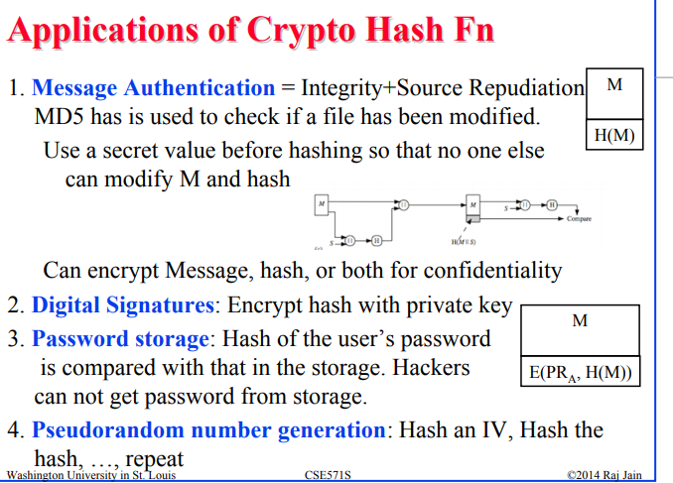
Notes:
from .Raj Jain Washington University in Saint Louis Saint Louis, MO 63130

Slide 9
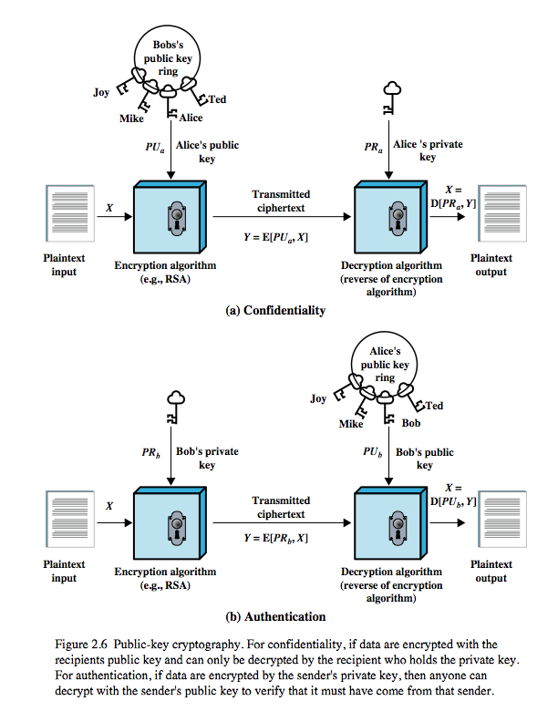
Public Key Authentication
Authentication and/or data integrity
Notes:
Figure 2.7b shown here illustrates another mode of operation of public-key cryptography, where a user encrypts data using his or her own private key. Anyone who knows the corresponding public key will then be able to decrypt the message. This is directed toward providing authentication and/or data integrity. If a user is able to successfully recover the plaintext from Bob’s ciphertext using Bob’s public key, this indicates that only Bob could have encrypted the plaintext, thus providing authentication.
Further, no one but Bob would be able to modify the plaintext because only Bob could encrypt the plaintext with Bob’s private key. This can be adapted to provide authentication or data integrity. Suppose that Bob wants to send a message to Alice and, although it is not important that the message be kept secret, he wants Alice to be certain that the message is indeed from him. In this case Bob could use his own private key to encrypt the message. Here the entire message is encrypted, which, although validating both author and contents, requires a great deal of storage and additional processing cost. A more efficient way of achieving the same results is to encrypt a small block of bits that is a function of the document. Such a block, called an authenticator, must have the property that it is infeasible to change the document without changing the authenticator. If the authenticator is encrypted with the sender's private key, it serves as a signature that verifies origin, content, and sequencing. A secure hash code such as SHA-1 can serve this function. It is important to emphasize that the digital signature does not provide confidentiality. That is, the message being sent is safe from alteration but not safe from eavesdropping.

Slide 10
Public Key Infrastructure (PKI)
Public Key Infrastructure (PKI): integrated system of software, encryption methodologies, protocols, legal agreements, and third-party services enabling users to communicate securely
PKI systems based on public key cryptosystems; include digital certificates and certificate authorities (CAs)
Notes:
Cryptography Tools
Public Key Infrastructure (PKI) is an integrated system of software, encryption methodologies, protocols, legal agreements, and third-party services that enables users to communicate securely.
PKI systems are based on public key cryptosystems and include digital certificates and certificate authorities (CAs).

Slide 11
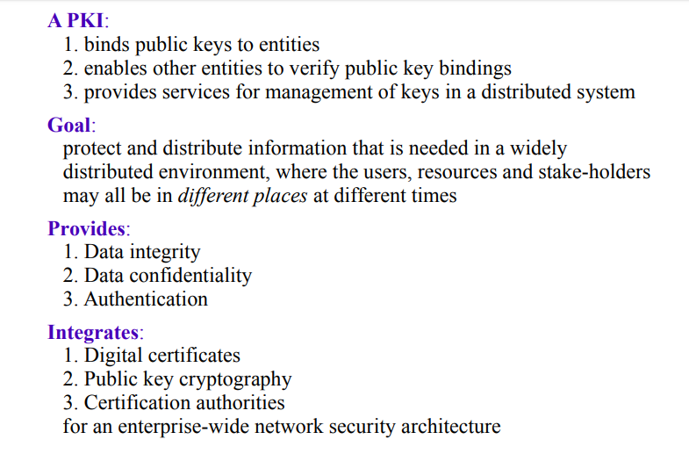

Slide 12
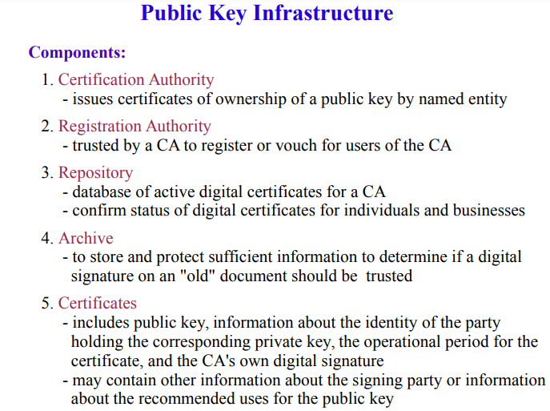

Slide 13
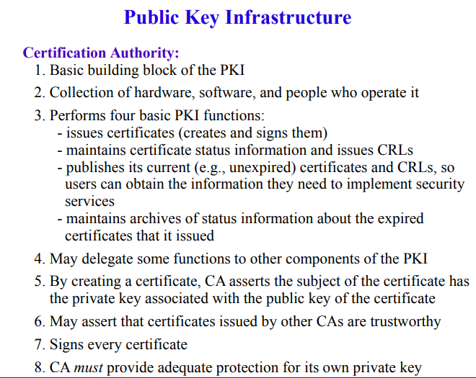

Slide 14
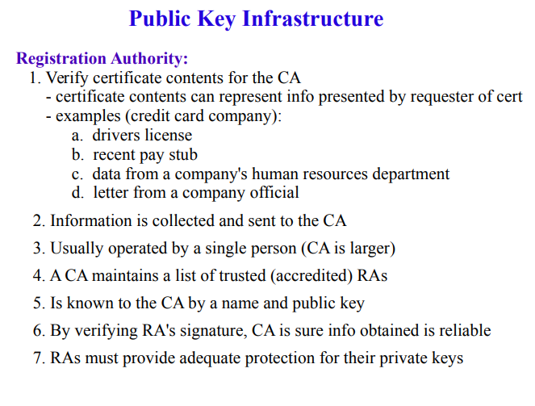

Slide 15
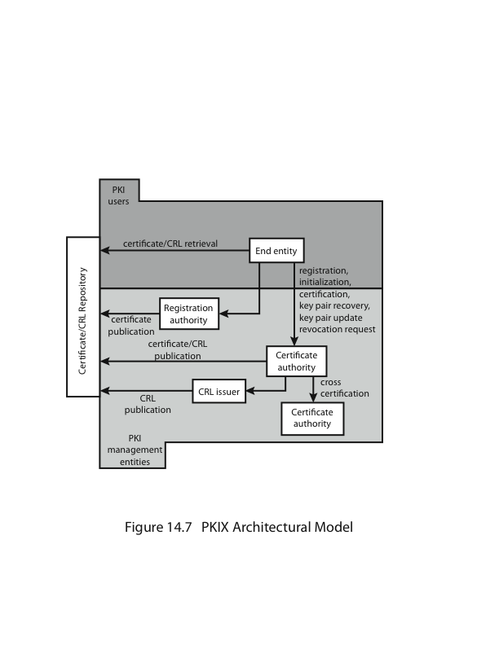
Public Key Infrastructure
Notes:
RFC 2822 (Internet Security Glossary) defines public-key infrastructure (PKI) as the set of hardware, software, people, policies, and procedures needed to create, manage, store, distribute, and revoke digital certificates based on asymmetric cryptography. Its principle is to enable secure, convenient, and efficient acquisition of public keys. The IETF Public Key Infrastructure X.509 (PKIX) working group has setup a formal (and generic) model based on X.509 that is suitable for deploying a certificate-based architecture on the Internet.
Stallings Figure 14.16 shows interrelationships among some key elements:
• End entity: A generic term used to denote end users, devices (e.g., servers, routers), or any other entity that can be identified in the subject field of a public key certificate. End entities can consume and/or support PKI-related services.
• Certification authority (CA): The issuer of certificates and (usually) certificate revocation lists (CRLs). It may also support a variety of administrative functions, although these are often delegated to Registration Authorities.
• Registration authority (RA): An optional component that can assume a number of administrative functions from the CA. The RA is often associated with the End Entity registration process, but can assist in a number of other areas as well.
• CRL (certificate revocation list) issuer: An optional component that a CA can delegate to publish CRLs.
• Repository: A generic term used to denote any method for storing certificates and CRLs so that they can be retrieved by End Entities.

Slide 16
PKIX Management
functions:
registration
initialization
certification
key pair recovery
key pair update
revocation request
cross certification
protocols:
CMP(certificate management protocols ),
CMC(certificate management messages )
Notes:
PKIX stands for Public Key Infrastructure X. 509. The X. 509 standard defines the structure, format, and fields for digital certificates, it also specifies the procedures for distributing public keys.
PKIX identifies a number of management functions that potentially need to be supported by management protocols, as shown in Figure 14.16:
• Registration: whereby a user first makes itself known to a CA, prior to issue of a certificate(s) for that user. It usually involves some off-line or online procedure for mutual authentication.
• Initialization: to install key materials that have the appropriate relationship with keys stored elsewhere in the infrastructure.
• Certification: process where a CA issues a certificate for a user's public key, and returns it to the user's client system and/or posts it in a repository.
• Key pair recovery: a mechanism to recover the necessary decryption keys when normal access to the keying material is no longer possible.
• Key pair update: key pairs need to be updated and new certificates issued.
• Revocation request: when authorized person advises need for certificate revocation, e.g. private key compromise, affiliation change, name change.
• Cross certification: when two CAs exchange information used in establishing a cross-certificate, issued by one CA to another CA that contains a CA signature key used for issuing certificates.
The PKIX working group has defined two alternative management protocols between PKIX entities. RFC 2510 defines the certificate management protocols (CMP), which is a flexible protocol able to accommodate a variety of technical, operational, and business models. RFC 2797 defines certificate management messages over CMS (RFC 2630) called CMC. This is built on earlier work to leverage existing code.
The Certificate Management Protocol is an Internet protocol used for obtaining X.509 digital certificates in a public key infrastructure. CMP is a very feature-rich and flexible protocol, supporting any types of cryptography

Slide 17
PKI services
PKI protects information assets in several ways:
Authentication – Digital Certificate
To identify a user who claim who he/she is, in order to access the resource.
Non-repudiation – Digital Signature
To make the user becomes unable to deny that he/she has sent the message, signed the document or participated in a transaction.
Confidentiality - Encryption
To make the transaction secure, no one else is able to read/retrieve the ongoing transaction unless the communicating parties.
Integrity - Encryption
To ensure the information has not been tampered during transmission.
Authorization. Digital certificates issued in a PKI environment can replace user IDs and passwords, enhance security, and reduce some of the overhead required for authorization processes and controlling access privileges

Slide 18
Digital Signatures
Encrypted messages that can be mathematically proven to be authentic
Created in response to rising need to verify information transferred using electronic systems
Asymmetric encryption processes used to create digital signatures
Notes:
Digital Signatures
An interesting thing happens when the asymmetric process is reversed, that is the private key is used to encrypt a short message.
The public key can be used to decrypt it, and the fact that the message was sent by the organization that owns the private key cannot be refuted.
This is known as non-repudiation, which is the foundation of digital signatures.
Digital Signatures are encrypted messages that are independently verified by a central facility (registry) as authentic.

Slide 19
Digital Signature
Digital signature can be used in all electronic communications
Web, e-mail, e-commerce
It is an electronic stamp or seal that append to the document.
Ensure the document being unchanged during transmission.

Slide 20

How digital Signature works?
User A
Transmit via the Internet
Use A’s private key to sign the document
User B received
the document with
signature attached
Verify the signature
by A’s public key stored
at the directory
User B

Slide 21
Digital Signature Generation and Verification
Message Sender
Message Receiver
Message
Message
Hash function
Hash function
Public
Key
Digest
Private
Key
Encryption
Decryption
Signature
Expected Digest
Digest
Notes:
Digital signatures work by proving that a digital message or document was not modified—intentionally or unintentionally—from the time it was signed. Digital signatures do this by generating a unique hash of the message or document and encrypting it using the sender's private key.
Verifying a signature will tell you if the signed data has changed or not. When a digital signature is verified, the signature is decrypted using the public key to produce the original hash value. The data that was signed is hashed. If the two hash values match, then the signature has been verified.

Slide 22
Digital Certificates
Electronic document containing key value and identifying information about entity that controls key
Digital signature attached to certificate’s container file to certify file is from entity it claims to be from
Notes:
Digital Certificates and Certificate Authorities
As alluded to earlier, a digital certificate is an electronic document, similar to a digital signature, attached to a file certifying that this file is from the organization it claims to be from and has not been modified from the originating format.
A Certificate Authority is an agency that manages the issuance of certificates and serves as the electronic notary public to verify their worth and integrity.

Slide 23
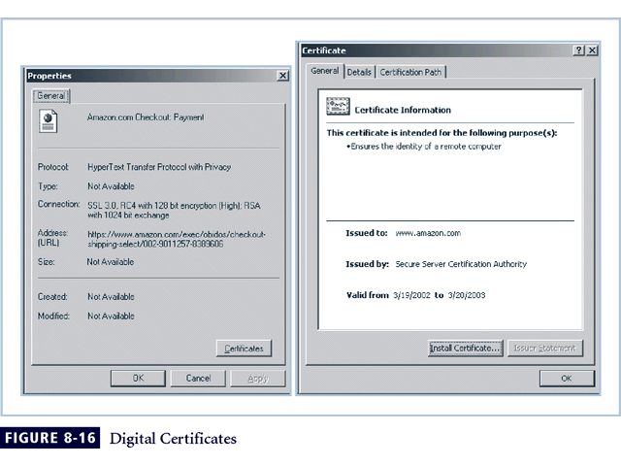
Figure 8-5 Digital Signatures

Slide 24
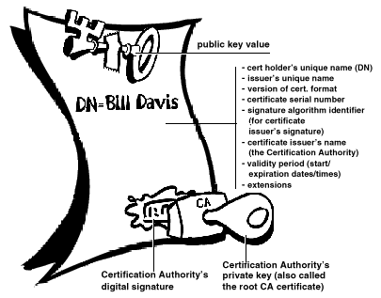
Digital Certificate
Reference

Slide 25
Protocols for Secure Communications
Secure Socket Layer (SSL) protocol: uses public key encryption to secure channel over public Internet
Secure Hypertext Transfer Protocol (S-HTTP): extended version of Hypertext Transfer Protocol; provides for encryption of individual messages between client and server across Internet
S-HTTP is the application of SSL over HTTP; allows encryption of information passing between computers through protected and secure virtual connection
Notes:
Securing the Web
Secure Electronic Transactions (SET) was developed by MasterCard and Visa in 1997 to provide protection from electronic payment fraud.
SET works by encrypting the credit card transfers with DES for encryption and RSA for key exchange, much as other algorithms do.
SET provides the security for both Internet-based credit card transactions and the encryption of swipe systems of those credit cards in retail stores.
Secure Socket Layer was developed by Netscape in 1994 to provide security in online electronic commerce transactions.
It uses a number of algorithms, but mainly relies on RSA for key transfer and IDEA, DES or 3DES for encrypted symmetric key-based data transfer.
Secure Hypertext Transfer Protocol (SHTTP) is an encrypted solution to the unsecured version of HTTP.
It provides an alternative to the aforementioned protocols and can provide secure e-commerce transactions as well as encrypted Web pages for secure data transfer over the Web, using a number of different algorithms.
Secure Shell (SSH) provides security over remote access connections using tunneling. It provides authentication services between a client and server.
IP Security (IPSec) is the cryptographic authentication and encryption product of the IETF’s IP Protocol Security Working Group, defined in RFC 1825, 1826 and 1827.
IP Security (IPSec) is used to create Virtual Private Networks (VPNs) and is an open framework for security development within the TCP/IP family of protocol standards.

Slide 26
Protocols for Secure Communications (continued)
Securing E-mail with S/MIME, PEM, and PGP
Secure Multipurpose Internet Mail Extensions (S/MIME): builds on Multipurpose Internet Mail Extensions (MIME) encoding format by adding encryption and authentication
Privacy Enhanced Mail (PEM): proposed as standard to function with public key cryptosystems; uses 3DES symmetric key encryption
Pretty Good Privacy (PGP): uses IDEA Cipher for message encoding
Notes:
Securing E-mail
A number of encryption cryptosystems have been adapted in an attempt to inject some degree of security into e-mail, a notoriously unsecured medium.
S/MIME builds on the Multipurpose Internet Mail Extensions (MIME) encoding format by adding encryption and authentication through digital signatures based on public key cryptosystems.
Securing E-mail
Privacy Enhanced Mail (PEM) was proposed by the Internet Engineering Task Force (IETF) as a standard to function with the public key cryptosystems.
PEM uses 3DES symmetric key encryption and RSA for key exchanges and digital signatures.
Pretty Good Privacy (PGP) was developed by Phil Zimmerman and uses the IDEA Cipher, a 128-bit symmetric key block encryption algorithm with 64 bit blocks for message encoding.
IDEA performs 8 rounds on 16 bit sub-blocks using algebraic calculations.
PGP also uses RSA for symmetric key exchange and for digital signatures.

Slide 27
Protocols for Secure Communications (continued)
Securing Web transactions with SET, SSL, and S-HTTP
Secure Electronic Transactions (SET): developed by MasterCard and VISA in 1997 to provide protection from electronic payment fraud
Uses DES to encrypt credit card information transfers
Provides security for both Internet-based credit card transactions and credit card swipe systems in retail stores
Notes:
Securing Web Transactions with SET, SSL, and S-HTTP
Just as PGP, PEM, and S/MIME work to secure e-mail operations, a number of related protocols work to secure Web browsers, especially at electronic commerce sites.
Among these are Secure Electronic Transactions (SET), Secure Socket Layer (SSL), Secure Hypertext Transfer Protocol (S-HTTP), Secure Shell (SSH-2), and IP Security (IPSec).
Secure Electronic Transactions (SET) was developed by MasterCard and VISA in 1997 to provide protection from electronic payment fraud.
SET uses DES to encrypt credit card information transfers and RSA for key exchange. SET provides the security for both Internet-based credit card transactions and credit card swipe systems in retail stores.

Slide 28
References & further readings
Computer Security: Principles and Practice :Chapter 2 – Cryptographic Tools by William Stallings and Lawrie Brown
Cryptography and network security by William stalling chapters :11,12,13,14
Understanding Public Key Infrastructure (PKI) An RSA Data Security White Paper

