Slide 1

Book Shop Employee Management Database (MySQL) [NSU ACM-W Learning Bootcamp 2]
Asfaria Chowdhury
Id: 1931741642

Slide 2

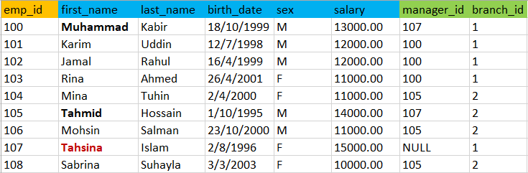
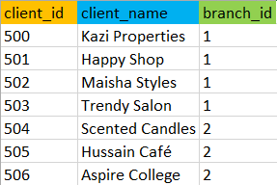
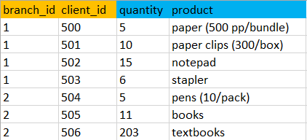

Database Schema
KEYS
Employee
Client
Branch
Product

Slide 3
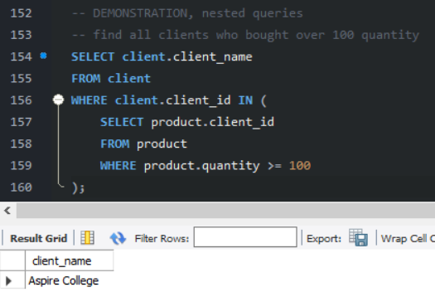
DEMONSTRATION, Nested Queries

Slide 4
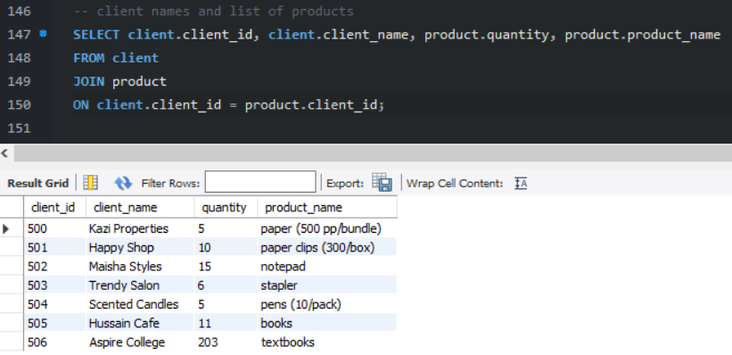
DEMONSTRATION, ‘Join’

Slide 5
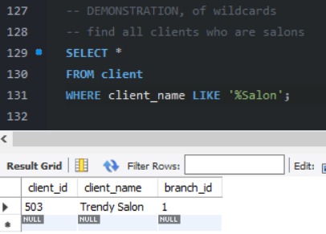
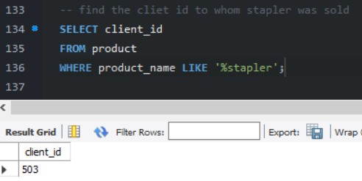
DEMONSTRATION, Wildcards

Slide 6
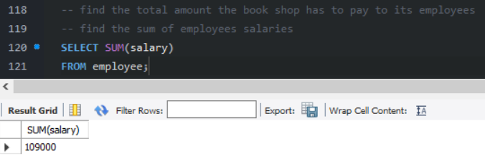
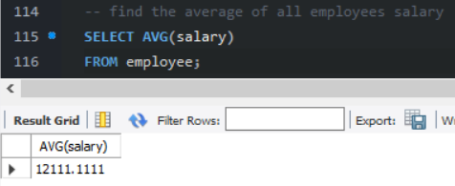
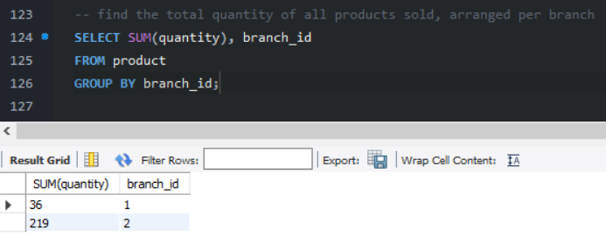
DEMONSTRATION, Functions

Slide 7
Thank you.
Asfaria Islam Chowdhury
ID: 1931741642
Gmail: asfaria.chowdhury@northsouth.edu
LinkedIn: https://www.linkedin.com/in/asfaria-chowdhury-16424b1bb/

