Slide 1
Newspaper - Bootstrap
NSU ACM-W Learning
Bootcamp, Dec 2020
Asfaria CHOWDHURY
ID: 1931741642

Slide 2
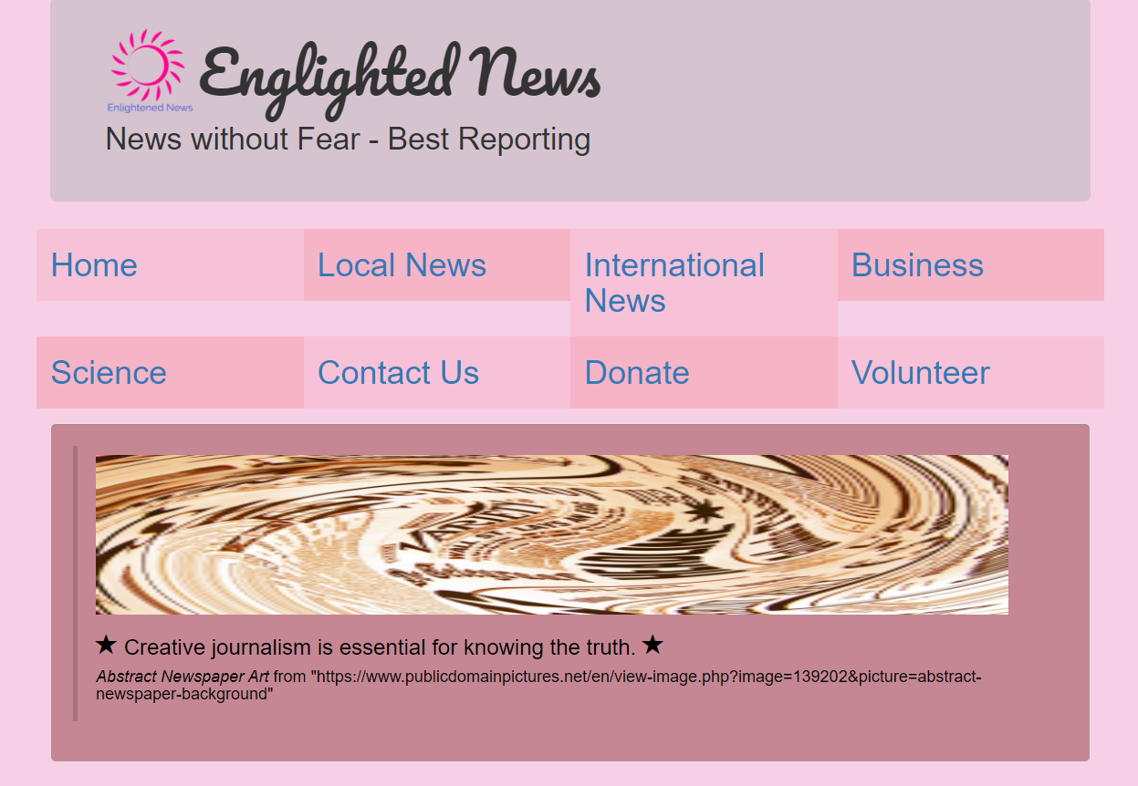
Home.html uses jumbotron to format the news website name. The default well colour is changed from grey to purple. The blockquote is used to insert text, image and glyphicon inside well. The default font colour of blockquote is changed to black.

Slide 3

Home.html uses collapsed columns, news links that open in new tab, and glyphicons for the purple buttons.

Slide 4
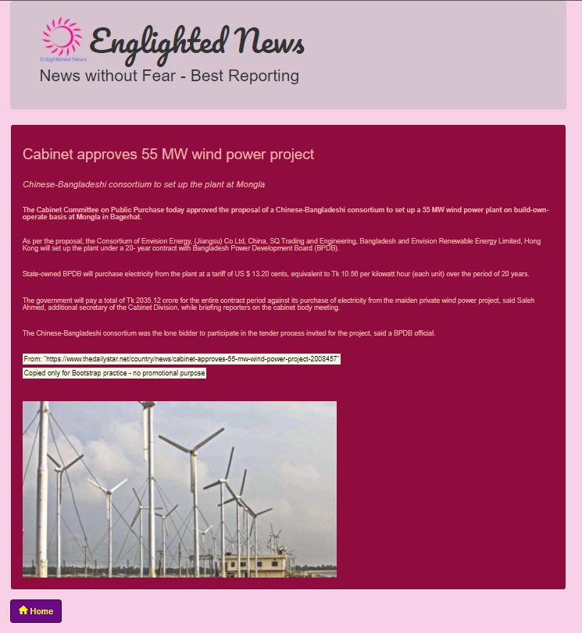
Local_News.html uses well for the article. The default well colour and default well text colour is changed from grey to red & yellow. In addition, a home button is created using glyphicon, which redirects back to Home.html [in new tab]

Slide 5
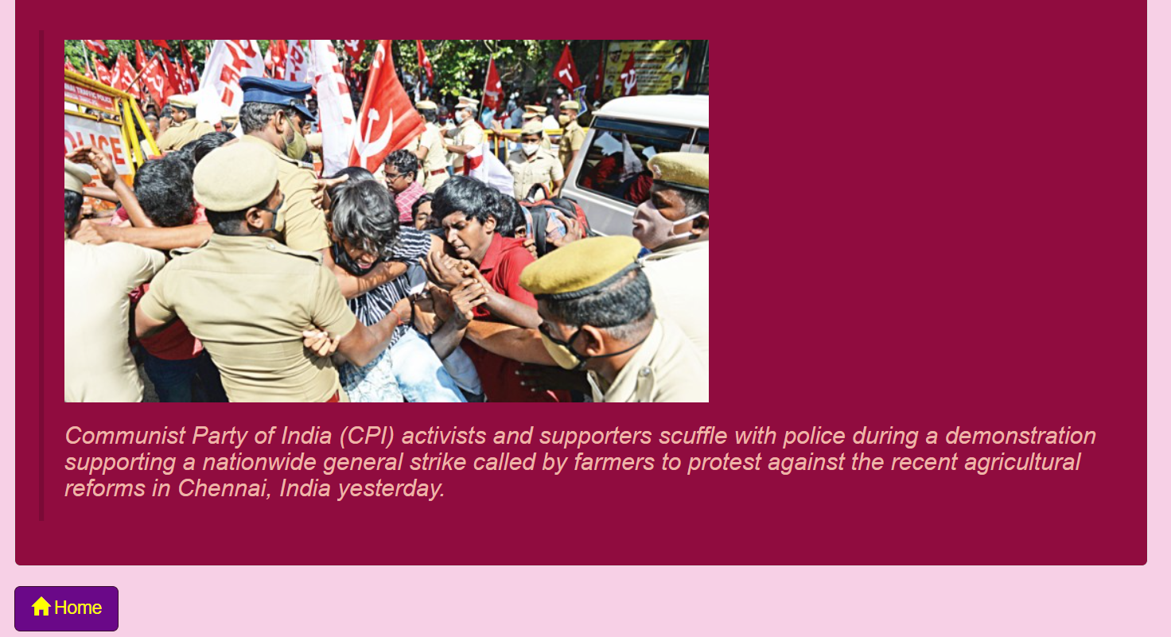
International_News.html follows a similar format, where the entire article is placed inside a red well. In addition, the image is inserted inside a blockquote, and the caption is formatted in a bigger italic text.

Slide 6
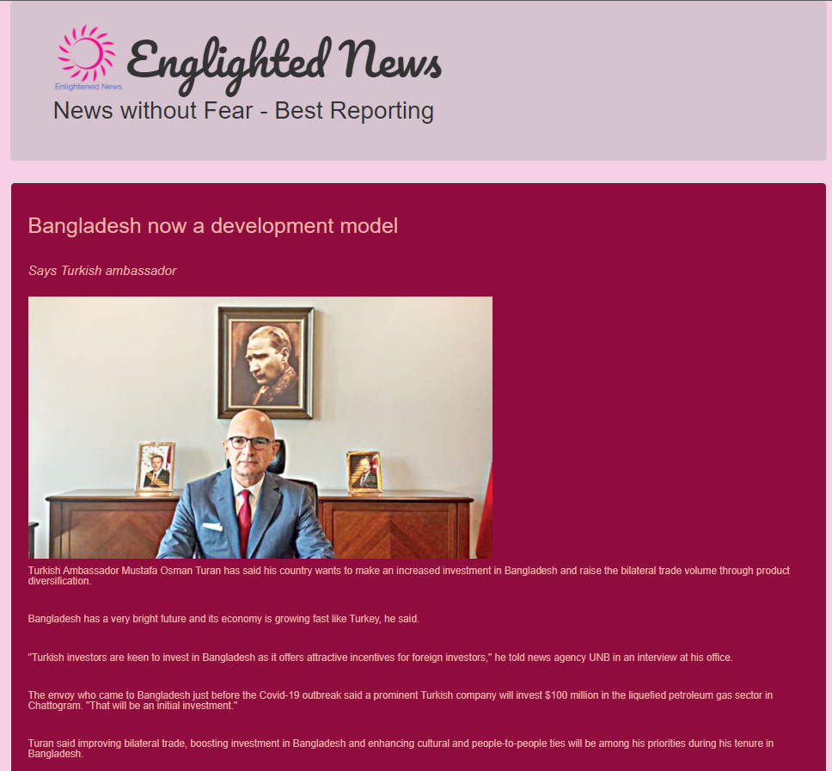
Business.html follows a similar format [whole page not shown – bottom part has Home button].

Slide 7
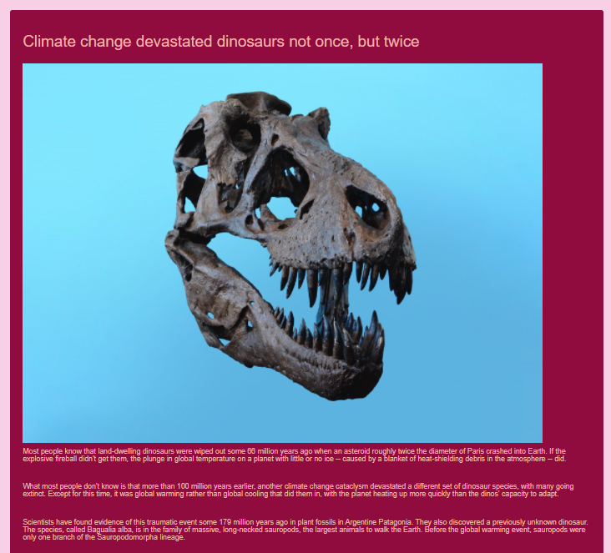
Same for Science.html [whole page not shown]

Slide 8
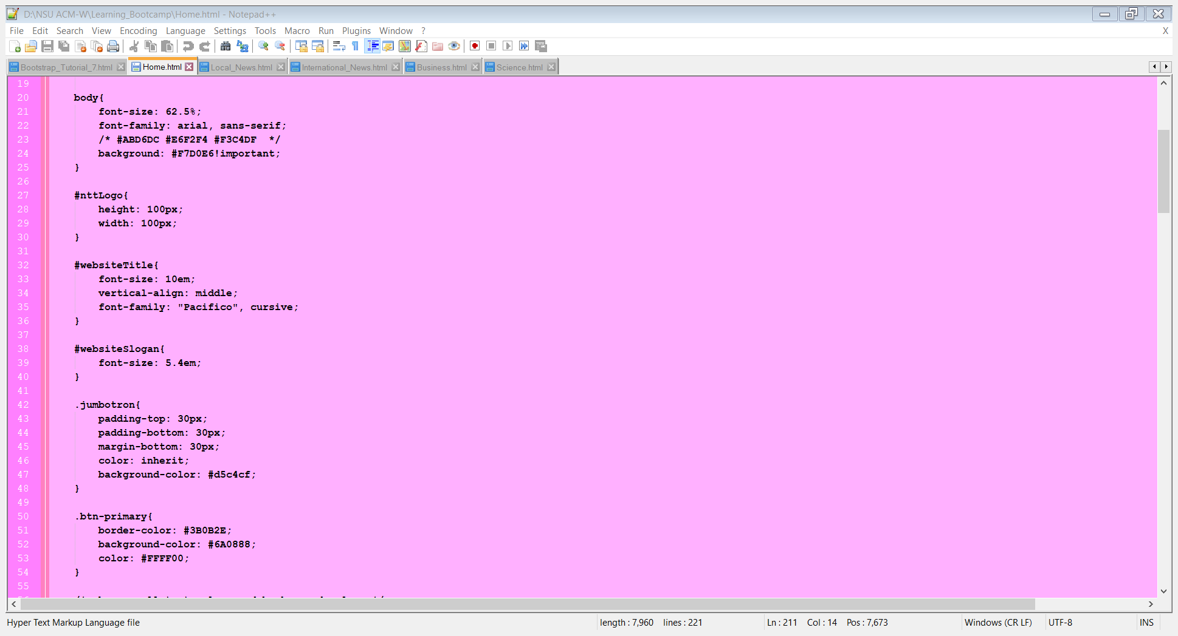
All html files used these code lines to format
the website name (inside jumbotron) and
Button colours (purple button with yellow text
And yellow glyphicons).

Slide 9
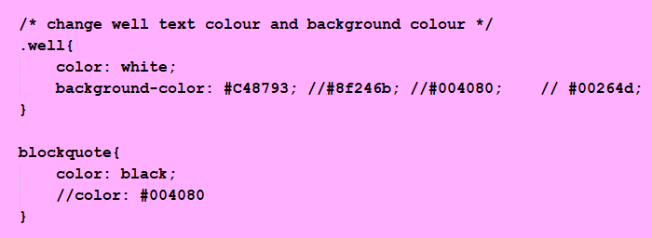
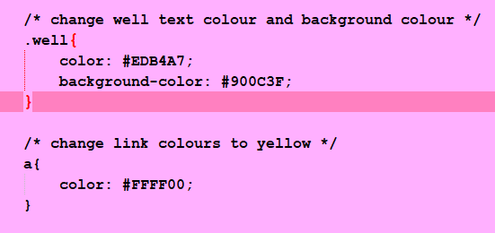
Home.html uses these well and blockquote formatting. The well background is purple and blockquote text is black.
The rest of the files use these code lines, where the well is red and the links are yellow coloured.

Slide 10
News articles & images are taken from these websites for Bootstrap practice and not for promotional purposes.
Abstract Newspaper Art from https://www.publicdomainpictures.net/en/view-image.php?image=139202&picture=abstract-newspaper-background
Science article from https://www.thedailystar.net/toggle/news/climate-change-devastated-dinosaurs-not-once-twice-1998293
Business article from https://www.thedailystar.net/business/news/bangladesh-now-development-model-2008185
International News article from https://www.thedailystar.net/world/news/farmers-stage-nationwide-strike-2008313
Local News article from https://www.thedailystar.net/country/news/cabinet-approves-55-mw-wind-power-project-2008457

Slide 11
Asfaria CHOWDHURY
ID: 1931741642, North South University (NSU)
Github Project: AsfariaChowdhury/Learning_Bootcamp: NSU ACM-W Bootcamp December 2020 (github.com)
Github Profile: AsfariaChowdhury (github.com)
Linkedin: (1) Asfaria Chowdhury | LinkedIn
Email: asfaria.chowdhury@northsouth.edu
“NewsPaper Bootstrap” project submitted to NSU ACM-Women Learning Bootcamp, December 2020
***Previous Project***
“Bank” using Java’s object oriented features
Github Project: AsfariaChowdhury/NSUACM-WCodingMarathonBank (github.com)
Project submitted to NSU ACM-Women 48 hour Coding Marathon

