Slide 1

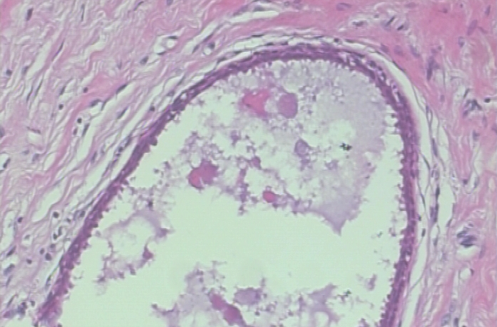
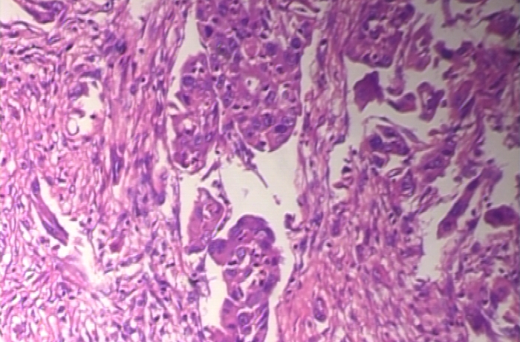
An Energy-Efficient Deep Learning Model for Breast Cancer Detection
Presented By-
Asfia Haque Arpi (221-35-972)
Supervisor: Mr. Suprove Chandra Sarkar,
Lecturer, Department of Software Engineering, DI

Slide 2


Outlines
Research Gaps and Problem Statement
Objectives and Contribution
Research Scope and Literature Review
Methodology
References

Slide 3
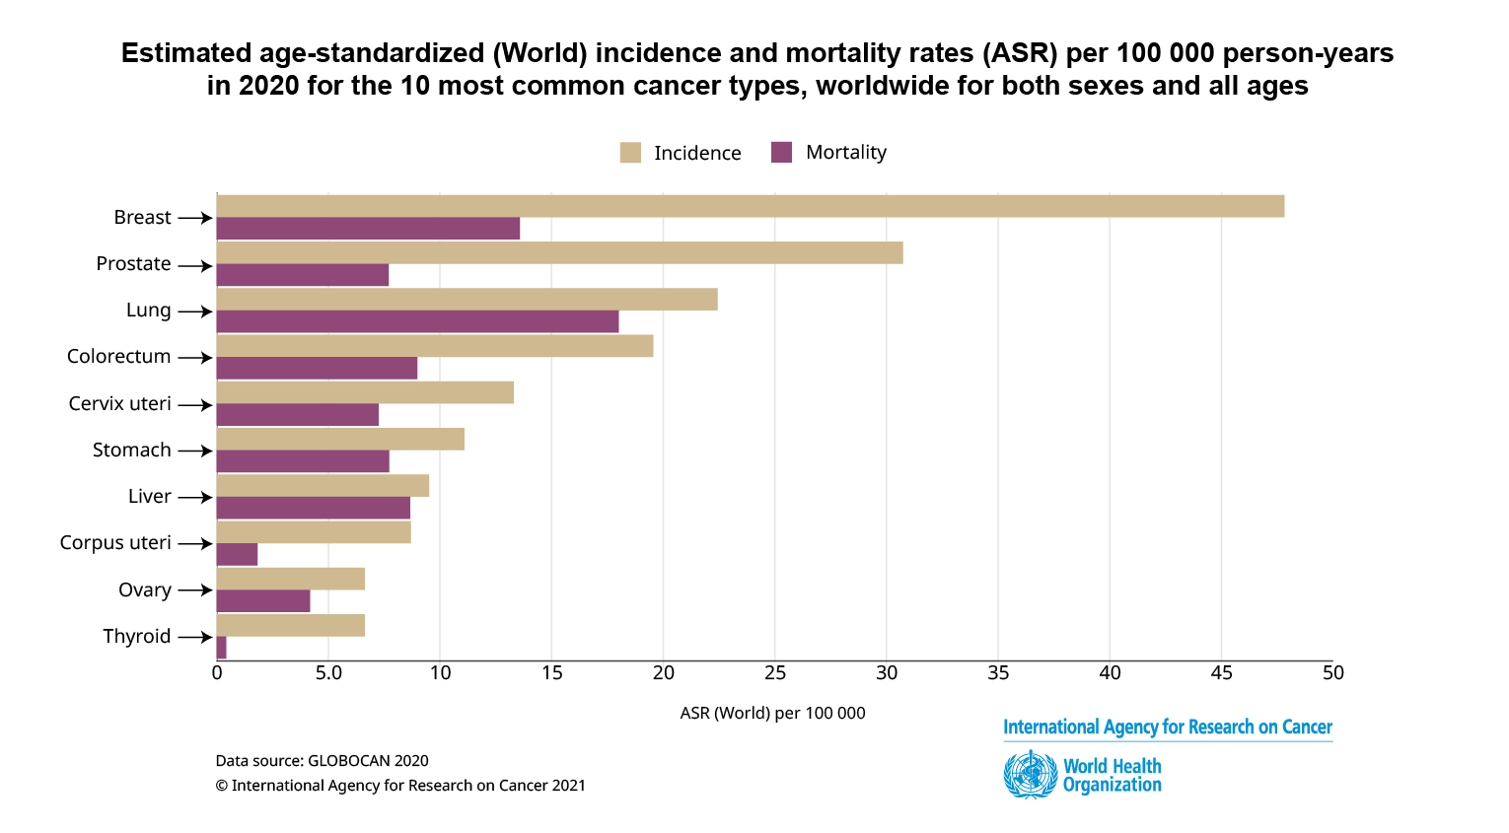
Problem Statement
One of the main causes of death for women
Urgent need for scalable, accurate diagnosis.
Existing models have poor dataset generalization.
Models are too complex for environments with
limited resources.

Slide 4
Research Gaps
Lack of generalization across diverse datasets limits model robustness.
Lack of energy-efficient design while developing a deep learning model.
Lack of magnification diversity limits adaptability in histopathological image analysis.
Lack of clinical data integration weakens real-world diagnostic applicability.

Slide 5
Transition to objective
Improving generalization across diverse datasets
Exploring energy-efficient model design
Focusing on developing a robust and generalizable deep learning model for breast cancer detection using histopathological images.
Enhancing adaptability across different magnification levels

Slide 6
Objectives
To improve generalization, train on diverse datasets.
To design energy-efficient deep learning model, can reduce computational cost,
To enhance adaptability, include varied magnification levels in training.
To increase diagnostic applicability, integrate clinical data into the model.

Slide 7
Research Scope
Excluding the mammogram-based dataset, focusing on the histopathological datasets.
Designing energy-efficient deep learning models to reduce computational overhead.
Limiting classification to a binary outcome, excluding multiclass modeling.
Developing a robust model across diverse datasets to improve generalization and reliability.
Exploring magnification diversity to enhance adaptability in histopathological image analysis.
Integrating clinical data to strengthen real-world diagnostic applicability.

Slide 8
Literature Review
Paper List | Paper Title | Contributions | Limitations
1 | PSO-optimized fractional order CNNs for enhanced breast cancer detection Author: A. Rajasekhar Yadav et al. (2025) Dataset: INBreast (Mammograms) Results: 99.35% accuracy, 98.2% specificity, 99% sensitivity | Improved image filtering for clearer mammograms Created Frac-CNN for better cancer detection Used PSO to optimize Frac-CNN | Limited dataset diversity can reduce model generalizability (410 images) Model bias, no external checks Hard to interpret lesion details
2 | Deep learning and vision transformers-based framework for breast cancer and subtype identification Author: Ishrat Jahan et al. (2025) Dataset: Warwick HER2 dataset(Histopathological image) Results: Patch: 96.74% (cancer), 89.78% (subtype); WSI: F1 99.06% | Used Score-CAM for interpretability and pathologist validation Improved cancer and subtype detection insights Tested at 10x and 20x magnification to cut computational cost | Low number of lobular carcinoma cases in the dataset Artificially increasing lobular carcinoma samples may not fully replicate real variability

Slide 9
Paper List | Paper Title | Contributions | Limitations
3 | Enhancing breast cancer prediction through stacking ensemble and deep learning integration Author: Fatih Gurcan et al. (2025) Dataset: Breast Cancer Wisconsin (Tabular) Results: Accuracy: 97.72% F1 Score: 0.9819, Training Time: 15.42 seconds | Proposed a novel Stacking ensemble model combining top ensemble (LGBM, CB, etc.) and deep learning (CNN, RNN, etc.) methods. Identified 11 key diagnostic features using feature importance ranking. Identified 11 key diagnostic features using feature importance ranking. | Dataset Bias: Relies only on the Wisconsin dataset Lack of External Validation: Not tested on real-world or varied clinical data. Feature Sensitivity: Performance depends on engineered features ensemble model can use for improvement. Stability Concerns: Model performance may vary with changes in data or preprocessing.

Slide 10
Paper List | Paper Title | Contributions | Limitations
4 | Ensemble Deep Learning-Based Image Classification for Breast Cancer Subtype and Invasiveness Diagnosis from Whole Slide Image Histopathology Author: Aadhi Aadhavan Balasubramanian et al. (2024) Dataset: BACH & BreakHis (Histopathological) Results: Patch: 95.31% (BACH), 98.43% (BreakHis) | Introducing a novel image patching technique. Enhancement of ensemble techniques with advanced optimization and adaptive methods. Development of generalizable models across datasets and clinical settings. Implementation of image patching to manage computational complexity. | No discussion of external validation on independent datasets. (That's why it's unclear that the model will work well on an independent dataset.) It doesn't provide a performance breakdown on different subtypes of breast cancer or in image magnification levels. No integration with clinical or genomic metadata.

Slide 11
Paper List | Paper Title | Contributions | Limitations
5 | Deep learning empowered breast cancer diagnosis: Advancements in detection and classification Author: Jawad Ahmad et al. (2024) Dataset: CBIS-DDSM(Mammograms) Results: 99.16% classification accuracy | Developed an integrated CAD framework Introduced a fused YOLO-based model for lesion detection Proposed BreastNet-SVM, a customized AlexNet variant for classifying lesions as benign or malignant. Utilized Associated-ResUNets for superior segmentation performance | No clinical or demographic data integration Challenges with calcification lesion detection due to shape/location variability. Clinical and regional data are not included, limiting personalized diagnosis. Accuracy for medical imaging tasks may be decreased by using natural image pre-training.

Slide 12
Paper List | Paper Title | Contributions | Limitations
6 | Breast Cancer Detection and Localizing the Mass Area Using Deep Learning Author: Md. Mijanur Rahman et al. (2024) Dataset: MIAS (mammography) Results: 93.0% accuracy (detection), 97% | Groundbreaking approach (U-Net and YOLO) Quick Identification of the tumor with greater precision Prioritizes mass classification over mass localization, resulting in an uneven distribution of attention. | Depending only on the MIAS dataset it may limit its usefulness to larger populations and other imaging settings. Small sample size can make an impact on robustness Dataset mostly covers particular geographical areas

Slide 13
Paper List | Paper Title | Contributions | Limitations
7 | Convolution Neural Network for Breast Cancer Detection and Classification Using Deep Learning Author: Basem S. Abunasser et al.(2024) Dataset: BreakHis(Histopathological) Results: accuracy of 98.30%, | Introduced custom model BCCNN for 8-class breast cancer classification Applied GAN-based data augmentation to expand the dataset Tested across multiple magnification levels for performance evaluation | Limited to specific magnification levels (40x, 100x, 200x, 400x) Lack of external validation There is no mention of explainability techniques

Slide 14
Paper List | Paper Title | Contributions | Limitations
8 | Cancer Unveiled: A Deep Dive Into Breast Tumor Detection Using Cutting-Edge Deep Learning Models Author: Wishal Arshad et al. (2023) Dataset: Breast Histopathological Images Results: accuracy (99%), VGG-16 (98%) and MobileNetV2 (97%). | First systematic test of InceptionV3, ResNet152V2, MobileNetV2, VGG-16, DenseNet-121 one of the first to comprehensively compare multiple state-of-the-art CNN architectures Focus on histopathology, not mammograms. (which one is better?) Uniform benchmarking of CNNs. Fills gap in histopathology AI research. | Limited dataset. (162 breast cancer slide image) Binary classification only.(but there can be multiple subtype of tumor)

Slide 15
Paper List | Paper Title | Contributions | Limitations
9 | Breast Cancer Detection and Prevention Using Machine Learning Author: Arslan Khalid et al.(2023) Dataset: Breast Cancer Wisconsin (Tabular) Results: achieved 96.49% accuracy | Used three feature selection methods for better model performance. Integrated both CC and MLO mammogram views. Compared six ML models for classification. | Limited to mammograms only, no clinical/genomic data. No model interpretability techniques used. Single dataset, lacks external validation.
10 | Breast Cancer Classification From Histopathological Images Using Patch-Based Deep Learning Modeling Author: Irum Hirra et al.(2021) Dataset: Histopathological Image Results: Accuracy: 86% | Novel Framework ( Pa-DBN-BC) Provides the automatic and accurate representation of features from images with the help of DBN. Fewer hardware resources. Binary classification only Grayscale image conversion. | Data dependency Several models are cost-intensive due to training time or architecture complexity Lack of experimental data.

Slide 16
Paper List | Paper Title | Contributions | Limitations
11 | Hybrid Deep Learning EfficientNetV2 and Vision Transformer (EffNetV2-ViT) Model for Breast Cancer Histopathological Image Classification Year: 2024 Journal: IEEE Access | Introduced a hybrid deep learning model integrating CNN (EffNetV2) and transformer (ViT) architectures to capture both local and global image features. Achieved improved classification accuracy and robustness in breast cancer histopathology images compared to standalone models. Demonstrated that feature fusion enhances representation power and reduces overfitting. | Focused only on binary classification (benign vs malignant). Computationally expensive due to hybrid structure. Model evaluated on a single dataset (BreakHis), limiting generalizability.
12 | Detection of Breast Cancer in Digital Breast Tomosynthesis with Vision Transformers Authors: Idan Kassis et al. Year: 2024 Journal: Scientific Reports (Nature Publishing Group) | Proposed a novel CAD system for 3D DBT breast cancer detection using Swin Transformer. Demonstrated the benefits of attention-based models for medical imaging. Provided explainable visualizations using Grad-CAM for interpretability. | Dataset collected from a single medical center (limited diversity). Binary classification (no benign vs malignant differentiation). High computational requirements for 3D data.

Slide 17
Paper List | Paper Title | Contributions | Limitations
13 | Deep Learning and Vision Transformers-Based Framework for Breast Cancer and Subtype Identification Neural Computing and Applications (Springer) Year: 2024 Journal: IEEE Access | Proposed a ViT-based framework for breast cancer classification. Introduced Progressive Fine-Tuning (PFT) for better generalization. Achieved 94.49% accuracy and 0.921 AUC without data augmentation. Outperformed multiple pretrained CNN models in comparison. Used 10-fold cross-validation for reliable evaluation. Reduced overfitting and improved robustness on small medical datasets. | Dataset size relatively small (111 WSIs); needs larger, multi-center validation. Only two subtypes (ductal, lobular) analyzed — other subtypes excluded. Patch imbalance between ductal and lobular classes. Requires further evaluation for generalizability in diverse medical environments.

Slide 18
Paper List | Paper Title | Contributions | Limitations
14 | Enhancing Breast Cancer Detection in Ultrasound Images: An Innovative Approach Using Progressive Fine-Tuning of Vision Transformer Models International Journal of Intelligent Systems (Wiley) | Proposed ViT-based framework for ultrasound breast cancer classification Introduced Progressive Fine-Tuning (PFT) for gradual layer adaptation Reduced overfitting on small datasets Compared ViT with VGG16/19, DenseNet121/169/201, Inception, ResNet152V2 Used 10-fold cross-validation for robust testing Achieved high accuracy (94.49%) and AUC (0.921) without data augmentation | Dataset relatively small (650 images used). No data augmentation — model robustness under varied imaging conditions not tested. Model not yet validated across different ultrasound devices or multi-center data. Focused only on benign vs malignant (normal excluded).

Slide 19
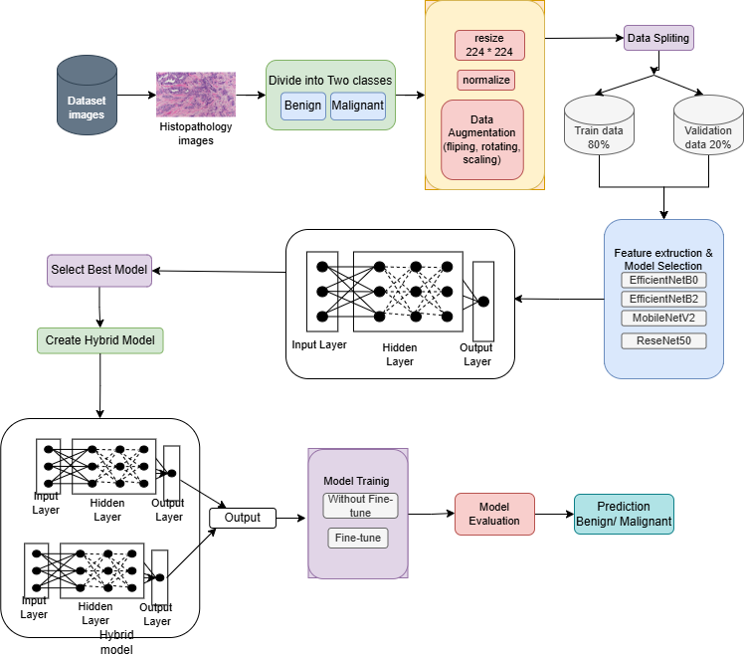
Methodology

Slide 20
Fine-Tuned CNN Model Results

Slide 21
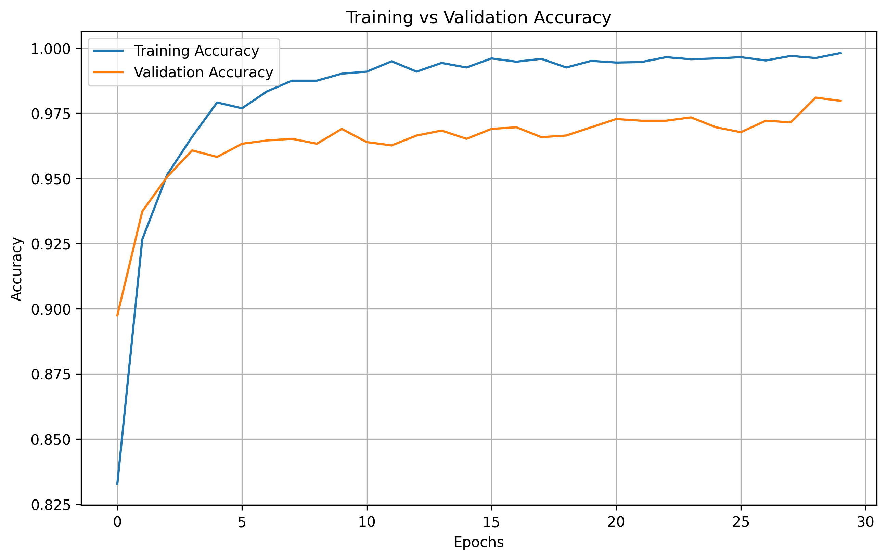
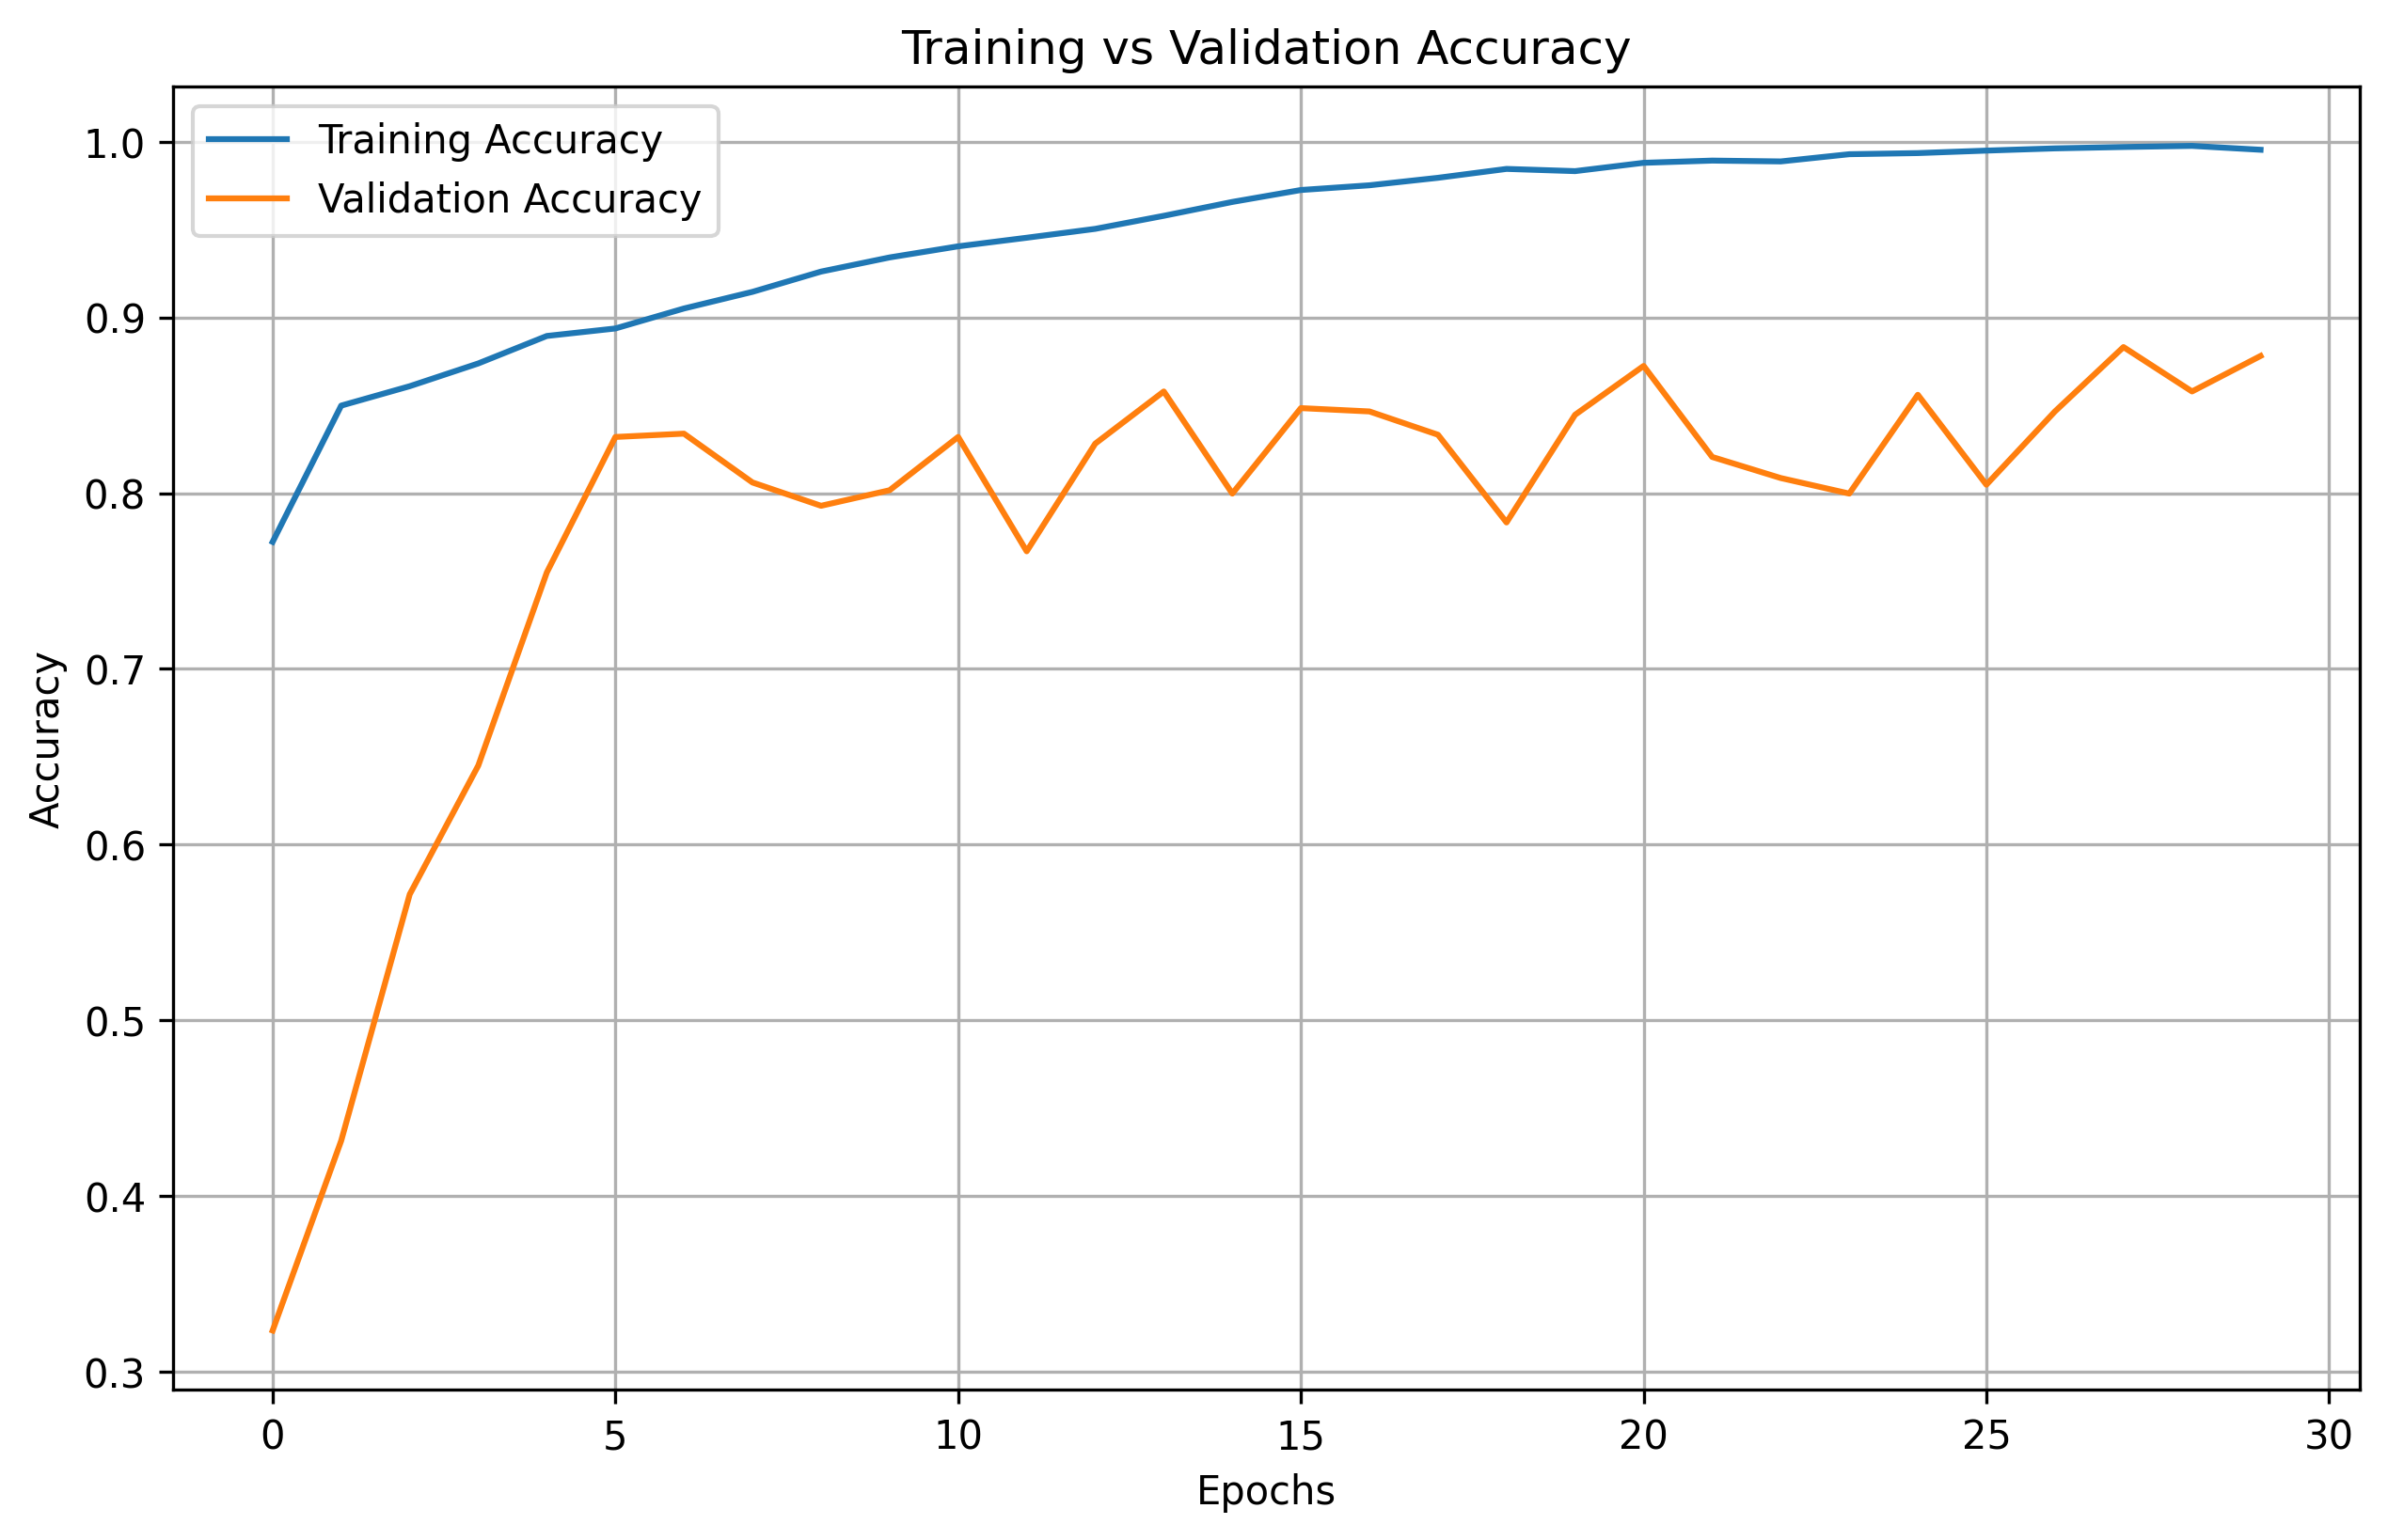
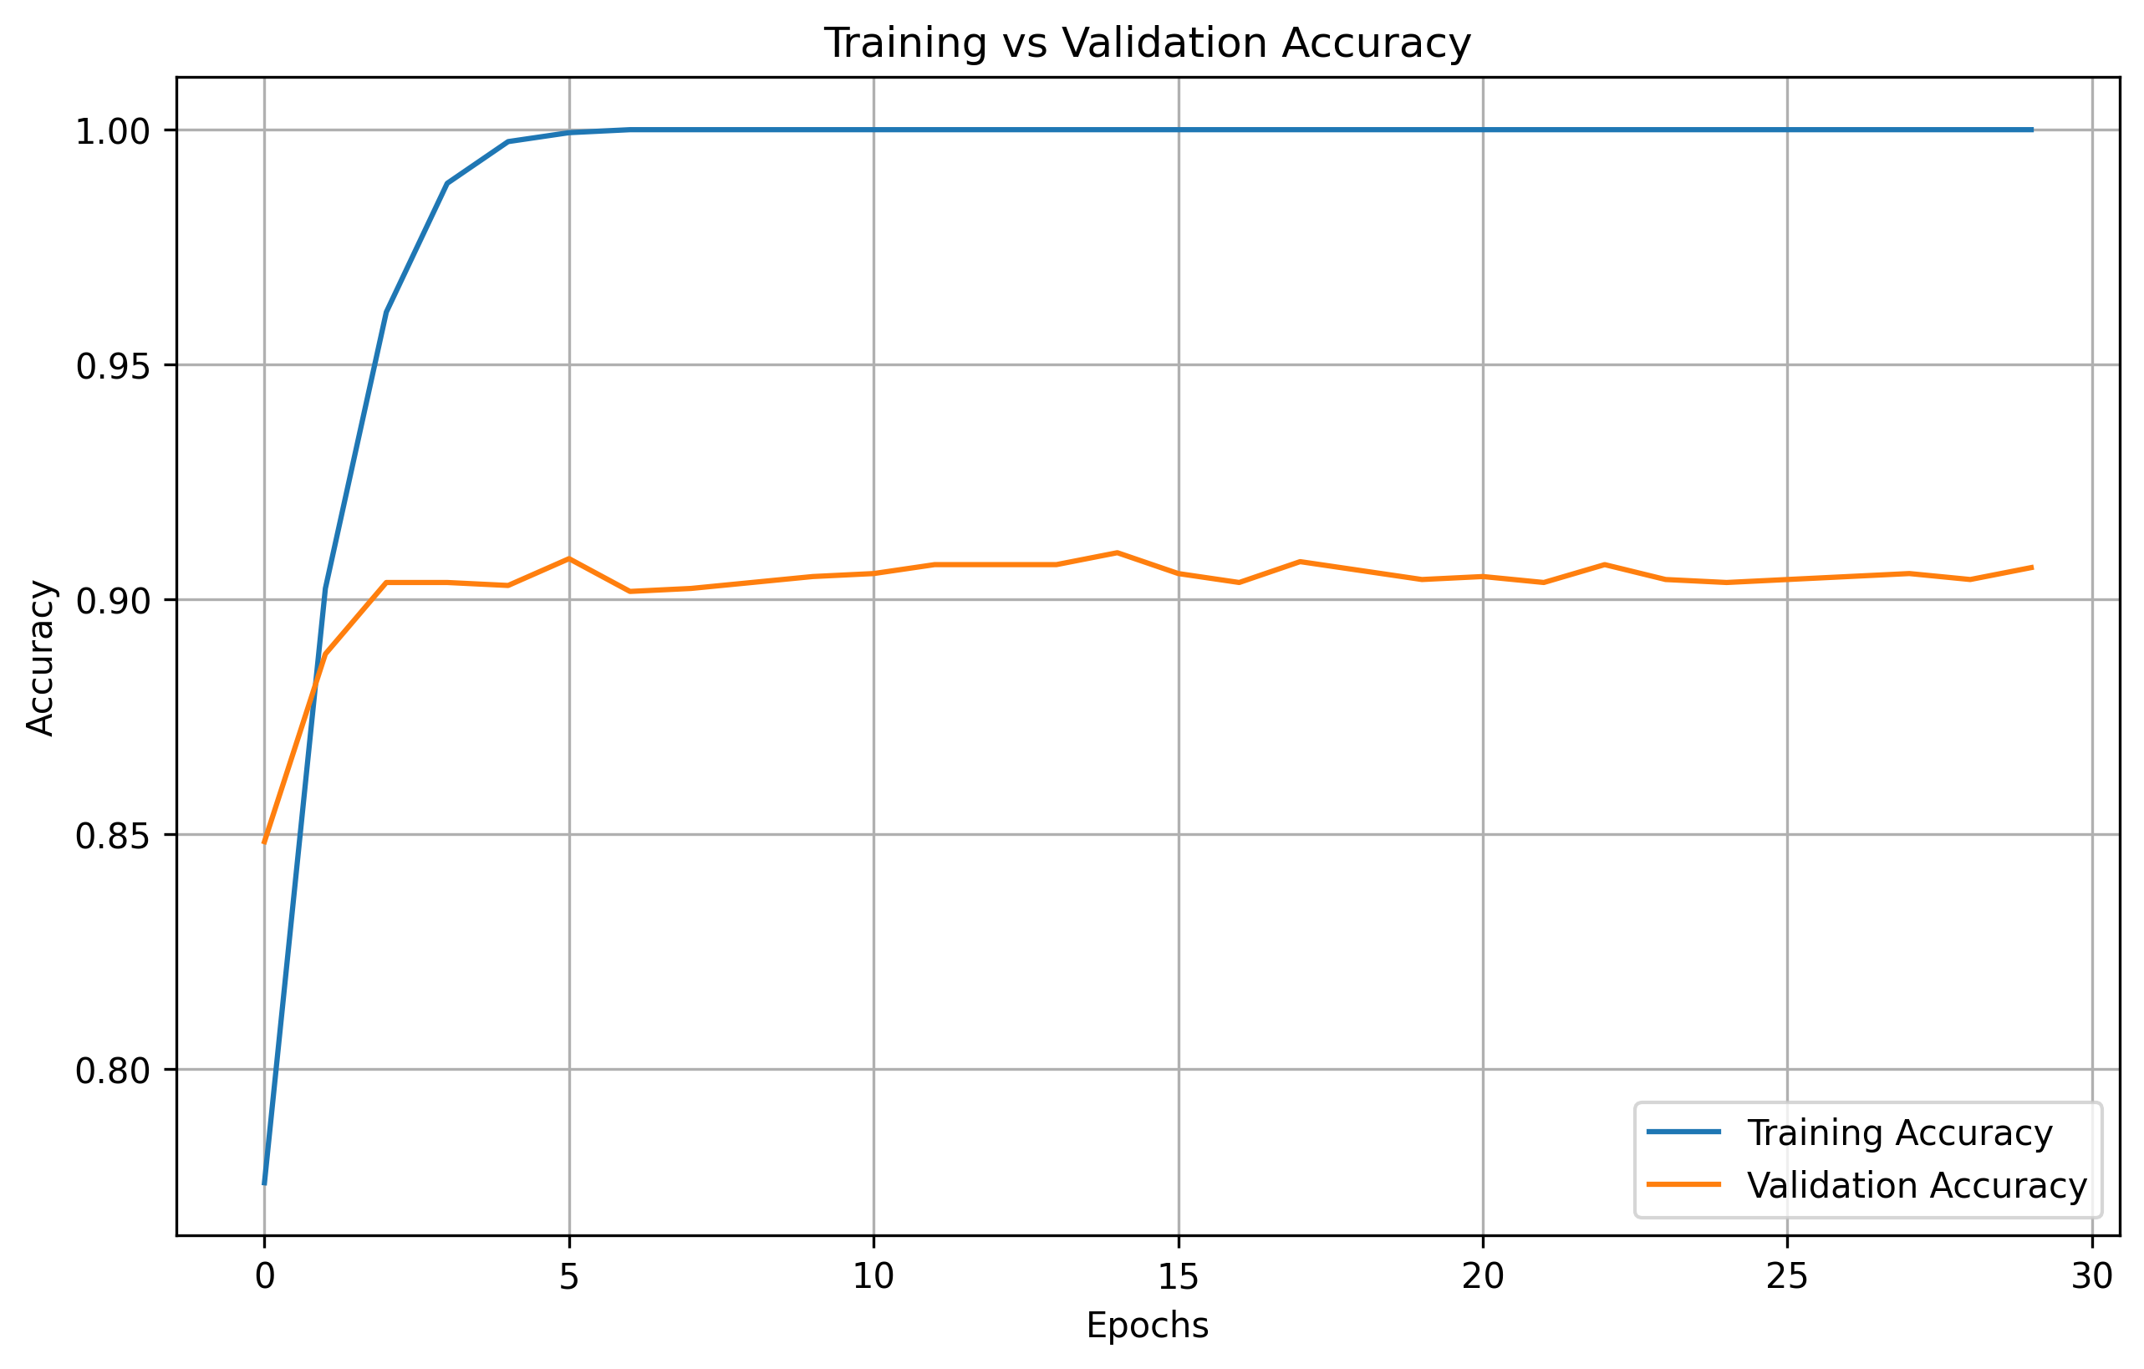
Results in Chart- Training Vs Validation Accuracy
EfficientNetB0
EfficientNetB2
MobileNetV2
RestNet50

Slide 22
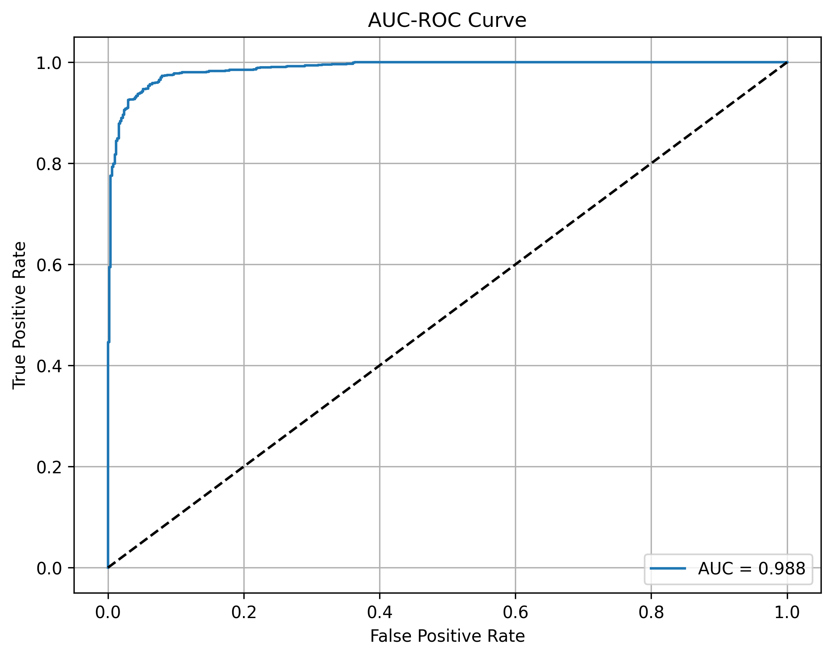
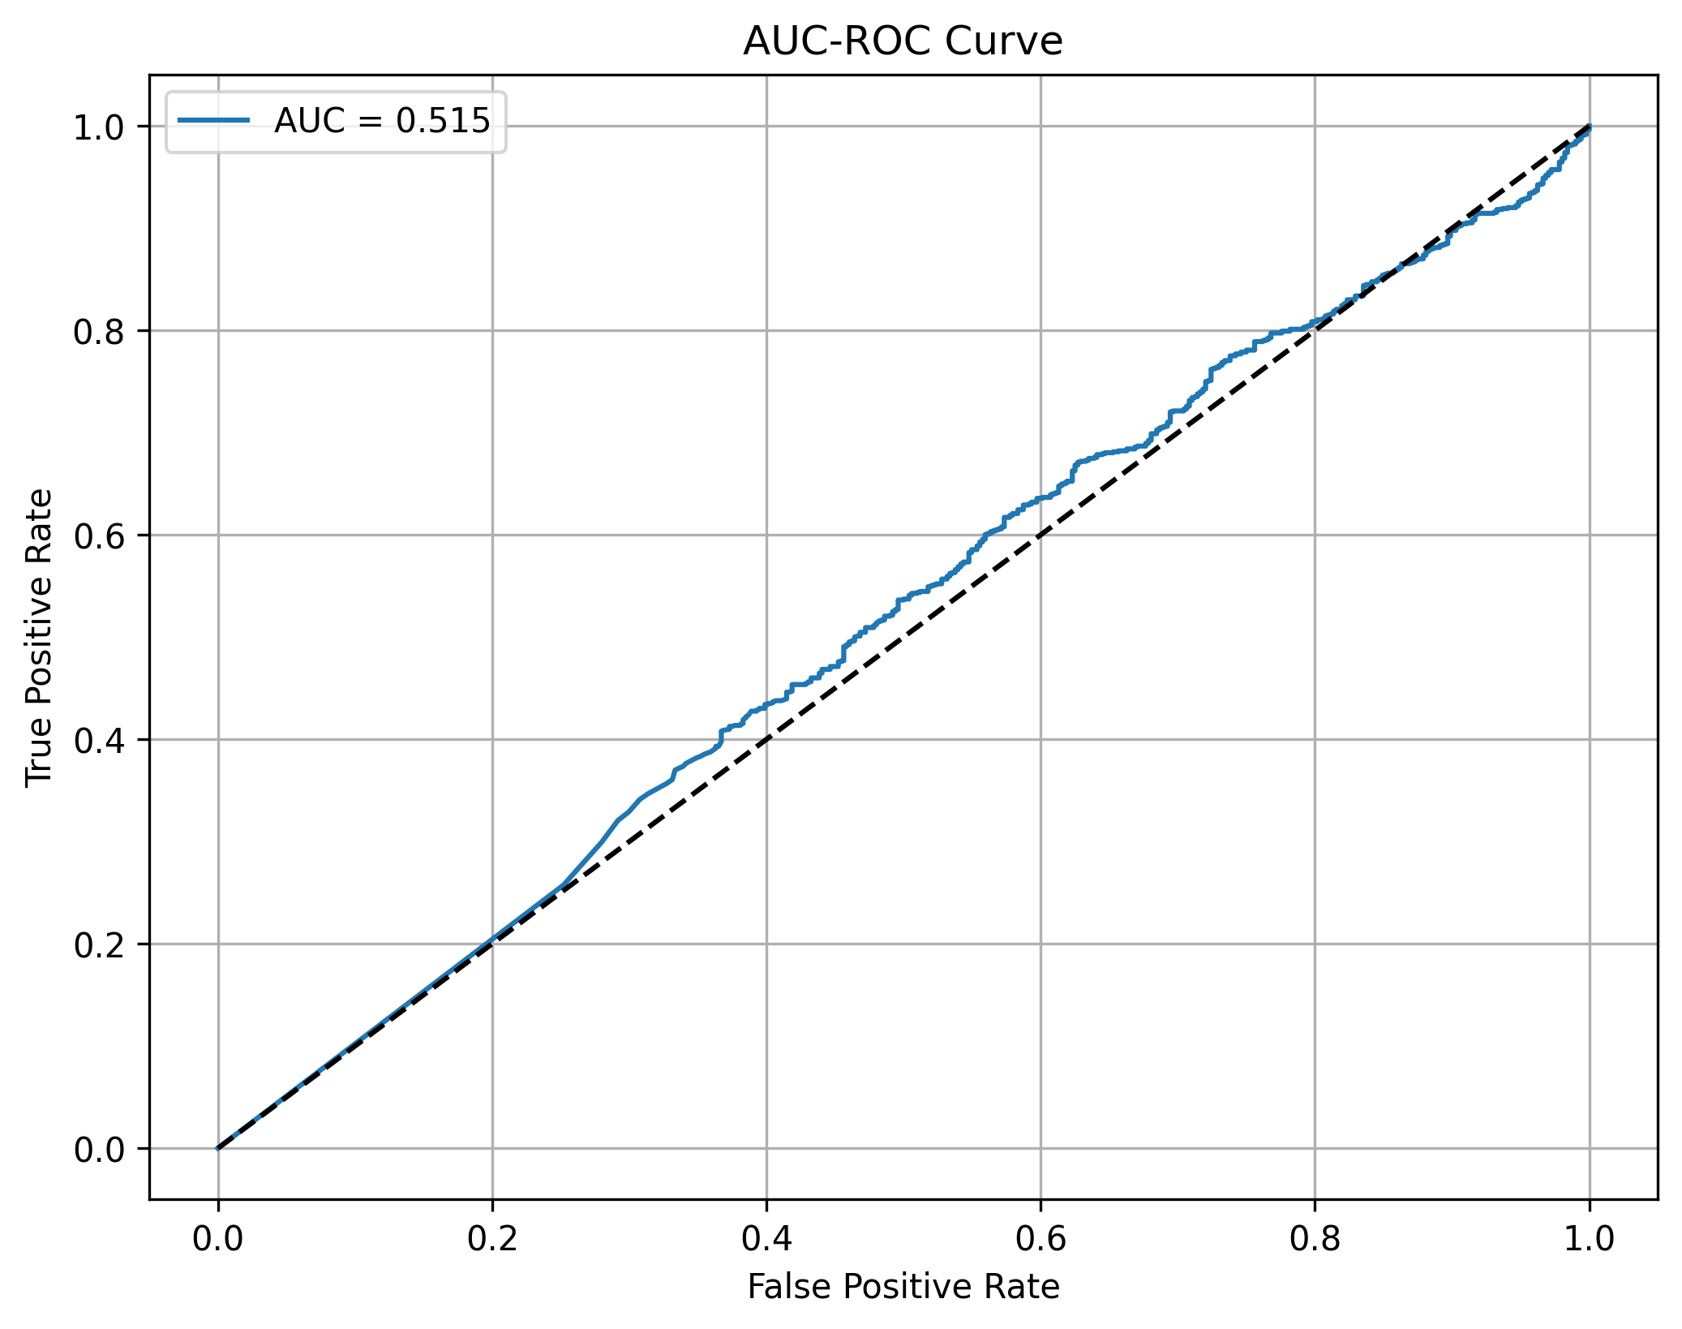
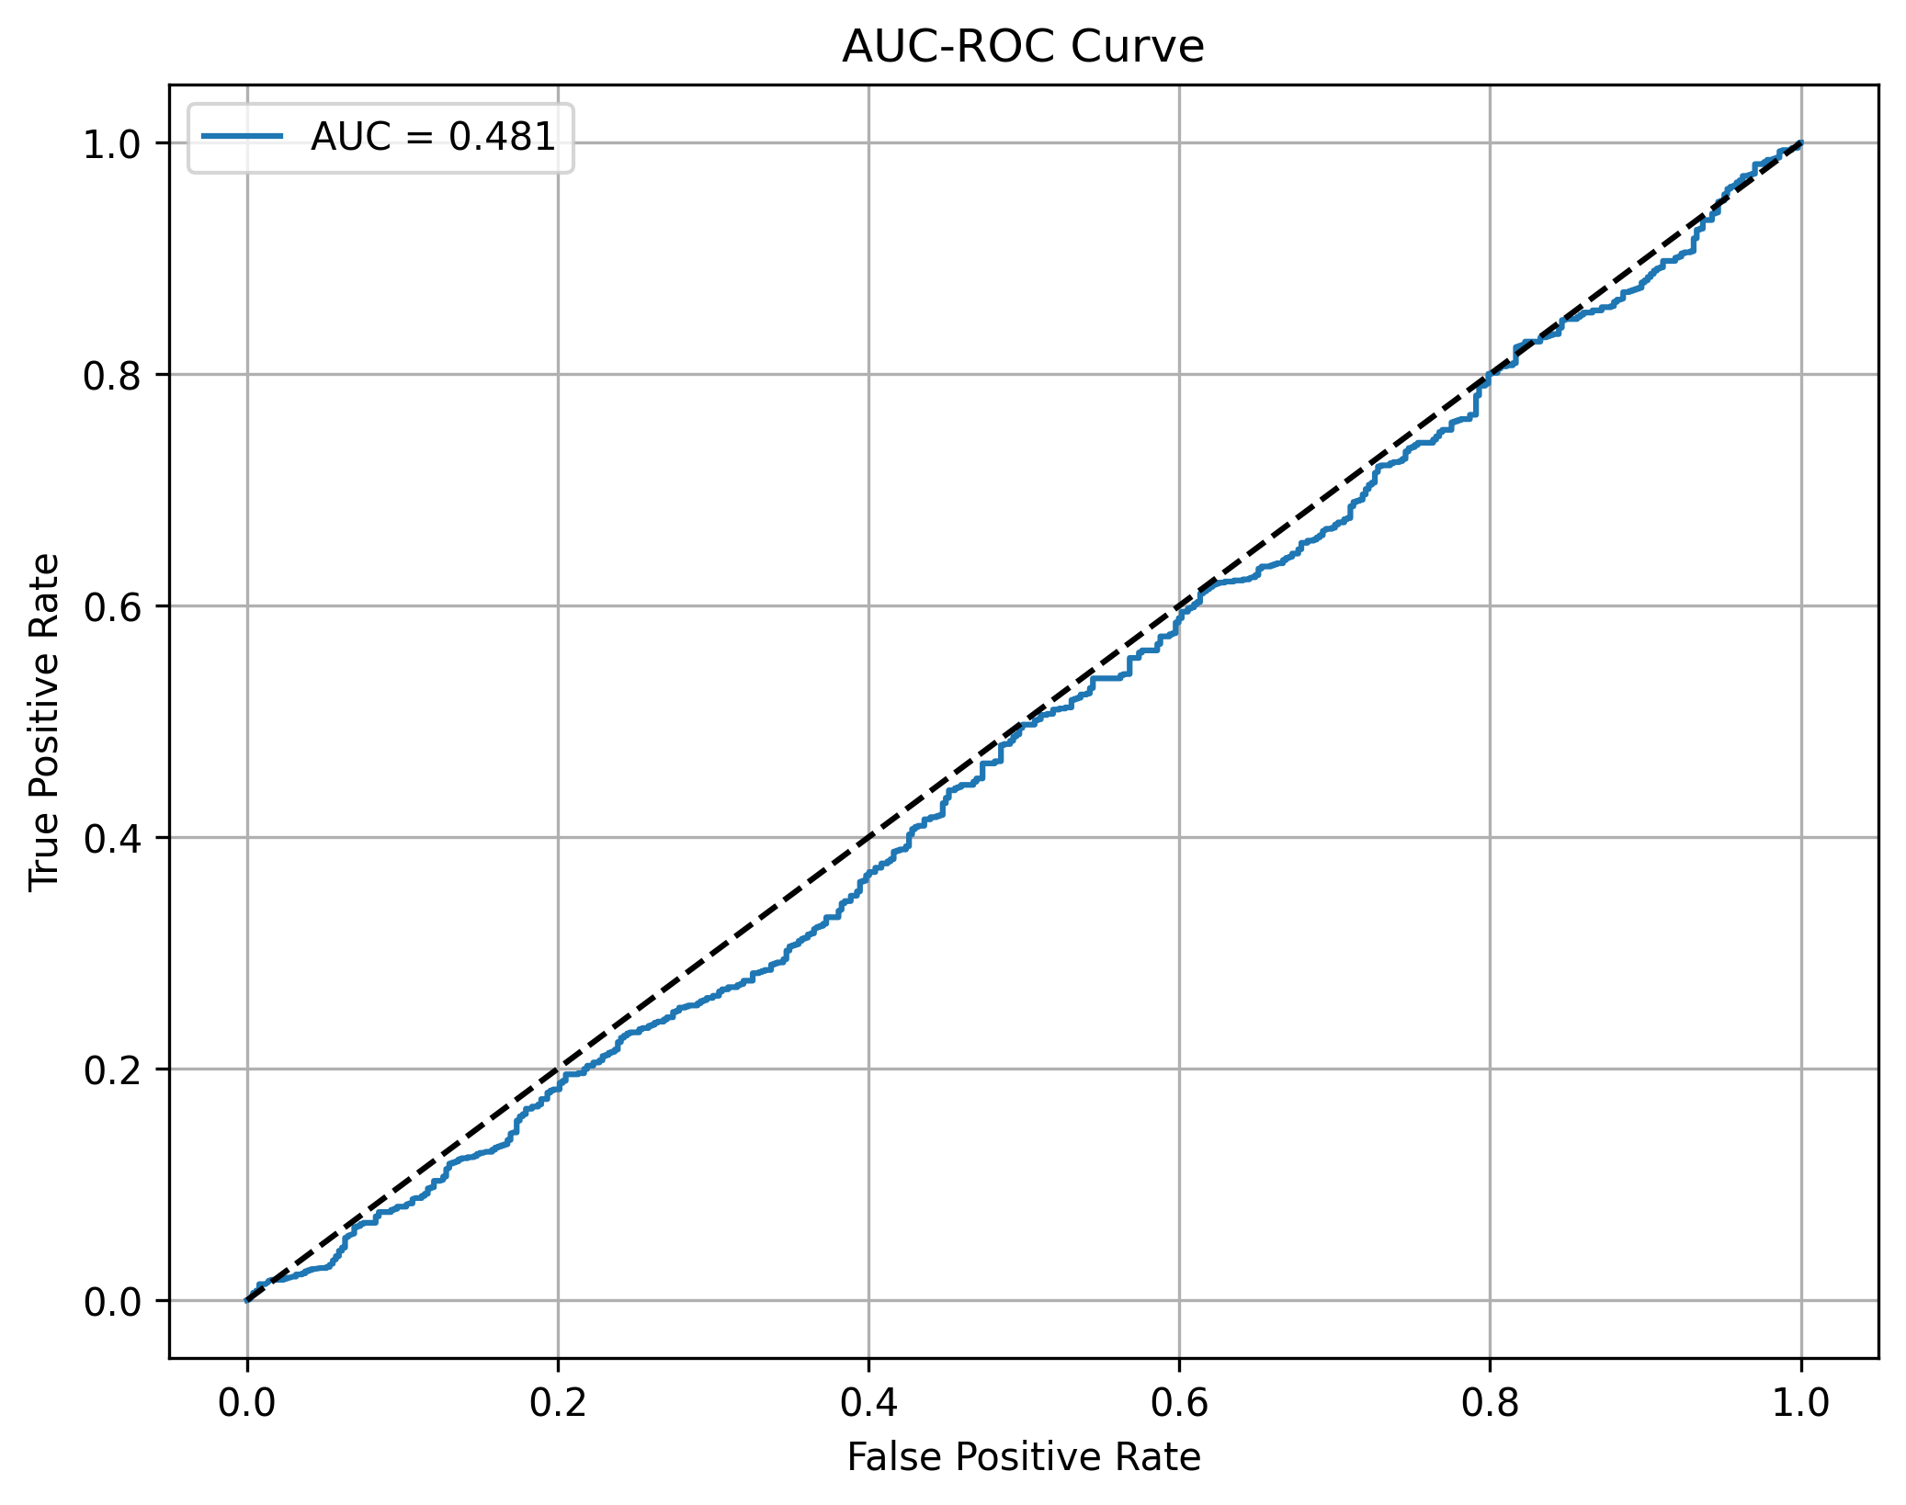
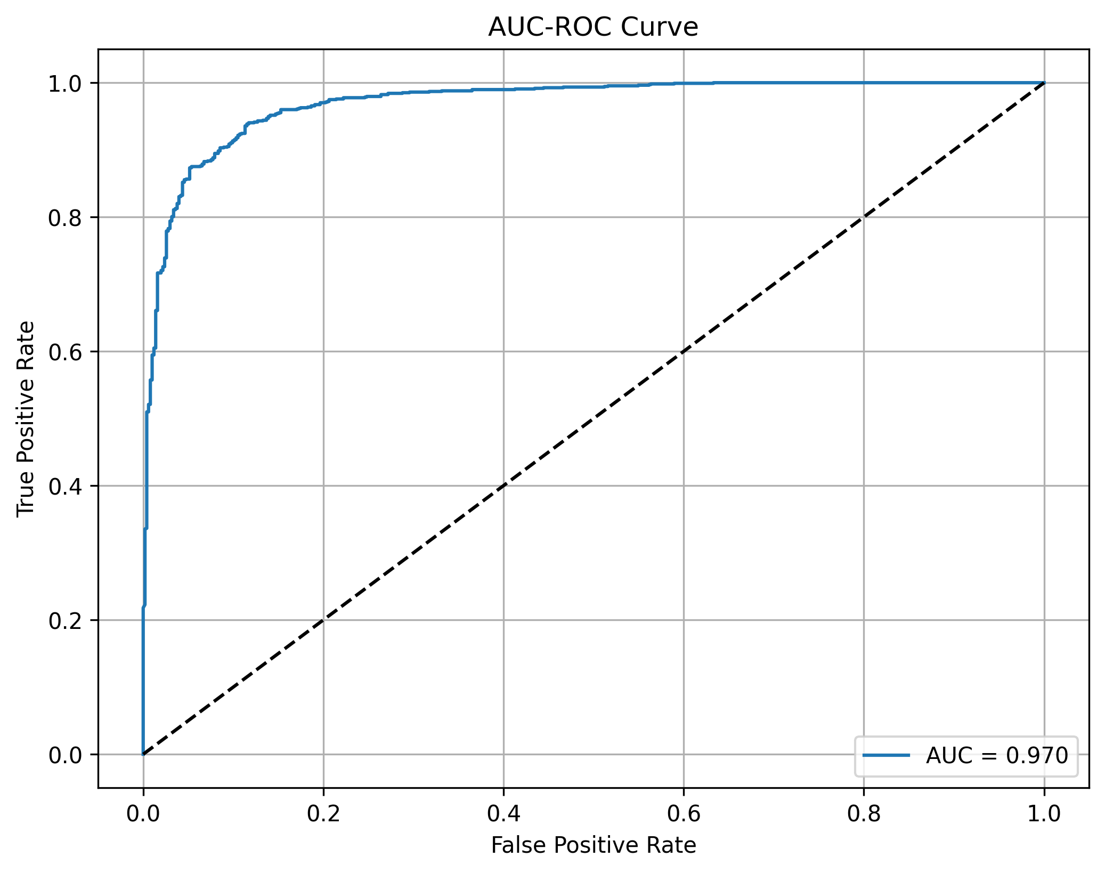
Results in Charts- ROC-AUC Curve
EfficientNetB0
EfficientNetB2
MobileNetV2
RestNet50

Slide 23
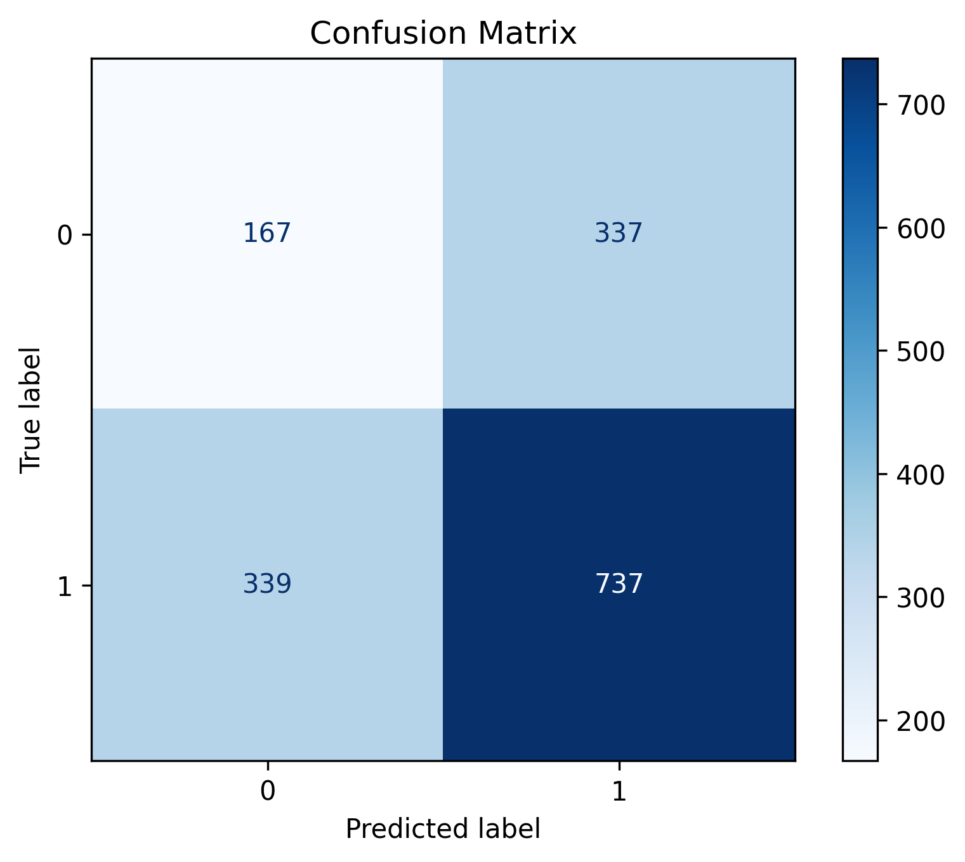
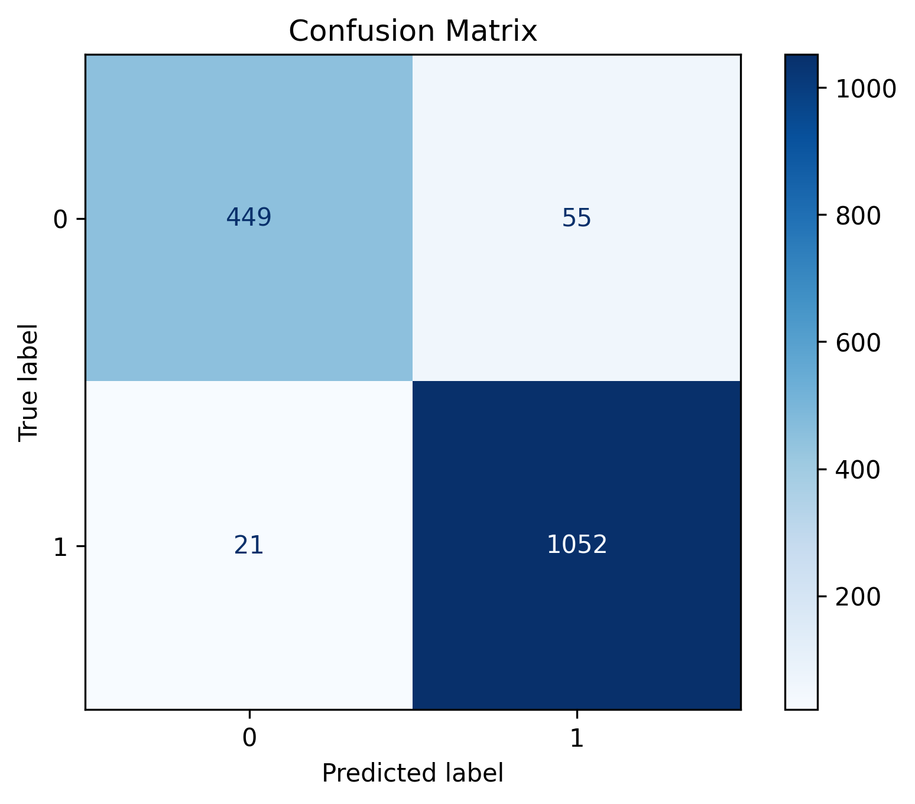
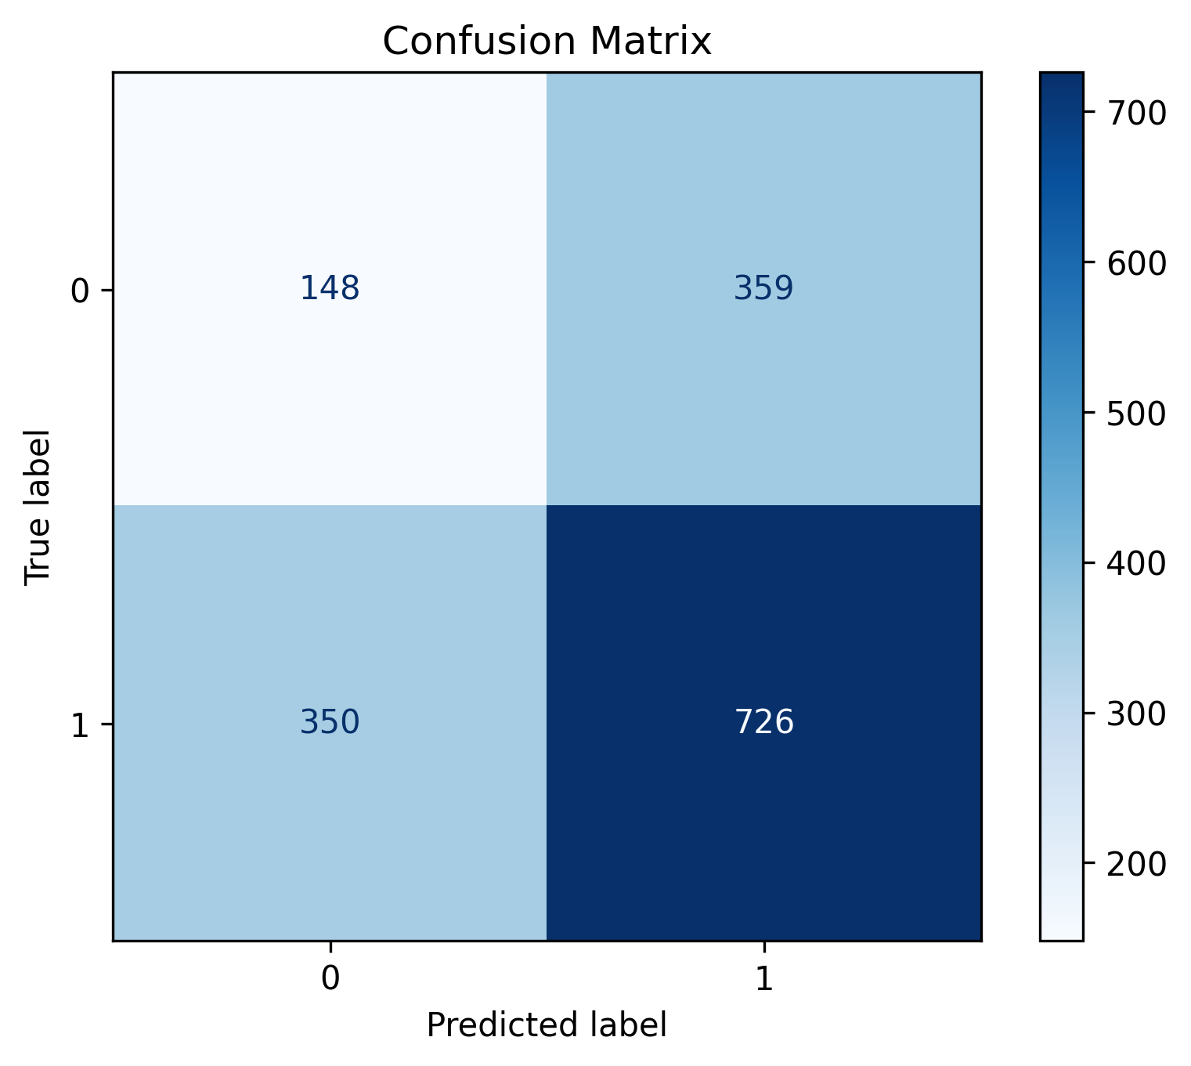
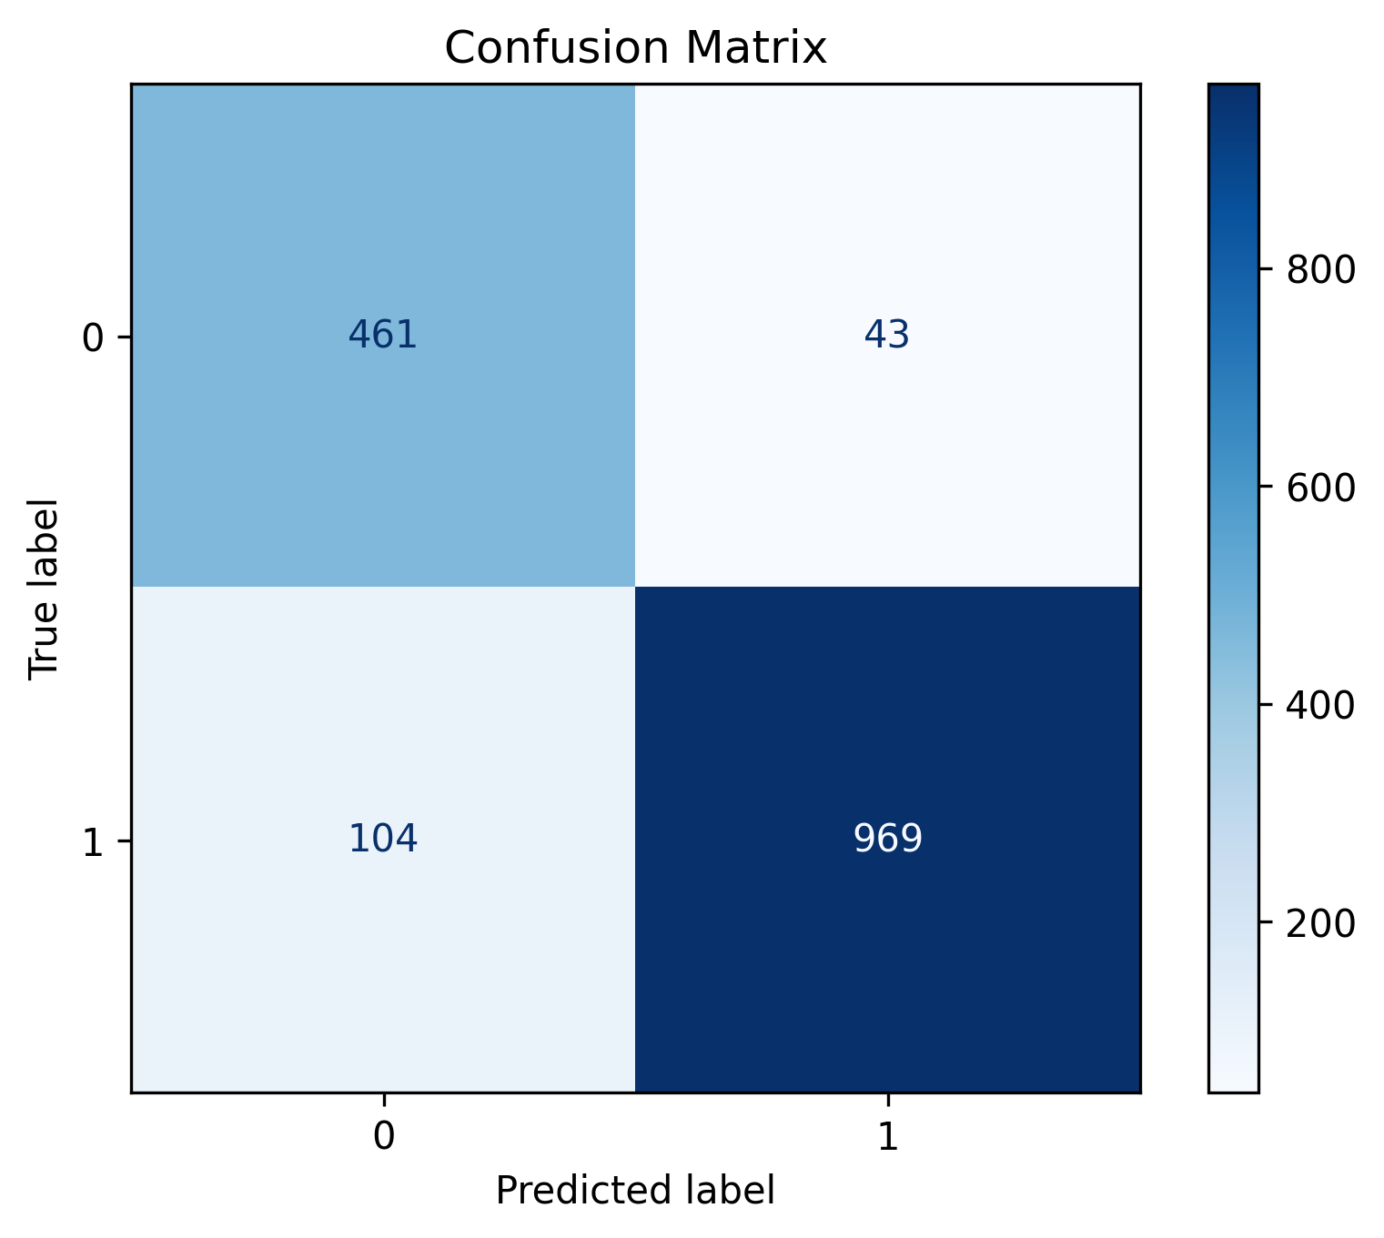
Results in Charts- Confusion Matrix
EfficientNetB0
EfficientNetB2
MobileNetV2
RestNet50

Slide 24
Ensemble Model Results

Slide 25
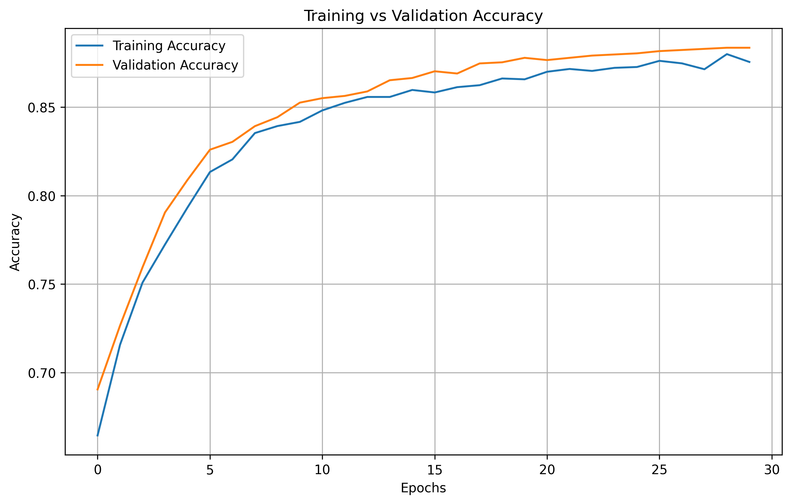
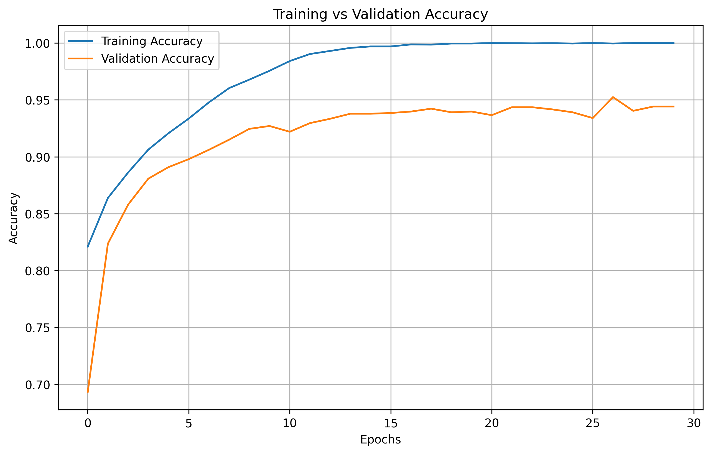
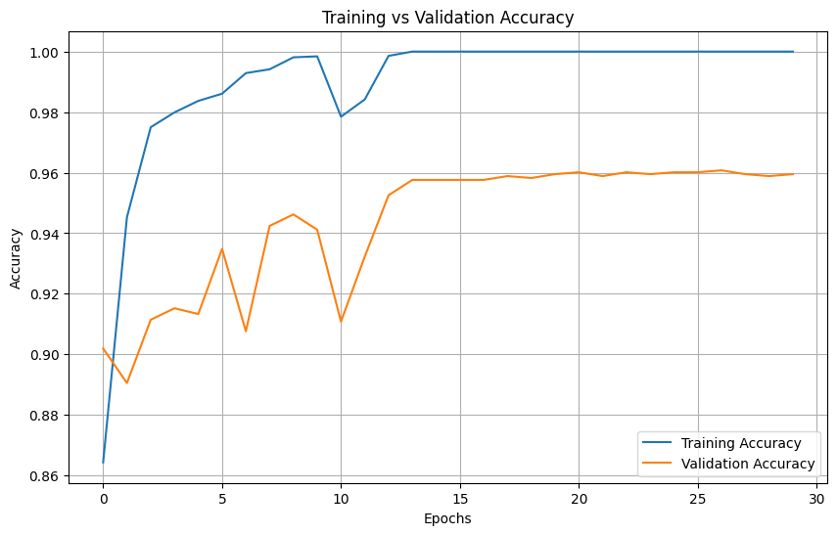
Results in Chart- Training Vs Validation Accuracy
EfficientNetB0+MobileNetV2
EfficientNetB0+MobileNetV2
EfficientNetB0+RestNet50

Slide 26
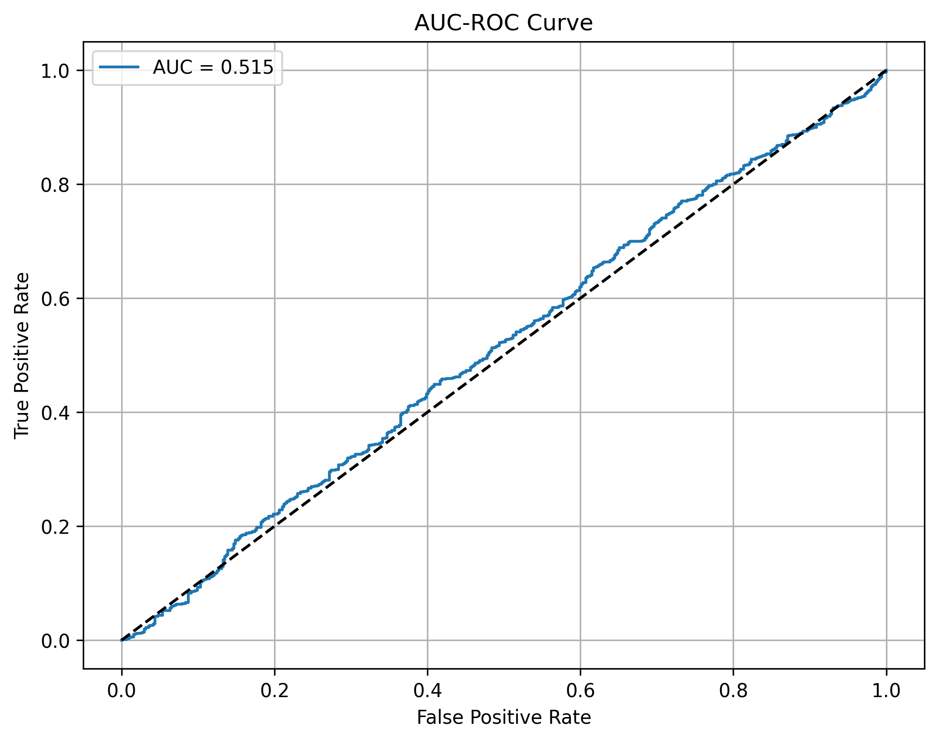
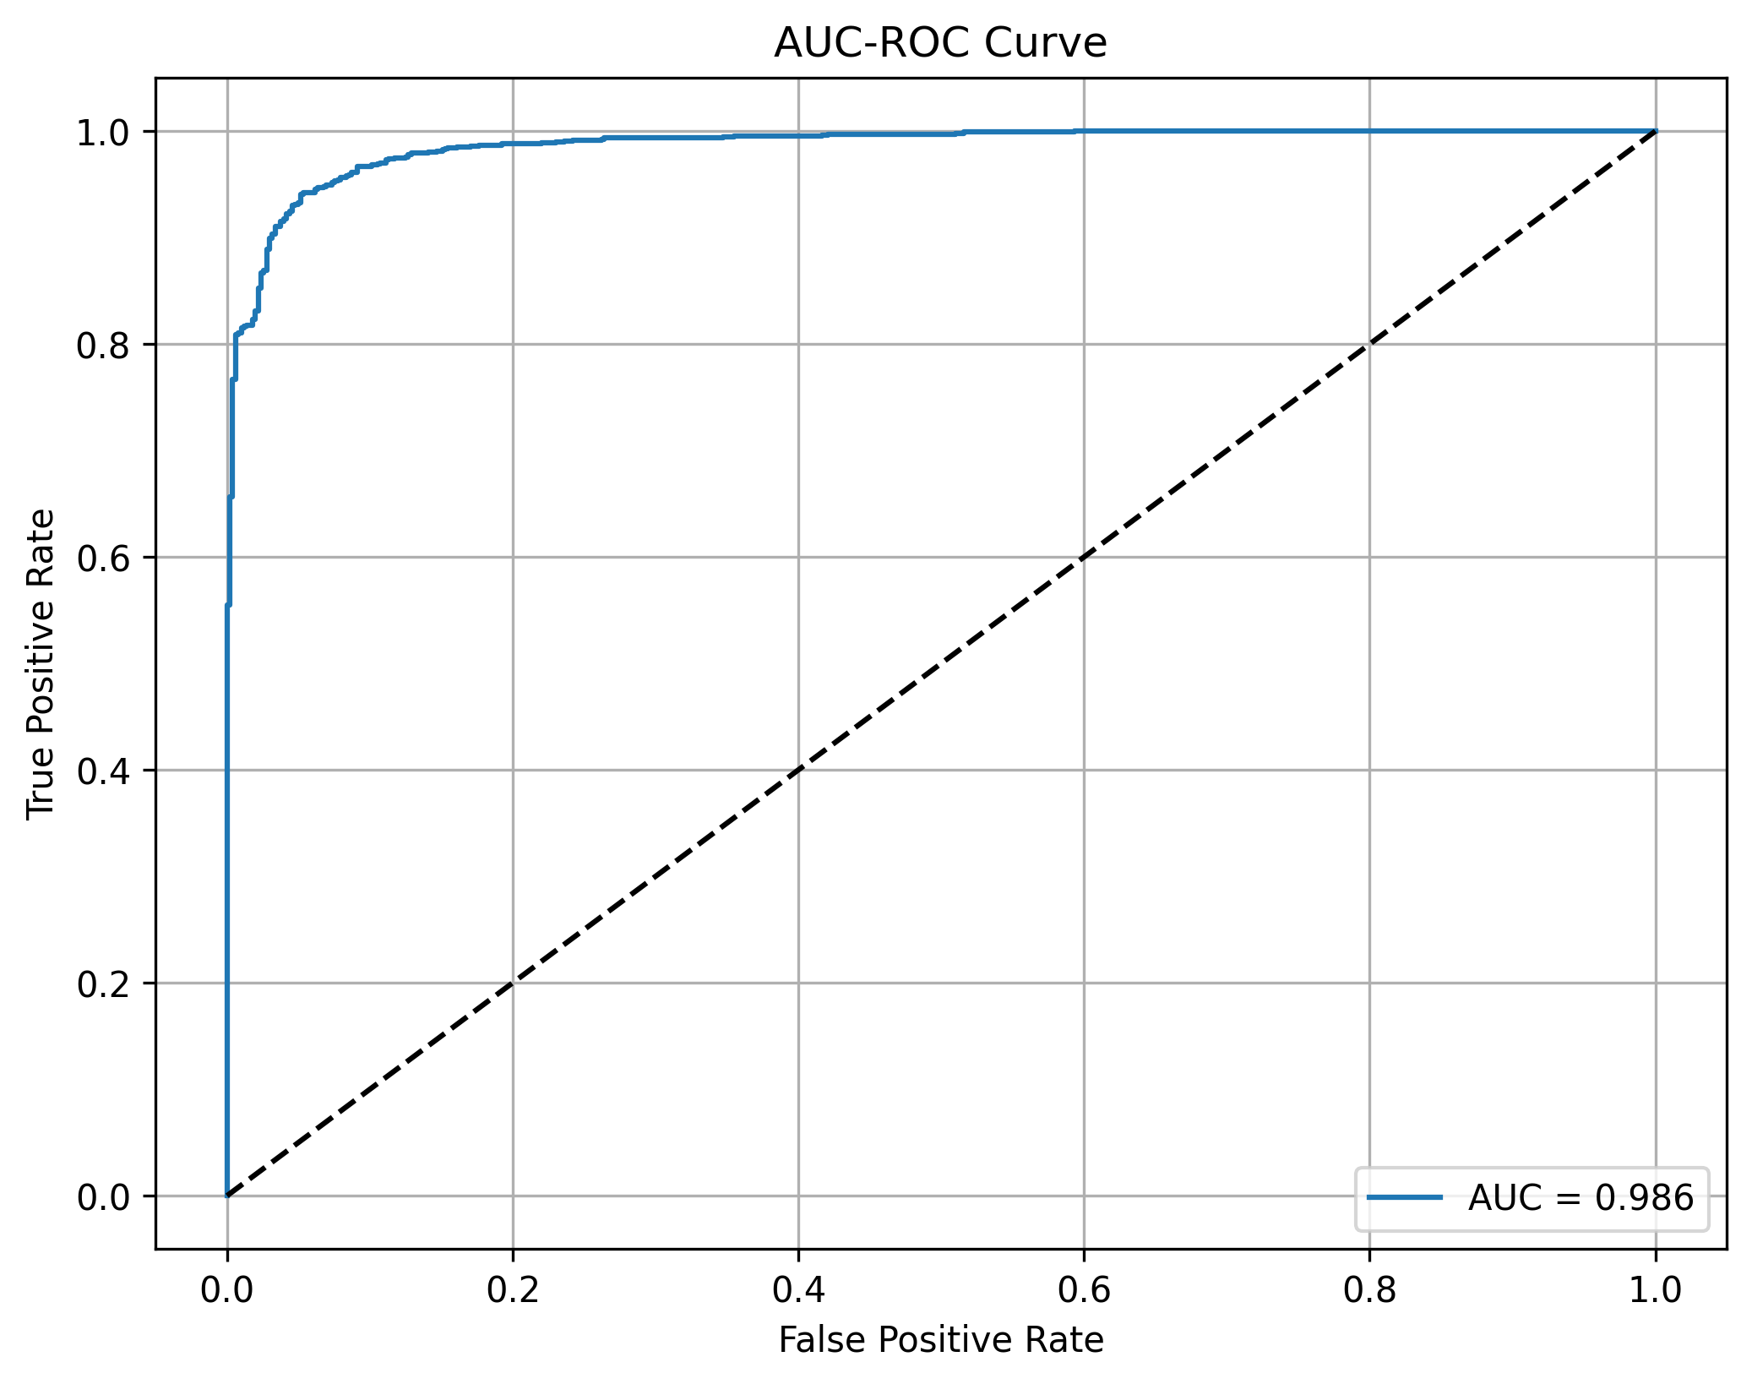
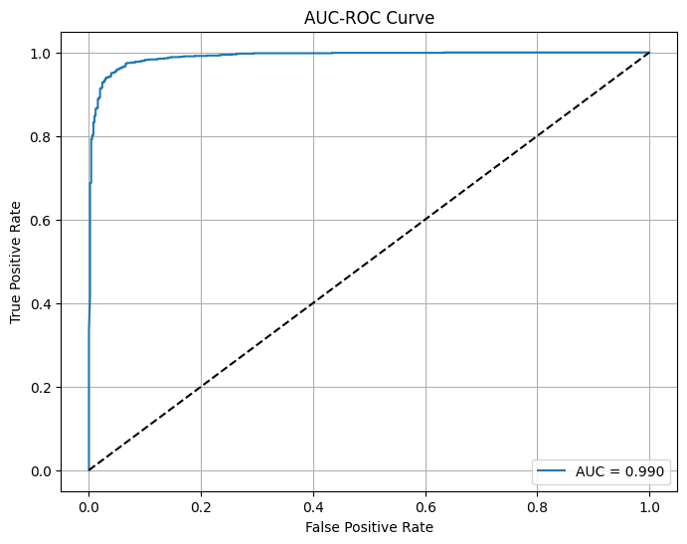
Results in Charts- ROC-AUC Curve
EfficientNetB0+MobileNetV2
EfficientNetB0+MobileNetV2
EfficientNetB0+RestNet50

Slide 27



Results in Charts- Confusion Matrix
EfficientNetB0+MobileNetV2
EfficientNetB0+RestNet50
EfficientNetB0+MobileNetV2

Slide 28
Conclusion
This study developed a deep learning framework for breast cancer detection using histopathological images. Fine-tuned models and hybrid ensembles achieved high performance, reaching up to 95.95% accuracy. The results demonstrate that the proposed approach provides reliable and robust classification suitable for real-world diagnostic use.

Slide 29
Future Work
• Expanding the study to multi-hospital datasets can strengthen model reliability across diverse populations.
• Incorporating multimodal inputs such as patient history or genomic data may improve prediction accuracy.
• Deploying the model as a user-friendly clinical application can support pathologists in routine diagnostics.

Slide 30
References
Jahan, I., Chowdhury, M.E.H., Vranic, S. et al. Deep learning and vision transformers-based framework for breast cancer and subtype identification. Neural Comput & Applic 37, 9311–9330 (2025).
Gurcan, F. (2025). Enhancing breast cancer prediction through stacking ensemble and deep learning integration. PeerJ Computer Science, 11, e2461.
Balasubramanian, A. A., Al-Heejawi, S. M. A., Singh, A., Breggia, A., Ahmad, B., Christman, R., ... & Amal, S. (2024). Ensemble deep learning-based image classification for breast cancer subtype and invasiveness diagnosis from whole slide image histopathology. Cancers, 16(12), 2222.
Ahmad, J., Akram, S., Jaffar, A., Ali, Z., Bhatti, S. M., Ahmad, A., & Rehman, S. U. (2024). Deep learning empowered breast cancer diagnosis: Advancements in detection and classification. Plos one, 19(7), e0304757.

Slide 31
References
Rahman, M. M., Jahangir, M. Z. B., Rahman, A., Akter, M., Nasim, M. A. A., Gupta, K. D., & George, R. (2024). Breast Cancer Detection and Localizing the Mass Area Using Deep Learning. Big Data and Cognitive Computing, 8(7), 80.
Abunasser, B. S., Al-Hiealy, M. R. J., Zaqout, I. S., & Abu-Naser, S. S. (2023). Convolution neural network for breast cancer detection and classification using deep learning. Asian Pacific journal of cancer prevention: APJCP, 24(2), 531.
W. Arshad et al., "Cancer Unveiled: A Deep Dive Into Breast Tumor Detection Using Cutting-Edge Deep Learning Models," in IEEE Access, vol. 11, pp. 133804-133824, 2023, doi: 10.1109/ACCESS.2023.3335604.

Slide 32
References
Khalid, A., Mehmood, A., Alabrah, A., Alkhamees, B. F., Amin, F., AlSalman, H., & Choi, G. S. (2023). Breast cancer detection and prevention using machine learning. Diagnostics, 13(19), 3113.
I. Hirra et al., "Breast Cancer Classification From Histopathological Images Using Patch-Based Deep Learning Modeling," in IEEE Access, vol. 9, pp. 24273-24287, 2021, doi: 10.1109/ACCESS.2021.3056516.
Kassis, I., Lederman, D., Ben-Arie, G., Rosenthal, M. G., Shelef, I., & Zigel, Y. (2024). Detection of breast cancer in digital breast tomosynthesis with vision transformers. Scientific Reports, 14(22149). https://doi.org/10.1038/s41598-024-72707-2

Slide 33

THANK YOU

Slide 34

Question ???

