Slide 1

Project Title - Seasonal Agriculture Performance Analysis
ASFIA FATHIMA
METHODIST COLLEGE OF ENGINEERING AND TECHNOLOGY
AICTE STU ID : STU6729ba499e1261730787913
https://github.com/Asfiashub/VOIS_internship.git
Internship ID=INTERNSHIP_17830691666a4779eecfe8a

Slide 2

PROBLEM STATEMENT
Agricultural activities are influenced by seasonal variations in environmental conditions, farming practices, resource availability and market conditions. As a result, agricultural performance may differ from one season to another. However, raw agricultural data does not clearly explain how agricultural performance changes across seasons or what patterns can be observed in different seasonal conditions. The problem is to analyze the given agricultural dataset and investigate seasonal differences in agricultural performance by identifying meaningful patterns, trends, relationships and variations within the available data.

Slide 3
Project Description This project performs an end-to-end data analytics study on a seasonal agriculture dataset containing 25 attributes across environmental, operational, production and economic categories. The workflow includes: - Data cleaning (missing values, duplicates, data type checks) - Descriptive statistical analysis - Univariate, bivariate and multivariate visual analysis - Outlier detection using IQR - Seasonal comparison of yield, profit, water usage and efficiency - Correlation analysis between environmental and performance variables

Slide 4
Project Description-contd - Evidence-based insights and recommendations for seasonal planning The dataset covers multiple states, districts and crops, allowing performance to be compared not just across seasons but across crop type and irrigation method as well. Tools used: Python, Pandas, NumPy, Matplotlib, Seaborn (Google Colab / Jupyter Notebook). No machine learning or dashboarding is involved — this is a pure exploratory data analytics project.

Slide 5

WHO ARE THE END USERS?
- Farmers and agricultural planners — to understand which season and
practices yield better returns for a given crop.
- Agricultural policy makers / government bodies — to plan seasonal
resource allocation (water, fertilizer subsidies) more effectively.
- Agribusiness and agri-input companies — to identify seasonal demand
patterns for fertilizers, irrigation equipment and seeds.
- Researchers and students — as a reference for seasonal agricultural
performance trends and data-driven decision making.
- Financial institutions / crop insurers — to assess seasonal risk and
profitability patterns when evaluating agricultural lending or insurance.

Slide 6
Technology Used
Language: Python 3
Libraries:
- Pandas — data loading, cleaning, aggregation
- NumPy — numerical operations
- Matplotlib — base plotting
- Seaborn — statistical visualizations (box plots, heatmaps, pair plots)

Slide 7
Technology Used
Environment: Google Colab / Jupyter Notebook
Techniques:
- Descriptive statistics (mean, median, std, IQR)
- Missing value & duplicate handling
- IQR-based outlier detection
- Univariate, bivariate and multivariate visualization
- Correlation analysis (heatmap)
- Groupby-based seasonal aggregation

Slide 8
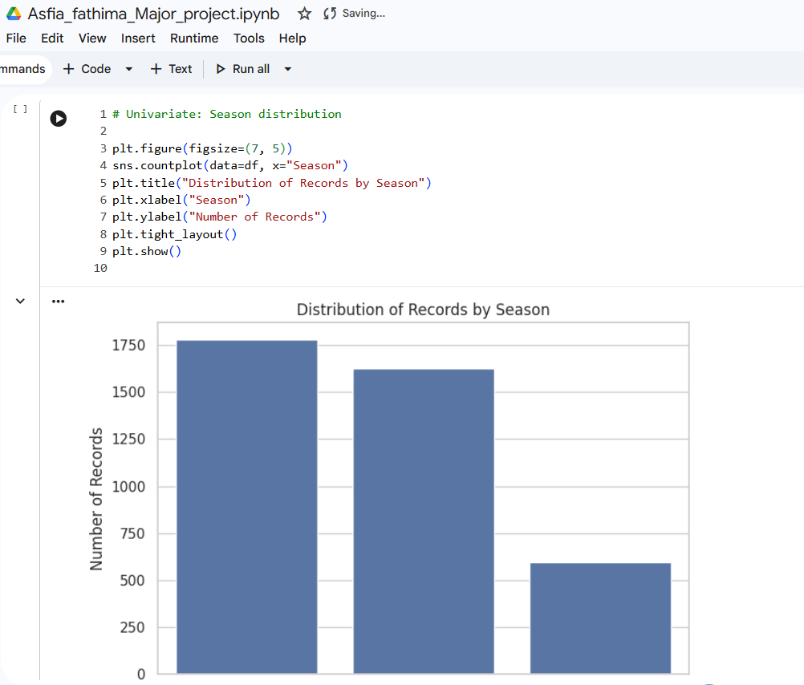
RESULTS
[Add screen shots of your code ]

Slide 9
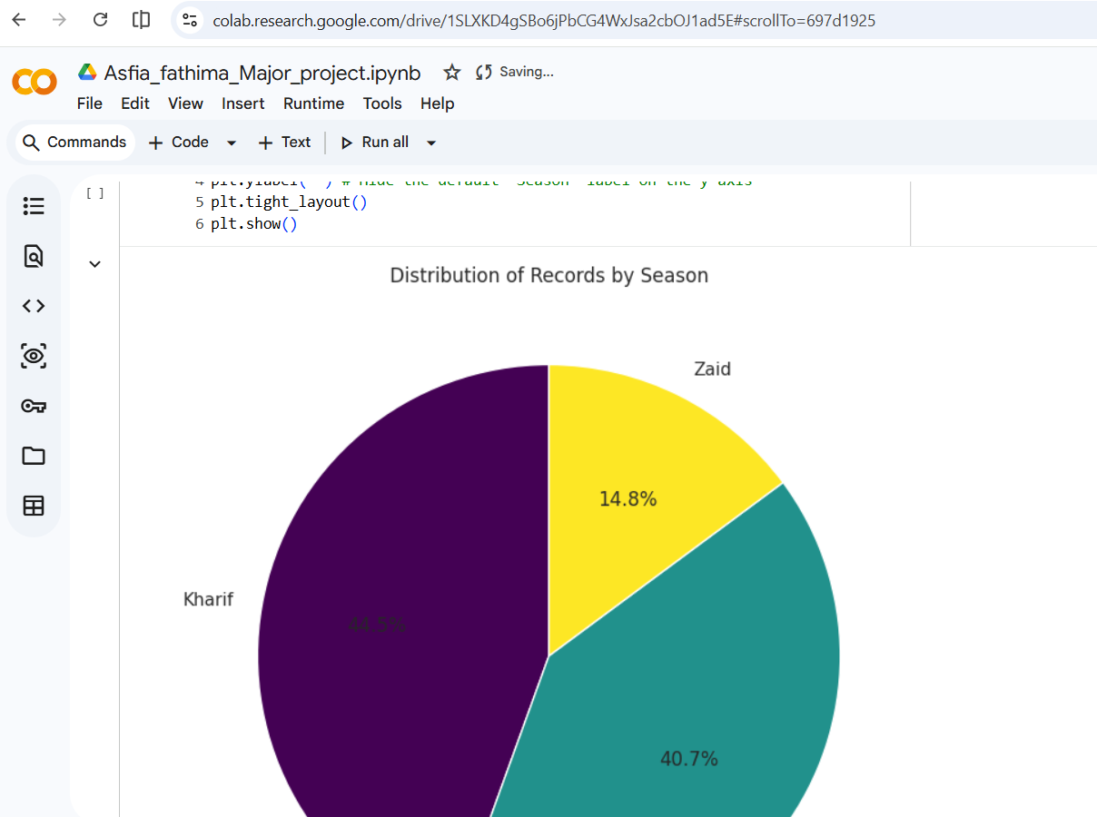
RESULTS
[Add screen shots of your code ]

Slide 10
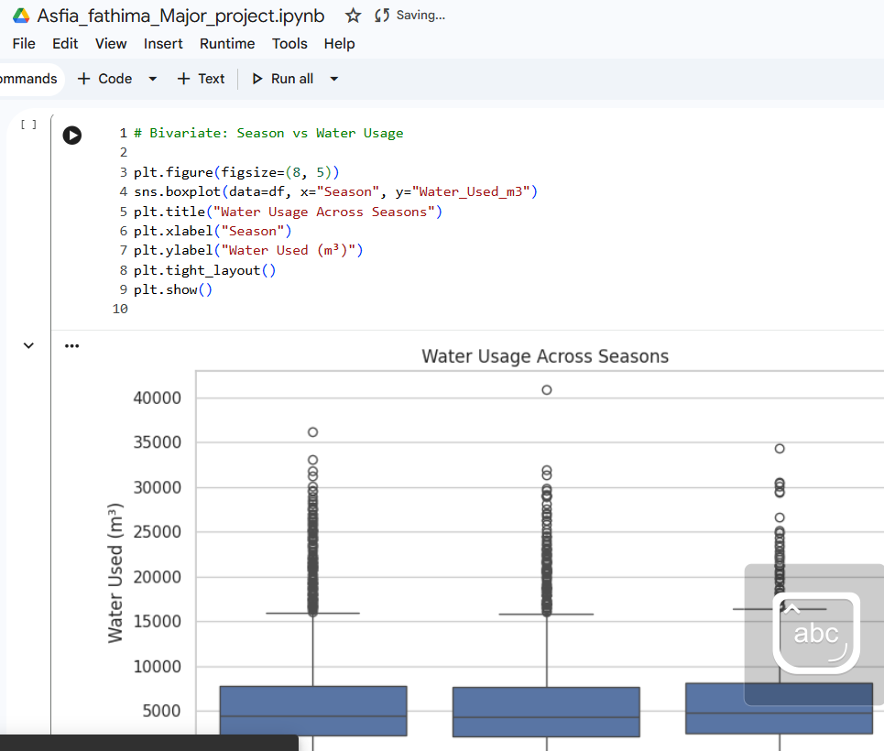
RESULTS
[Add screen shots of your code ]

Slide 11
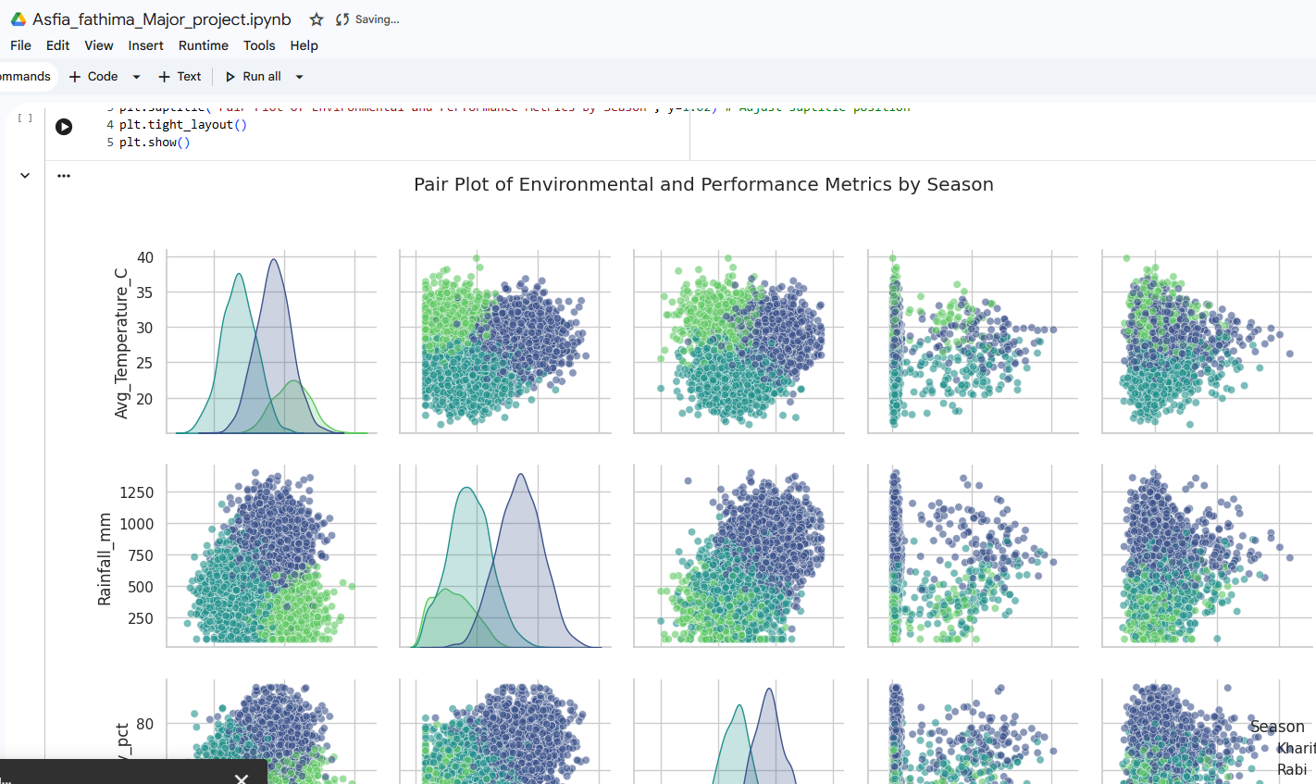
RESULTS

Slide 12
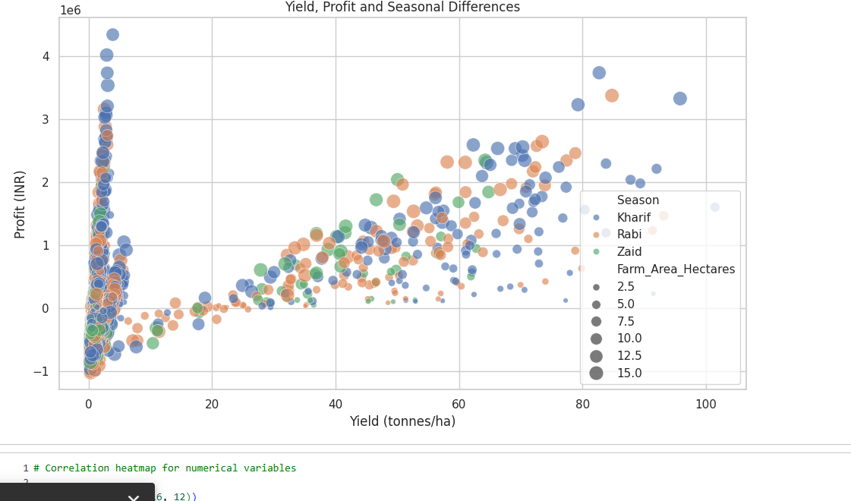
RESULTS

Slide 13
Future scope
- Extend the analysis with regional-level breakdowns once reliable
location data is available.
- Incorporate time-series data across multiple years to study
year-over-year seasonal trends rather than a single snapshot.
- Apply machine learning models (e.g. yield prediction) as a follow-up
to this descriptive analysis.
- Build an interactive dashboard (Power BI / Tableau / Streamlit) for
real-time seasonal performance monitoring.
- Integrate real-time weather and market price feeds to make the
analysis dynamic rather than static.

Slide 14
GitHub Link
Project Repository: https://github.com/Asfiashub/VOIS_internship.git
Repository includes:
- Jupyter Notebook (.ipynb)
- Dataset (.csv)
Presentation (.pptx)
Pdf

Slide 15

VOIS Course completion certificate - Course name- Data Visualization

Slide 16

Thank you
.
.
https://github.com/Asfiashub/VOIS_internship.git

