Slide 1
"The Agile Compiler Framework Simulator"
Presented By :
Asfiqul Alam Emran (231902049)
Fardin Islam (231902039)
Abdullah Al Baki Ruhin (231902057)
Presented To:
Kazi Hasnayeen Emad
Lecturer, Software Engineering
Green University of Bangladesh
Page 01

Slide 2

Agenda
Introduction
11. Challenges Faced
12. Future Work
13. Conclusion
Project Objective
Features Implemented
Lexical Analysis
Syntax Analysis
Semantic Analysis
Intermediate Code Generation
Code Optimization
Code Generation
LL(1) Parsing

Slide 3
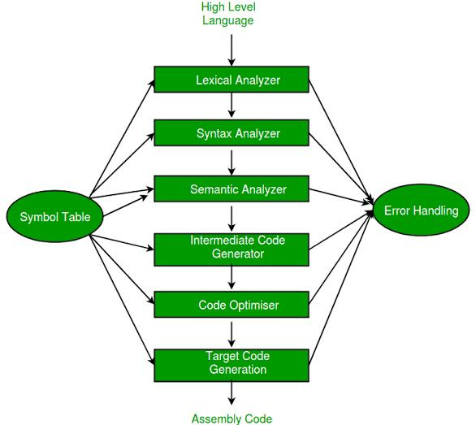
Introduction
What is a Compiler?
Project Focus
Translates high-level code to machine code
Mini-compiler implemented in C
Compilation Phases
Emphasis on key compilation stages

Slide 4
Project Objective
Understand Compiler Phases
Menu-Driven Program
Study lexical, syntax, and semantic analysis
Interactive compilation-related tasks
Code Generation
Produce intermediate and target code outputs
Page 04

Slide 5
Features Implemented
Lexical Analyzer
Syntax Analyzer
Validation & Classification
Code Generation
Token Generation
LL(1) Parsing Table
Intermediate Code
Comment Recognition
Parsing Process
String & Identifier Validation
Target Code
Operator Classification
Page 05

Slide 6
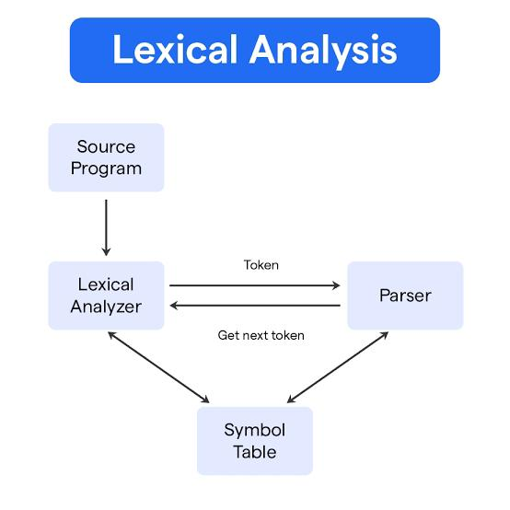



Lexical Analysis
Input
Source code in C-like syntax
Process
Recognize keywords, identifiers, operators, constants
Remove or classify comments
Tokenize input for analysis
Output
List of tokens
Page 06

Slide 7



Syntax Analysis
LL(1) Parsing
2
Use parsing table for predictive analysis
Grammar Check
1
Validate code structure and syntax rules
Validation
Check nesting, expressions, statement order
3
Page 07

Slide 8
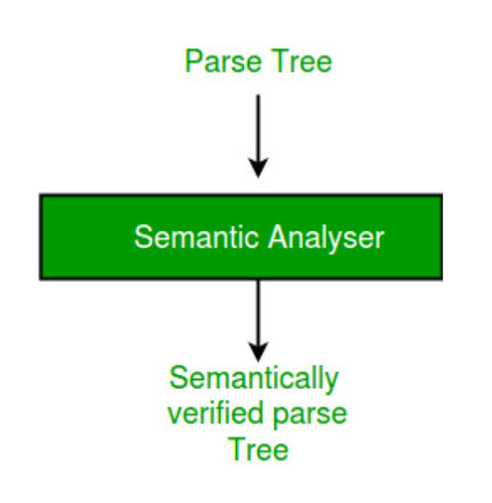
Semantic Analysis
Meaning Validation
Check correct usage of statements
Declaration Checks
Verify variables declared before use
Type Checking
Ensure logical consistency

Slide 9
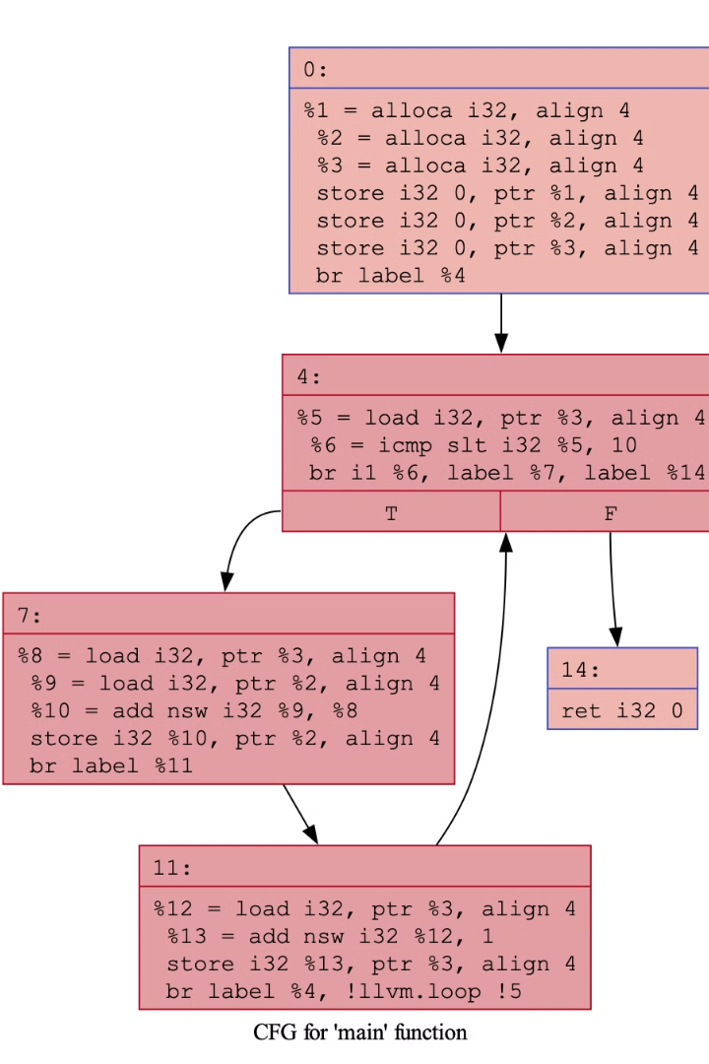
Intermediate Code Generation
Code Conversion
Example Format
From high-level to intermediate form
Uses three-address code representation
Purpose
Enables code optimization & target code generation

Slide 10
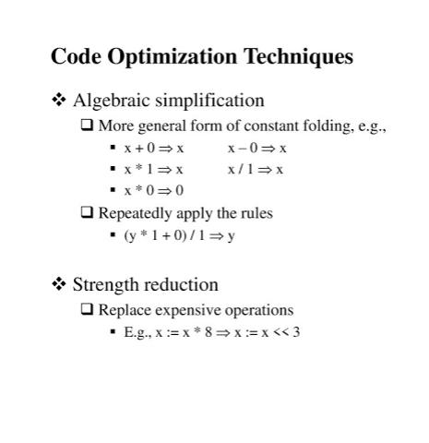
Code Optimization
Remove redundant code
Reorder operations
Minimize memory use
Improve computation
Enhances runtime efficiency and resource utilization
Page 10

Slide 11
Code Generation
~ Final code output in target language (C, Python, Java, etc.)
~ Maps intermediate instructions to actual code
~ Handles syntax conversion and formatting
Page 11

Slide 12
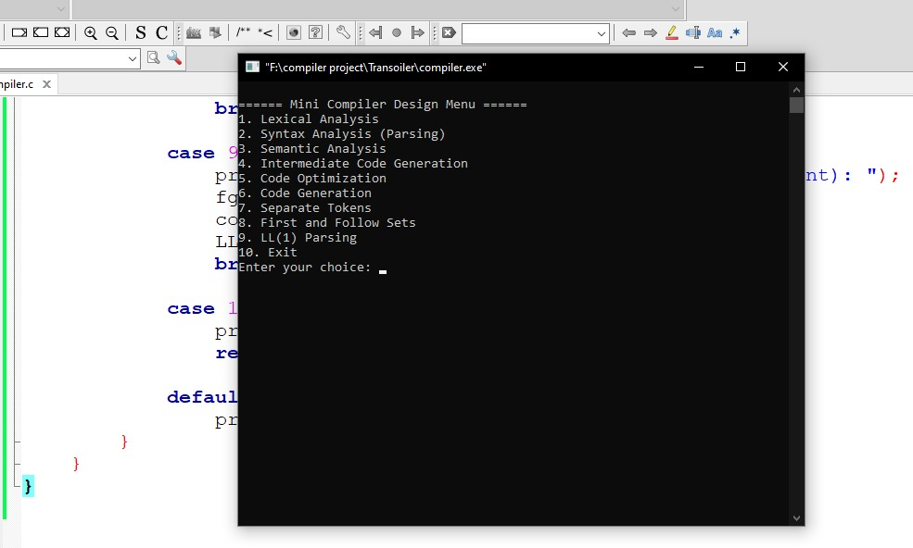
OUTPUT :

Slide 13
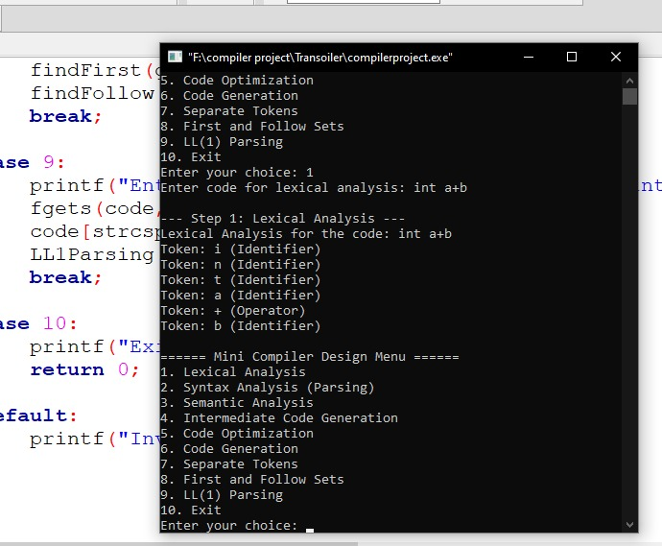

Slide 14
Challenges Faced
Managing all compiler phases in one program
Error handling in grammar
Analysis Maintaining structure across different language outputs
Page 12

Slide 15
Future Work
Add support for user-defined functions
Implement error recovery and reporting
Expand language compatibility
Integrate graphical interface (GUI)Include symbol table and full semantic checker
Page 13

Slide 16
Conclusion
Successfully implemented a basic compiler with core phases
Gained deep understanding of compilation theory
Scope for future enhancements in language features and usability
Page 14

Slide 17


