Slide 1
Design and Development of a Wall Traversing Robot for Inspection Purposes

Slide 2



Project Team
Syed Hasnain Rizvi
Hasan Rehman
Muhammad Asfandyar Durrani
Hamis Yawar
2

Slide 3
1.
OVERVIEW

Slide 4
OVERVIEW
What is a wall traversing robot?
Why do we need it?
Why are we working on it?

Slide 5
What is a wall traversing robot?
A type of mobile robot which uses different mechanisms for moving on vertical surfaces
Designed with the purpose of fulfilling tasks where surface contact is required
Inspection and surveillance of difficult places is needed at various organizations

Slide 6
Why do we need it?
Can perform tasks that a human would deem too dangerous
Can reduce a lot of manual and labor work at elevated surfaces
Inspection and surveillance of difficult places is needed at various organizations

Slide 7
Why are we working on it?
It is a field with enormous untapped potential
It requires solid innovations, critical analysis and creative thinking
Demand of multiple axis moving robot is high and it is a good prospect for start up

Slide 8
PROBLEM STATEMENT
Objective
The aim is to develop a four wheeled mobile robot that is capable of traversing on a vertical surface in any direction, according to user instructions or autonomously.
Mobility
Versatility
Stability

Slide 9

Proposed Methodology
Electronics
Design
Locomotion
Negative Thrust
Kinematics Analysis
Path Planning
Mechanical Design
Remote Control

Slide 10
2.
ELECTRICAL DESIGN

Slide 11
Electrical
To supply power to the whole robot
Locomotion & wall clinging mechanisms of the robot
Manual path trajectory and motion planned trajectory
Feedback from sensors

Slide 12
Control Diagram
Battery
Actuators
Raspberry Pi
Motor Driver
ESC
NodeMCU
Gear Motor
Camera
EDF
Receiver

Slide 13
Negative Thrust
The base concept of Negative Thrust is to create a partial vacuum while sucking the air
AN EDF along with a motor will be fitted at the center of the robot
This will create a negative thrust and keep the robot connected to the wall

Slide 14
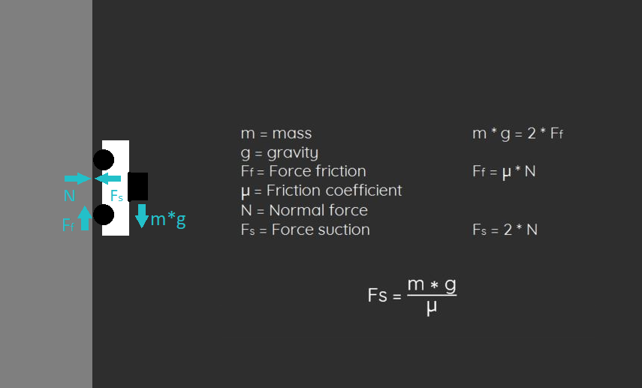

Slide 15
1226
Deaths in construction places in 2006

Slide 16
1226
806
66%
Deaths in construction places
Falling from raised structures
Huge majority

Slide 17
Kinematic Motion
We are making a 4 wheeled robot with each wheel having a hub mounted motor
All the motors have independent motion from each other, but the collective motion drives the robot
Based on this, we will use the differential wheel turning method to steer our robot

Slide 19
Positioning
An accelerometer is a sensor that measures the acceleration.
Double integration of the measured acceleration will give us the displacement.
The displacement will always let the MCU know the exact location of the wall traversing robot in XYZ plane.

Slide 20
Battery
To supply power to the EDF, MC & Raspberry Pi
Careful consideration with weight to energy ratio as to provide consideration working time

Slide 21
Controller
To control the basic functions and EDF of the robot
To calculate the position and orientation using data from sensors
To communicate with Processor

Slide 22
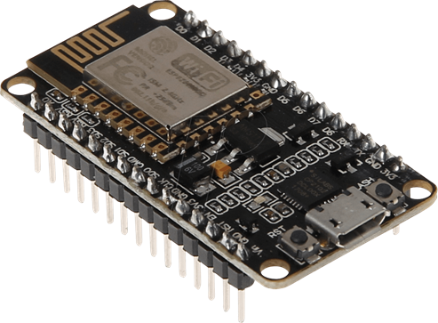
NodeMCU
Has a SoC Wi-Fi ESP8266
Has a higher RAM and flash memory
Programming similar to Arduino

Slide 23
NodeMCU Specifications
Operating Voltage | 3.3 V
Input Voltage | 7-12V
Current Consumption | 10uA~170mA
Flash Memory | 4 MB
Wi-Fi | IEEE 802.11 b/g/n
Microprocessor | Tensilica 32-bit RISC CPU Xtensa LX106
Clock Speed | 80MHz
SRAM | 64 KB
GPIOs | 17 (multiplexed with other functions)
UART/I2C/SPI | 1 Each

Slide 24
Type of Control
Manual Control
Uses esp8266 to connect to a web server
Create an online interface
Control using any web browser
Motion Planning
Uses processing ide
Create an interface
User friendly

Slide 25
3.
MECHANICAL DESIGN

Slide 26
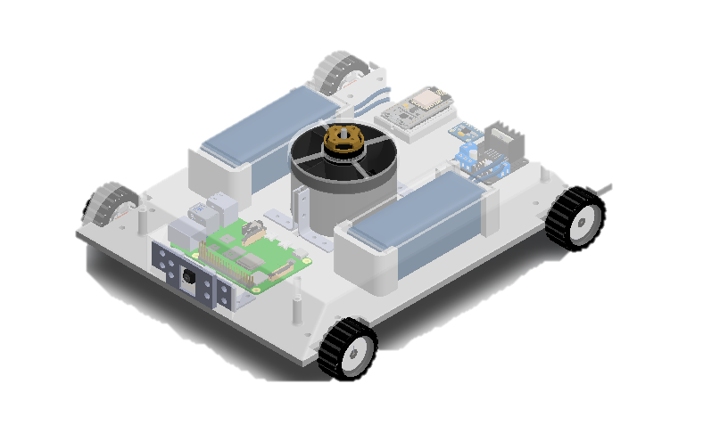

Slide 27
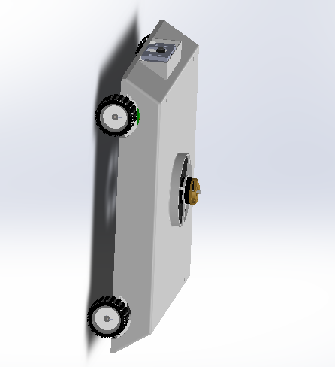
Mechanical Design
Modular Design
CG Balanced
Compact and Durable Structure
Nylon Nuts for Damping
Aerodynamic Symmetric Structure

Slide 28
Applications
Surveillance
Inspection on elevated surfaces, nuclear sites, etc.
Pattern Drawing
Painting and sketching on walls, ships, etc.
Fire Rescue
Ability to traverse in locations where human activity is dangerous
Cleaning
Cleaning of high rise buildings
Videography
Capturing photos and videos from complicated and wide angles

