Slide 1
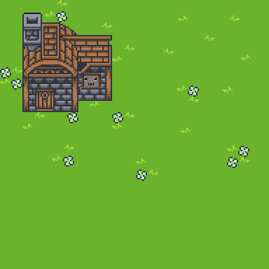

2021-9-4
house
cat
“house cat”
Credit: scofanogd and Angel

Slide 2
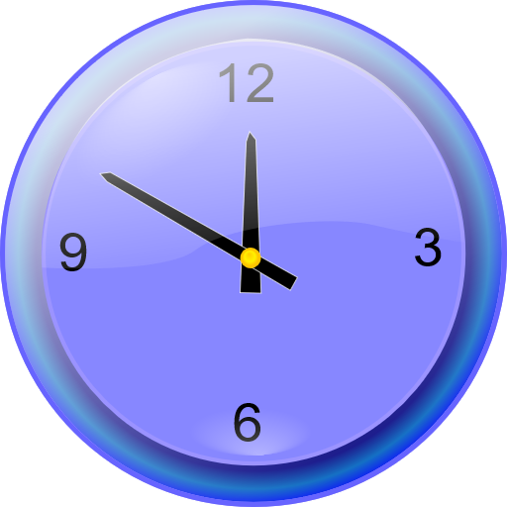
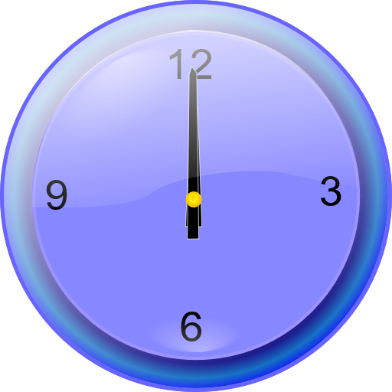
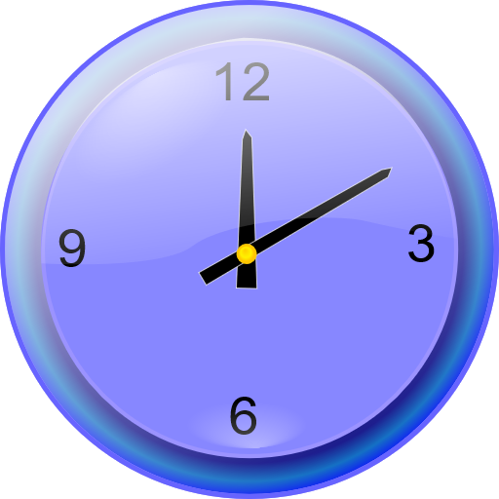



2021-9-4
Past
Present
Future
Action
Credit: AntumDeluge https://opengameart.org/node/98592
Credit: cinameng https://opengameart.org/content/cardboard-box-0
Credit: bart https://opengameart.org/content/man

Slide 3
ano
ase
2021-9-8
Uncertain identity
(a/an)
__·kia
Shared referent
(the)
i
su
katu
(TBD)
Speaker
(me)
Listener
(you)
Near to
Speaker
(this)
Near to
Listener
(that)
ta
kua
kona
?
?
3rd party
That one over there
Which one?
Is it one?

