Slide 1



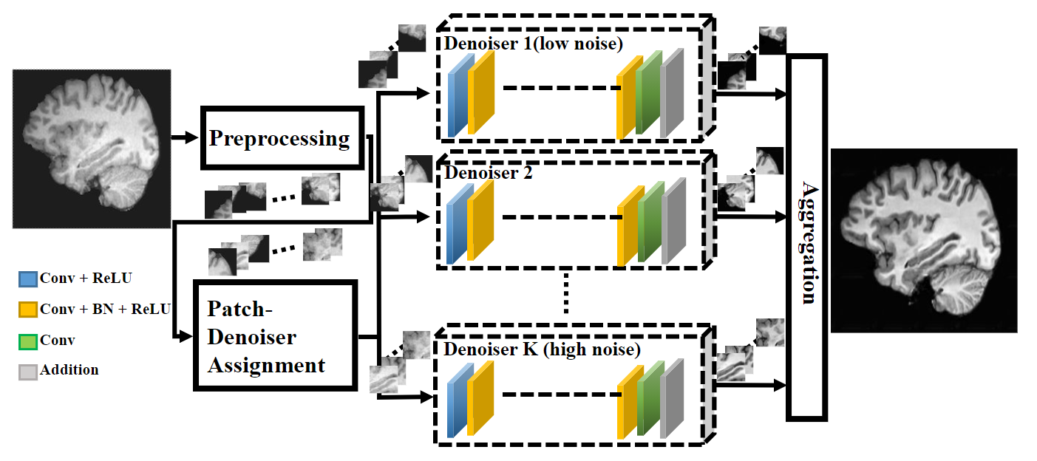
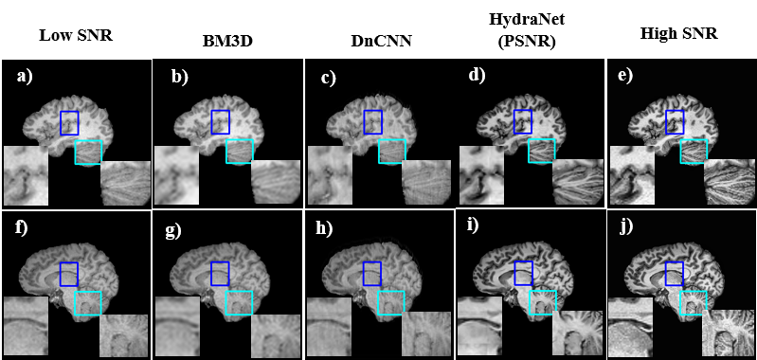
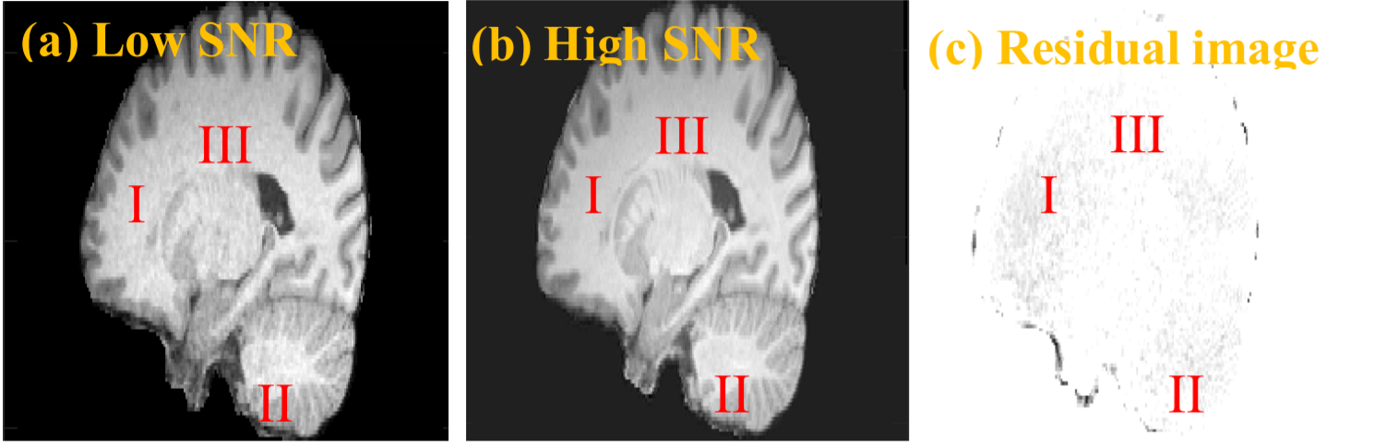
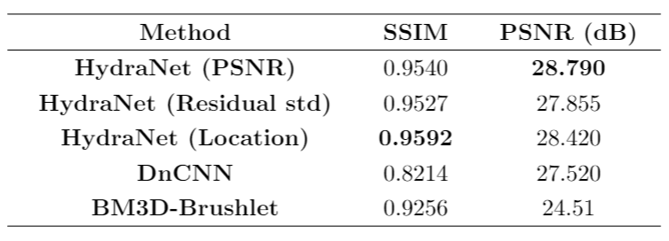
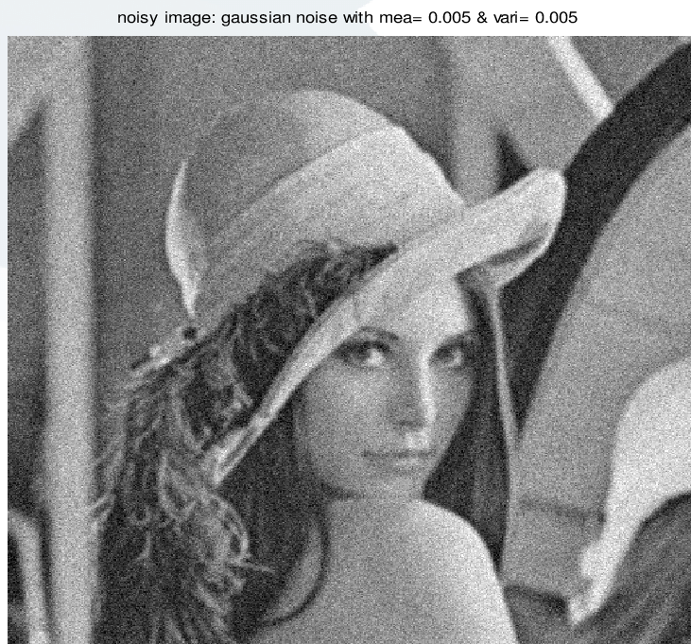
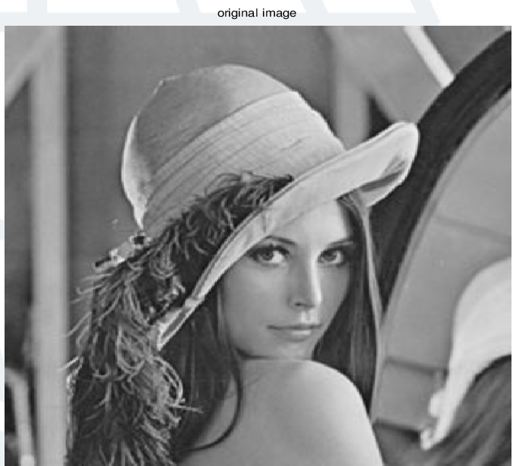
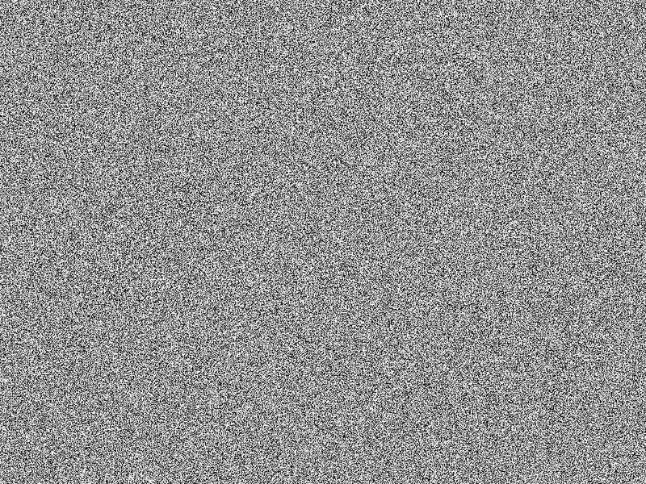
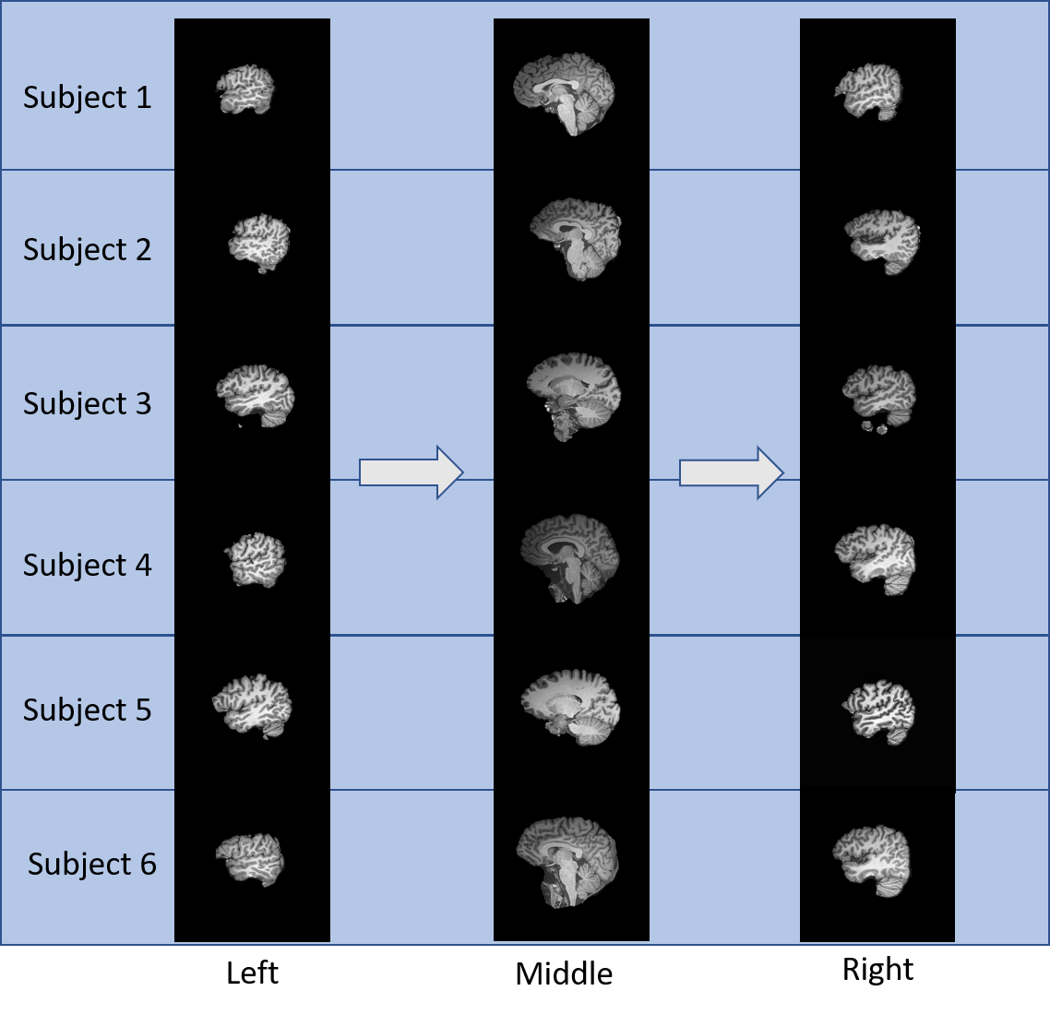
HydraNet – A Multi-branch Convolutional Neural Network Architecture for MRI Denoising Stephen Gregoryª, Hu Cheng^{b}, Sharlene Newman^{c} , Yu Gan^{d}
ªDepartment of Computer Science, The University of Alabama | ^{b}Department of Psychological and Brain Sciences, Indiana University, Bloomington |
^{c}Department of Psychology, The University of Alabama | ^{d}Department of Electrical and Computer Engineering, The University of Alabama
INTRODUCTION
METHODS
RESULTS
MRI scans => expensive. High quality MRI scans are even more expensive.
HydraNet can save time and money, and help doctors make better diagnoses
HydraNet uses multi-branch architecture to denoise images
HydraNet increases quality of brain scans at no cost to MRI technicians
HydraNet consists of n denoiser networks
Each denoiser => DnCNN [1]
Denoisers specialize for specific noise characteristics
Run-time => volumes split into slices, further split into patches, passed to denoisers via estimated noise
3 HydraNet experiments compared with DnCNN [1] and BM3D [2] on 2 MRI subjects
Superior qualitatively (Fig. 5) & quantitatively (Fig. 6)
Shown in (Fig. 5), HydraNet learns to simultaneously denoise the highly complex teal regions and the simpler blue regions with comparable efficacy
HydraNet addresses the fundamental issue of denoising medical images, which are much more difficult to predict and denoise than natural images.
Fig. 3: HydraNet Architecture
PSNR = 24.51
SSIM = 0.9256
PSNR = 27.52
SSIM = 0.8214
PSNR = 28.79
SSIM = 0.9540
We experiment with 3 estimates of noise characteristics:
1. Peak Signal to Noise Ratio (High PSNR ≈ High Noise)
2. Residual Standard Deviation (High σ ≈ High Noise)
3. Slice Location (Fig. 4) (Similar Regions ≈ Similar Noise)
Fig. 5: Denoising Results for sample MRI slices from each of BM3D, DnCNN, and HydraNet
Fig. 1: Residual between low SNR and high SNR MRI scans
(a) Low SNR
(a) High SNR
(c) Residual image
Fig. 6: Quantitative Results for BM3D, DnCNN, and HydraNet
Fig. 2: Residual between low SNR and high SNR Natural Images
CONCLUSIONS
The noise distribution from MRI images (Fig. 1) is not uniform, in contrast to natural images (Fig. 2). This makes them harder to denoise.
HydraNet takes a promising step towards effective denoising of medical images
Providing real noisy data is essential for training/evaluating deep-learning-based denoisers.
More work is needed to establish metrics for evaluating noise in both natural and medical images
Existing Deep Learning Methods are trained by adding Additive white Gaussian noise (AWGN) to clear images and attempting to recover the original images.
This process breaks down for medical images,
Noise distribution in MRI is not Gaussian, not spatially invariant.
Noise can’t be predicted or duplicated by synthetic addition
HydraNet is trained with real noise to overcome this issue.
Fig. 4: Sample slices from left, middle, and right portions of each MRI subject, showcasing qualitative correlation between regions
In future work, we plan to generalize HydraNet to a 3-dimensional architecture with 3D Convolutions for faster training, inference, and superior results.
Hypotheses:
1. Multiple specialized denoisers can perform better than a single general denoiser
2. Real noise in training data produces better models
3. Good metrics are used to predict noise characteristics
REFERENCES
Zhang, K. et. al. IEEE TIP 26(7), 3142–3155 (2017)
Ahn, B, arxiv: 1704.00524, 2017
Hor ́e, A. et. al. ICPR, 2366–2369 (2010).
Zhou, W., et. al. IEEE TIP 13(4), 600–612 (2004)
ªDepartment of Computer Science, The University of Alabama | ^{b}Department of Psychological and Brain Sciences, Indiana University, Bloomington |
^{c}Department of Psychology, The University of Alabama | ^{d}Department of Electrical and Computer Engineering, The University of Alabama

