Slide 1

Elimination of epsilon production with GUI
- by,
M. Charanjeeth Kumar (RA2111026010082)
M. Ashraf (RA2111026010091)
M. Poorna Pradeep Reddy(RA2111026010094)
Subject Name: Formal Language and Automata
Faculty Name : Mrs. J. Jayasudha
Subject Code: 18CSE301T

Slide 2
Objective of Elimination of epsilon production with GUI
The objective of elimination of epsilon production with GUI is to provide a user-friendly interface for users to eliminate
epsilon productions from context-free grammars (CFGs). Epsilon productions are productions that produce the empty
string, and they can make CFGs more difficult to parse. By eliminating epsilon productions, one can make CFGs more
efficient and easier to understand.
The GUI for epsilon production elimination should provide the following features:
The ability to display the CFG in a user-friendly way.
The ability to identify epsilon productions in the CFG. The ability to load a CFG from a file.
The ability to eliminate epsilon productions from the CFG. The ability to save the modified CFG to a file.
The GUI should also be easy to use and navigate. It should be designed to be accessible to users with a variety of skill
levels, from beginners to experts.
Here are some specific examples of how the GUI could be used to eliminate epsilon productions:
The user could load a CFG from a file. The GUI could then display the CFG in a user-friendly way, such as by using a tree
structure or a table.
The user could then identify epsilon productions in the CFG by looking for productions that produce the empty string.
The user could then eliminate epsilon productions from the CFG by using the GUI to remove them from the grammar.
The user could then save the modified CFG to a file.
By providing a user-friendly GUI for epsilon production elimination, one can make it easier for users to improve the
efficiency and readability of their context-free grammars.

Slide 3
Application Elimination of epsilon production with GUI
The elimination of epsilon production with GUI can be applied in a variety of fields, including:
Compiler design: Compilers use CFGs to parse the source code of a program. By eliminating epsilon
productions from the CFG, compilers can be made more efficient and easier to develop.
Natural language processing: NLP applications use CFGs to model the syntax of language. By eliminating
epsilon productions from the CFG, NLP applications can be made more accurate and efficient.
Machine learning: CFGs can be used to represent a variety of machine learning models, such as decision trees
and hidden Markov models. By eliminating epsilon productions from the CFG, machine learning models can
be made more efficient and easier to understand.
Here is a specific example of how the elimination of epsilon production with GUI could be used in the field of
compiler design:
A compiler developer is working on a compiler for a new programming language. The compiler uses a CFG to
parse the source code of programs in the new language. However, the CFG contains a number of epsilon
productions. This is making the compiler difficult to develop and inefficient.
The compiler developer can use a GUI for epsilon production elimination to remove the epsilon productions from
the CFG. Once the epsilon productions have been removed, the compiler will be more efficient and easier to
develop.

Slide 4
Explanation :
The elimination of epsilon production with GUI is a process of removing epsilon productions from a context-free grammar (CFG) using a graphical user interface (GUI). Epsilon productions are productions that produce the empty string, and they can make CFGs more difficult to parse. By eliminating epsilon productions, one can make CFGs more efficient and easier to understand.
Here is a step-by-step explanation of how to use a GUI for epsilon production elimination:
Load the CFG from a file.
Identify the epsilon productions in the CFG.
Eliminate the epsilon productions from the CFG.
Save the modified CFG to a file.

Slide 5
Identifying epsilon productions:
An epsilon production is a production that produces the empty string. For example, the following production is an epsilon production:
A -> ε
This production means that the non-terminal symbol A can produce the empty string.
To identify epsilon productions in a CFG, you can use the following algorithm:
Create a set of epsilon productions, and initialize it to the empty set.
Iterate over all productions in the CFG.
For each production, check if the right-hand side of the production is the empty string.
If the right-hand side of the production is the empty string, add the production to the set of epsilon productions.
Repeat steps 2-4 until no new epsilon productions are added to the set.
Eliminating epsilon productions:
There are a number of algorithms for eliminating epsilon productions from a CFG. One common algorithm is to use the following steps:
Create a new start symbol for the CFG.
For each production that produces the empty string, replace the production with a production that produces the new start symbol.
Remove all epsilon productions from the CFG.
For each production that produces the new start symbol, find all productions that produce the right-hand side of the production.
For each production that is found, replace the production with a production that produces the left-hand side of the production.
Repeat steps 4-5 until there are no more productions that produce the new start symbol.
Remove the new start symbol from the CFG.

Slide 6
Contribution
Charan - Developed code for elimination of epsilon from given cfg
Ashraf - Using the given code Gui has been developed
Poorna - Report has been done according to given format

Slide 7
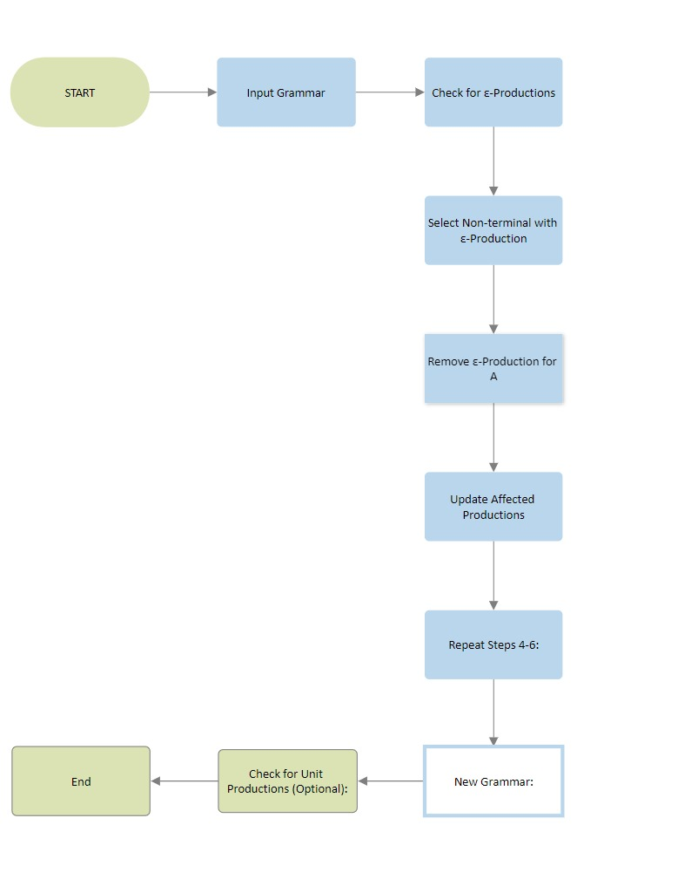
Flow chart :

Slide 8
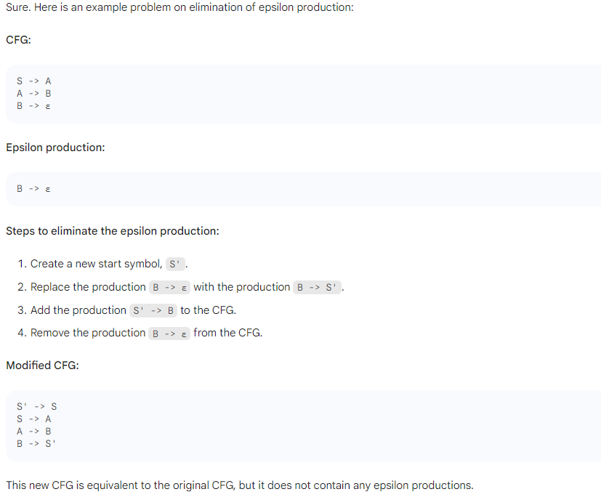
Example problem:

Slide 9
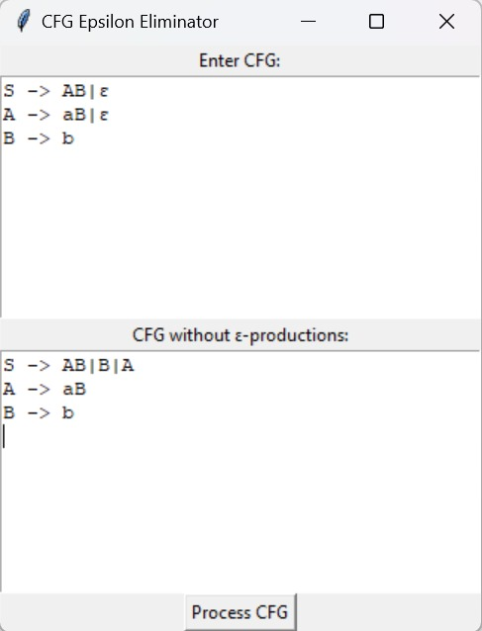

Slide 10
Conclusion :
The elimination of epsilon production with GUI is a valuable tool that can be used to make CFGs more efficient and easier to understand. A GUI for epsilon production elimination can provide a user with a number of features that can make the process of eliminating epsilon productions easier and more accurate.

