Slide 1
JavaScript Hackathon 2020 Quarantine-Entertainment

Slide 2
Featuring:
Trivia
Bucket Lists
Cocktails
Games
Insults
Kitten
Judgement on your age
Interactive Background

Slide 3
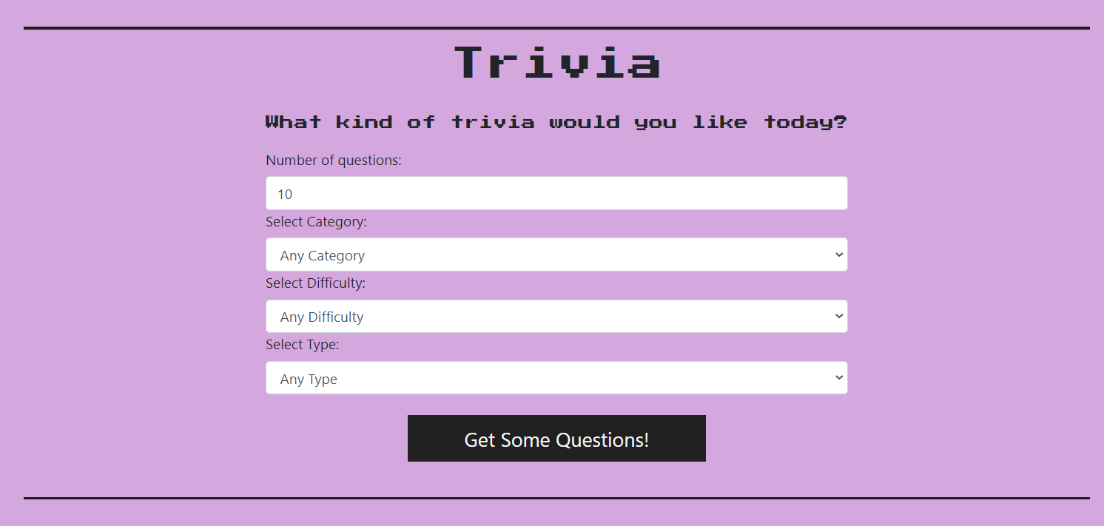
Utilises the Open Trivia Database API - https://opentdb.com/api_config.php
User can select from a number of different options on the form to decide on the types of questions they want
The user receives a list of trivia questions that they can use to host a trivia game.
If any options aren’t changed they will default to anything from that option

Slide 4
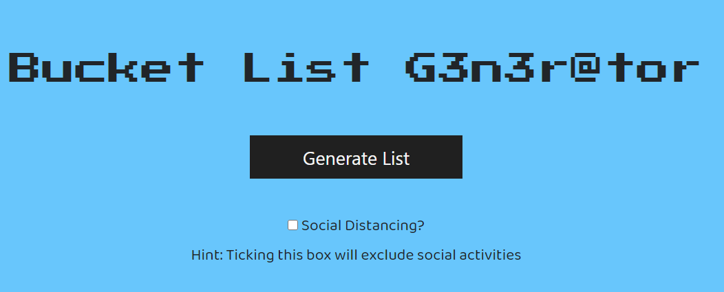
Utilises the Bored API - https://www.boredapi.com/
Generates 10 activities that the user can try out
If the user is stuck in quarantine and not allowed out then they can select the social distancing option to exclude social activities

Slide 5
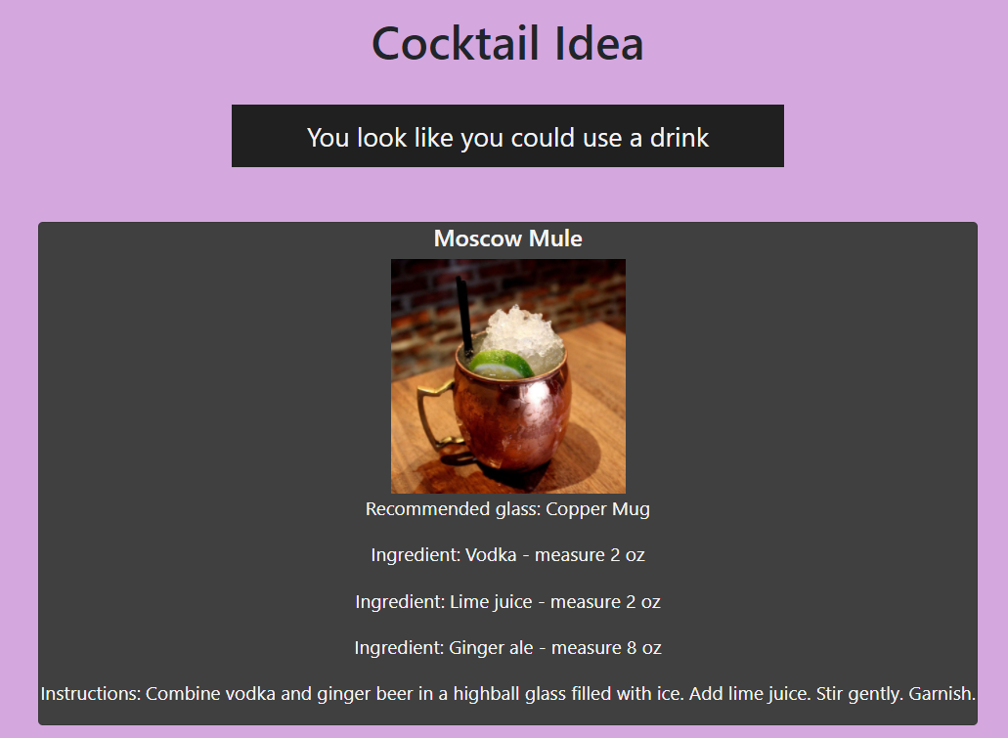
Utilises the CocktailDB API - https://www.thecocktaildb.com/api.php
Generates a drink for the user to make
The drink will show all ingredients and how much is required for each ingredients.
Instructions are shown below.
As the drinks are alcoholic a popup comes up when clicking on the page, if the user says they are underage they’re redirected back to the homepage.

Slide 6
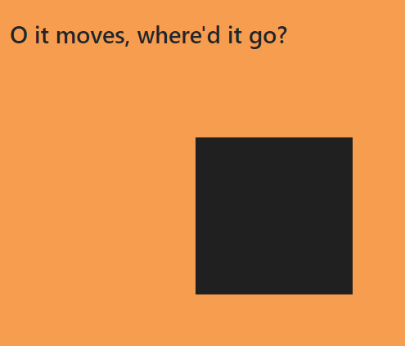

Using JavaScript when the box is clicked an event is triggered to move the box and make it smaller.
The move can go outside the standard view height and width so the user might need to scroll to find the box.

Slide 7
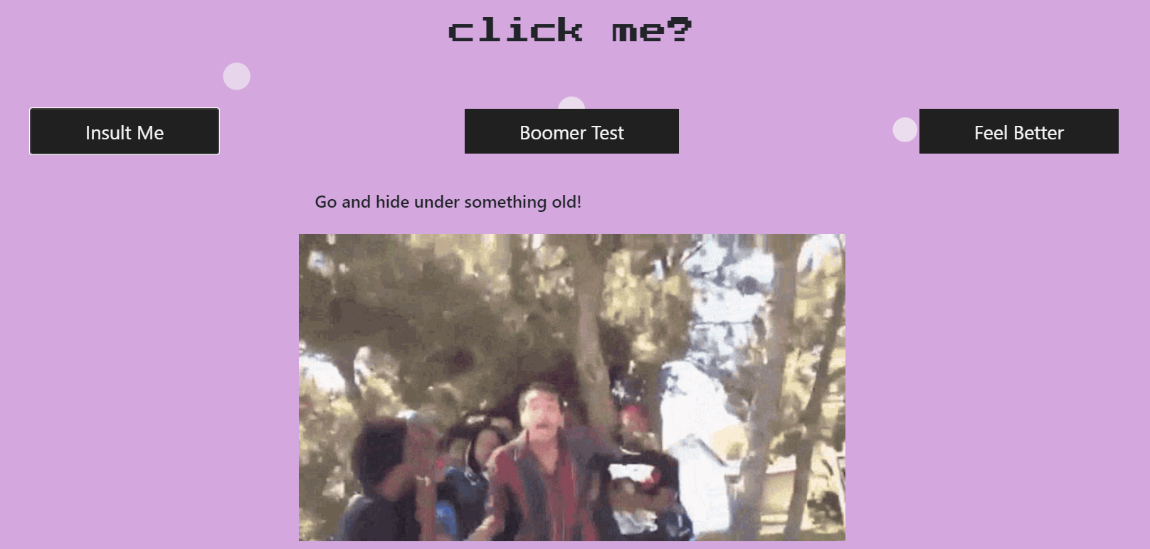
Utilises the Evil Insult Generator API - https://evilinsult.com/api/
If you’re feeling spicy you can click the insult me button to get a randomly generated insult with a complimentary meme.

Slide 8

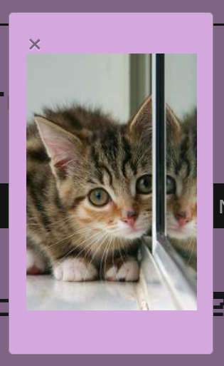
Utilises the Placekitten API - https://placekitten.com/
If you’re feeling sad about being insulted you can click on the feel better button to get a picture of a cat and a meow sound.
Image pops up in a modal so it can easily be closed when you’re ready.

Slide 9
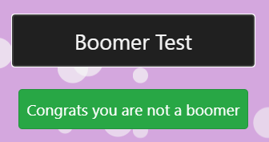
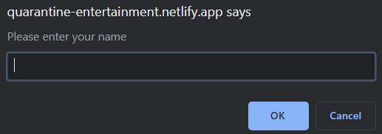
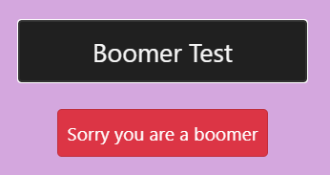
Utilises the Agify API - https://agify.io/
This API predicts your age based on your name.
Depending on how old Agify thinks you are a message is displayed telling you if you’re a boomer or not.

Slide 10
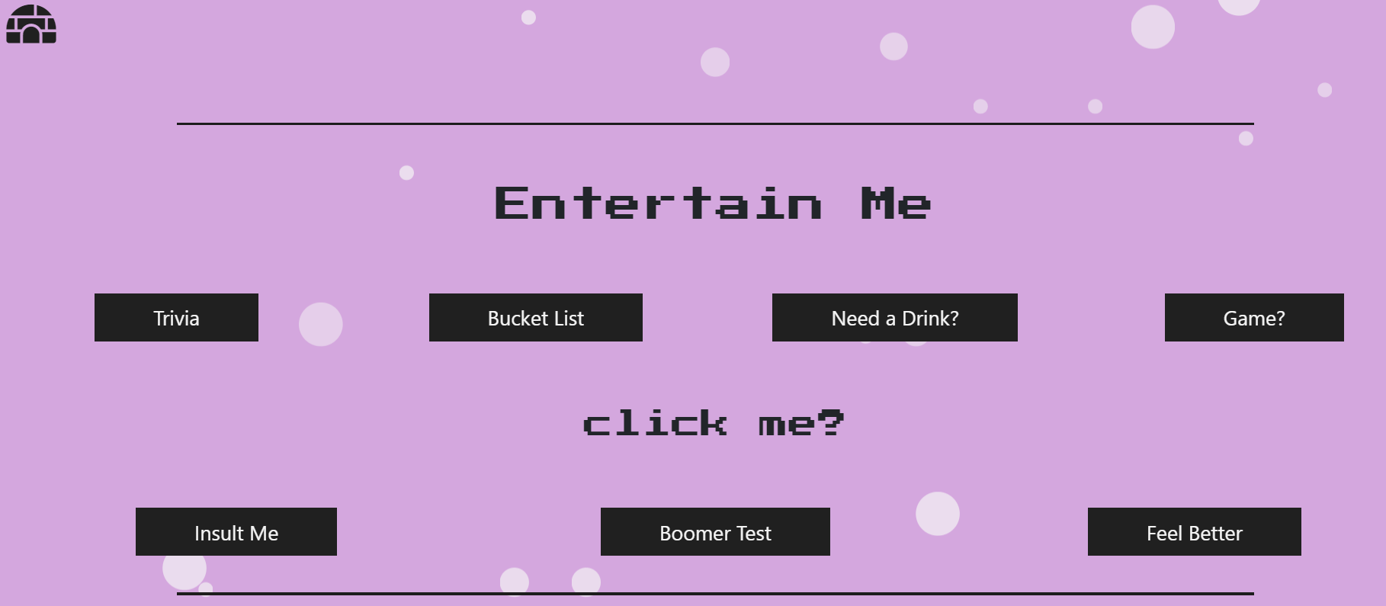
When you move your mouse around bubbles are generated in the background moving up the page.
As you move your mouse more the rate at which the bubbles generate increases.

Slide 11
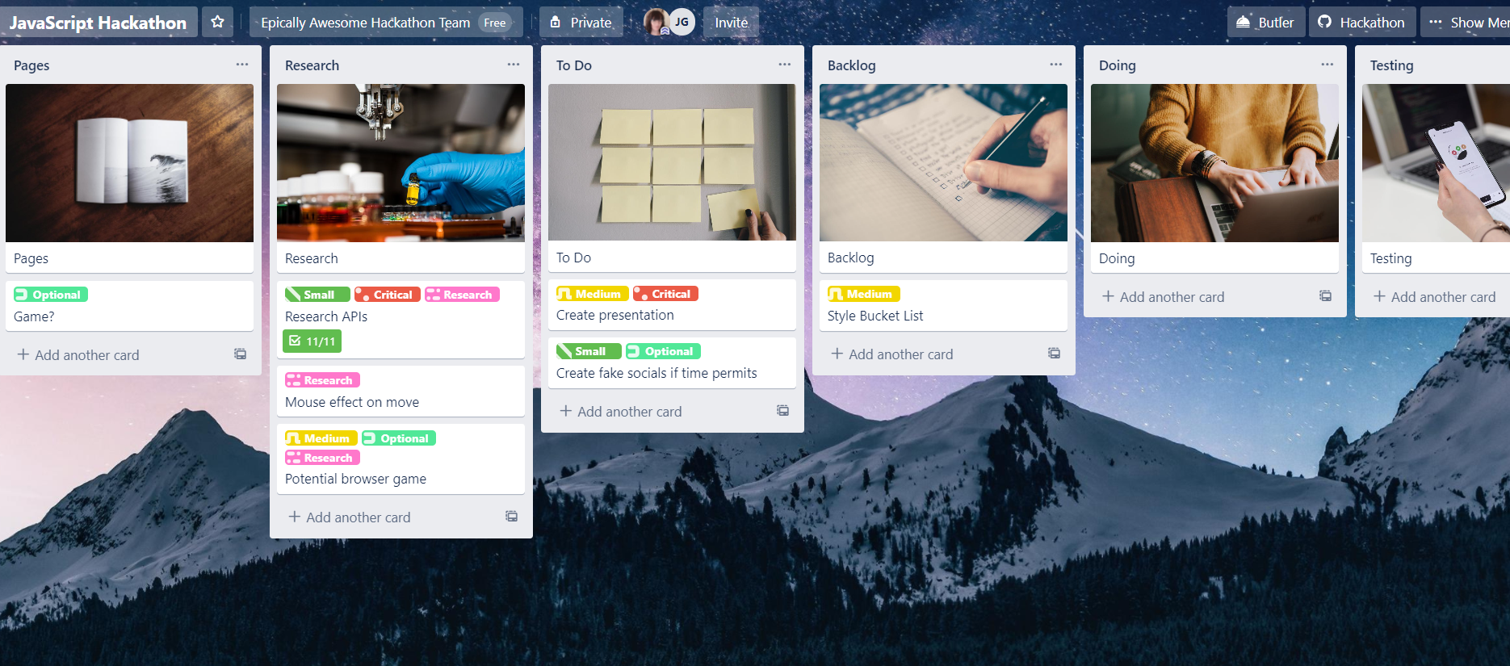
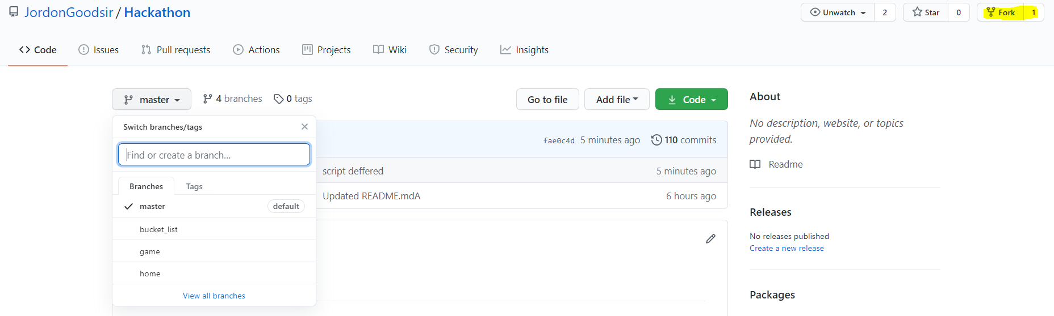
Planning & Git Workflow
For planning and tracking tasks we used Trello
Our git workflow was a forking workflow. We used a central repository and one of us forked the repo and both worked on feature branches for each page

Slide 12
Demonstration, Code Walkthrough and Questions!

