Slide 1
Christmas MERN Project
Your presents is requested at this presentation.

Slide 2
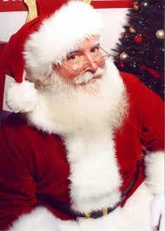
What is it?
North Pole Post is Santa’s new site dedicated to allowing kids to add their letter to santa online and allow you an easy place to keep track of the gifts you want to buy for Christmas.

Slide 3
Challenges and Wins

Slide 4
Let’s take a tour of https://north-pole-post.netlify.app/

Slide 5
A round of Santa-plause, please.
Any questions?

