Slide 1

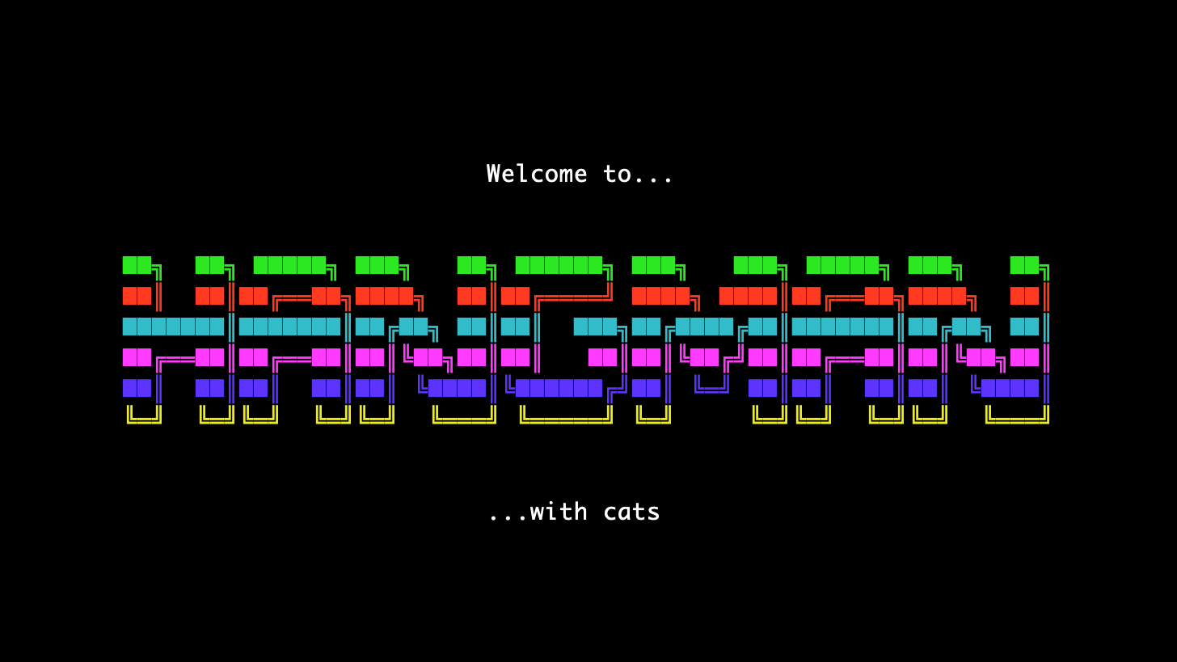

Slide 2

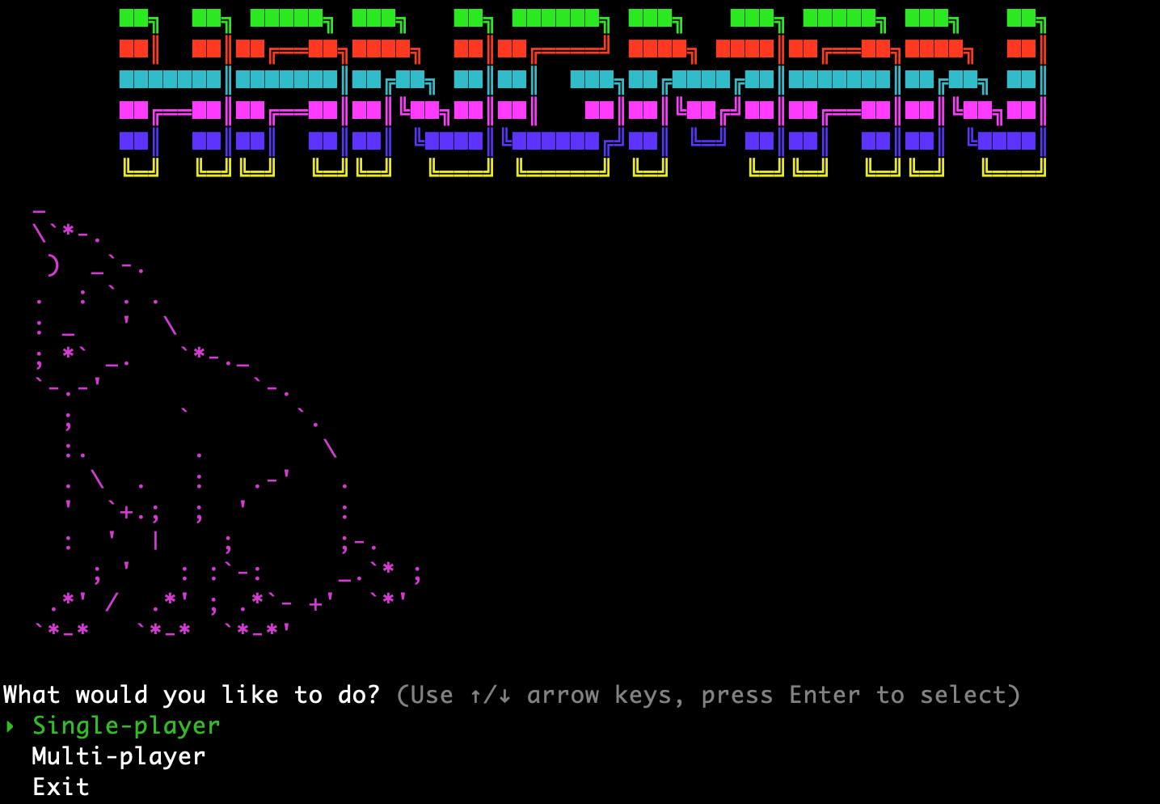
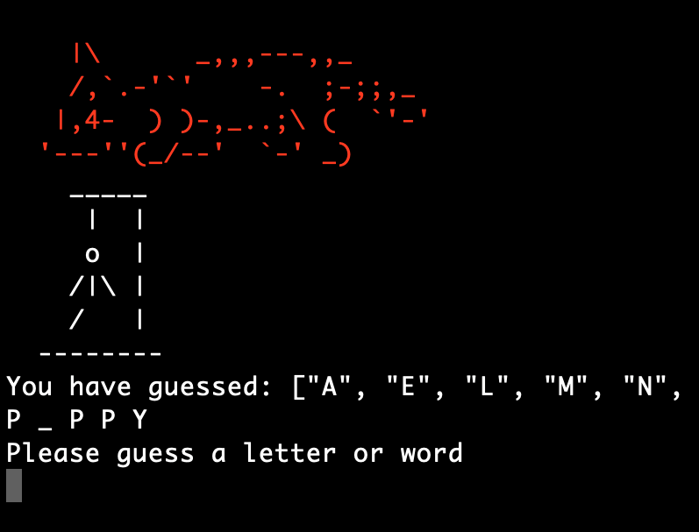
Walkthrough
From the main menu the user can select single-player, multi-player or to exit.
Upon selecting a game mode an instruction screen will appear relevant to the mode chosen.
The word to be guessed is then either generated randomly using random-word-generator for single-player or chosen by one person in multi-player.
The user then guesses letters or a full word until they run out of guesses or guess the word.
A game over screen is displayed showing win or loss and user can choose to play again or exit.

