Slide 1

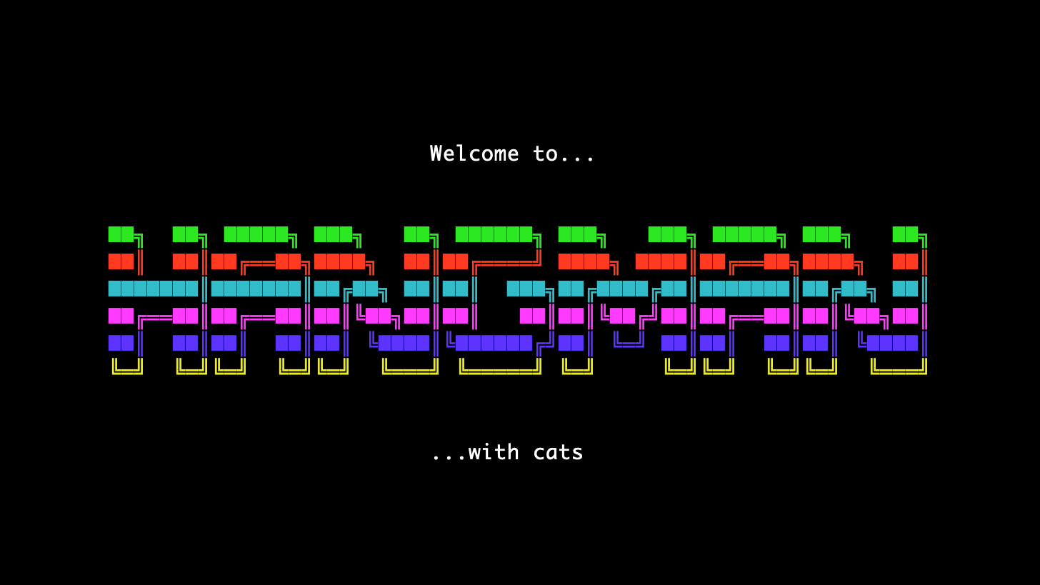

Slide 2

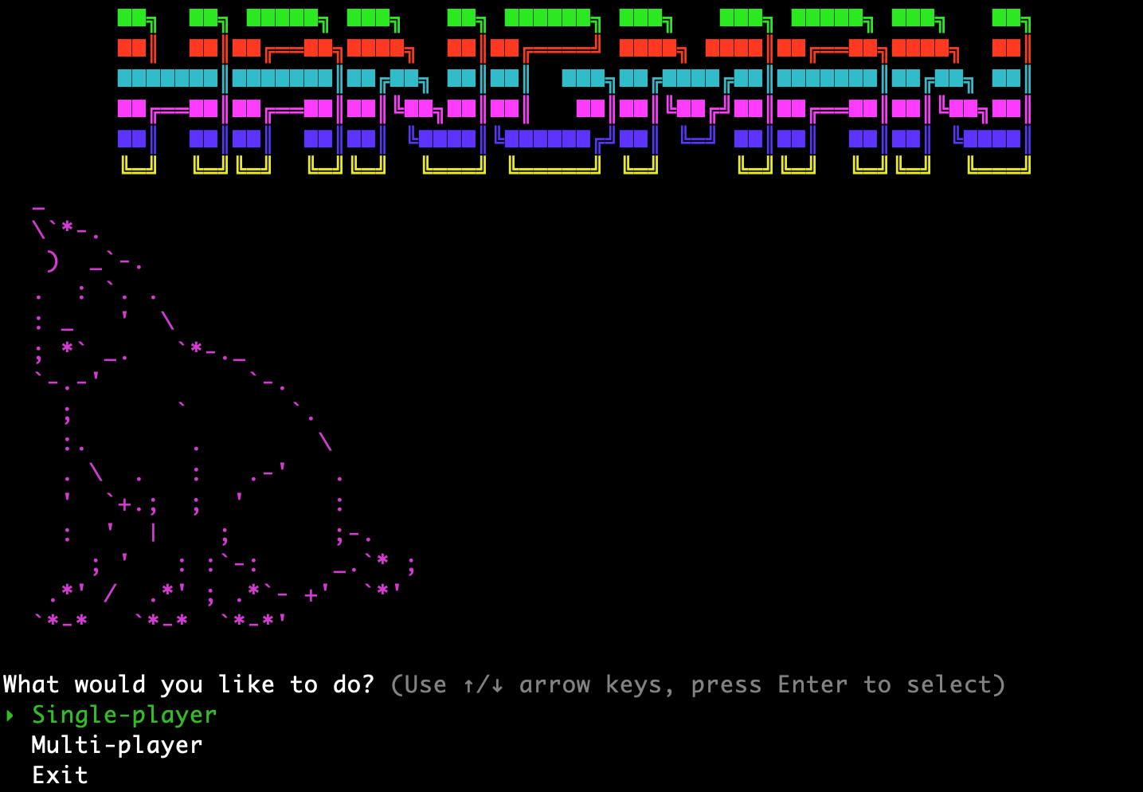
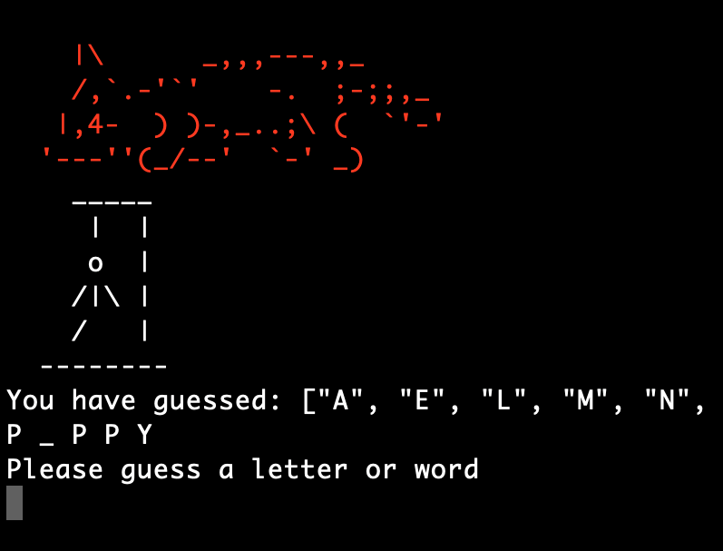
Walkthrough
From the main menu the user can select single-player, multi-player or to exit.
Upon selecting a game mode an instruction screen will appear relevant to the mode chosen.
The word to be guessed is then either generated randomly using random-word-generator for single-player or chosen by one person in multi-player.
The user then guesses letters or a full word until they run out of guesses or guess the word.
A game over screen is displayed showing win or loss and user can choose to play again or exit.

Slide 3
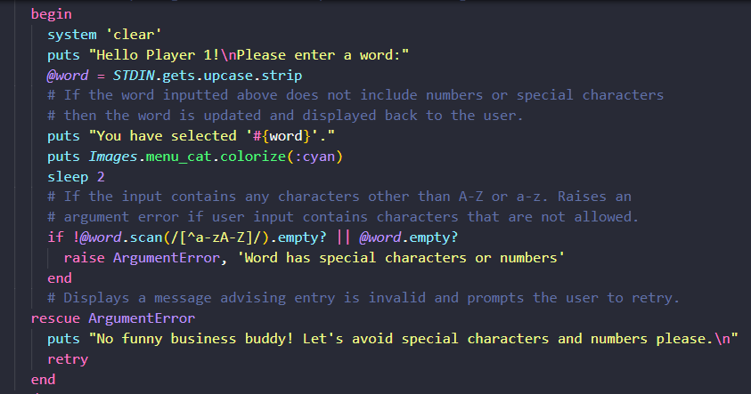
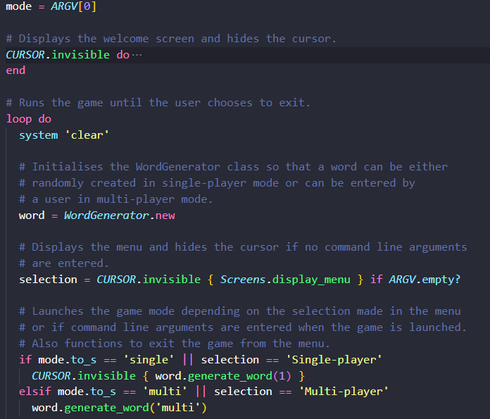
Error Handling
Command Line Arguments
Due to the amount of user input I had to develop some error handling. The below code checks the user input and ensures only letters are entered and the user is prompted to retry their entry until this condition is met.
To cover the command line argument section of the rubric I decided to have three different game modes. One for the full game including menu if no arguments are entered, one to run a game with only single-player mode available if “single” is entered on the command line and one to run only multi-player mode if “multi” is entered on the command line.

Slide 4
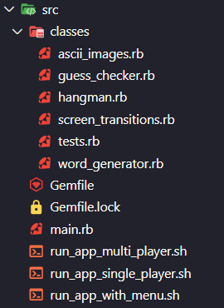
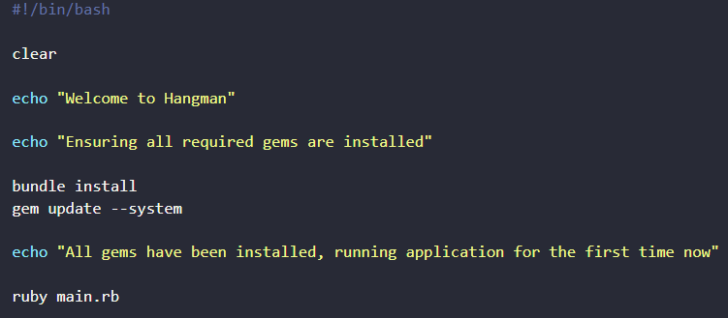
File Structure
Executable Files
I created 3 executable files to demonstrate the command line arguments available in the code. These were made executable using the chmod command in the terminal and a variation of the below script in the .sh file.
The classes folder includes all classes and modules called to run the game.
This simplified adding in the amount of ASCII art that I used and also helped me keep related files together.
The main application runs from the main.rb file and all gems, classes and modules are required here.
I have also included my three executable files alongside this to install gems on running the game for a smoother user experience.

Slide 5
Questions?

Slide 6

Thank you!!

