Slide 1
NP-Hard & NP-Complete Problems

Slide 2
Decision Versus Search Problems
Decision Problem
Search Problem
YES/NO answers
Find a Hamilton cycle in G if one exists, else return NO
Does G have a Hamilton cycle?
Find a 3-coloring of G if one exists, else return NO
Can G be 3-colored ?

Slide 3
Hard problems / Easy problems
Hard Problem
Easy Problem
Finding the shortest simple path between vertices v and w in a given graph
Determine if there is an Euler tour in a given graph
Testing 2-colorability
Satisfiability when each clause has two literals
Finding the longest simple path between vertices v and w in a given graph
Determine if there is a Hamiltonian circuit in a given graph
Testing 3-colorability
Satisfiability when each clause has three literals

Slide 4
Fast and slow
Fast
Slow
Algorithms whose running time is polynomial in input size
Algorithms whose running time is exponential in input size
Or worse…
Or in between???

Slide 5
What is an efficient algorithm?
Is an O(n) algorithm efficient?
How about O(n log n)?
polynomial time
O(n^{c}) for some
constant c
O(n²) ?
O(n¹⁰) ?
O(n^{log n}) ?
non-polynomial
time
O(2^{n}) ?
O(n!) ?

Slide 6
Class P
One of the most fundamental complexity classes.
It contains all decision problems that can be solved by a deterministic Turing machine using a polynomial amount of computation time, or polynomial time.
A language L is in P if and only if there exists a deterministic Turing machine M, such that
M runs for polynomial time on all inputs
For all x in L, M outputs 1
For all x not in L, M outputs 0

Slide 7
The Class P
We say a set L µ Σ* is in P if there is
a program A and
a polynomial p()
such that for any x in Σ*,
A(x) runs for at most p(|x|) time
and answers question “is x in L?” correctly.

Slide 8
Class NP
NP (nondeterministic polynomial): class of decision problems whose proposed solutions can be verified in polynomial time = solvable by a nondeterministic polynomial algorithm

Slide 9
NP
A set L ∈ NP
if there exists an algorithm A and a polynomial p( )
For all x ∈ L
For all x′ ∉ L
there exists y with |y| ≤ p(|x|)
For all y′ with |y′| ≤ p(|x′|)
such that A(x,y) = YES
we have A(x′,y′) = NO
in p(|x|) time
in p(|x|) time

Slide 10
Recall the Class P
We say a set L µ Σ* is in P if there is
a program A and
a polynomial p()
such that for any x in Σ*,
A(x) runs for at most p(|x|) time
and answers question “is x in L?” correctly.
can think of A as “proving” that x is in L

Slide 11
P ⊆ NP
For any L in P, we can just take y to be the empty string and satisfy the requirements.
Hence, every language in P is also in NP.

Slide 12
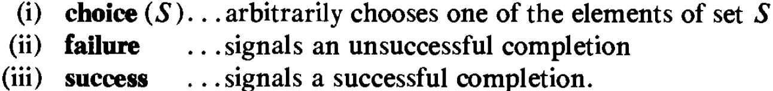
NP
To specify such algorithms we introduce one new function and two new statements

Slide 13
Non-deterministic Searching
j = choice(1,n);
if A[j] = x then {write (j); Success();}
Write (0); Failure();

Slide 14
Non-deterministic Sorting
for i = 1 to n do B[i] = 0; //initialize
for i = 1 to n do
{
j = choice(1,n);
if B[j] ≠ 0 then Failure();
B[j] = A[i];
}
for i = 1 to n-1 do //verify order
if B[i] > B[i+1] then Failure();
write (B[i:n]);
Success();

Slide 15
Definition : Decision and Optimization
Case 1: The decision problem can be solved in polynomial time iff the corresponding optimization problem can.
Case 2: If the decision problem cannot be solved in polynomial time then the optimization problem cannot either.

Slide 16
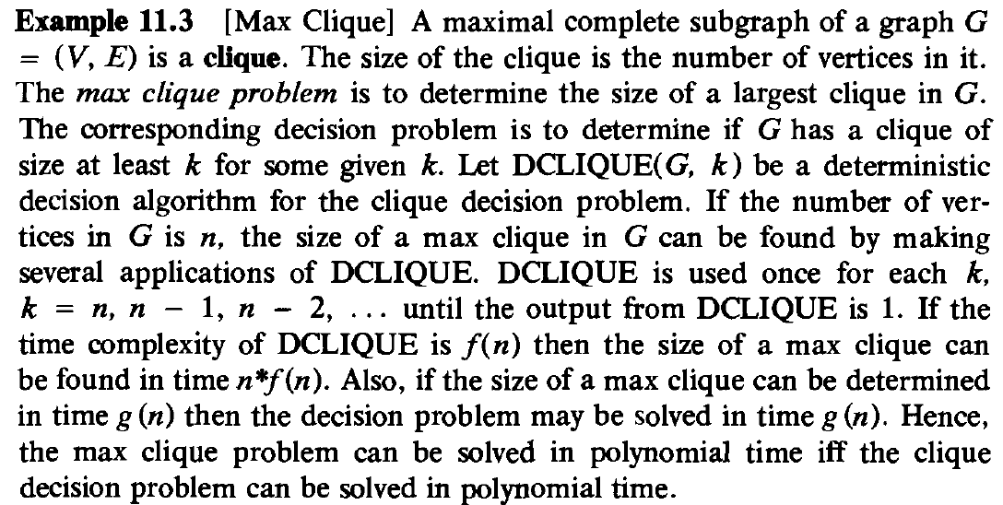
Example : Max Clique

Slide 17
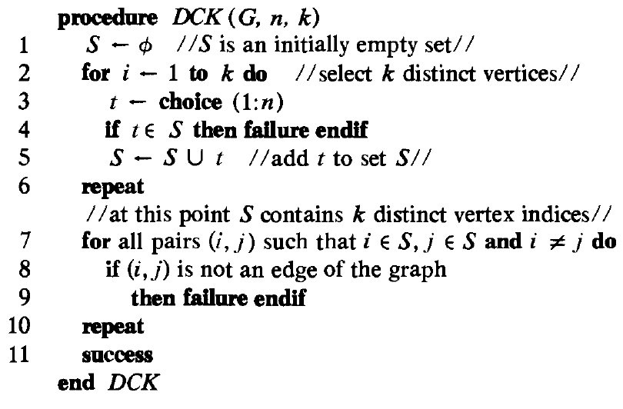
Example : Max Clique

Slide 18
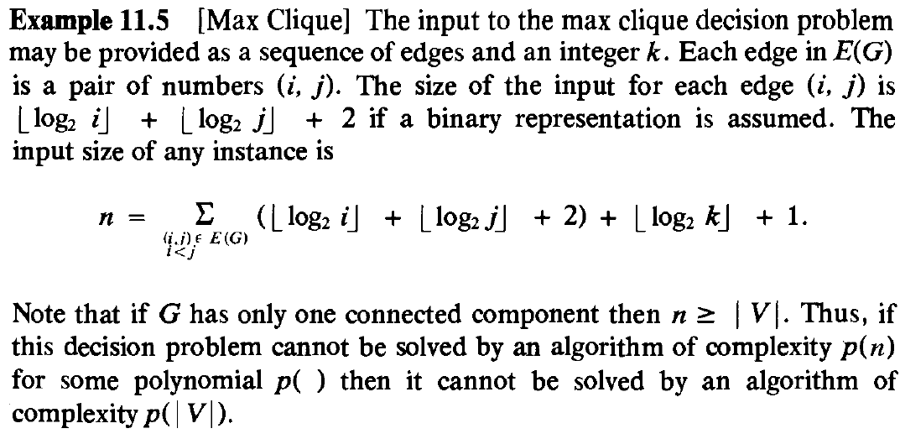
Example : Max Clique

Slide 19
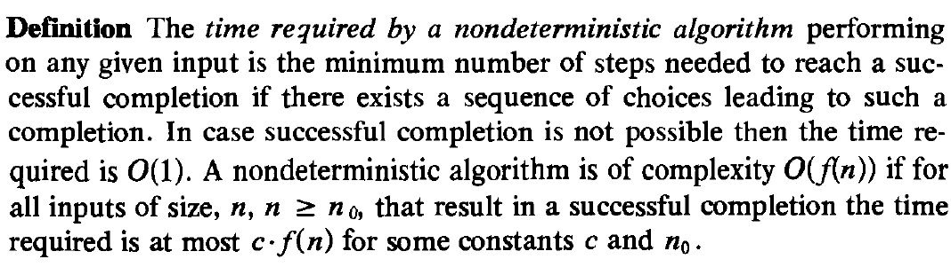
Definition: Time Requirement

Slide 20
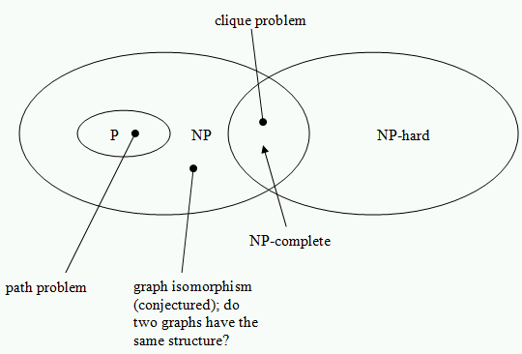
NP classes

Slide 21
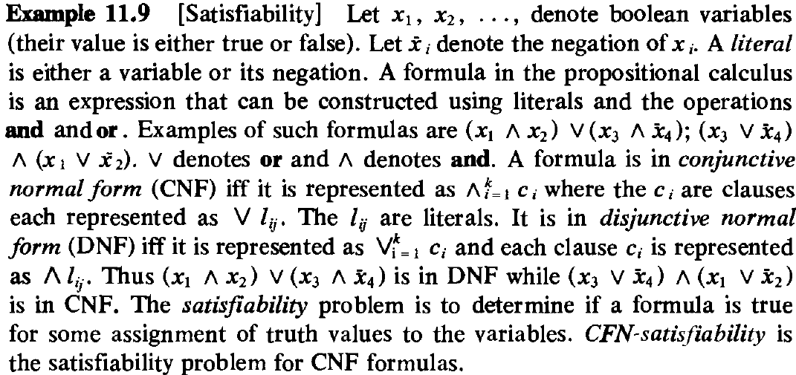
Satisfiability

Slide 22
SAT
Instance: A Boolean formula.
Problem: To decide if the formula is satisfiable.
A satisfiable Boolean formula:
F
T
T
F
T
T
An unsatisfiable Boolean formula:

Slide 23
SAT is in NP: Non-Deterministic Algorithm
Guess an assignment to the variables.
Check the assignment.
F
T
T
F
T
T
x₁
F
✓
x₂
T
x₃
T

Slide 24
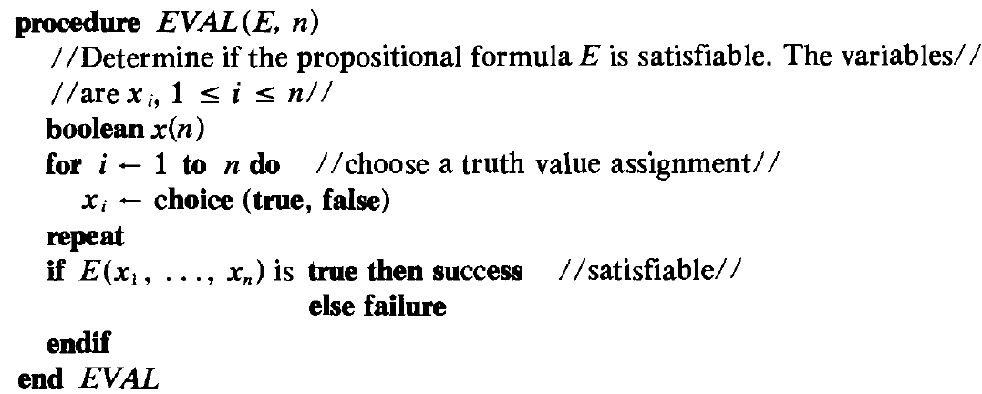
Nondeterministic satisfiability

Slide 25
Reducibility
Let P₁ and P₂ be two problems.
P₁ reduces to P₂ in time t(n) if an instance of P₁ can be converted into an instance of P₂ and a solution for P₁ can be obtained from a solution for P₂ in time ≤ t(n)

Slide 26
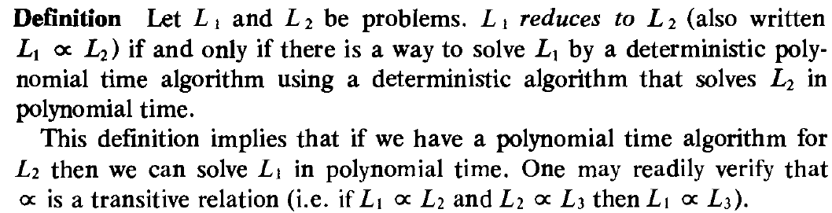
NP Reducibility

Slide 27
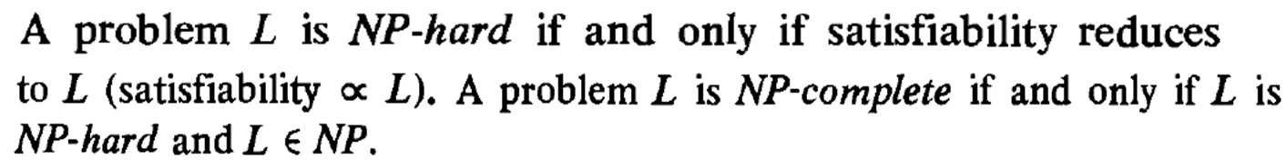
NP Hard NP Complete

Slide 28
NP Hard NP Complete
It is easy to see that there are NP-hard problems that are not NP-complete.
Only a decision problem can be NP-complete. However, an optimization problem may be NP-hard.
Furthermore if L₁ is a decision problem and L₂ an optimization problem, it is quite possible that L₁∞ L₂
Yet, optimization problems cannot be NP-complete while decision problems can.
There also exist NP-hard decision problems that are not NP-complete.

Slide 29
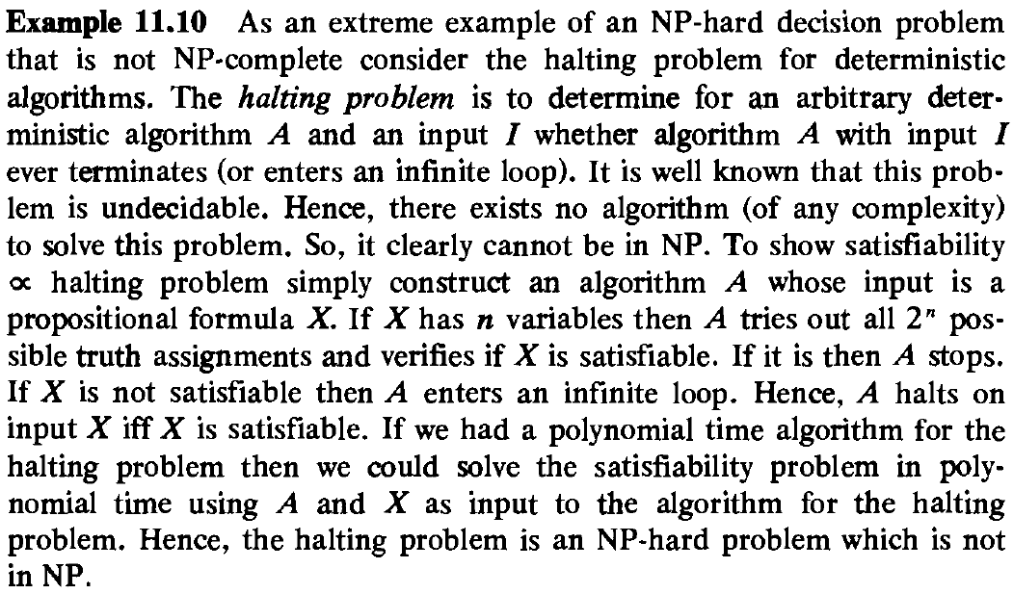
NP/NP-Complete vs. NP Hard

Slide 31
COOK’s Theorem

Slide 32
NP-Hard Problems
Pick a problem L₁ already known to be NP-hard.
Show how to obtain (in polynomial deterministic time) an instance I' of L₂ from any instance I of L₁ such that from the solution of I' we can determine (in polynomial deterministic time) the solution to instance I to L₁.
Conclude from (2) that L₁ ∞ L₂
Conclude from (1), (3) and the transitivity of ∞ that L₂ is NP-hard.

Slide 33

Clique Decision Problem (CDP)
Prove satisfiability ∞ CDP
Conclude CDP is NP-Hard.
CDP is NP-Complete as CDP $∈$ NP

Slide 34
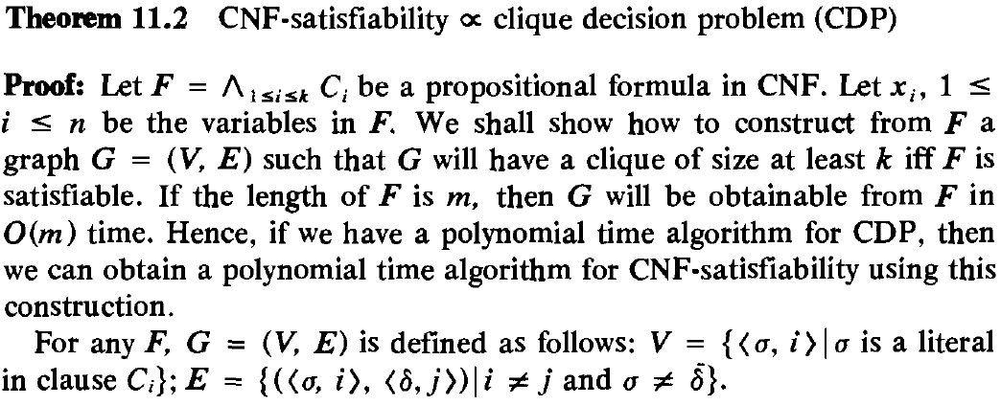

Slide 35
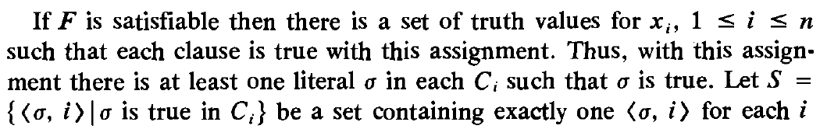
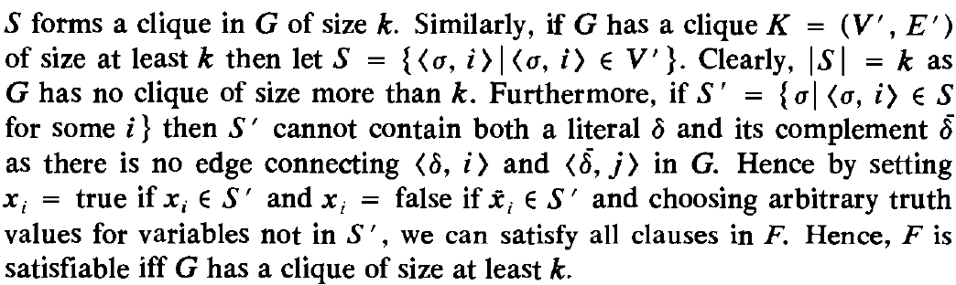

Slide 36
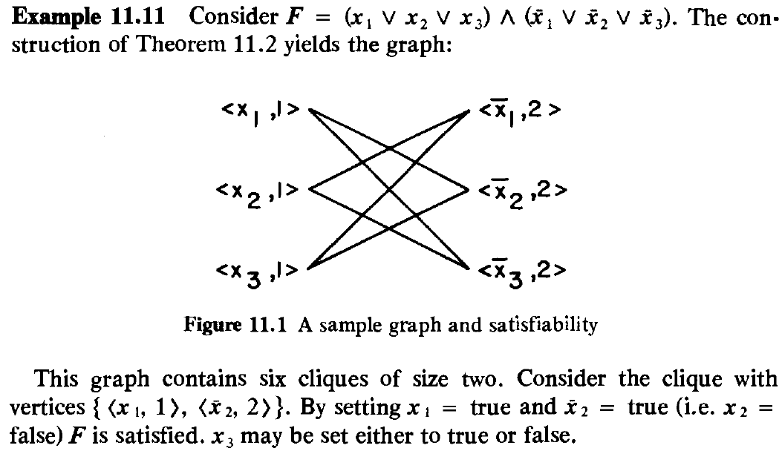

Slide 37
3CNF formula:
literal
clause
Each clause has three literals

Slide 38
A 5-clique in graph
Language:
CLIQUE = { : : graph
contains a -clique}

Slide 39
Theorem:
3CNF-SAT is polynomial time
reducible to CLIQUE
Proof:
give a polynomial time reduction
of one problem to the other
Transform formula to graph

Slide 40
Transform formula to graph.
Example:
Clause 2
Create Nodes:
Clause 3
Clause 1
Clause 4

Slide 41
Add link from a literal to a literal in every
other clause, except the complement

Slide 42
Resulting Graph

Slide 43
The formula is satisfied if and only if
the Graph has a 4-clique
End of Proof

Slide 44
SELF
Theorem : 11.5,11.6,11.8,11.9

