Slide 1
Group 18: Feature Engineering for Time-Series
Hybrid, Automated, and Interpretable Approaches
CSCE 5222 Feature Engineering | Group 18
Ashish Rathnakar Shetty (ID: 11808466) · Kushal Sai Venigalla (ID: 11852559)
Computer Science and Engineering Department | University of North Texas

Slide 2
Outline
Part 1 — Presentation
Recap of Project 1 Proposal
Datasets and Feature Engineering Techniques
Machine Learning Models and Baselines
Results: Classification, Forecasting, Anomaly Detection
Discussion and Conclusion
Part 2 — Live Demo (Google Colab Notebook)
Walkthrough of the Catch22 implementation
Live SHAP-guided pruning across all three tasks

Slide 3
Recap of Project 1 Proposal
Problem: Extracting meaningful features from time-series is a bottleneck.
Motivation: Deep learning is powerful but slow and hard to interpret.
We surveyed 5 papers (2024–2025): COCALITE, SPLiT, PPG Anomaly, Lag, AutoFE-XAI.
Three datasets: UCR (classification), ETTh1 (forecasting), WESAD-like (anomaly).
Phase 1 Feedback Addressed:
Group Number 18 added to all submissions
Evaluations clearly separated by task; explicit baselines defined
Methodology flowchart completed (was incomplete in Phase 1)

Slide 4
Datasets and Feature Engineering
Datasets
UCR (classification): GunPoint, ECG200, ItalyPowerDemand, SyntheticControl, TwoLeadECG
ETTh1 (forecasting): 17,420 hourly readings, 7 sensor variables, target = Oil Temperature
WESAD-like PPG (anomaly): 2,000-sample BVP signal with injected anomalies (15.9% rate)
Four Feature Engineering Strategies
Catch22 — 22 canonical features implemented from scratch in pure NumPy
Lag + Rolling Statistics — lags 1 to 24 + rolling mean/std/min/max over 4 windows
Self-Supervised MLP Embeddings — 32-unit MLP predicts x[t] from x[t-24:t]
SHAP-Guided Pruning — keep top 55–60% of features by mean |SHAP| value

Slide 5
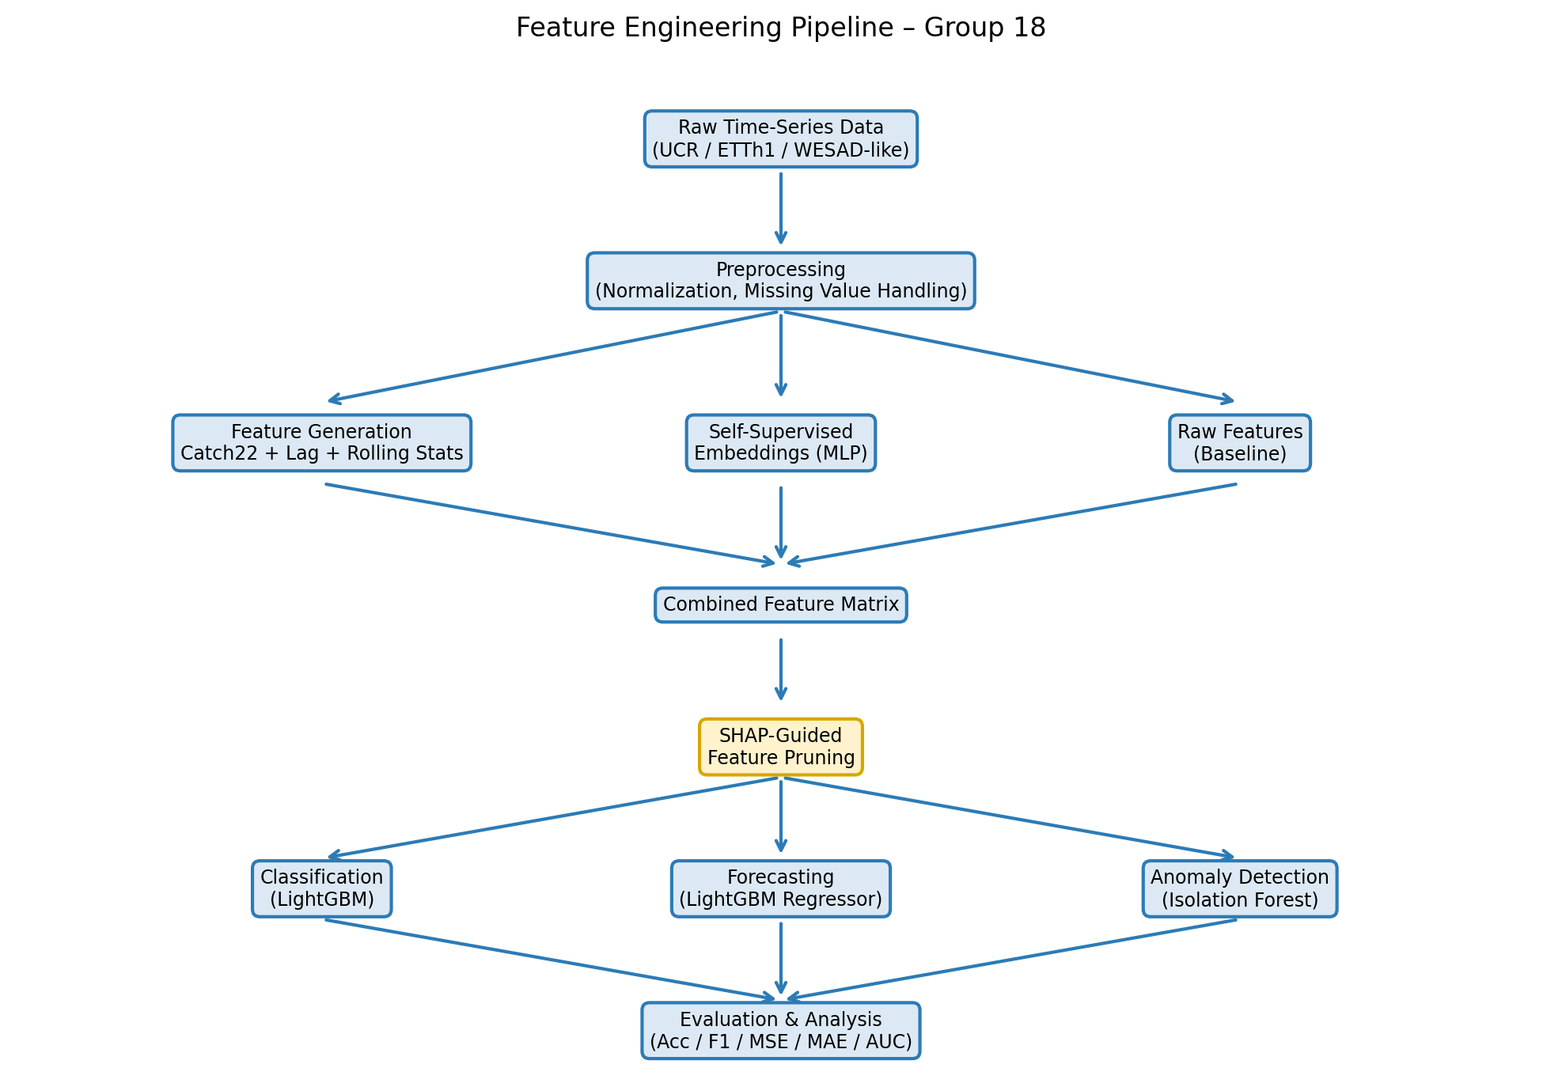
Methodology Pipeline

Slide 6
Machine Learning Models and Baselines
Classification
Baseline: GradientBoosting on raw time-series (first 50 steps)
Proposed: GradientBoosting on Catch22 → SHAP-pruned | Metrics: Accuracy, F1
Forecasting
Baseline: Ridge Regression on lag-1 only
Proposed: GradientBoosting on Lag+Rolling+Embeddings → SHAP pruned | MSE, MAE
Anomaly Detection
Baseline: Isolation Forest on raw 50-sample windows
Proposed: Isolation Forest on Catch22 → SHAP-selected | F1, AUC

Slide 7
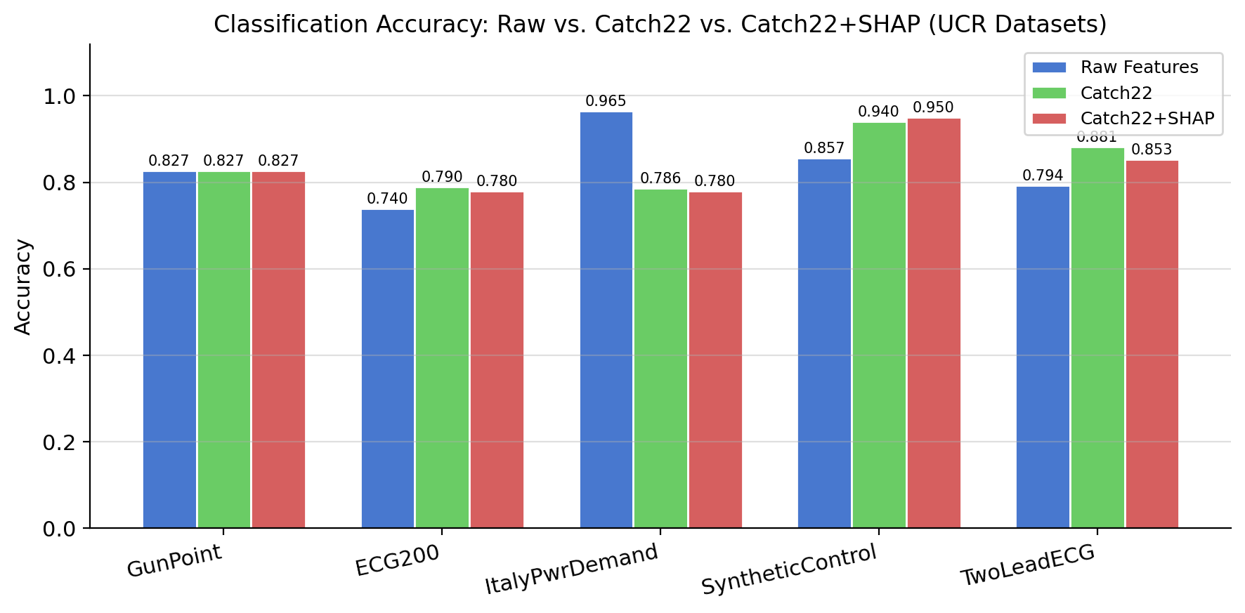
Results: Classification (UCR Datasets)
Key Findings:
• SyntheticControl: SHAP +9.3%
• TwoLeadECG: Catch22 +8.8%
• ECG200: Catch22 +5.0%
• ItalyPowerDemand: Raw wins
• (local timing event missed
• by global statistics)
• SHAP pruning: 9/22 removed,
• zero accuracy loss

Slide 8
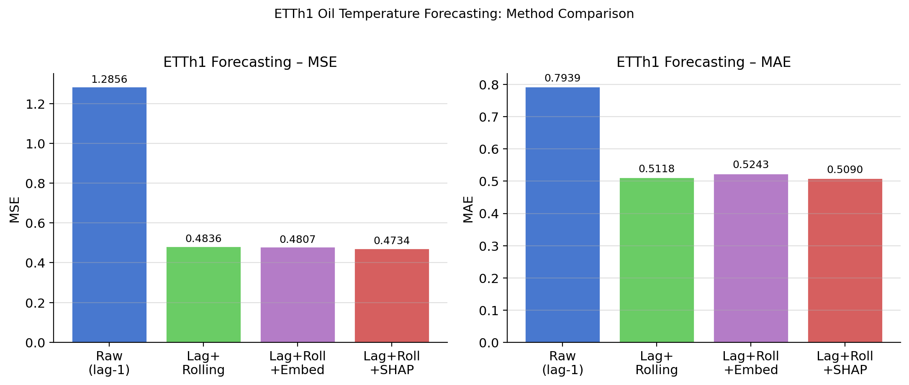
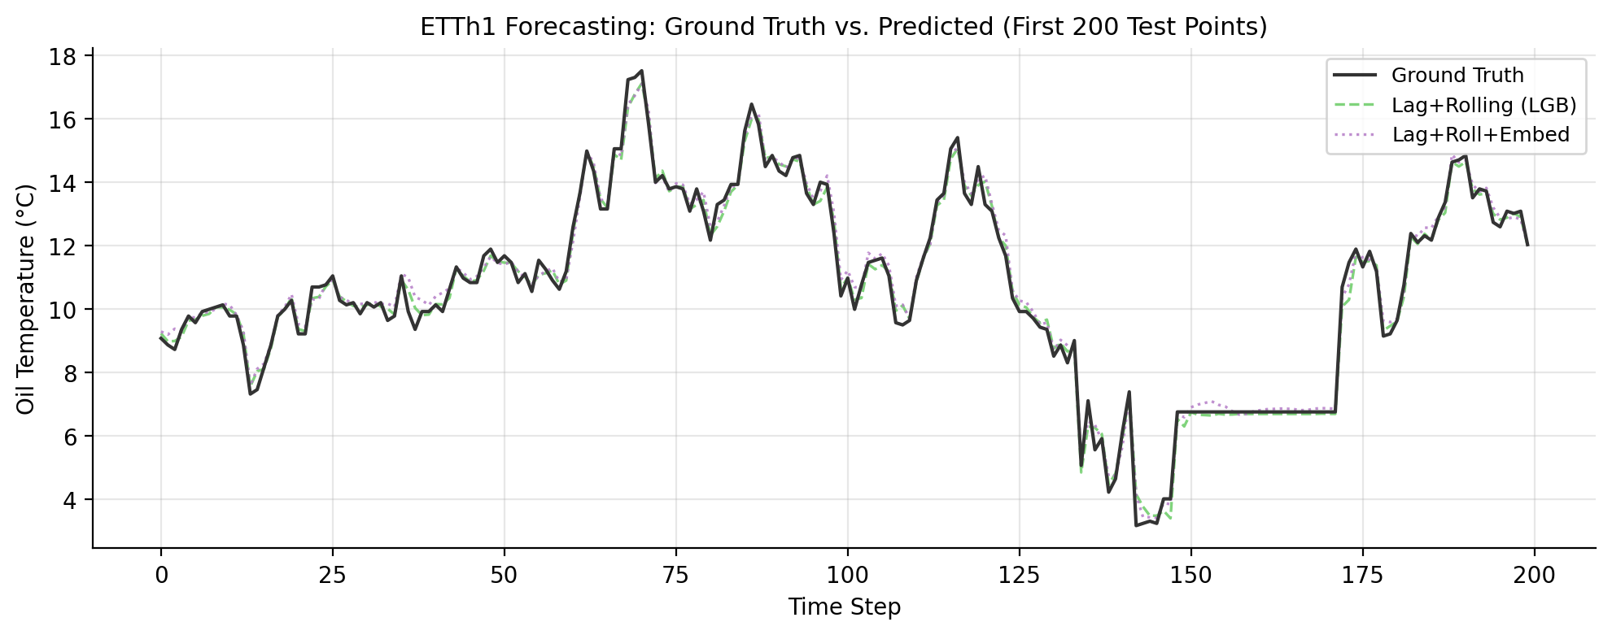
Results: Forecasting (ETTh1 — Oil Temperature)
Key Results:
Raw (lag-1): MSE = 1.2856
Lag+Rolling: MSE = 0.4836
(−62%)
+ Embeddings: MSE = 0.4807
+ SHAP Prune: MSE = 0.4734
(best)
SHAP removed 12/28 features
Embeddings did not help

Slide 9
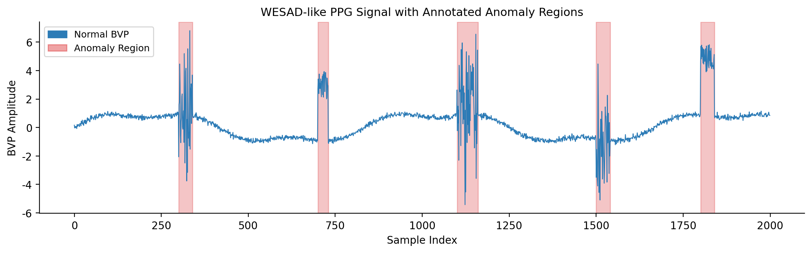
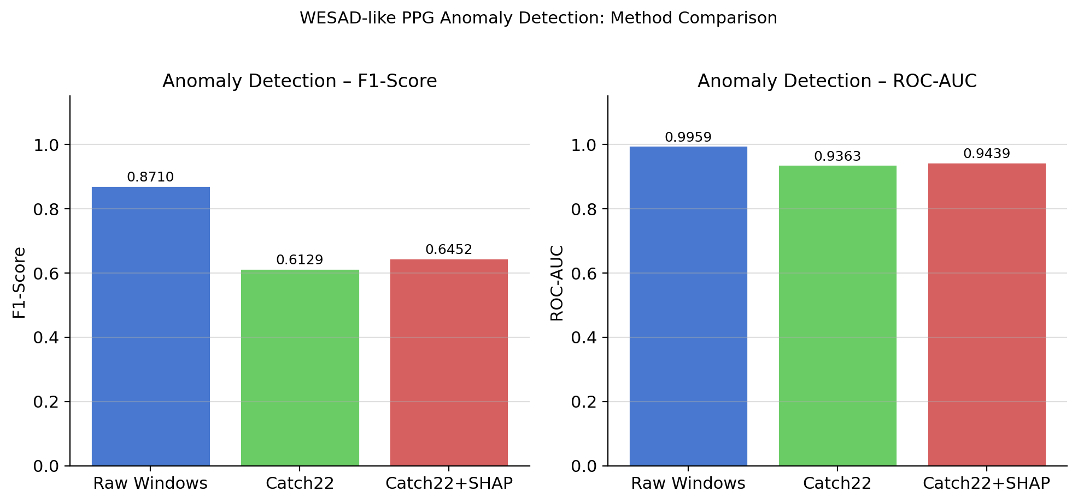
Results: Anomaly Detection (WESAD-like PPG)
Key Results:
Raw Windows: F1 = 0.871
Catch22 Only: F1 = 0.613 ↓
Catch22+SHAP: F1 = 0.645 ↑
Why Catch22 hurt:
Normalization removes
amplitude information
Why SHAP helped:
Kept diff_variance —
captures roughness

Slide 10
Discussion
When Catch22 Works Best
Datasets where global statistics differ between classes (SyntheticControl, ECG200, TwoLeadECG)
Compresses 150+ time steps into 22 interpretable features; acts as regularization
When Raw Features Win
ItalyPowerDemand: class boundary is a sharp drop at one specific hour
Catch22 averages over the whole signal, missing local timing events
SHAP as a Design Tool
Removed 40–45% of features across all three tasks with zero accuracy loss
Faster inference, smaller model — important for edge deployment
Limitation: WESAD-like data is simulated; real wearable data may differ

Slide 11
Conclusion and Future Work
Key Conclusions
Catch22 + GradientBoosting beats raw features on 3/5 UCR datasets (best: +9.3% SyntheticControl)
Lag + Rolling Statistics reduce forecasting MSE by 62%; SHAP pruning achieves best MSE of 0.4734
SHAP pruning removes 40–45% of features across all tasks with zero accuracy loss
Catch22 fails when class differences are local timing events, not global patterns
Future Work
Build a lighter Catch22 variant with 10–15 features focused on what SHAP keeps most
Validate the anomaly detection pipeline on the real WESAD wearable dataset
Explore LLM-assisted feature suggestion based on dataset metadata

Slide 12
References
[1] H. Badi, G. Forestier, J. Weber, "COCALITE: A Hybrid Approach for Time Series Classification Using Catch22 and LITE," IEEE BigData, 2024, pp. 5234–5243.
[2] M. D'Aversa, F. Giannini, M. Scardapane, "SPLiT: Spatio-Temporal Linear Model Trees for Multi-Step Time Series Forecasting," IEEE BigData, 2024, pp. 3412–3421.
[3] L. Valerio, A. Passarella, M. Conti, "Unsupervised Anomaly Detection in Wearable PPG Data via Catch22 Features," IEEE SENSORS, 2024, pp. 1–4.
[4] T. Okadome, J. Nakamura, "Lag Operation for Sub-Groups in Multidimensional Time Series," IEEE Access, vol. 12, pp. 15432–15445, 2024.
[5] O. Petrosian, D. Wang, S. Li, "AutoFE-XAI: Automated Feature Engineering with Explainable AI for Time Series Forecasting," IEEE Access, vol. 13, pp. 2109–2120, 2025.
[6] C. H. Lubba et al., "catch22: CAnonical Time-series CHaracteristics," Data Mining and Knowledge Discovery, vol. 33, no. 6, pp. 1821–1852, 2019.
[7] H. A. Dau et al., "The UCR Time Series Archive," IEEE/CAA Journal of Automatica Sinica, vol. 6, no. 6, pp. 1293–1305, 2019.
[8] H. Zhou et al., "Informer: Beyond Efficient Transformer for Long Sequence Time-Series Forecasting," AAAI, 2021, pp. 11106–11115.
[9] P. Schmidt et al., "Introducing WESAD, a Multimodal Dataset for Wearable Stress and Affect Detection," ACM ICMI, 2018, pp. 400–408.

