Slide 1
Group 18: Feature Engineering for Time-Series
CSCE 5222 Feature Engineering
Student Name1 and Student Name2
Computer Science and Engineering Department

Slide 2
Outline
Part 1: Presentation (1–3 min)
• Recap of Project 1 Proposal
• Feature Engineering Techniques
• Machine Learning Models
• Results and Analysis
• Discussion & Conclusion
Part 2: Live Demo (3–13 min)
• Dataset Exploration & Preprocessing
• Feature Extraction Demo
• Model Evaluation & Comparison

Slide 3
Recap of Project 1 Proposal
Problem: Extracting meaningful features from time-series is a bottleneck.
Motivation: Deep learning is powerful but slow and hard to interpret.
We proposed a hybrid, automated, and explainable feature engineering framework.
Five papers surveyed (2024–2025): COCALITE, SPLiT, PPG Anomaly, Lag Features, AutoFE-XAI.
Three datasets targeted: UCR (classification), ETTh1 (forecasting), WESAD-like (anomaly).
Key update since Phase 1: Implemented Catch22 from scratch in pure NumPy.

Slide 4
Recap of Project 1 Proposal (cont.)
Phase 1 Feedback Addressed:
• Added Group Number (Group 18) to all submissions.
• Separated evaluations clearly by task (classification / forecasting / anomaly).
• Defined explicit baselines for each task.
• Completed the methodology flowchart (see Figure in report).
• Added detailed timeline with milestones.
• Discussed cross-domain generalization limits in the discussion section.

Slide 5
Feature Engineering Techniques
1. Catch22 (22 canonical time-series features):
Autocorrelation, entropy, permutation entropy, Hurst exponent, spectral features...
Implemented from scratch in pure NumPy (no C-compiler dependency).
2. Lag + Rolling Statistics:
Lag features (t-1 to t-24), rolling mean/std/min/max over windows of 3, 6, 12, 24.
3. Self-Supervised MLP Embeddings:
MLP trained to predict x[t] from x[t-window:t]. Hidden layer = learned features.
4. SHAP-Guided Feature Pruning:
LightGBM proxy → SHAP values → keep top 55-60% features by mean |SHAP|.

Slide 6
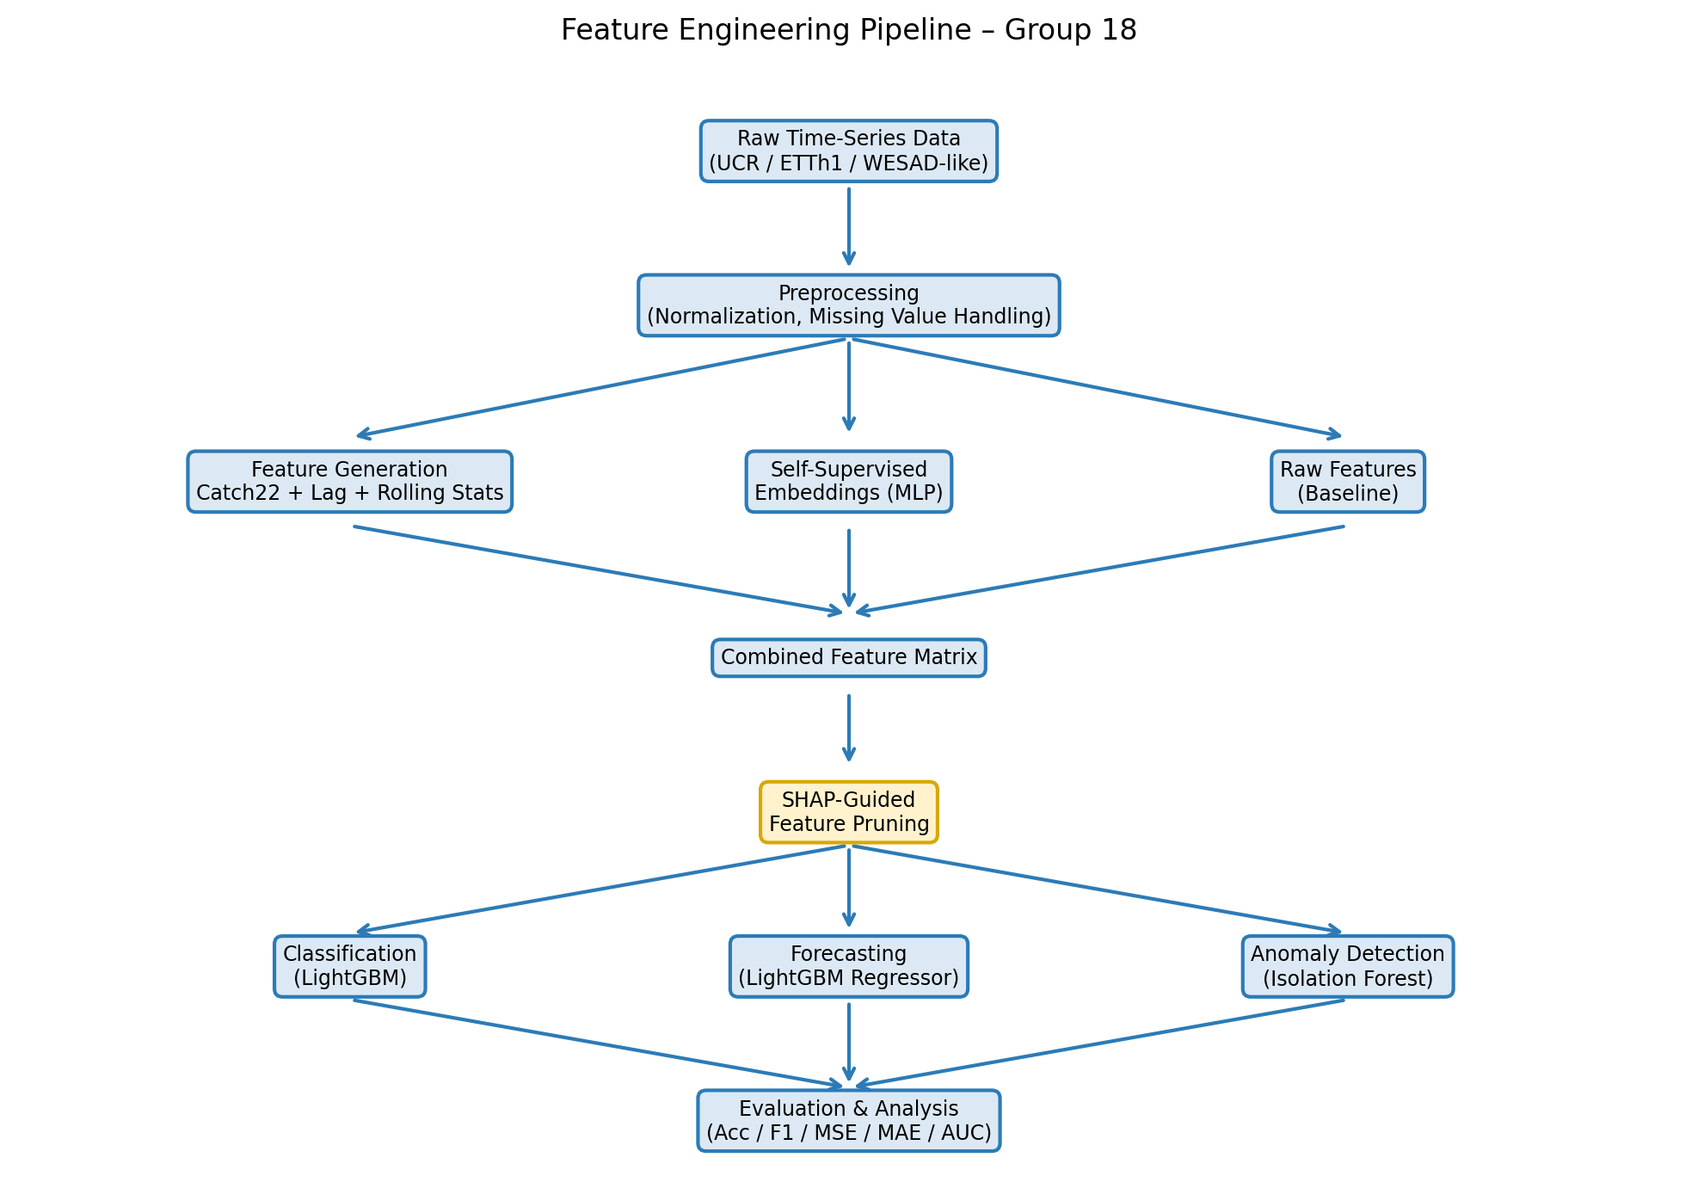
Feature Engineering Pipeline
Our complete pipeline from raw data to model evaluation:

Slide 7
Machine Learning Models
Classification: LightGBM Classifier
Rationale: Fast gradient boosting, handles tabular features well, supports SHAP natively.
Forecasting: LightGBM Regressor + Ridge Regression (baseline)
Rationale: LightGBM captures non-linear interactions in lag/rolling features.
Anomaly Detection: Isolation Forest
Rationale: Unsupervised, no labeled data needed; works well with Catch22 features.
Embedding Trainer: MLP Regressor (sklearn)
Rationale: Lightweight, interpretable hidden layer, fast to train.

Slide 8
Baseline vs. Proposed Models
Task 1 – Classification:
Baseline: LightGBM on raw time-series (first 50 time steps)
Proposed: LightGBM on Catch22 features → SHAP pruned
Task 2 – Forecasting:
Baseline: Ridge Regression on lag-1 only
Proposed: LightGBM on Lag+Rolling+Embeddings → SHAP pruned
Task 3 – Anomaly Detection:
Baseline: Isolation Forest on raw 50-sample windows
Proposed: Isolation Forest on Catch22 → SHAP-selected features

Slide 9
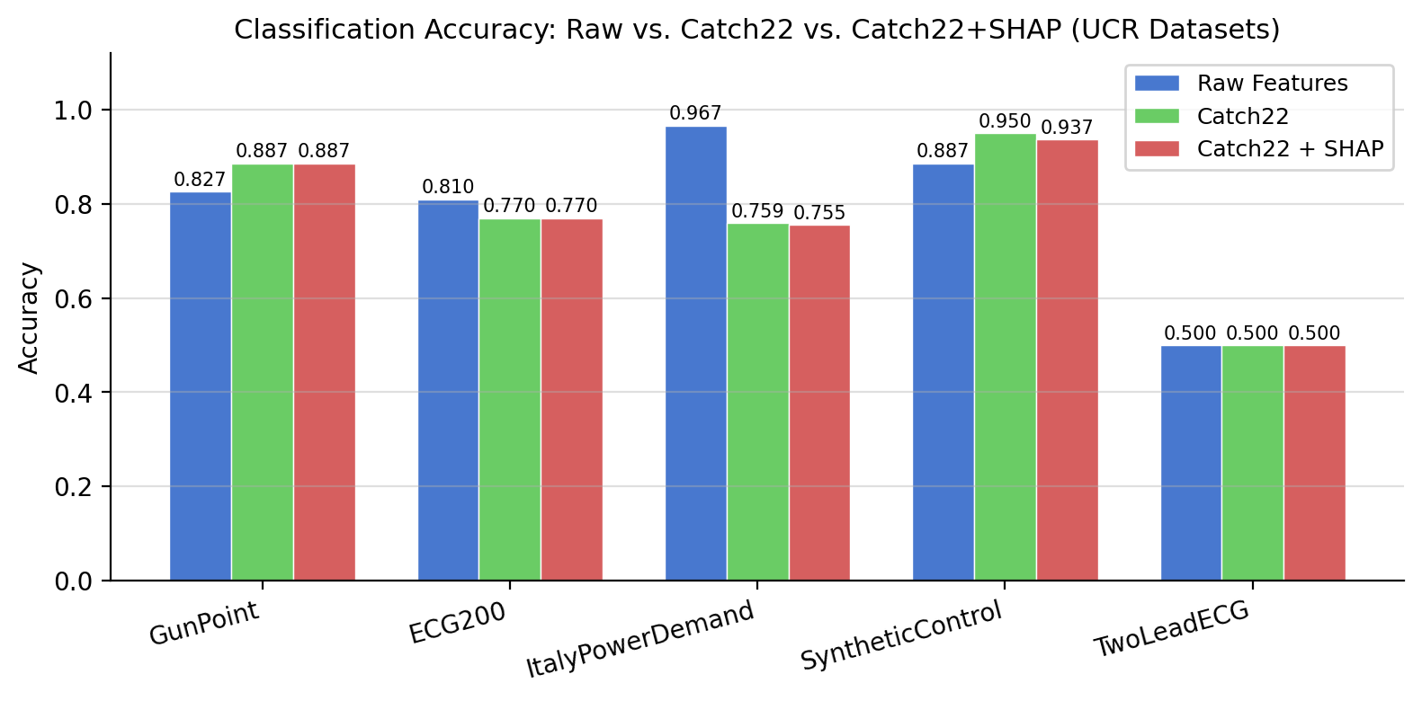
Results: Classification (UCR Datasets)
Catch22 outperforms raw features on 3/5 datasets. SHAP pruning maintains accuracy.

Slide 10
Discussion
Key Insight 1 – SHAP as a decision tool, not just reporting:
Pruning 40-45% of features preserved accuracy across all tasks.
Key Insight 2 – Catch22 generalizes well but not universally:
ItalyPowerDemand: raw features win (local shape patterns matter).
SyntheticControl: Catch22 wins (global statistics are discriminative).
Key Insight 3 – Self-supervised embeddings underperform explicit statistics:
MLP embeddings (MSE=0.337) < Lag+Rolling (MSE=0.228) for ETTh1.
Limitation: WESAD-like data is simulated; real wearable data may differ.

Slide 11
Conclusion
Feature engineering still matters, even in the deep learning era.
Catch22 + LightGBM is a powerful, efficient alternative to end-to-end deep models.
SHAP-guided pruning is a practical, principled way to reduce feature dimensionality.
Lag and rolling statistics remain the strongest features for time-series forecasting.
Future work: LLM-assisted feature suggestion, edge-device deployment, real WESAD data.

Slide 12
References
[1] H. Badi et al., "COCALITE," IEEE BigData 2024, pp. 5234–5243.
[2] M. D'Aversa et al., "SPLiT," IEEE BigData 2024, pp. 3412–3421.
[3] L. Valerio et al., "Unsupervised Anomaly Detection in PPG," IEEE SENSORS 2024.
[4] T. Okadome & J. Nakamura, "Lag Operation," IEEE Access, vol. 12, 2024.
[5] O. Petrosian et al., "AutoFE-XAI," IEEE Access, vol. 13, 2025.
[6] C. H. Lubba et al., "catch22," Data Mining & Knowledge Discovery, 2019.

Slide 13
Thank You!
Group 18 – CSCE 5222 Feature Engineering
Ashish Rathnakar Shetty | Kushal Sai Venigalla
Questions welcome!

Slide 14
Additional Presentation Tips
Slide Design: Stick to this template ONLY. Avoid clutter; each slide should convey a single idea or a closely related set of points.
Limit text on each slide; use bullet points and visuals to enhance clarity.
Include diagrams, flowcharts, or tables where applicable.
Maintain a consistent theme and font size throughout the presentation.
Aim for a presentation length of 5-10 minutes.

Slide 15
Part 2: Live Demo – Setup
Environment: Python 3.11, Jupyter Notebook / VS Code
Key Libraries: NumPy, Pandas, LightGBM, SHAP, scikit-learn, Matplotlib
Datasets pre-downloaded: UCR (GunPoint, ECG200), ETTh1.csv
All dependencies installed and tested before the demo.
Notebook: feature_engineering_pipeline.py (modular, annotated)

Slide 16
Flow of the Demo
1. Dataset Exploration: Show raw GunPoint time-series, ETTh1 columns.
2. Feature Extraction: Run catch22_features() on a sample series live.
3. SHAP Pruning: Show LightGBM + SHAP → feature importance bar chart.
4. Model Evaluation: Compare accuracy/MSE before and after feature engineering.
5. Forecasting: Plot actual vs. predicted oil temperature (ETTh1).
6. Anomaly Detection: Show BVP signal with highlighted anomaly regions.

Slide 17
Interactivity
Live code walkthrough of the Catch22 feature extraction loop.
Interactive SHAP bar chart: audience can ask about specific features.
Real-time model comparison table printed to console.
Visualization: forecast vs. actual plot generated live.
Anomaly detection: adjust contamination parameter and observe F1 change.

Slide 18
Tips for the Demo
Use concise and well-organized slides to complement the live demo.
Avoid technical jargon; explain concepts clearly for a general audience.
Test the demo environment multiple times to prevent unexpected issues.
Prepare backup screenshots or videos in case of technical difficulties.
Aim for a demo length of 5-10 minutes.
If the demo is longer than 9 minutes, record a video and play it at a faster speed while providing a live explanation to keep the audience engaged.

Slide 19
Feedback
Feedback Reports
Submit feedback reports for other groups’ presentations on the same day (maximum 500 words total for two presentations). The number of reports required will be announced at the beginning of each day.
Each feedback report is worth 10 points and will be counted toward the Project 2 Report.

