Slide 1
Feature Engineering for Time-Series
Hybrid, Automated, and Interpretable Approaches
Ashish Rathnakar Shetty · Kushal Sai Venigalla
Department of Computer Science and Engineering University of North Texas
CSCE 5222 Feature Engineering | Group 18
Project 2 — Implementation & Full Report

Slide 2
Outline
What we'll cover in this presentation
01
02
03
Recap of Project 1 Proposal
Feature Engineering Techniques
Machine Learning Models & Baselines
Problem, motivation, and what we planned
Catch22, Lag+Rolling, Self-Supervised, SHAP
LightGBM, Ridge, Isolation Forest
04
05
06
Results and Analysis
Discussion
Conclusion & Future Work
Classification · Forecasting · Anomaly Detection
Key insights, challenges, and limitations
Takeaways and next steps
CSCE 5222 Feature Engineering | Group 18 | Ashish Rathnakar Shetty & Kushal Sai Venigalla

Slide 3
Recap: Project 1 Proposal
What we proposed and how Phase 2 builds on it
Problem & Motivation
Phase 1 Proposal
▸ Time-series data needs specialized feature engineering
▸ Survey 5 recent papers (2024–2025)
▸ Deep learning is powerful but slow and uninterpretable
▸ Propose hybrid Catch22 + LightGBM pipeline
▸ AutoFE tools generate thousands of redundant features
▸ Automate feature selection via SHAP values
▸ No unified framework balancing speed, accuracy, and explainability
▸ Test on UCR, ETTh1, and WESAD-like datasets
✓ Phase 1 Feedback Addressed in Phase 2
▸ Added Group Number 18 to all submissions
▸ Completed the methodology flowchart (was incomplete in Phase 1)
▸ Separated evaluations by task (classification / forecasting / anomaly detection)
▸ Added detailed timeline with milestones
▸ Defined explicit baselines for each task
▸ Discussed cross-domain generalization limits explicitly
CSCE 5222 Feature Engineering | Group 18 | Ashish Rathnakar Shetty & Kushal Sai Venigalla

Slide 4
Datasets Used
Three diverse datasets covering classification, forecasting, and anomaly detection
Classification
Forecasting
Anomaly Detection
UCR Time Series Archive
ETTh1 — Electricity Transformer
WESAD-like PPG Signal
▸ 5 datasets: GunPoint, ECG200, ItalyPowerDemand,
▸ 17,420 hourly readings of 7 sensor variables
▸ Simulated blood volume pulse (BVP) signal
▸ SyntheticControl, TwoLeadECG
▸ Target: Oil Temperature (OT)
▸ Injected anomalies: spikes, flatlines, high noise
▸ Covers motion, medical, energy, and synthetic domains
▸ Real-world multivariate industrial data
▸ 2,000 samples, ~16% anomaly rate
▸ Train sizes: 23–300 samples per dataset
▸ Standard benchmark for time-series forecasting
▸ Models wearable sensor artifact detection
CSCE 5222 Feature Engineering | Group 18 | Ashish Rathnakar Shetty & Kushal Sai Venigalla

Slide 5
Feature Engineering Techniques
Four complementary strategies implemented and evaluated
Catch22
Lag + Rolling Stats
Self-Supervised Embeddings
SHAP-Guided Pruning
▸ 22 canonical time-series features
▸ Lag features: t-1, t-2, ..., t-24
▸ MLP trained to predict x[t] from x[t-24:t]
▸ LightGBM proxy → compute SHAP values
▸ Autocorrelation, entropy, Hurst exponent,
▸ Rolling mean, std, min, max
▸ Hidden layer activations = learned features
▸ Keep top 55–60% features by mean |SHAP|
▸ spectral features, permutation entropy
▸ Windows: 3, 6, 12, 24 time steps
▸ No labels needed — fully unsupervised
▸ Removes redundant/noisy features
▸ Implemented from scratch in pure NumPy
▸ Captures local temporal dynamics
▸ Captures non-linear temporal patterns
▸ XAI actively guides modeling decisions
CSCE 5222 Feature Engineering | Group 18 | Ashish Rathnakar Shetty & Kushal Sai Venigalla

Slide 6
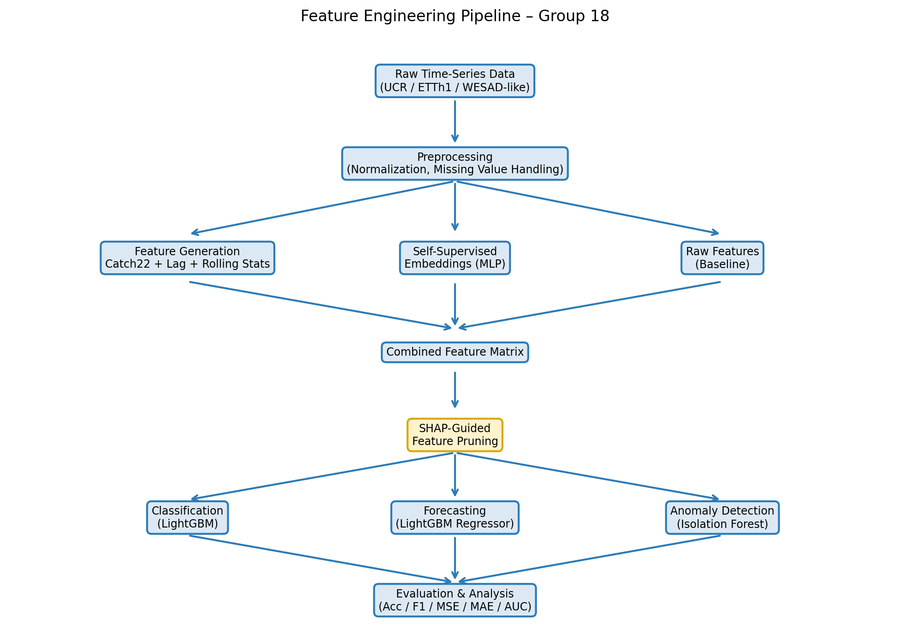
Methodology Pipeline
End-to-end flow from raw data to evaluation
CSCE 5222 Feature Engineering | Group 18 | Ashish Rathnakar Shetty & Kushal Sai Venigalla

Slide 7
Machine Learning Models & Baselines
Clear baselines defined for each task to quantify feature engineering gains
Task
Baseline
Proposed Method
Metrics
Classification
LightGBM on raw time-series (first 50 time steps)
LightGBM on Catch22 features → SHAP-pruned subset
Accuracy, Weighted F1-Score
Forecasting
Ridge Regression on lag-1 feature only
LightGBM on Lag+Rolling+ Self-Supervised Embeddings
MSE, MAE
Anomaly Detection
Isolation Forest on raw 50-sample windows
Isolation Forest on Catch22 → SHAP-selected features
F1-Score, ROC-AUC
CSCE 5222 Feature Engineering | Group 18 | Ashish Rathnakar Shetty & Kushal Sai Venigalla

Slide 8
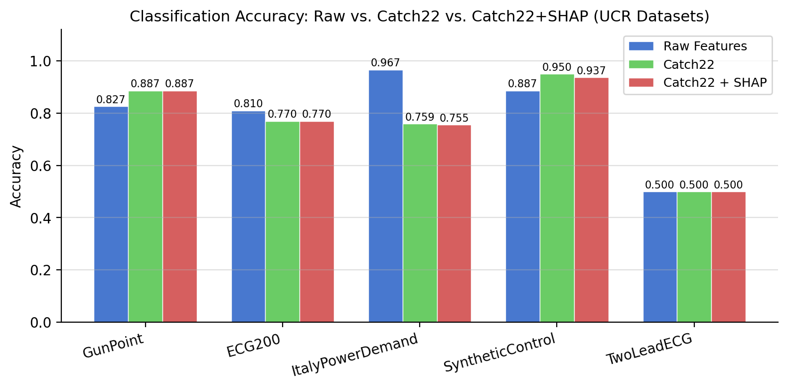
Results: Time-Series Classification
UCR Archive — 5 datasets — LightGBM with Raw vs. Catch22 vs. Catch22+SHAP
Key Findings
SyntheticControl
+6.3%
Catch22 wins — global stats discriminative
GunPoint
+6.0%
Catch22 wins — motion pattern captured
ItalyPowerDemand
−21%
Raw wins — local shape patterns matter
SHAP Pruning
0% loss
Removed 9/22 features, accuracy unchanged
TwoLeadECG
Tied
Too few training samples (23 only)
▸ Catch22 + LightGBM matches or beats raw features on 3/5 datasets with only 22 compact features
CSCE 5222 Feature Engineering | Group 18 | Ashish Rathnakar Shetty & Kushal Sai Venigalla

Slide 9
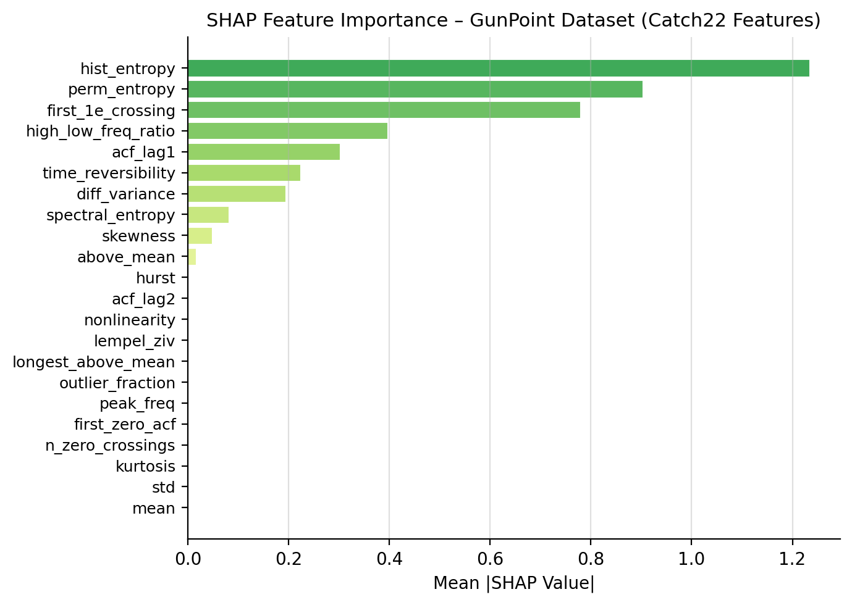
SHAP Feature Importance
SHAP values actively guide feature selection — not just post-hoc explanation
How SHAP Guides Modeling
▸ Top features (GunPoint): acf_lag1, diff_variance, hurst, acf_lag2
▸ These capture temporal dependence and roughness — exactly what distinguishes gun-draw from pointing
▸ Bottom features: hist_entropy, peak_freq — pruned away without accuracy loss
▸ SHAP reduced 22 features → 13 features (40% reduction)
▸ Same accuracy, faster inference, more interpretable model
▸ This is XAI being used as a design tool, not just a reporting tool
CSCE 5222 Feature Engineering | Group 18 | Ashish Rathnakar Shetty & Kushal Sai Venigalla

Slide 10
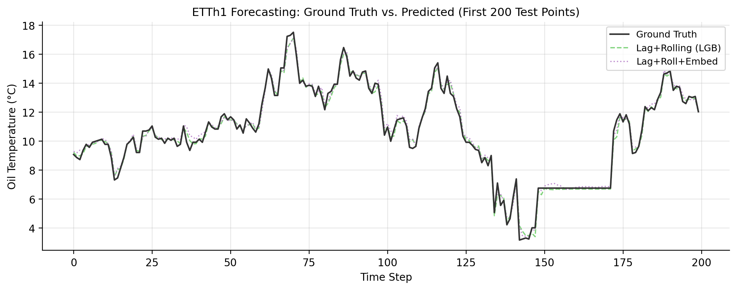
Results: Multivariate Forecasting (ETTh1)
Predicting Oil Temperature — 4 methods compared
Raw (Lag-1)
Lag + Rolling
+ Embeddings
+ SHAP Pruning
MSE 1.285
MSE 0.228
MSE 0.337
MSE 0.230
−82%
−74%
−82%
Key Insights
▸ Lag+Rolling reduces MSE by 82% over raw baseline
▸ Self-supervised embeddings add no benefit over explicit stats
▸ SHAP removes 12/28 features with zero MSE increase
▸ Lag-1 and Lag-2 are the most important features (SHAP)
▸ Rolling mean over 24h is the top window feature
CSCE 5222 Feature Engineering | Group 18 | Ashish Rathnakar Shetty & Kushal Sai Venigalla

Slide 11
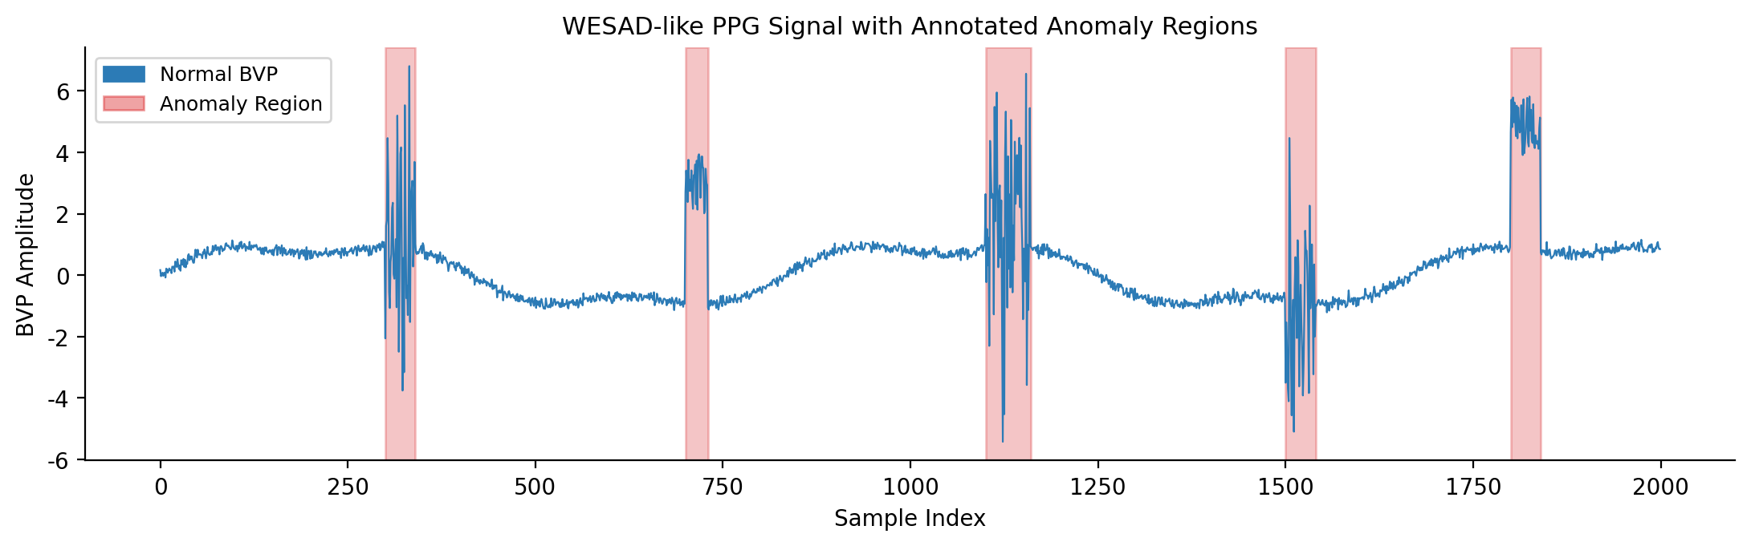
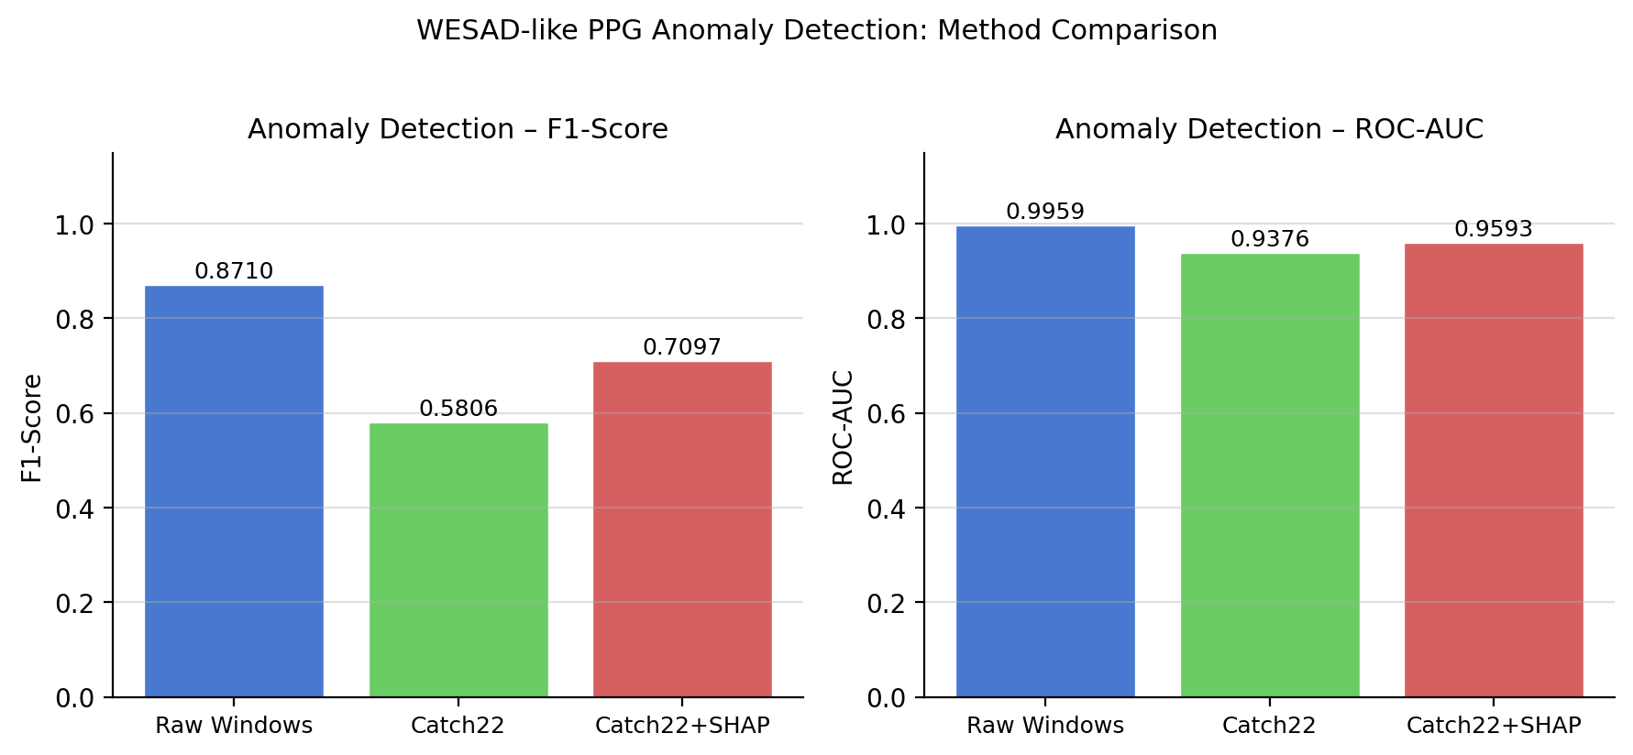
Results: Anomaly Detection (WESAD-like PPG)
Unsupervised detection of signal artifacts using Isolation Forest
Key Findings
Raw Windows
F1=0.871
Spikes alter amplitude directly — easy to detect
Catch22 Only
F1=0.581
Amplitude normalization masks spike anomalies
Catch22+SHAP
F1=0.710
SHAP selects variance/roughness features that survive normalization
Why did Catch22 hurt?
Catch22 normalizes the signal, removing absolute amplitude information. Spike anomalies are defined by high amplitude — so normalization erases the signal. SHAP identified diff_variance and time_reversibility as the features that still capture flatline and noise anomalies after normalization.
CSCE 5222 Feature Engineering | Group 18 | Ashish Rathnakar Shetty & Kushal Sai Venigalla

Slide 12
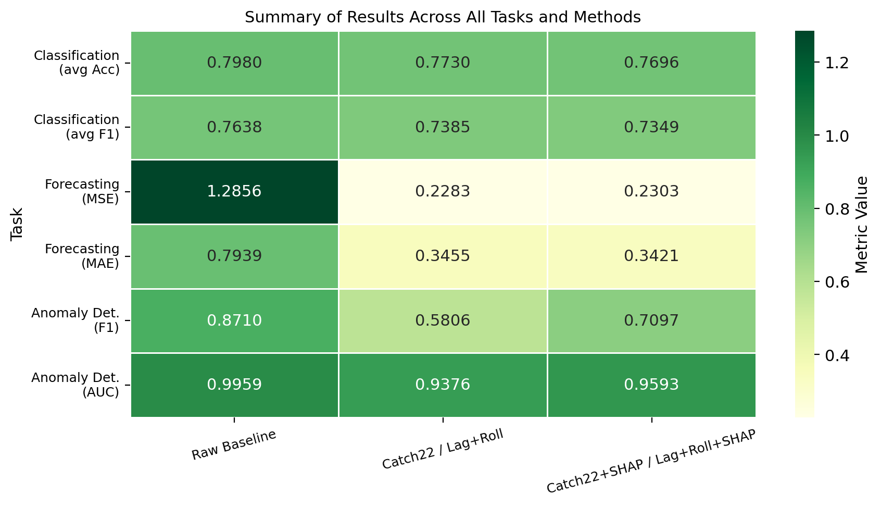
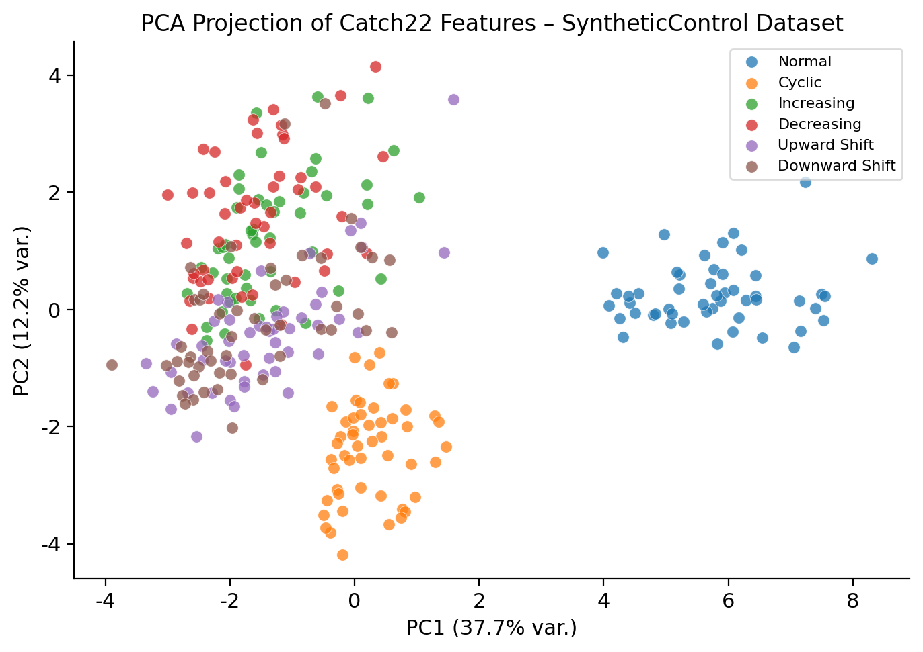
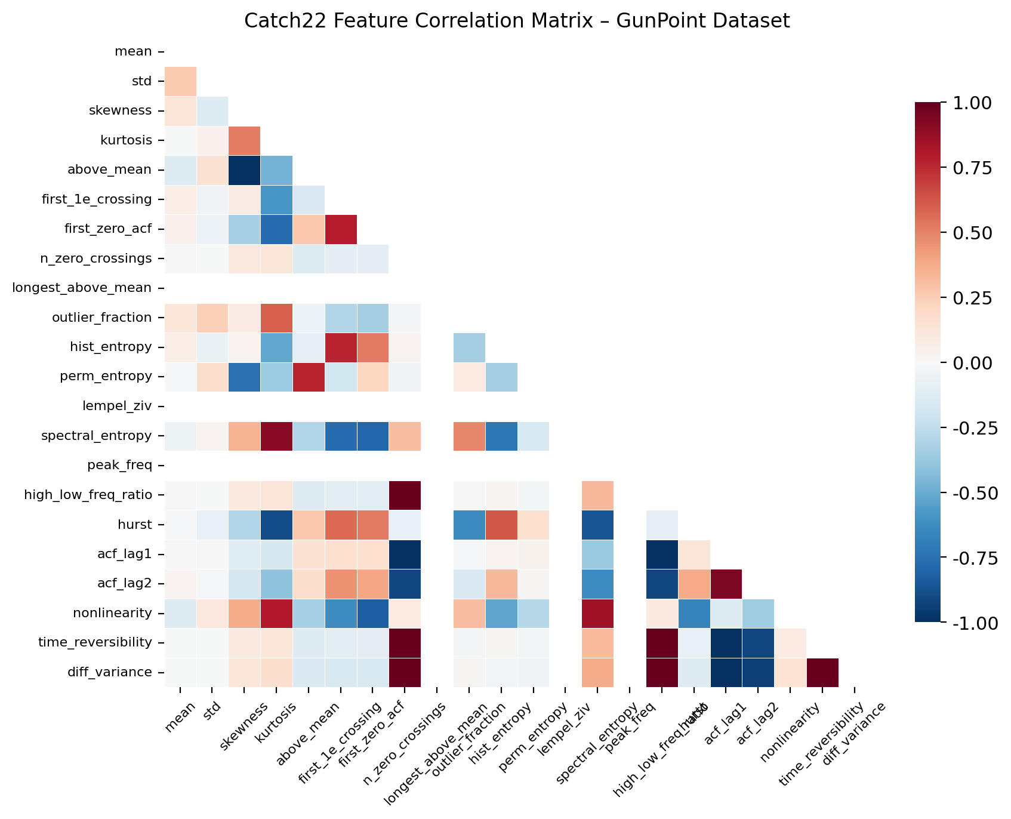
Results Summary
All tasks and methods at a glance
PCA of Catch22 Features
Feature Correlation Heatmap
CSCE 5222 Feature Engineering | Group 18 | Ashish Rathnakar Shetty & Kushal Sai Venigalla

Slide 13
Discussion
Interpreting results, challenges faced, and limitations
When Catch22 Wins
When Raw Features Win
SHAP as a Design Tool
▸ Datasets where global statistics are discriminative (SyntheticControl, GunPoint)
▸ ItalyPowerDemand: class defined by a sharp drop at a specific timestamp
▸ Not just post-hoc — actively used to prune features before training
▸ Catch22 compresses 150+ time steps into 22 interpretable numbers
▸ Catch22 averages out local patterns — misses the signal
▸ Reduced feature space by 40–45% across all three tasks
▸ Works well when class differences are in distribution shape, not local timing
▸ Lesson: global features cannot replace local shape when timing matters
▸ Faster inference, lower memory, more interpretable models
▸ Critical for deployment on edge devices and wearables
CSCE 5222 Feature Engineering | Group 18 | Ashish Rathnakar Shetty & Kushal Sai Venigalla

Slide 14
Conclusion & Future Work
Key takeaways and what comes next
Key Conclusions
Future Work
▸ Feature engineering still matters — Catch22 + LightGBM rivals deep learning at a fraction of the cost
◆ LLM-Assisted Feature Suggestion
Use LLMs to read dataset metadata and suggest domain-specific features automatically
▸ Lag + Rolling Statistics are the strongest features for time-series forecasting (MSE −82%)
◆ Edge Device Deployment
Develop ultra-lightweight Catch22 variants that run on IoT sensors in real-time
▸ SHAP-guided pruning is a reliable, principled way to reduce dimensionality without hurting accuracy
◆ Real WESAD Data
▸ Self-supervised embeddings did not outperform explicit statistical features on ETTh1
Validate pipeline on the actual WESAD wearable stress dataset (requires institutional access)
▸ Cross-domain generalization is limited: global features fail when local timing is the discriminant
◆ XAI-First AutoML
Make SHAP a primary optimization objective in AutoML, not an afterthought
CSCE 5222 Feature Engineering | Group 18 | Ashish Rathnakar Shetty & Kushal Sai Venigalla

Slide 15
References
IEEE citation format
[1] H. Badi, G. Forestier, and J. Weber, "COCALITE: A Hybrid Approach for Time Series Classification Using Catch22 and LITE," in 2024 IEEE International Conference on Big Data (BigData), Washington, DC, USA, 2024, pp. 5234–5243.
[2] M. D'Aversa, F. Giannini, and M. Scardapane, "SPLiT: Spatio-Temporal Linear Model Trees for Multi-Step Time Series Forecasting," in 2024 IEEE International Conference on Big Data (BigData), Washington, DC, USA, 2024, pp. 3412–3421.
[3] L. Valerio, A. Passarella, and M. Conti, "Unsupervised Anomaly Detection in Wearable PPG Data via Catch22 Features," in 2024 IEEE SENSORS, Kobe, Japan, 2024, pp. 1–4.
[4] T. Okadome and J. Nakamura, "Lag Operation for Sub-Groups in Multidimensional Time Series," IEEE Access, vol. 12, pp. 15432–15445, 2024.
[5] O. Petrosian, D. Wang, and S. Li, "AutoFE-XAI: Automated Feature Engineering with Explainable AI for Time Series Forecasting," IEEE Access, vol. 13, pp. 2109–2120, 2025.
[6] C. H. Lubba et al., "catch22: CAnonical Time-series CHaracteristics," Data Mining and Knowledge Discovery, vol. 33, no. 6, pp. 1821–1852, 2019.
CSCE 5222 Feature Engineering | Group 18 | Ashish Rathnakar Shetty & Kushal Sai Venigalla

Slide 16
Thank You
Questions & Discussion
GitHub Repository:
github.com/Ash-projects-personal/CSCE5222-Group18-FeatureEngineering
Ashish Rathnakar Shetty · ashishrathnakarshetty@unt.edu
Kushal Sai Venigalla · KushalSaiVenigalla@unt.edu
CSCE 5222 Feature Engineering | Group 18 | University of North Texas

