Slide 1
PEGA

Slide 2
Chapter 2 Introduction to Pega
Warsame
Pega Platform is a low code application development tool
Pega enables process automation
Includes guidance on best practices
Extend on pre-built application to save time and reduce costs
Build custom applications specifically tailored for you business
Pega applications may be deployed on the cloud or on the premises

Slide 3
Chapter 2: Situational Layer Cake
Warsame
The Situational Layer Cake approach is reusing application functions in different areas of your application
Rules are logical instructions of the application
Rules are grouped with other application rules to form a Ruleset
Ruleset
Ruleset
Ruleset
Common Application ruleset

Slide 4
Chapter 2: Pega studios
Aswene
Studio: | Features & Uses: | For:
APP | Application development (case design, UI, data+integration, etc) | Business analysts, application developers, front-end developers, data engineers
DEV | Advanced functionality (system settings, security, versioning+source control, etc) | Experienced application developers, account and security administrators
ADMIN | System operations (logs, jobs, queue processors, etc) | System administrators
PREDICTION | Develop AI and machine learning models for predictive, adaptive and text analytics, monitor performance and optimise models | Data scientists, decision architects
Notes:
Version+source control - changes to large documents

Slide 5
Chapter 3 Case Life Cylce
Warsame
The case life cycle is a modelling technique allowing business users to interact with a case the same way they would think about it.
Case Type - It is an abstract model of a business transaction
Case - A specific instance of the transaction

Slide 6
Chapter 3 Stages
Warsame
Represents a significant change in the status of a case
Each stage consists of one or more processes, which is made up of one or more steps
Primary stages are the high-level phases of a case life cycle
Happy path is the path a case would take if it does not deviate from the primary stages

Slide 7
Chapter 3 Alternate Stages.
Warsame
By default, when a stage is complete, there is an automatic transition to the next stage.
Alternate stages are used for when a case does not follow the primary stages
Example: If an item is out of stock, the case may move to an alternate stage to handle the ordering of items not in stock.
A change stage step can be used to transition back from the alternate stage to a primary stage.

Slide 8
Chapter 5: Optional actions
Aswene
Enables users to carry out an action no matter what stage or step the case is in.
Can execute sporadic tasks without affecting the main events (primary/happy path) of the case life cycle.
Two types of optional actions:
Optional process -> case-wide
Optional user action -> stage-only

Slide 9
Chapter 5: Conditionals
Aswene
Specifies if a stage or process will continue to completion or be skipped
User entered values must match the condition to run the stage or process the condition is in
Example: a process of payment collection is only carried out if the user checks the box to buy what is in the cart, else the process is skipped as it is not needed
Multiple conditions can be added -> Use the logical AND/OR to do so
Example: some sites require a minimum of 3 items in a cart to go to the checkout, so condition would be Buy=True & Items<=3, only then the checkout process is carried out

Slide 10
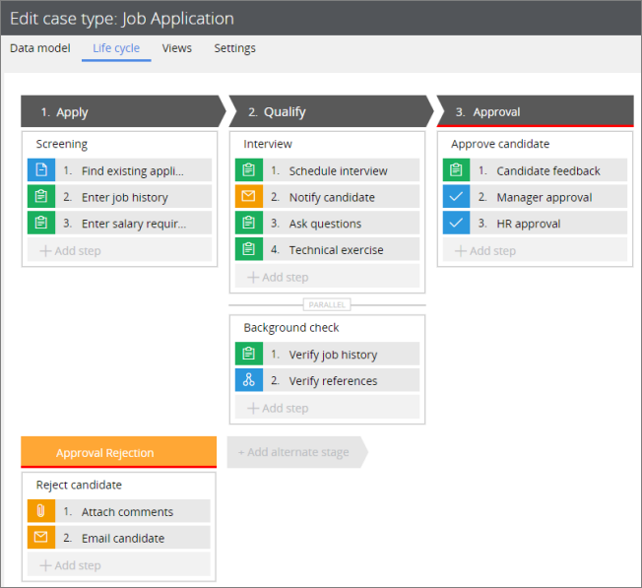
Chapter 5: Parallel processing
Aswene
Multiple processes carried out at the same time
All parallel processes are triggered when the stage starts
Increases efficiency

Slide 11
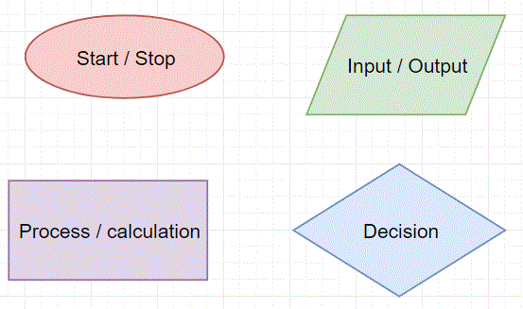
Chapter 5: Decision points
Aswene
In PEGA, a flow diagram is generated to model the sequence of events of a business process
Decision shapes are used to add a conditional path to cases that may require more than one outcome
Defining the “when” condition of different outcomes allows the workflow to advance automatically
Decision shapes used are:

