Slide 1
How AuxoCase decides
Scoring, routing and learning inside HubSpot: the mechanics behind the numbers
Technical walkthrough · November 2026

Slide 2
One Python service, three jobs, HubSpot as the system of record
FastAPI and Jinja2 for the pages, SQLite for the service's own state, scikit-learn for the model, httpx for HubSpot. One process; the jobs run on timers inside it.
In development a mock HubSpot in SQLite carries the real API's semantics: webhooks that duplicate and reorder, batch writes with per-record status, compare-and-set owners, property history. The real client is the same interface over the v3 API.
Nothing lives outside HubSpot that an SDR needs: the score, rank, reason and routing are written to the contact, and the SDR works from HubSpot's tasks and sequences.
175 tests, offline, no model calls. CLI for every job: seed, sync, train, approve, score, route, monitor, simulate, eval, serve.
HubSpot · contacts, companies, engagements, deals, owners, tasks, sequences
Job 1 · score
enrich → features → calibrated p(demo) → reader (quotes, ±10) → reason → flag → rank → batch write auxo_*
Job 2 · route
pool of unowned MQLs ≤ 30 days → p × freshness → team's weekly reach, 8% random → round robin, compare-and-set owner, task → held queue, SLA
Job 3 · learn
outcomes → labels → channel p-chart → monthly retrain on a time split → verdict rules → sign-off → live, shadow, rescore
Webhook or polling in; auxo_* properties, owner, tasks and meetings out. The handoffs are Blueprint's three jobs, kept as drawn.

Slide 3
What it reads from HubSpot, what it writes back, and how
Every write is idempotent: scores are keyed by contact, model version and a hash of the feature row, so a retry or a replayed webhook writes nothing new.
Writes to auxo_* properties do not re-trigger the scorer. The owner is set with compare-and-set so two routing passes cannot assign the same lead twice, and an assignment counts only when both the owner and the task exist.
Batch writes read the per-record status of a 207 reply and retry only the records that failed. With the real client, unsigned webhooks are refused.
The real client (hubspot/real.py) is written from the official docs and has not been run against a live portal; property internal names must be confirmed on the portal.
Direction | What | Mechanism
Read | Contact created, property changed | Webhook subscription to /webhooks/hubspot, or search polling by last-modified
Read | Emails, calls, meetings, replies | Engagements on the contact, polled every minute for the first touch and its outcome
Read | Deal stages, lead status, meetings | Hourly outcome sync into booked / worked-no-demo / not-worked labels
Write | auxo_score, auxo_probability, auxo_rank, auxo_reason | Batch property writes, keyed by contact + model + input hash
Write | auxo_review_flag, auxo_holdout, auxo_below_gate | The reader's open flag kinds; the exploration and below-gate marks
Write | hubspot_owner_id, a task due in 4 h | Compare-and-set on the owner; task and owner both required
Write | auxo_email_subject, auxo_email_body, sequence enrolment | The drafted email as contact tokens; step one is a manual email task the SDR sends
Write | Meetings, closed lead status | Demos booked for the SDR; replies that close the lead

Slide 4
Job 1: from a HubSpot record to one calibrated number
Eight steps, each deterministic except the reader, and the reader is boxed in: it may add or remove at most 10 points and only with quotes code finds in the record.
Before a model exists the channel-aware points table scores every lead; it stays as the cold start and as the baseline every version is measured against.
The reason an SDR sees is a template filled from the model's own per-feature contributions, so it is exact, and the counterfactual line says what would change the score most.
Scoring runs every 5 minutes on the change feed, 25 leads a batch; a new live model rescores the pool best-ranked first, within a time budget so the other jobs keep their minute.
1 Enrich
a blank title or size asked once of the licensed tool, written back, logged
5 Explain
per-feature contributions → fixed-wording reason codes → a counterfactual line
2 Features
channel, seniority, size band, industry, country; page views, forms, pricing views, webinar, referral, competitor
6 Flag
near the line, a large referral, text aimed at the scorer, the reader unsure → marketing's Leads to check
3 Model
calibrated p(demo) from the live logistic regression; the points table before one exists
7 Rank
place in the current pool of unowned MQLs created in the last 30 days
4 Reader
Claude lists buying signals in the notes with exact quotes; code verifies each, caps the effect at ±10 points
8 Write
batch write of auxo_* properties, keyed by contact + model + input hash

Slide 5
The features: computable from the record, nothing personal
Seventeen features, every one computable at scoring time from HubSpot fields alone, so any score can be reproduced from the record by its input hash.
Names, emails and note text are never features. Notes go only to the bounded reader. A blank is its own value: a missing title is 'unknown', not 'junior', which is what HubSpot's points get wrong for referrals and webinars.
Each contribution maps to a fixed sentence, so the reason on the lead is the model's arithmetic in words, not a generated paragraph.
Kind | Feature | Reason wording, when it moves the score
Categorical | channel | it came in as a partner or customer referral · through a webinar · through the website …
Categorical | seniority | the contact is C-level · a director · an individual contributor · there is no job title on record
Categorical | size_band | the company has 50 to 149 employees, inside the target band · the company size is unknown
Categorical | industry, country_group | fit against BrightPath's customers
Behaviour | log_page_views, log_visits, num_form_submissions, pricing_page_views, email_clicks_30d | it viewed the pricing page · it submitted two forms
Behaviour | webinar_registered, webinar_attended | it registered for a webinar · it attended a webinar
Fit | is_referral, has_competitor, in_target_size | the company already uses a competing payroll vendor · it is in the 50 to 500 employee band
Hygiene | is_student_or_intern, has_notes | the job title suggests a student or intern

Slide 6
Training protocol: tested once on unseen months, shipped as tested
Regularised logistic regression by default, because its contributions are exact; a gradient-boosted challenger wins only if it beats it on the time split and stays calibrated.
Labels are three-state: booked, worked without a demo, not worked. Not worked is unlabelled, never a negative, and leads younger than the maturity window are excluded, not counted as misses.
Fit on the oldest months of a 12-month window, choose the family and fit the Platt calibrator on the next two, report the newest two once. The model that goes live is the one measured; nothing is refitted.
Metrics at the capacity line K: precision@K and lift over HubSpot's points and over the points table, AUC-PR beside its base rate, Brier, expected calibration error. Never accuracy.
Train · Oct 2025 – Apr 2026 (7 months)
Calibrate · May–Jun
Test · Jul–Aug
demo-v6, the live model, on its own split
Train: fit LR and HGB on the feature matrix.
Calibrate: pick the family on precision@K, fit the Platt calibrator that maps the ranking score to a probability; its version travels with the model's.
Test: 1,652 leads, 897 booked; precision 0.690 at K 481 against HubSpot's 0.559; ECE 0.014. Reported once, stored in the registry, shown beside the live model at sign-off.
Live: the pool is rescored best-ranked first; the previous model stays as a shadow for one cycle and its precision on recent labels is shown beside the live one.

Slide 7
What the model adds over the points tables, every version
Against HubSpot's points, every version finds 13 to 26% more demos in its top K on the same test leads. Against the service's own channel-aware points table, the gap is close to nothing.
That is expected on worked leads: the SDRs' past choices hide the difference, because only leads someone chose to work have labels. On the generator's hidden truth, across every MQL, the model's 500 a month book 348 demos against 292 for HubSpot's points and 345 for the table.
The exploration slice is what closes that gap on real data over time: 8% of slots go to leads the ranking did not choose.
Lift at K is precision@K divided by the baseline's precision on the same leads; K is capacity's share of each version's test leads.

Slide 8
Live against the rest: the table the sign-off page compares
This is the table marketing signs from. Lifts and calibration error compare across columns; precision only within one, since each version has its own test months and K.
demo-v6 went live by the automatic sign-off: better lift over HubSpot than demo-v1, calibration within a point of it, more labelled rows. demo-v7 ranks best of all but its numbers are off by 12.7 points, so the rules sent it back whatever its lift.
Six candidates were each trained after one more simulated month; the months are the generator's clock.
Measure | demo-v6 · live | demo-v1 · previous live | demo-v7 · sent back
Trained | 2 Oct 2026 | 3 May 2026 | 1 Nov 2026
Trained on, then calibrated on | Oct 2025–Apr 2026 · May–Jun | not recorded | Nov 2025–May 2026 · Jun–Jul
Tested on · leads · booked | Jul–Aug 2026 · 1,652 · 897 | Feb–Mar 2026 · 1,000 · 358 | Aug–Sep 2026 · 2,228 · 1,277
Precision at K | 0.690 at K 481 | 0.448 at K 299 | 0.736 at K 626
HubSpot's points · points table | 0.559 · 0.699 | 0.375 · 0.445 | 0.585 · 0.713
Lift over HubSpot's points | 1.234× | 1.196× | 1.260×
Lift over the points table | 0.988× | 1.008× | 1.034×
Calibration error (ECE) | off by 1.4 points (0.014) | off by 0.7 points (0.007) | off by 12.7 points (0.127)
AUC-PR (base rate) | 0.677 (0.543) | 0.446 (0.358) | 0.706 (0.573)
Labelled rows · booked | 5,595 · 2,550 | 5,404 · 1,880 | 6,248 · 3,029

Slide 9
Calibration: when demo-v6 says 55%, about 54% book
The score on a lead is a probability, and on the test months it holds: across the bands with enough leads the gap between what the model said and what booked is a point or two.
Expected calibration error is 0.014 over 1,652 test leads. Bands under 30 leads are shown hollow on the page and read loosely; here they are left out.
This is the property that makes the number shared: a 55 means the same thing to marketing planning a campaign and to an SDR choosing what to call next.
A candidate whose calibration is more than a point worse than the live model's is sent back by the rules, whatever its ranking: an SDR cannot act on a number that lies.
Score band | Leads | Average score | Booked
20–30% | 33 | 26% | 12%
30–40% | 89 | 36% | 34%
40–50% | 382 | 46% | 46%
50–60% | 595 | 55% | 54%
60–70% | 387 | 64% | 64%
70–80% | 137 | 74% | 77%
80–90% | 15 · few | 82% | 93%

Slide 10
Job 2: routing within capacity, ordered by value now
Fixed rules, no AI. The pool is the unowned MQLs created in the last 30 days, ordered by p(demo) × 0.5 once a lead is past its first day.
The team holds at most its reach in untouched leads: a week's touches at its monthly capacity, handed out round robin, skipping full desks. 8% of slots go to a lead drawn at random from below the line, marked auxo_holdout. The first email or call logged in HubSpot is the first touch; within a minute the slot is refilled.
A task due in 4 hours alerts the SDR; no touch in 24 hours brings a reminder. A strong lead unplaced for 24 hours, or one the skips model says the SDRs would skip, goes to the manager's held queue with the reason.
Runs every 5 minutes, one lead at a time under a write lock, owner set by compare-and-set.
Freshness discount | Waiting leads a desk | Touched within 24 h | Demos a month
off | 3 | 15% (13–17%) | 205 (196–215)
on | 3 | 31% (29–33%) | 224 (214–235)
on | 2 | 49% (49–50%) | 249 (236–259)
on | 1, refilled on touch | 64% (61–66%) | 274 (267–280)
python run.py queue-limits --seeds 5: one simulated month per setup at the brief's capacity, seeds 101 to 105, range in brackets. History booked 172.

Slide 11
Capacity is measured from the SDRs' own touches, not typed
Leads a month = SDRs × hours a month ÷ minutes a lead. Minutes a lead = the cold touch, less what the AI steps take off it, plus two follow-ups unless they are sent for the SDR.
Two inputs are read from HubSpot: the minutes a cold touch is the median gap between one first touch and the next inside a working session (a gap over 45 minutes ends a session), and the hours a month is the time in those sessions scaled to a month.
Each replaces its default once the evidence is there: 30 gaps across 2 SDRs, or 10 days with a touch for 2 SDRs. A figure typed on the Leadership page wins over both; typing the measured one back drops the typed one.
The capacity line, the Overview, the simulator and the cost report all read the result, so one change moves every page.
Input | Default | Now | Source
Minutes a cold touch | 20 | 20 (measured so far: 17.5) | assumed until 2 SDRs have 30 gaps; 11 touches by 3 SDRs so far
Minutes a follow-up, SDR sends it | 5 × 2 | 0 | follow-ups sent for the SDR
Minutes logging a call | 4 | 1 | call notes written up
Minutes booking a demo | 8 | 1 | demos booked for the SDR
Minutes a skip | 3 | held instead | likely skips held for the manager
Hours an SDR gives leads a month | 20.8 | 20.8 | assumed until 2 SDRs have 10 active days
Leads a month | 500 | 1,031 (86 a desk) | 12 × 20.8 h ÷ 14.55 min
The call-log, booking and skip savings apply on the share of touches that are calls, that book, or that would have been skipped, so the net is 14.55 minutes a lead on the demo data.

Slide 12
Job 3: outcomes flow back and the monitor says when to retrain
Every hour meetings, deal stages and lead status become labels. Every day a p-chart per channel sets the observed demo rate against the average score of the leads worked, with limits three standard errors either side; under 30 worked leads a month is held, not judged.
Faster follow-up changed the base rate: leads booked more because they were touched sooner, so January 2027 is above prediction on five of six channels. That is the alarm; the fix is a retrain, not a channel weight.
Every 30 days a candidate is trained on the sliding window of mature labels and appears on the Lead scoring page beside the live model.
The close model trains only on post-demo rows and is reported separately; closed-won is never the demo model's target.
Channel | Worked | Demos | Flag
Website | 605 | 347 | above prediction, retrain due
Paid ads | 145 | 71 | above
Email | 82 | 44 | above
Events | 86 | 44 | inside limits
Referral | 48 | 38 | above
Webinar | 75 | 62 | above

Slide 13
The sign-off is fixed rules; the reader only puts them into words
A manager who does not know ML should not read seven columns of decimals to sign a model off. Code compares the candidate with the live model on three things they can feel and writes one line.
The rules run at every page load, so a verdict is never missing. Claude words the reasons in one sentence; code keeps it only if it starts with the verdict, stays under 60 words, uses no modelling word and cites no figure the facts do not hold. Otherwise the rules' own wording stands.
Automatic sign-off, on unless switched off by name: each run sends back what the rules send back, promotes the approvable candidate whose picks book the most demos, and sends the rest back as not the best of the round. The rows are ordinary approvals, so Decisions shows them like a person's.
Rule, against the live model on each one's own test leads | Verdict
Calibration error more than one point worse than the live model's | Send back, whatever the lift: the number on a lead could not be believed
Lift over HubSpot's points better by more than 0.005 and at least as many labelled rows | Approve
Lift no better, or fewer labelled rows | Send back: a reshuffle of every queue would buy nothing
Test results not recorded | Send back: it cannot be judged
The line under demo-v6's sign-off, worded from the rules' facts
“Approve: its top picks book 23 percent more demos than HubSpot's list would, where demo-v1's 20 percent; when it says a lead is 55 percent, about 54 percent of those leads book, so the number on a lead can be believed; and it learned from more worked leads, 5,595 against 5,404.”
Checked: starts with the verdict · 52 words · no 'lift', 'calibration', 'model' or 'rows' · every figure (23, 20, 55, 54, 5,595, 5,404) is one of the facts.

Slide 14
Where Claude is used, and what code checks before anyone sees it
The model never asks the reader for a number. Every generative step reads text, must quote the record, and is checked by code; a malformed answer falls back to the deterministic path.
Three modes behind one interface: AUXO_LLM=cli runs the Claude Code CLI headlessly, api the Anthropic API, and the default offline a scripted reader, so the whole system, the tests and the demo run without a model.
Each call is metered, so the cost report prices a demo with the reader's own spend in it (about 2 cents a draft at the defaults).
Reader | Reads | Produces | Code's check
Signals | the lead's notes | buying signals with exact quotes | each quote found verbatim; effect capped at ±10 points
Reason | the model's contributions | a plain-English rewrite | every fact in the rewrite is in the contributions
Emails, call brief | the record and the score's drivers | first email, follow-ups, opener, questions, voicemail | template fallback; checked for facts, length, no promises
Replies | a reply as HubSpot logs it | kind + one-line summary; the answer drafted | fixed kinds; out of office never counts as an answer
Call notes | fragments in the call log | summary, size, next step, follow-up | facts must come from the fragments
Scheduling | an interested reply | three times offered; the named time booked | the time must parse; a taken slot gets new times
Loss reasons | free-text closed-lost reason | one of seven categories, with a quote | category dropped if the quote is not in the text
Flags | the record of a lead next out | a flag kind from a fixed list, with evidence | evidence verbatim in the record; never changes a score
Verdict | the rules' reasons and facts | one sentence | verdict word first, < 60 words, no jargon, only the facts' figures

Slide 15
The five AI steps, as code: a switch, a trigger, an action, a check
Each step is a setting the sales manager throws on the Leadership page, recorded by name, and a module under routing/ with its reader under llm/.
All five act only after the SDR's first touch and stop the moment the lead answers or books, or when the SDR stops them from the lead page. On the mock the sends are logged; on a real portal the sequence's own steps send from the rewritten contact tokens.
Each takes minutes off the capacity formula only on the share of touches it applies to, so the saving on the Leadership page is what the SDRs' own mix of calls, bookings and skips earns.
Switch | Module | Trigger | Action | Minutes
followups_auto | routing/followups.py | first email was the first touch | follow-up at +3 days, last email at +7, drafted from that day's activity, sent from the SDR | 10 → 0 a lead
replies_auto | routing/replies.py, llm/replies.py | a reply lands on an owned lead | interested or a question: answer drafted, lead first in queue; not now: date recorded; not interested, wrong person, unsubscribe: closed | 10 → 4 a reply
call_notes_auto | routing/callnotes.py, llm/callnotes.py | a call logged with notes | summary and facts on the lead, size on the company, next step as a task, follow-up drafted | 4 → 1 a call
skips_auto | routing/skips.py | every routing pass | skip and junk decisions counted by trait, smoothed; a trait skipped clearly above the rest holds the lead with the reason | 3 saved a skip
scheduling_auto | routing/scheduling.py, llm/scheduling.py | an interested reply | three free times from the SDR's calendar offered; a named time booked in HubSpot, confirmed, follow-ups stopped | 8 → 1 a booking

Slide 16
What it costs: about $65,000 to go live, then about $180 a month
The software is built: 13,000 lines, 175 tests, a mock portal with HubSpot's semantics. The one-off cost is the work of putting it on BrightPath's portal and running it for a measured month, about 470 hours.
At $120 an hour for a senior engineer that is $52,000; with a 25% contingency for what a live portal turns up, about $65,000, well under the brief's $100,000 to $300,000. BrightPath's own time is the HubSpot admin, the sales manager and marketing for the setup and two hours of training an SDR.
Running it is one small server and the model calls: about 10 million tokens a month, metered by the Claude CLI on the demo's 1,550 calls so far at the same per-call cost it reports to Revenium, scaled to 1,128 leads worked a month. Drafting on Opus is most of it; HubSpot needs no new seats and the enrichment tool is already licensed.
Model spend is about 12 cents a demo against $26 of SDR time and $4,800 a demo is worth. One month of the simulated gain ($2.3 M of first-year contract value) covers the build thirty times over; at a tenth of that gain, once.
One-off: going live on BrightPath's portal | Hours | Cost
Live HubSpot integration: properties, webhooks, batch writes, sequences, meetings, calendars checked against the portal | 120 | $14,400
First model on three years of history, outcome fields mapped, enrichment tool and loss reasons connected | 100 | $12,000
Hosting, secrets, backups, monitoring, security review | 40 | $4,800
The SDRs' sequence, saved views or CRM card, onboarding and docs | 40 | $4,800
The measured month: support, fixes, AI steps on one at a time, first retrain and sign-off | 80 | $9,600
BrightPath's own time: HubSpot admin 40 h, manager and marketing 20 h, SDR training 24 h | 84 | $6,000
Total, with a 25% contingency on the engineering | 464 | about $65,000
Running, a month | Model | Calls | Tokens a call | Cost
First email, follow-up, last email | Opus | 2,800 | 1,260 | $44
Call briefs, demos booked, replies triaged, call notes | Opus, Sonnet | 2,660 | 1,500 | $26
Signals, reasons and flags on scored leads | Sonnet | 4,130 | 850 | $13
Verdicts, loss reasons; likely skips need no model | Sonnet | 120 | 1,000 | under $1
Hosting, one small server (HubSpot seats and enrichment already paid) |  |  |  | $100
Total |  | 9,700 | ~10 M a month | about $180

Slide 17
Who may do what, and what keeps the pages and writes safe
Three roles. The role on the session decides the sidebar and what each route allows; who approved, released or threw a switch is recorded from the session, never typed.
Passwords are scrypt hashes; five wrong tries lock the account for fifteen minutes. Sessions are HttpOnly cookies stored as hashes, idle twelve hours at most.
Only the host names in AUXO_ALLOWED_HOSTS are served; a write from another site's origin is refused; every response carries nosniff, no-framing and a content security policy that allows scripts from this service only. Forms that act on a lead or a model carry the state the person saw, so a stale edit is refused and explained.
Role | Sees | May
SDR | their own queue and its leads | work, skip, junk, nudge a rank; send the checked drafts; stop the follow-ups
Sales manager | overview, every queue, held & overdue, decisions, leadership, lead scoring, leads to check | everything: set capacity, throw the switches, run jobs, manage staff, release held leads with a note, sign off for either team
Marketing | lead scoring, how it decides, leads to check | approve or send back for marketing, resolve flags, switch the automatic sign-off off
Webhooks
Signed by HubSpot's app secret with the real client; unsigned ones refused. The mock's duplicated and reordered events are handled the same way.
Personal data
Business contacts only. No names, emails or note text in the features; the service's database keeps the scores and decisions, HubSpot keeps the record.
Least privilege
The private app gets the contact, engagement, task, sequence and meeting scopes it writes with and nothing wider; the MCP server, if used, is read-only.

Slide 18
The jobs on timers inside the server
run.py serve runs the jobs on timers in the same process; each run is one row in the Overview's recent runs, and a failed job never stops the others.
Training only produces a candidate; it goes live through the sign-off. Rescoring after a promotion stops after 45 seconds a run so the other jobs keep their minute, and resumes best-ranked first.
AUXO_SCHEDULER=off turns the timers off and AUXO_EVERY_<JOB>_MIN changes an interval; every job is also a CLI command and a /jobs/* endpoint, so a HubSpot or n8n workflow can call it.
On the demo data the service clock is frozen, so leads never age into new holds or reminders there; run.py rebase moves the dates onto the present and lets the clock run.
Job | Every | What it does
score | 5 min | scores new or changed leads from the change feed, 25 a batch, writes auxo_*
rescore | 1 min | after a model goes live, rescores the pool best-ranked first, 45 s a run
route | 5 min | fills the team's reach, round robin, 8% exploration; holds and reminders
touches | 1 min | reads first touches, call outcomes and replies from the contacts' activity
outreach | 1 min | drafts the first email for new assignments, enrols the sequence
followups | 5 min | sends the follow-up and last email on their day, when switched on
flags | 10 min | marketing's leads to check; the verdict sentences; the automatic sign-off
remind | 60 min | re-alerts assigned leads with no first touch by the 24 h SLA
sync | 60 min | meetings, deal stages and lead status into outcome labels
monitor | daily | the per-channel p-chart of observed against predicted demo rate
train | 30 days | a candidate model on the sliding window of mature labels

Slide 19
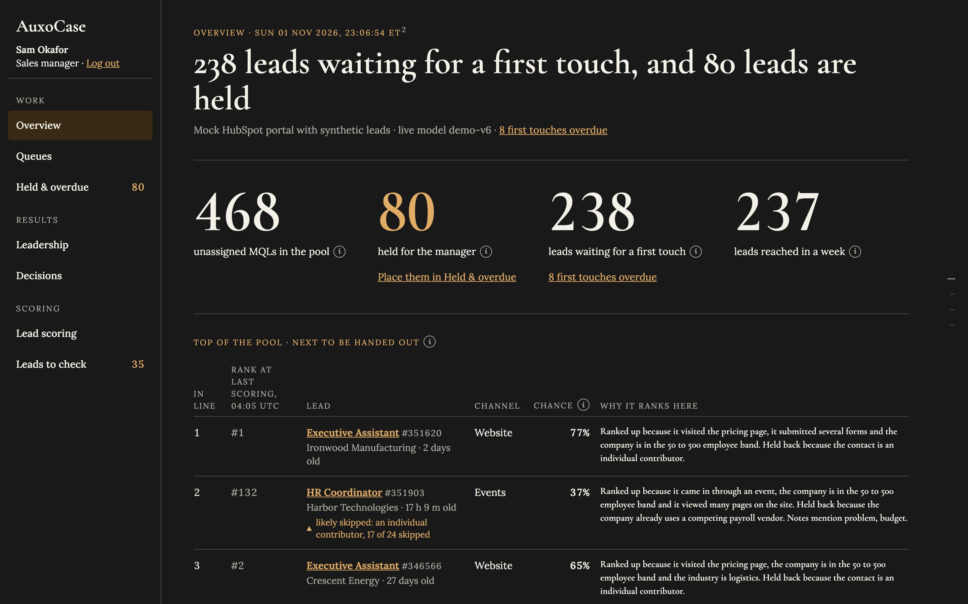
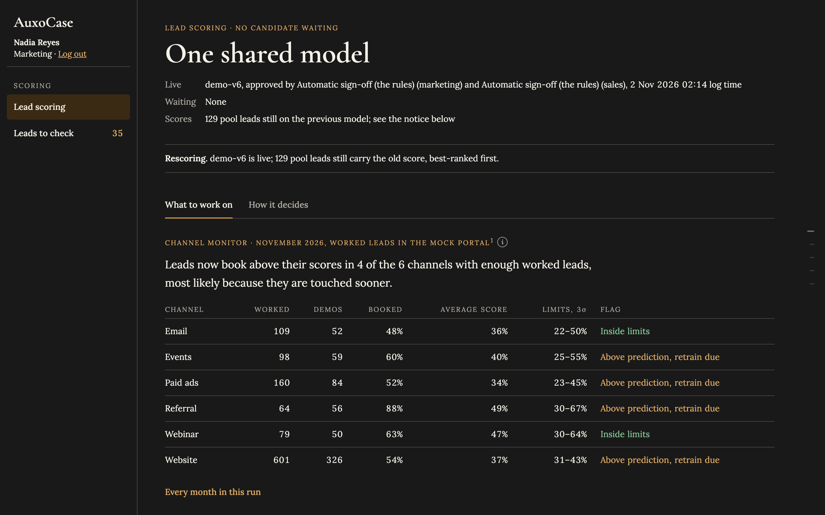
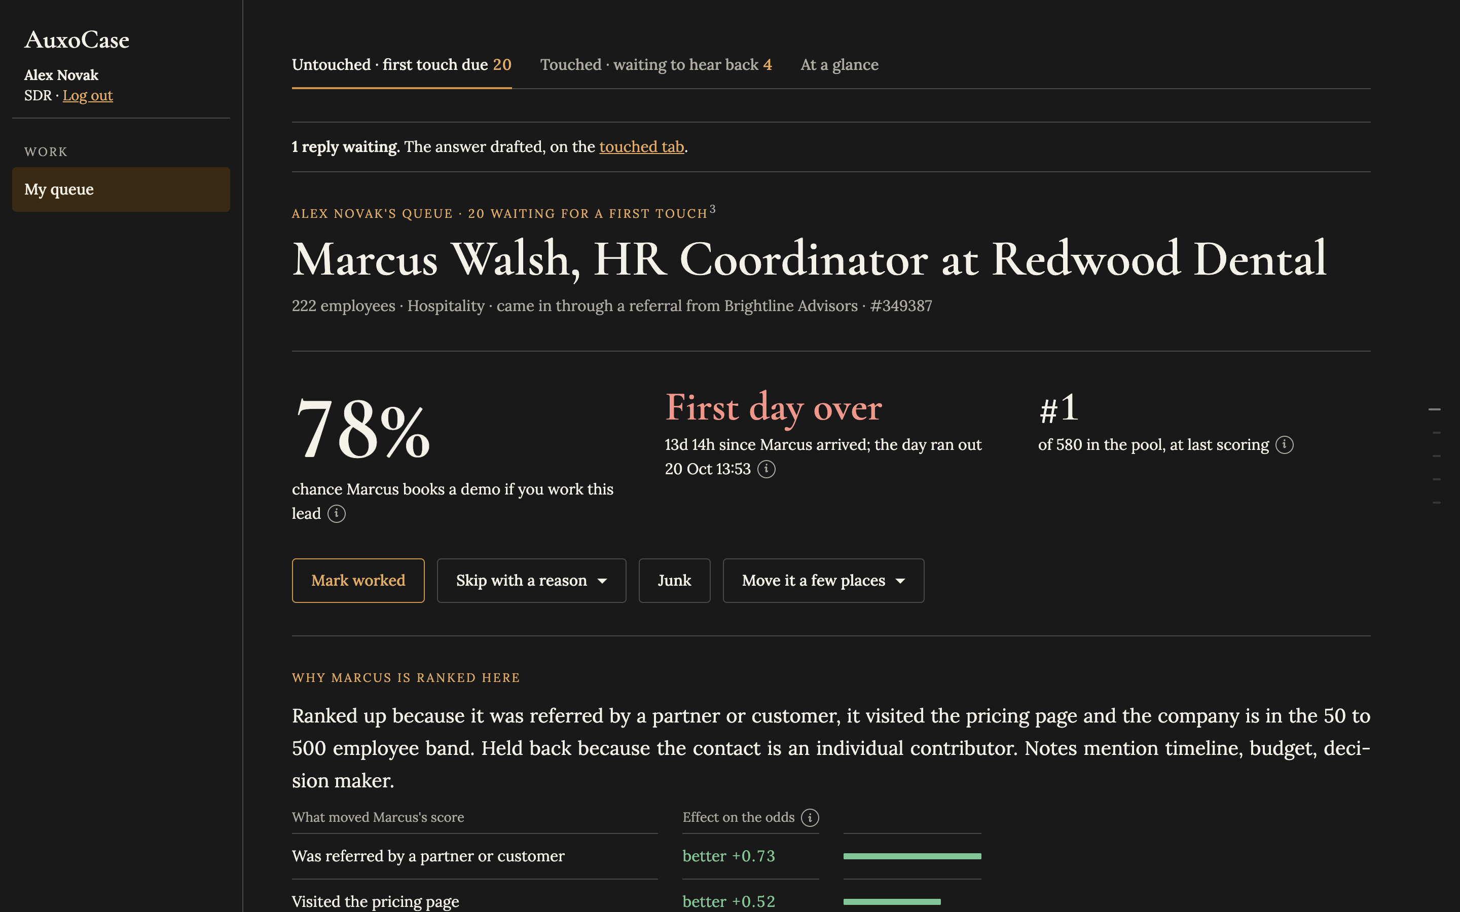
See it running: one page a role, each a link to the demo
Sales manager · Overview
Logged in as manager: the pool, leads reached in a week, every SDR's numbers; held queue, decisions and leadership in the sidebar.
Marketing · Lead scoring
Logged in as marketing: what to work on, the live model and its sign-off; How it decides and Leads to check beside it.
SDR · Alex Novak's queue
Logged in as sdr1: one lead at a time with its odds, rank and reason, the drafted email and the call brief.
Click a screenshot or its title to open the page on the machine running the service (localhost:8002); the accounts and password are on the login page. Every page is also listed on the next slide.

Slide 20
Every demo page, by role
The mock portal runs on this machine at localhost:8002. Every page is behind a login; the demo accounts and the password are listed on the login page.
Log in as manager to see everything, as marketing for the scoring pages, and as sdr1 (Alex Novak) for one SDR's queue. Logging in as another account replaces the session.
Each row links to the page. Open the deck on the machine running the service, or swap the host for the deployment's.
Who | Page | What it shows
Sales manager · manager | Overview | Pool, leads reached in a week, every SDR's numbers, recent runs
Sales manager | Held & overdue | Leads held with a reason, released by hand with a note to the SDR
Sales manager | Decisions | Every worked, skipped, junk, approval and switch, by name
Sales manager | Leadership | The shared number, where the gain comes from, capacity and its switches
Marketing · marketing | Lead scoring | What to work on, the live model, the sign-off
Marketing | How it decides | What the model adds, every version, calibration, the channel monitor
Marketing | Leads to check | Records that disagree with their number, with the record's own words
SDR · sdr1 | Alex Novak's queue | One waiting lead at a time, the reason, the drafted email, the call brief
Any role | /jobs/* | The jobs as endpoints, for a HubSpot or n8n workflow; /webhooks/hubspot takes the subscription
Notes:
Demo accounts: manager (Sam Okafor), marketing (Nadia Reyes), sdr1 to sdr12; the password is on the mock portal's login page.

Slide 21
Known gaps, and the seven steps to a live portal
What is not yet proven, stated plainly.
The real HubSpot client has never run against a live portal; property internal names vary by portal and must be confirmed.
Every evaluation figure is on synthetic data; the first-day effect is the generator's assumption from BrightPath's answer 4.
The measured capacity rests on 11 first touches by 3 SDRs; the defaults stay in force until the thresholds are met.
On worked leads the model barely beats the channel-aware points table; the exploration slice must run for months before that gap can be read on real data.
Scoring below the MQL gate and the automated sequence below the capacity line are built and off; both wait for outcomes there.
Step | Going live in HubSpot
1 | Create the auxo_* contact properties (ensure_properties) and a private app with the scopes in docs/ARCHITECTURE.md
2 | Set HUBSPOT_PRIVATE_APP_TOKEN; point a webhook subscription at /webhooks/hubspot with HUBSPOT_APP_SECRET, or poll by last-modified; add the host to AUXO_ALLOWED_HOSTS
3 | Confirm property internal names against GET /crm/v3/properties/contacts on the portal
4 | Train the first model on the three years of history, mature labels only, exploration slice on from day one; set stale_lead_factor from the measured speed effect; one waiting lead a desk
5 | Connect the enrichment tool behind the Enricher interface (AUXO_ENRICH); run losses on the closed-lost history
6 | Create the SDRs' sequence: step one a manual email task from the auxo_email tokens; later steps automated from the same tokens; set AUXO_SEQUENCE_ID and connect each SDR's inbox
7 | Put the queue in a HubSpot CRM card or a saved view sorted by auxo_rank with auxo_reason as a column; the service's pages do the same standalone

Slide 22
Appendix: HubSpot's points against AuxoCase's points table
HubSpot's points model, as the brief describes it: title, size and pages, nothing for channel, nothing for a blank
AuxoCase's points table (points-v2): the cold start before a model is approved, and the baseline every model is measured against
What HubSpot scores | Points
Job title: C-level | 30
Job title: VP | 26
Job title: Director | 20
Job title: Manager | 12
Job title: individual contributor | 3
Job title left blank | 0
Company size 50 to 500 employees | 18
Company size 20 to 49 or 501 to 1,500 | 10
Company size outside that, or blank | 0
Page views: 12 or more · 7 · 4 · 2 | 25 · 18 · 10 · 5
Viewed the pricing page | 10
Channel (referral, webinar, event, website, email, paid ads) | nothing
MQL at 47 points or more | the gate
What AuxoCase scores | Points
Channel: referral · webinar · events | 25 · 18 · 10
Channel: website · email · paid ads | 8 · 5 · 4
Job title: C-level · VP · Director | 15 · 14 · 12
Job title: Manager · individual · blank | 8 · 2 · 0
Company size 150 to 299 | 15
Company size 50 to 149 · 300 to 500 | 12 · 12
Company size over 500 · blank · under 50 | 4 · 3 · 2
Attended a webinar | 8
Pricing page, a view (capped at 12) | 4
Form submitted, each (capped at 9) | 3
Page views, per 5 (capped at 6) | 1
Competing payroll vendor in place | −6
Student or intern title | −20
Kept between 0 and 100; a blank is not a zero
Once a model is approved it replaces the table: a calibrated probability from 17 features, with Claude's reading of the notes capped at ±10 points. On the test leads the live model finds 23% more demos in its top K than HubSpot's points and about as many as this table; the table's edge over HubSpot is the channel row.

Slide 23
Deterministic where it decides, generative only where it reads
A calibrated model ranks, fixed rules route and sign off, code checks every sentence the reader writes, and HubSpot stays the record.
Next: a live portal, one measured month, and the first retrain on BrightPath's own outcomes.

