Slide 1

MAHATMA GANDHI INSTITUTE OF TECHNOLOGY(A)
DEPARTMENT OF INFORMATION TECHNOLOGY
An Industry Oriented Mini Project(IT653PC)
On
SMART WATER SCARCITY ANALYSIS AND DISTRIBUTION SOLUTION
By
D Ashrith Reddy(22261A1216)
Aruri Nikhil(22261A1205) Batch ID: IT-25-13
Internal Supervisor
Mr. B. Lokesh
Assistant Professor
IOMP Supervisor
Dr. U. Chaitanya
Assistant Professor

Slide 2
OUTLINE
ABSTRACT
INTRODUCTION
EXISTING SYSTEM
PROPOSED SYSTEM
APPLICATIONS
REQUIREMENTS
LITERATURE SURVERY
PROBLEM STATEMENT
OBJECTIVES
MODULES DESCRIPTION
ALGORITHM
DESIGN ARCHITECTURE&UML DIAGRAMS
CODE EXECUTION
TEST CASES
CONCLUSION AND FUTURE ENHANCEMENT
REFERENCES

Slide 3
Abstract
Water scarcity is a growing concern worldwide, requiring efficient monitoring and distribution strategies for the growth and needs of common citizens as well as the entire society. The Smart Water Scarcity & Distribution System leverages Google Earth Engine (GEE), NASA GRACE, and MODIS, EOS-04 datasets to analyze groundwater levels and rainfall trends in real-time. This system provides precise water availability predictions, enabling authorities to plan optimal water distribution based on demand and scarcity levels.
The system utilizes remote sensing data to fetch historical and real-time water availability for any given location. It classifies regions into scarcity levels and predicts future water consumption using machine learning techniques. Real-time weather data from OpenWeatherMap API further enhances accuracy. Based on the collected data, the system generates visual trends and helps governments and municipalities distribute water efficiently to high-demand areas.
The system uses WorldPop and NASA SEDAC datasets as well to fetch the real time population and population density data to estimate the water consumption for each area based on which we can predict the water demand for every area based on the historical data.

Slide 4
Introduction
Water is one of the most essential resources for human survival, yet many regions around the world face water scarcity due to climate change, overuse, and poor distribution systems.
Identify water scarcity levels in different locations.
Predict water demand based on population and usage patterns.
Suggest optimized water distribution strategies to ensure fair supply.
The system will fetch real-time weather and hydrological data, analyze historical trends, and use machine learning models to estimate how much water is required for a given area.

Slide 5
Existing System
Groundwater levels are monitored using manual readings from observation wells, taken monthly or quarterly by government departments (e.g., CGWB, WRIS).
No integration of real-time APIs for weather, water demand, or remote sensing.
Delayed insights due to dependency on physical data collection and yearly reporting cycles.
Data is displayed in static government portals or documents, without interactive dashboards or maps.
Decision-making is based on intuition or generic thresholds, not real-time data insights or forecasts.

Slide 6
Proposed System
District-level water scarcity detection using real-time data and satellite imagery.
Classification of regions based on severity of water scarcity: Low, Medium, High, Critical.
User-friendly dashboard with maps, charts, and scores built in Streamlit.
Outputs Provided
Choropleth heatmaps: One for groundwater availability proxy (ET + SM) and One for scarcity index (composite score)
Real-time temperature, rainfall, humidity
Interactive district selector: Choose any region and instantly view data

Slide 7
Applications
Government & Water Resource Planning
Agriculture & Irrigation Management
Farmer Advisory & Rural Decision Support
Urban Water Supply & Municipal Planning
Climate Change Monitoring & Adaptation
Policy Making & Public Transparency
Research, Education & Academic Use

Slide 8
Hardware and Software Requirements
Hardware Requirements
Laptop/PC: Minimum Intel Core i5 / Ryzen 5, 8GB RAM, 256GB SSD.
Operating System: Windows 10/11, Ubuntu 20.04+, macOS 10.15+.
Software Requirements
Python 3.8+ (Main programming language).
Streamlit (For web-based UI & visualization).
Google Earth Engine (GEE) (Fetching groundwater, rainfall & population data).
OpenWeather API (Real-time temperature & humidity data).

Slide 9
Literature Survey
S.NO |  | AUTHOR NAMES, YEAR OF PUBLICATION | JOURNAL OR CONFERENCE NAME AND PUBLISHER NAME | METHODOLOGY/ ALGORITHM / TECHNIQUES USED | MERITS | DEMERITS | RESEARCH GAPS
 | 1. | Abdessamad Elmotawakkil et al., 2024 | Journal of Hydroinformatics, IWA Publishing | Gradient Boosting Regressor (GBR), SVR, Random Forest (RF), Decision Tree (DT) using GRACE, MODIS, and CHIRPS satellite data | Achieved 99% R² using GBR; integrated remote sensing & ML; high predictive accuracy | Computationally intensive; GBR model needs fine hyperparameter tuning | Lacks integration of real-time weather & population data; limited to Morocco region
 | 2. | Tao et al., 2022 | Environmental Earth Sciences, Springer | Support Vector Regression (SVR) using soil moisture and NDVI for groundwater prediction | Effective handling of nonlinear relationships; robust prediction | SVR peraformance sensitive to kernel and tuning | Limited scalability to different terrains
 | 3. | Awan et al., 2024 | Journal of Environmental Management, Elsevier | Ensemble learning with GBR and Random Forest using MODIS NDVI, LST, evapotranspiration | High precision in water demand estimation and vegetation stress mapping | Model complexity & computational cost | Limited use of local demographic inputs
 | 4. | Sarkar et al., 2024 | Sustainable Water Resources Management, Springer | Climate-aware groundwater demand prediction using GBR and weather models | Region-specific modeling; integrates climate trends | Model overfitting risks; less focus on spatial mapping | Does not address real-time data use or regional redistribution
Table 1 Literature Survey for Smart Water Scarcity Analysis and Distribution Solution

Slide 10
Problem Statement
Water scarcity is a growing global challenge, particularly in regions with variable rainfall, increasing population density, and insufficient groundwater monitoring infrastructure. Traditional systems lack predictive capability and spatial intelligence, resulting in delayed responses and poor resource allocation.
To address these limitations, there is a need for an intelligent system that leverages remote sensing data, real-time weather inputs, population dynamics, and machine learning models to accurately forecast water availability and optimize distribution..

Slide 11
Objectives
To monitor near real-time and historical environmental data using remote sensing datasets
To develop a model that can predict future water demand based on environmental and demographic inputs.
To classify regions based on water scarcity levels
To visualize data through interactive maps and graphs

Slide 12
Modules Description
1. Preprocessing & Feature Engineering Module
Cleans, normalizes, and transforms raw datasets into machine learning-ready formats. Handles missing data, spatial aggregation, and time-series alignment.
2. Machine Learning & Prediction Module
Uses models such as Gradient Boosting Regressor (GBR) to forecast future water demand and detect scarcity zones using trained features.
3. Scarcity Classification Module
Assigns severity levels to geographic regions based on predicted water availability versus population demand
4. Visualization & Mapping Module
Presents predictions through interactive graphs and geospatial heatmaps using Streamlit and Folium.

Slide 13
Algorithm
Gradient Boosting Regressor (GBR)
A powerful ensemble machine learning model that builds multiple weak learners in sequence.
Each new tree tries to correct the errors of the previous ones.
GBR is well-suited for tabular data with non-linear relationships, which is common in environmental modeling.
How it is used?
Collect historical and real-time environmental data (NDVI, ET, SM, LST, TWS, rainfall, temperature) for each district.
Train the model on historical data to learn patterns and relationships between features and scarcity levels.
Predict current or future water scarcity levels using real-time environmental inputs.
Use the predictions to classify regions

Slide 14
Algorithm
Model Layers (GBR)
1) Input Layer
Vector of environmental features over time
2) Decision Tree Ensemble (Boosting)
Series of regression trees trained to minimize prediction error iteratively
3) Output Layer
Predicted water scarcity score or groundwater proxy value (mm/month)

Slide 15
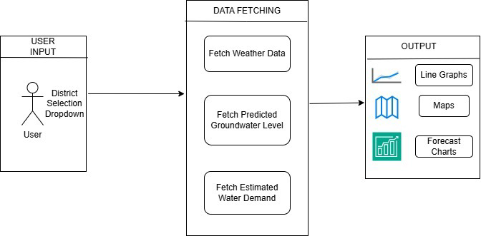
Design Architecture
Fig 1 Design Architecture of Smart Water Scarcity Analysis and Distribution Solution

Slide 16
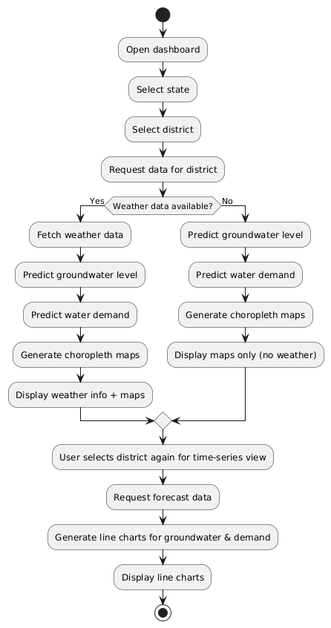
Activity Diagram
Fig 2 Activity Diagram of Smart Water Scarcity Analysis and Distribution Solution

Slide 17
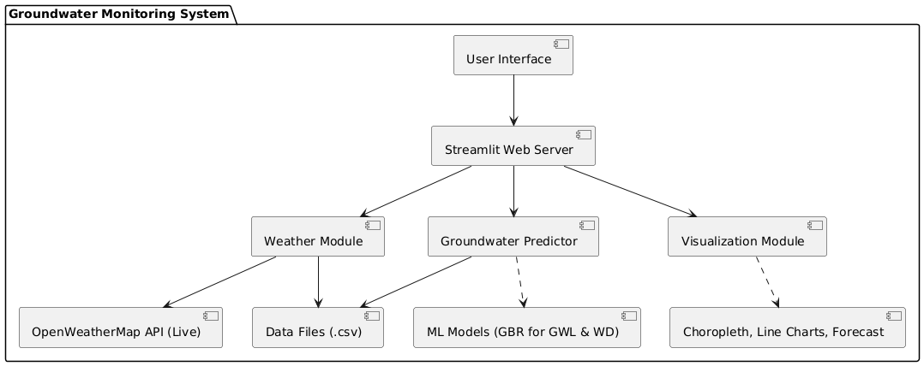
Component Diagram
Fig 3 Component Diagram of Smart Water Scarcity Analysis and Distribution Solution

Slide 18
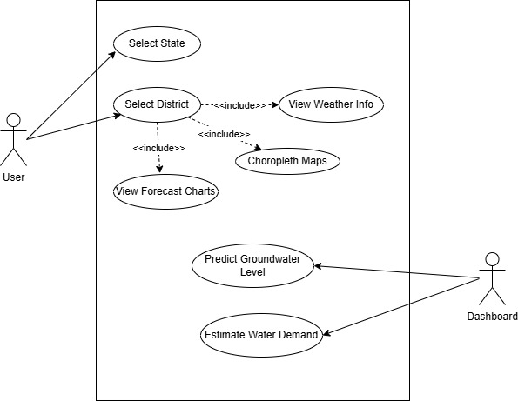
Use Case Diagram
Fig 4 Use Case Diagram of Smart Water Scarcity Analysis and Distribution Solution

Slide 19
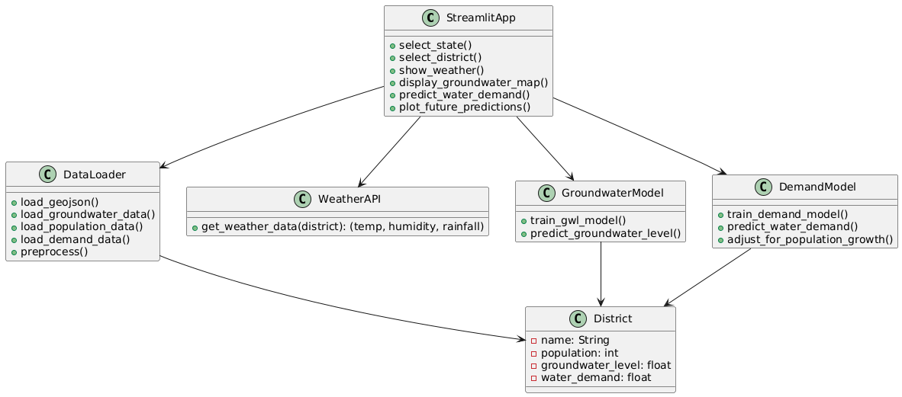
Class Diagram
Fig 5 Class Diagram of Smart Water Scarcity Analysis and Distribution Solution

Slide 20
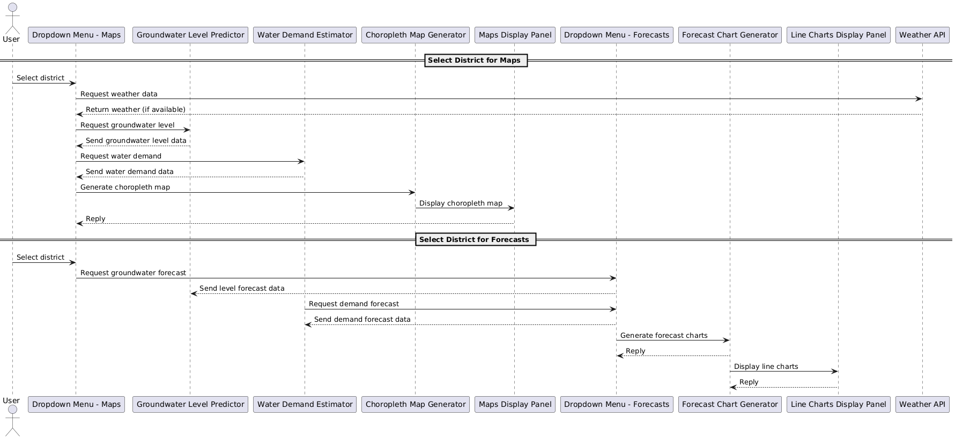
Sequence Diagram
Fig 6 Sequence Diagram of Smart Water Scarcity Analysis and Distribution Solution

Slide 21
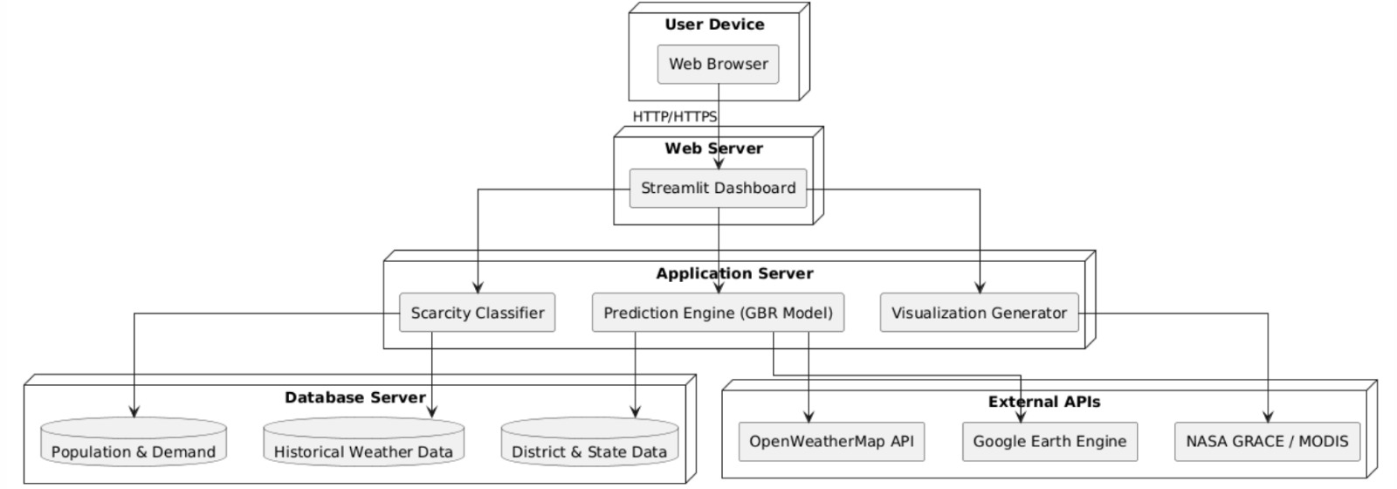
Deployment Diagram
Fig 7 Deployment Diagram of Smart Water Scarcity Analysis and Distribution Solution

Slide 22
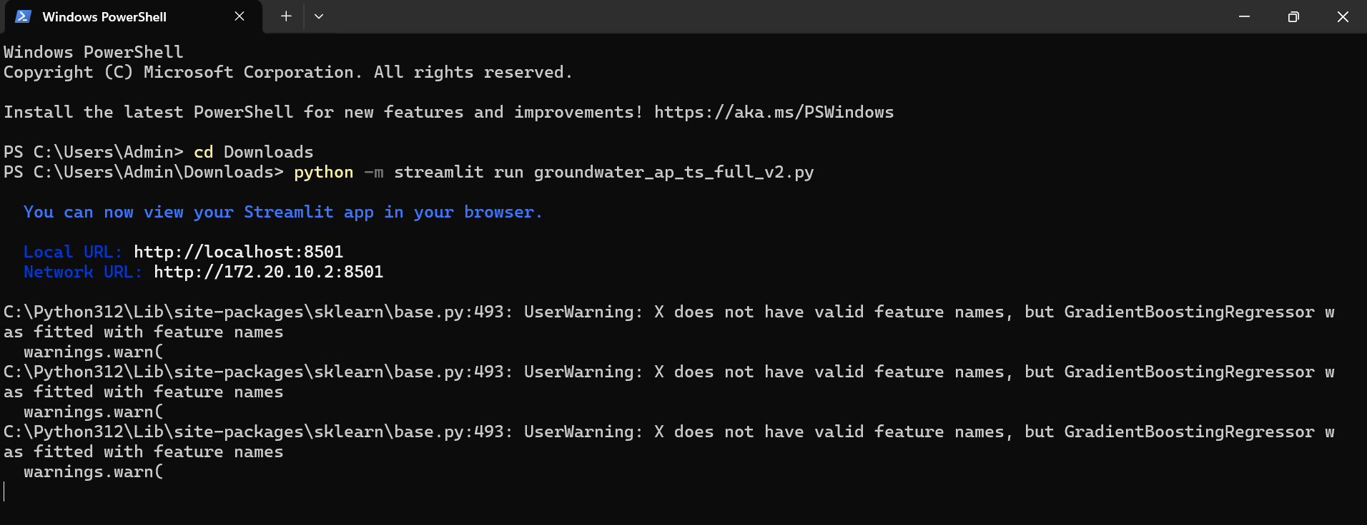
Code Execution
Fig 8 The commands to execute the code in Windows PowerShell

Slide 23
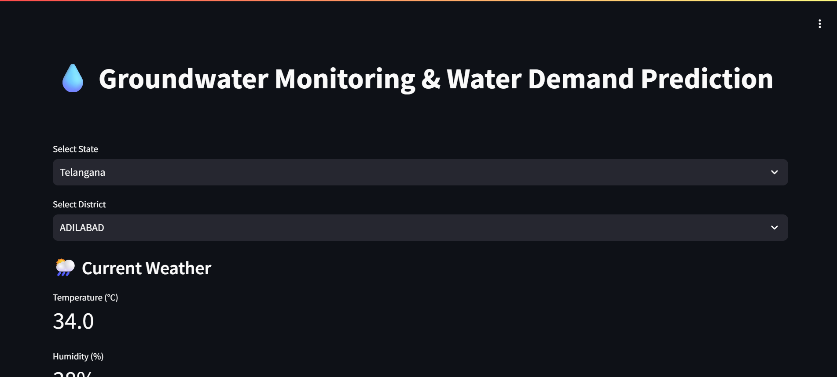
Code Execution
Fig 9 State and District Selection for Smart Water Scarcity Analysis

Slide 24
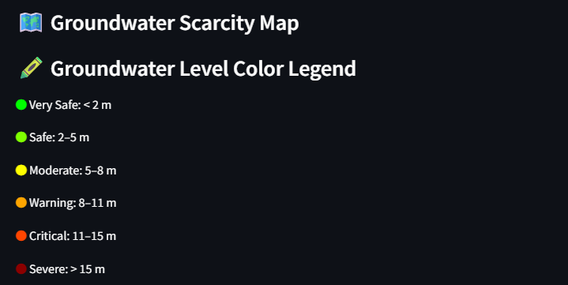
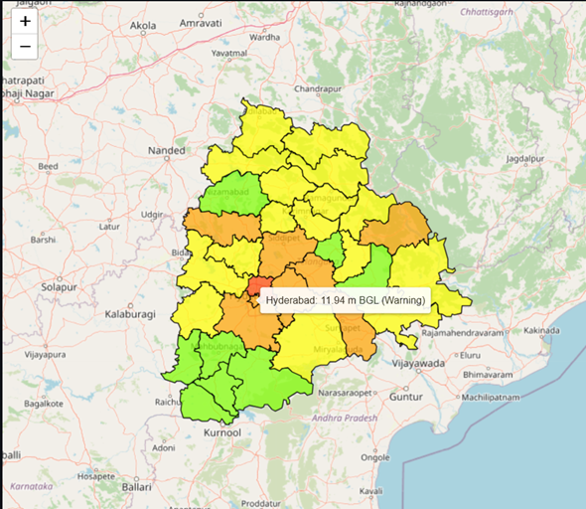
Code Execution
Fig 9 Color legend for Scarcity Map
Fig 10 Scarcity Map for the Telangana State

Slide 25
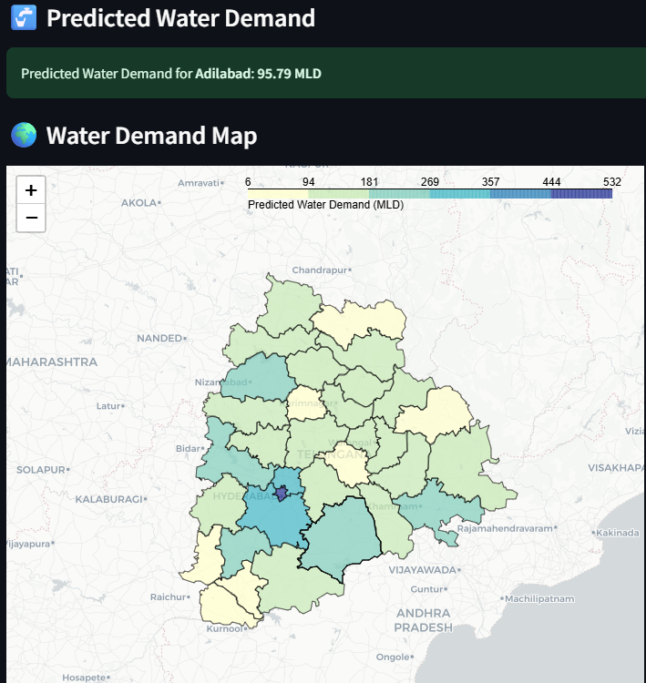
Code Execution
Fig 11 Water Demand value, Water Demand Map and its Color Legend

Slide 26
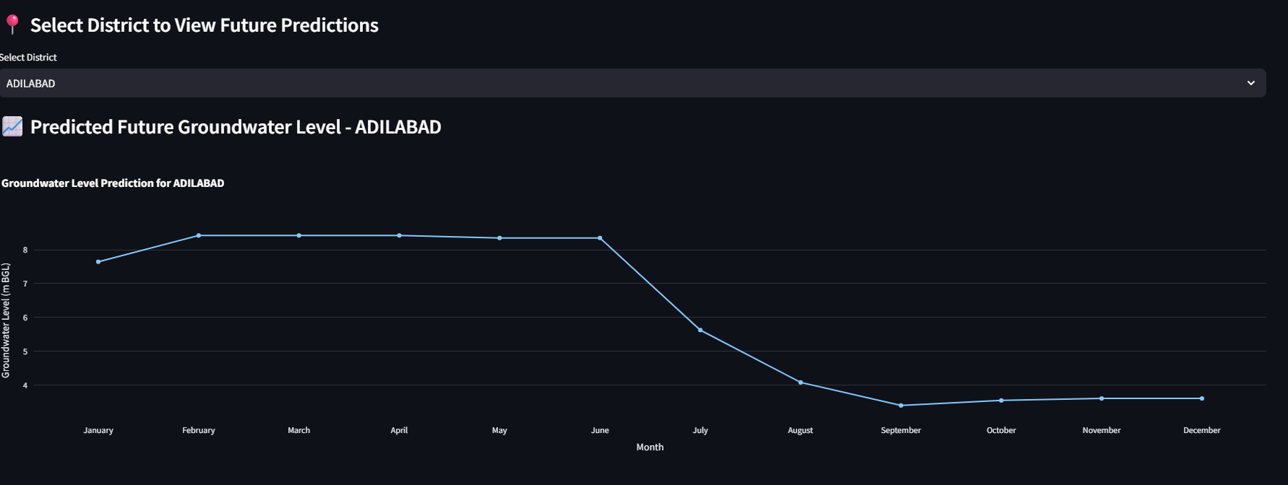
Code Execution
Fig 12 Forecast Line Chart for the selected district for Groundwater Level

Slide 27
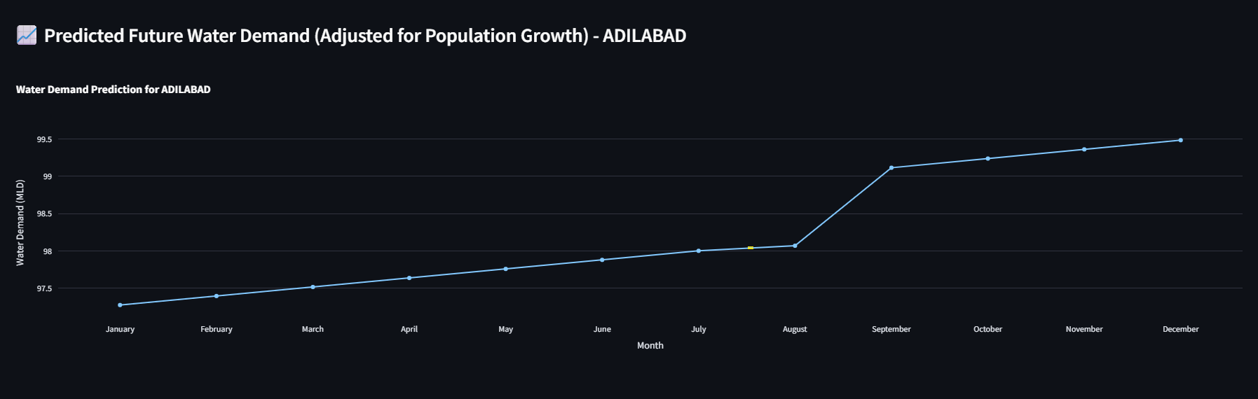
Code Execution
Fig 13 Forecast Level Chart for the selected district for Water Demand

Slide 28
Test Cases
S.NO |  | TEST CASE NAME | INPUT | EXPECTED OUTPUT | ACTUAL OUTPUT | REMARKS
 | 1. | Handle missing groundwater levels | Upload .csv with missing values in groundwater_level | Missing rows are dropped without error | Missing rows are dropped without error | Pass
 | 2. | State selection dropdown | Select “Andhra Pradesh” or “Telangana” | Appropriate district- level data loads | Appropriate district-level data loads | Pass
 | 3. | District selection | Select a district from dropdown | Dashboard updates all charts/maps for that district | Dashboard updates all charts/maps for that district | Pass
 | 4. | Weather API failure | Simulate network/API Failure | Warning message showing data not available | Warning message showing data not available | Pass
 | 5. | District name mismatch | Mismatched names in GeoJSON and CSV | Merge logic handles mapping correctly | Merges logic handles mapping correctly | Pass
Table 2 Test Cases for Smart Water Analysis and Distribution Solution

Slide 29
Conclusion
Using Gradient Boosting Regressor (GBR) models, it achieves:
District-level prediction of groundwater levels based on historical rainfall, temperature, and recharge factors.
Live weather integration using OpenWeatherMap API to support real-time analysis.
Water demand estimation considering both groundwater availability and population.
Choropleth mapping for visualizing scarcity and demand patterns.
Time-series forecasting for both groundwater levels and demand, adjusted for seasonal and population growth effects.
The interactive Streamlit dashboard empowers stakeholders to explore, compare, and monitor water stress conditions across regions with intuitive visualizations and forecasts.

Slide 30
Future Enhancements
Advanced Forecasting Models: Replace or supplement GBR with LSTM, XGBoost, or Prophet models for improved time-series prediction accuracy.
User Alerts and Notifications: Schedule monthly reports for water management authorities.
Mobile-Friendly Interface: Develop a mobile-responsive frontend or companion mobile app for on-field officers and farmers.
Dynamic Policy Simulation: Allow users to simulate effects of policy interventions like artificial recharge, crop change, or industrial usage regulation on future water levels
Climate Change Scenario Modeling : Incorporate IPCC RCP scenarios to predict long-term water stress under various climate trajectories.

Slide 31
References
Tian, Zhi-Wei, and Ru-Liang Qian. "Chinese Water Demand Forecast Based on iTransformer Model." IEEE Access (2024).
Arsene, D., Predescu, A., Stuparu, M., Truică, C.O., Mocanu, M. and Chiru, C., 2022, October. Predicting consumption events in a water monitoring system. In 2022 26th International Conference on System Theory, Control and Computing (ICSTCC) (pp. 74-79). IEEE.
Elmotawakkil, Abdessamad, Abdelkhalik Sadiki, and Nourddine Enneya. "Predicting groundwater level based on remote sensing and machine learning: a case study in the Rabat-Kénitra region." Journal of Hydroinformatics 26.10 (2024): 2639-2667.
Allen, M., Preis, A., Iqbal, M. and Whittle, A.J., 2013, July. Water distribution system monitoring and decision support using a wireless sensor network. In 2013 14th ACIS International Conference on Software Engineering, Artificial Intelligence, Networking and Parallel/Distributed Computing (pp. 641-646). IEEE.
Jain, S., Parida, A.K. and Sankaranarayanan, S., 2020. Water scarcity prediction for global region using machine learning. International Journal of Water, 14(1), pp.69-88.
Li, W., Finsa, M.M., Laskey, K.B., Houser, P. and Douglas-Bate, R., 2023. Groundwater level prediction with machine learning to support sustainable irrigation in water scarcity regions. Water, 15(19), p.3473.

Slide 32
Code Execution Video
Link-
https://drive.google.com/file/d/1nG1BeUHYW8YDcfmhuMBzoezdN92UU3c/view?usp=drivesdk

