Slide 1
IDEA TITLE
Bug_ Slayers
Solution/Idea
1.
AI-Based Early Detection Models.
2.
Personalized Counseling and Intervention.
4.
Real-Time Alerts for Teachers and Counselors.
3.
AI-Powered Chatbots for Anonymous Counseling.
5. Continuous Monitoring and Feedback.
Address Problems
Lack of Personalized Support.
Difficulty in Tracking Multiple Indicators.
Emotional and Psychological Barriers.
Resource Allocation.
Detail of Proposed Solution:
1.
To predict the likelihood of a student Droping .Out
2.
Student Specific Risk Factors and needs.
3 AI-Powered Chatbots to offers emotional support.
4.
AI Identifies a student at risk
5. Continuously track student academic.

Slide 2

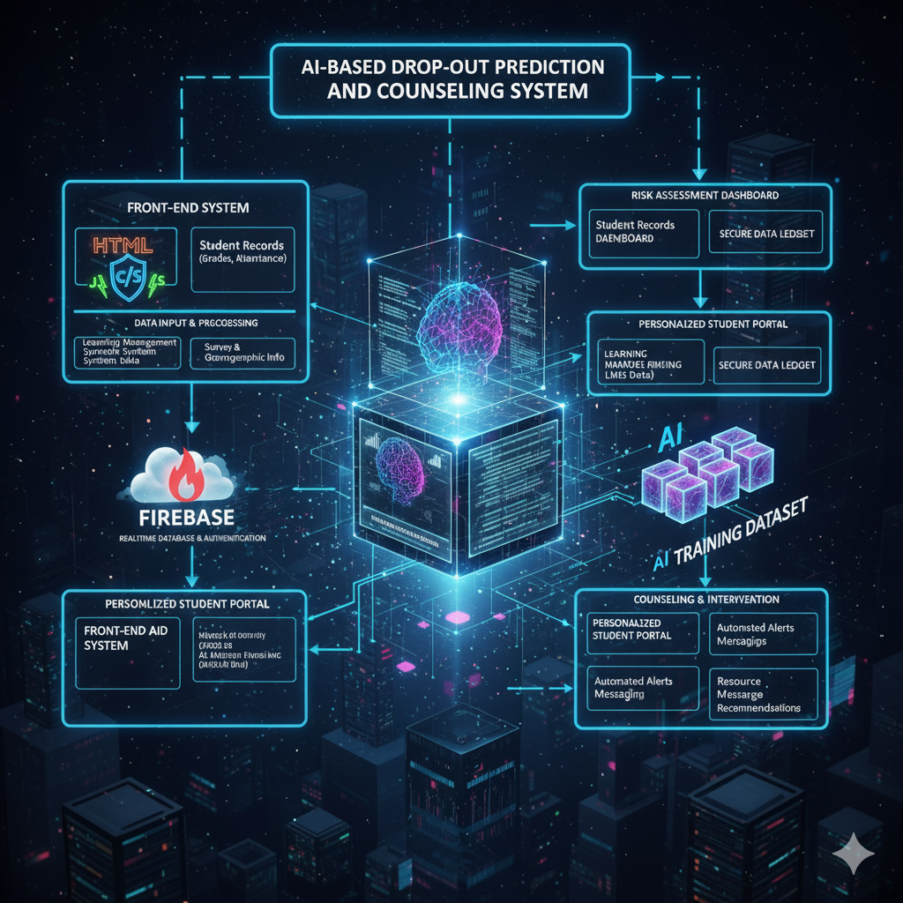
TECHNICAL APPROACH
Bug_ Slayers
Technologies to be used:
process for implementation: (Flow Charts)

Slide 3
FEASIBILITY AND VIABILITY
Bug_ Slayers
Analysis of the feasibility of the idea:
Strategies for overcoming these challenges:
Data Privacy.
Technical Training.
Operational Feasibility
Economic Feasibility
Resource gaps can be overcome through secure data policies.
Teacher Upskilling, and Phased implementation
3.
Technology
&
Data:

Slide 4
IMPACT AND BENEFITS
Bug_ Slayer
Benefits of the solution.
Timely Intervention
Increased Effectiveness
Accessibility and Anonymity
Crisis Prevention
Adaptive Care

