Slide 1
House Price Anticipation with Machine Learning
Submitted in the partial fulfillment for the award of the degree of
BACHELOR OF ENGINEERING
IN
CSE-AIML
Submitted by:
Manish Kumar Yadav 21BCS10262
Ashish Sharma 21BCS10436
Vidit Sharma 21BCS10469
Under the Supervision of:
Ms.Bhavna Nayyer
Department of AIT-CSE
DISCOVER . LEARN . EMPOWER

Slide 2
Outline
Introduction to Project
Problem Formulation
Scope of the project
Planning to implement
Methodology used
Results and Outputs
Conclusion
Future Scope
References

Slide 3

Introduction to Project
It is a predictive framework used to forecast the future prices of residential properties in a given real estate market.
This model leverages historical data, economic indicators, and other relevant factors to estimate how property values might change over time.
It assists stakeholders in making informed decisions related to real estate investments, property valuation, and overall market trends.
The House Price Anticipation Model employs various techniques from data analytics, machine learning, and econometrics to analyze historical data and identify patterns in these influencing factors.

Slide 4
Problem Formulation
The challenge involves selecting appropriate features, preprocessing the dataset, and training a regression model to achieve accurate price predictions.
The problem at hand is to develop a robust and accurate House Price Anticipation Model that effectively predicts future housing prices based on historical data and a multitude of influencing factors.
The challenge lies in formulating a mathematical and statistical framework that captures the intricate relationships between these factors and their impact on housing prices.

Slide 5
Scope of the project
To create a predictive model that can forecast housing prices over a defined time horizon.
To incorporate a comprehensive set of variables that contribute to housing price movements.
To mitigate challenges such as data gaps, non-linear relationships, and the potential for overfitting.
To ensure the model's reliability by evaluating and validating its predictive performance using appropriate metrics.
To develop insights that empower real estate professionals, investors, and policymakers to make informed decisions about property valuation and market trends.

Slide 6
Methodology
Dataset
Exploratory Data Analysis
Working with Feature Data
Feature Engineering
Scaling and Train Test Split
Creating a Model
Training the Model
Evaluation on Test Data
Predicting on a Brand New House

Slide 7
Feature column
id: Unique ID for each home sold
date: Date of the home sale
price: Price of each home sold
bedrooms: Number of bedrooms
bathrooms: Number of bathrooms, where .5 accounts for a room with a toilet but no shower
sqft_living: Square footage of the apartments interior living space
sqft_lot: Square footage of the land space
floors: Number of floors
waterfront: - A dummy variable for whether the apartment was overlooking the waterfront or not
view: An index from 0 to 4 of how good the view of the property was
condition: - An index from 1 to 5 on the condition of the apartment,
grade: An index from 1 to 13, where 1-3 falls short of building construction and design, 7 has an average level of construction and design, and 11-13 have a high quality level of construction and design.
sqft_above: The square footage of the interior housing space that is above ground level

Slide 8
Constraint Identification
Data Availability
Data Size
Data Quality
Computational Resources
Overfitting
Model Complexity:

Slide 9
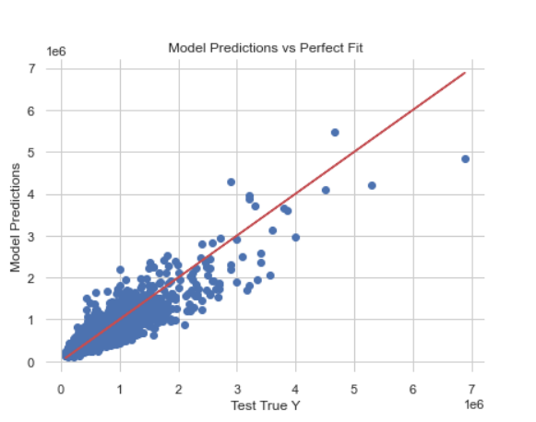
Results

Slide 10
Conclusion
House price prediction can benefit homeowners, buyers, investors, policymakers, and market participants in a variety of ways.
For homeowners, house price prediction can help them to determine the value of their home and to make informed decisions about when to sell.
For investors, house price prediction can help them to identify investment opportunities and to make informed investment decisions.

