Slide 1
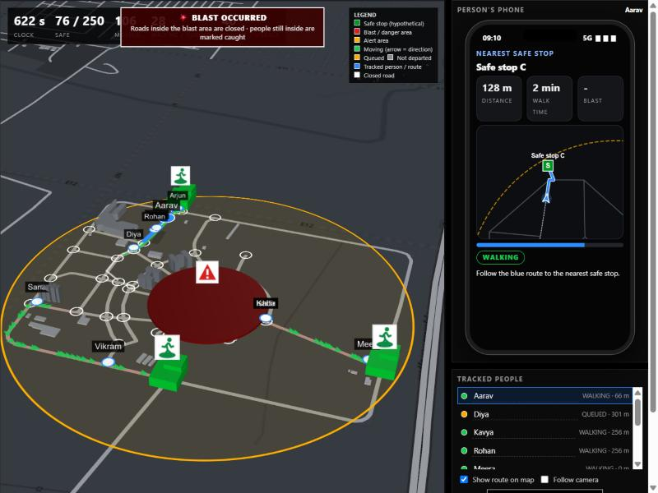
EDUCATIONAL SIMULATION · AMARAVATI CAMPUS
PANIC
ENGINE
Routing and warning time decide who reaches safety. We simulate it on a real campus road network.
Live 3D replay of run 11: 250 people on the campus map
Amrita Vishwa Vidyapeetham, Amaravati
Notes:
Introduce the project: an agent-based evacuation and emergency-alert simulator for Amrita Vishwa Vidyapeetham, Amaravati. It is an educational model, not a real alert system.

Slide 2
BACKGROUND
Why evacuation needs modelling
1
2
3
Warning time
Limited capacity
Simulated agents
How long before the hazard strikes people are told. Too little and nothing else matters.
Roads and exits hold only so many people. Everyone on one road means a queue.
Each person is an agent with a start, a destination and a route, on a real road network.
Notes:
A crowd must reach places of safety before a hazard strikes. Warning time and how the crowd moves through limited-capacity roads decide the outcome.

Slide 3
INSPIRATION
Inspired by the Cannes tsunami paper
Carles, Chapuis, Douvinet, Péroche and Bopp (2024)
KEPT
How early is the alert? Are people safe in time?
An Agent-Based Model to Simulate the Effects of Tsunami Warnings on Pedestrian Evacuation
PRIMA 2024, Kyoto, pp. 369-384
DOI 10.1007/978-3-031-77367-9_28
HAL hal-04794796
OURS
Our own model: a bomb scenario on a campus road network.
Notes:
We took inspiration from the paper; we did not replicate it. We kept its questions: how early is the alert, and are people safe in time. The bomb-scenario model is our own.

Slide 4
PROBLEM STATEMENT
The problem
Everyone is told to go to a safe place at the same moment. They pick the nearest exits and the same roads, queues form, and some run out of time before the strike.
How should people be routed, and how much warning time is needed, so that most reach safety in time?
Notes:
Everyone gets the alert at the same moment and picks the same nearest exits. Queues form. In our simulation everyone has a phone, so the issue is routing and warning time.

Slide 5
GOALS
Four objectives
Model movement
Compare strategies
1
2
Real road network with capacity limits
Identical crowds, different routing
Test warning time
Show and store
3
4
How much lead time before a strike
3D replay, phone view, SQL
Notes:
Model movement, compare strategies on identical crowds, test warning time, make results visible and stored.

Slide 6
ARCHITECTURE
How the system fits together
Map data
Agents
Engine
SQLite
Views
OSMnx, cached
seeded crowd
timestep loop
18 tables
3D + dashboard
Python · NetworkX · OSMnx · SQLite · Streamlit · deck.gl · pytest
Notes:
Map from OpenStreetMap via OSMnx. Agents generated from a seed. The engine steps time. Results go to SQLite and show in Streamlit and a deck.gl 3D replay.

Slide 7
AGENTS
Each person has a life cycle
WAITING
MOVING
EVACUATED
QUEUED
UNABLE
Moving and queued alternate as roads fill; a full safe stop or lost route ends in unable to evacuate.
Notes:
Waiting, moving, queued, then evacuated or unable to evacuate. Illegal transitions raise an error.

Slide 8
MOVEMENT
Roads slow down as they fill
Capacity
t = t0 × (1 + α · rᵝ)
people per road, from length and width
Queues
form at the tail of a full road
t0 free-flow time, r = people ÷ capacity
α = 0.6, β = 2
Safe stops
capacity plus throughput per step
Same crowd on the same road is faster when empty and much slower near capacity.
Notes:
BPR travel time: free-flow time inflated by the load ratio. Agents queue at the tail of a full road. Safe stops have capacity and throughput per step.

Slide 9
ROUTING STRATEGIES
Three ways to choose a route
Shortest path
Congestion-aware
Load-balanced
Free-flow time only. Everyone takes the quickest empty route.
Adds crowding and queue wait. Re-routes at 15% saving, every 30 s.
A central planner spreads people across safe stops.
t0
t0(1+α rᵝ) + γ q t0 / cap
path cost + load penalty
Notes:
Shortest path ignores crowding. Congestion-aware adds crowding and queue cost and re-routes if a route is at least 15 percent cheaper, checked every 30 seconds. Load-balanced assigns destinations centrally.

Slide 10
HAZARD
The bomb scenario timeline
ALERT
REACTION
STRIKE
phones inside the alert radius ring
short delivery delay + random reaction delay
roads and safe stops in blast area lost
"Caught" people are counted as simulated deaths: a measure of how late the alert was.
Notes:
A bomb has an alert radius, a blast radius, an alert time and a strike time. At the strike, roads inside the blast close, safe stops inside are lost, and anyone inside is counted as caught. No injuries or casualties are modelled or shown.

Slide 11
DATABASE
Everything is stored in SQL
18
3
9
tables
migrations
integrity checks
Scenarios, events, snapshots and outcomes are saved per run and analysed with SQL.
Notes:
SQLite via sqlite3 with versioned migrations and transactional run persistence. Analysis uses joins, aggregation and window functions, with a read-only SQL console and integrity checks.

Slide 12
DEMO
The application
Live simulation
3D replay, simulated phone, manual control
Analytics
congestion, bottlenecks, timelines
Strategies
compare runs, lead-time experiment
SQL
read-only console
Notes:
Streamlit dashboard with four tabs, a live deck.gl 3D replay with a simulated phone, and a real phone view that stays in sync over Wi-Fi.

Slide 13
RESULTS: BOMB DRILL
Deaths fall with warning time
Takeaway
Warning time decides the toll. The routing rule changes it by about 1 point or less.
Mean of 10 seeds, same crowd for all three.
Notes:
Bomb drill on the campus map: 250 people, blast radius 150 m, mean over 10 random crowds. A 60 second warning leaves about 21 percent caught in the blast; 300 seconds or more leaves none. The three routing strategies are within about 1 point of each other, inside the run-to-run spread. Caught people are simulated deaths in an educational model, not predictions.

Slide 14
RESULTS: CROWD STRESS
Routing matters when crowds jam
Takeaway
When everyone takes the shortest path, roads jam and fewer people get out. Avoiding crowds helps.
Educational model. Direction, not real-world prediction.
Notes:
Crowd stress test with no bomb: everyone leaves at once and has 30 minutes. On the synthetic grid shortest path gets about 61 percent out, congestion-aware and load-balanced about 78 percent. On the campus map shortest path gets 94 percent, the others 100. Mean over 10 seeds.

Slide 15
VERIFICATION
How we know it behaves
82
9
1
automated tests
SQL integrity checks
reproducibility check: same seed, same events
Simulation, routing, capacity, hazards, database, UI, and a Node test of the browser route finder.
Notes:
82 automated tests cover simulation, routing, capacity, hazards, database, UI and a Node test of the browser-side route finder. Same seed gives identical events.

Slide 16
HONEST LIMITS
Limits and ethics
Not validated
Simple model
Capacities and speeds are assumptions, not calibrated to real drills.
No spill-back, panic or group behaviour, or obstacles. Blast is a radius rule.
Simulated deaths
Not an alert system
People still inside the blast at the strike are counted as deaths in the model. Nothing graphic is shown.
It cannot send real alerts. Safe stops are hypothetical, not shelters.
Notes:
Be honest: not validated against real evacuations; assumptions throughout; caught people are counted as simulated deaths, nothing graphic; it cannot send a real alert; safe stops are not official shelters.

Slide 17
WRAP-UP
Next steps and conclusion
Future work
Conclusion
Real shelter and exit data
Calibrate against observed drills
Density-dependent speed
Panic and group behaviour
More hazard types
Routing and warning time change who reaches safety. PANIC ENGINE is a transparent, reproducible and visual way to test them on a real campus map.
github.com/Ash19123/panic-engine
ash19123.github.io/panic-engine
Notes:
Future work: real shelter data, calibration against drills, density-dependent speed, social-force and panic behaviour, more hazards, integration with authorities. Conclusion: routing and warning time change who reaches safety.

