Slide 1

Data-Flow-Based Normalization Generation Algorithm of R1CS for Zero-Knowledge Proof
Chenhao Shi, Hao Chen, Ruibang Liu, Guoqiang Li†
Shanghai Jiao Tong University

Slide 2
Contents
Research Background
Algorithm Design
Evaluation
Conclusion

Slide 3
Research BACKGROUND

Slide 4
Research Background
Increasing Importance
Primary Applications: Privacy Security, Scalability
Key Application Domains: Web3, Cryptocurrency, Financial Industry
Complex Transformation Process
Computation
Algebraic Circuit
R1CS
QAP
Zk-SNARKs
Linear Interactive Proof
Linear PCP

Slide 5
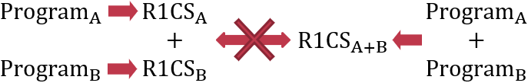

Research Background
Limitations in Conversing Arithmetic Circuits to R1CS
Limited Mergeability
Flexible R1CS Representations

Slide 6
Algorithm DESIGN

Slide 7
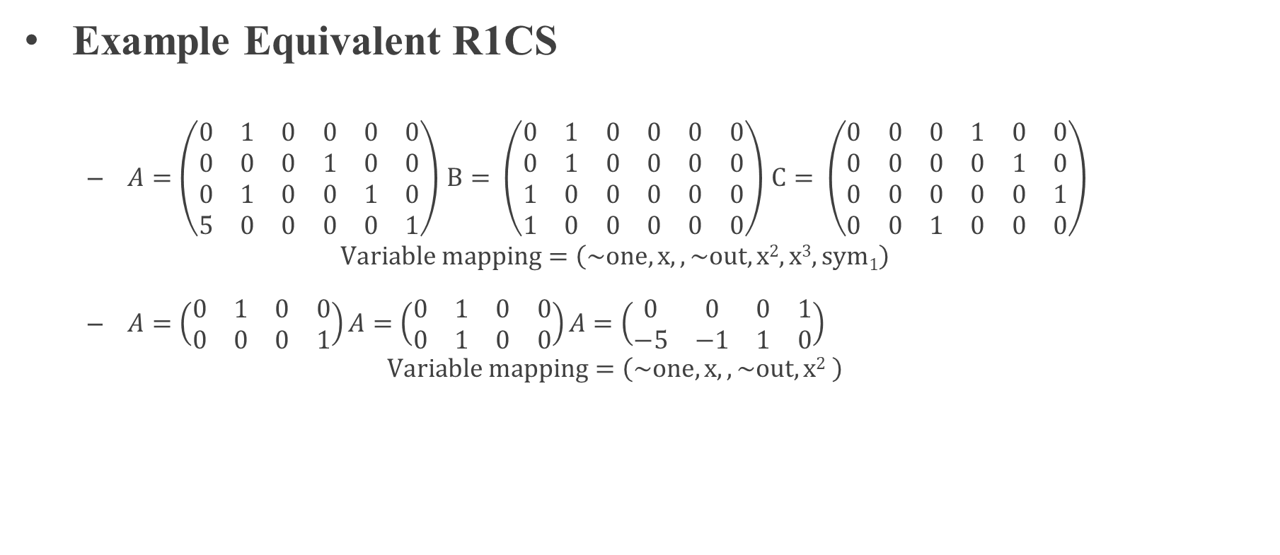
Algorithm Design
Example Equivalent R1CS
$A=\left(\begin{matrix}0 & 1 & 0 & 0 & 0 & 0 \\ 0 & 0 & 0 & 1 & 0 & 0 \\ 0 & 1 & 0 & 0 & 1 & 0 \\ 5 & 0 & 0 & 0 & 0 & 1\end{matrix}\right)$ $B= \left(\begin{matrix}0 & 1 & 0 & 0 & 0 & 0 \\ 0 & 1 & 0 & 0 & 0 & 0 \\ 1 & 0 & 0 & 0 & 0 & 0 \\ 1 & 0 & 0 & 0 & 0 & 0\end{matrix}\right)$ $C= \left(\begin{matrix}0 & 0 & 0 & 1 & 0 & 0 \\ 0 & 0 & 0 & 0 & 1 & 0 \\ 0 & 0 & 0 & 0 & 0 & 1 \\ 0 & 0 & 1 & 0 & 0 & 0\end{matrix}\right)$
$$Variable mapping=\left(\sim one, x,,\sim out,x2,x3,sym1\right)$$
$A=\left(\begin{matrix}0 & 1 & 0 & 0 \\ 0 & 0 & 0 & 1\end{matrix}\right)A=\left(\begin{matrix}0 & 1 & 0 & 0 \\ 0 & 1 & 0 & 0\end{matrix}\right)A=\left(\begin{matrix}0 & 0 & 0 & 1 \\ −5 & −1 & 1 & 0\end{matrix}\right)$
$$Variable mapping=\left(\sim one, x,,\sim out,x2 \right)$$

Slide 8
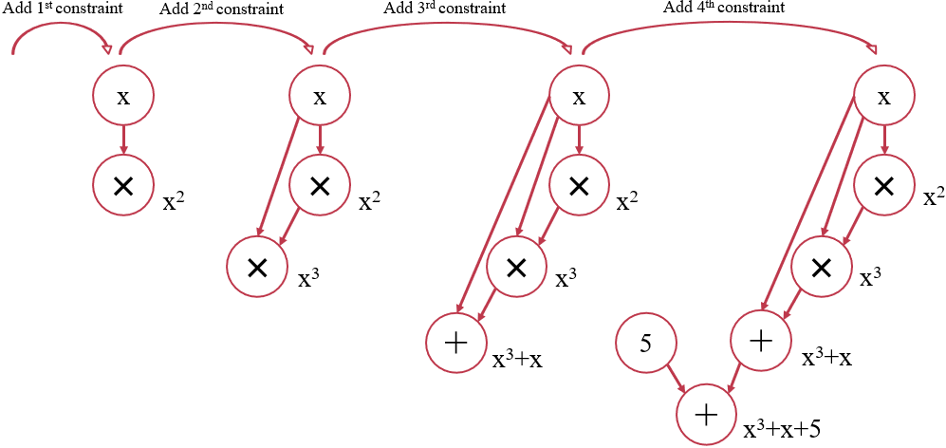
Algorithm Design: Construction of RNode Graph
Main Steps: Transform each equation and combine the results

Slide 9
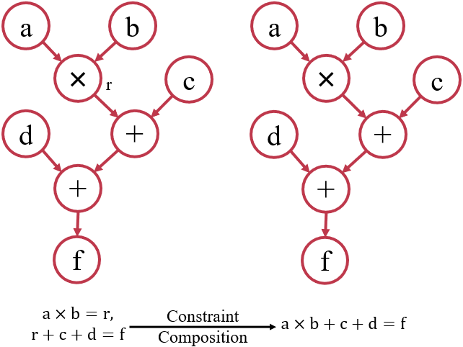
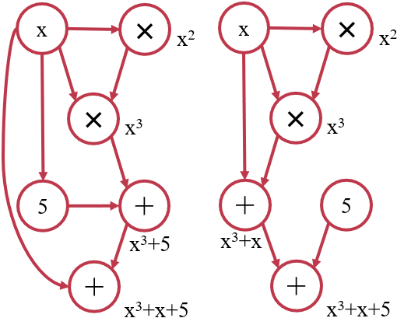
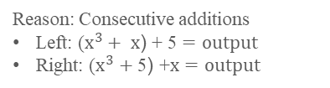
Algorithm Design: Construction of RNode Graph
The design of the RNode data structure minimizes changes to the overall structure.
Structural differences of RNode Graph of different R1CS remain.
Structural differences remain
Constraint composition will affect:
Intermediate variable selection.
Quantity and form of constraints.
Variable mapping.
Reason: Consecutive additions
Left: ($x^{3}+ x\text{) }\text{+ 5}=output$
Right: ($x^{3}+\text{5}\text{) }\text{+}x=output$
Additional abstraction is necessary.

Slide 10
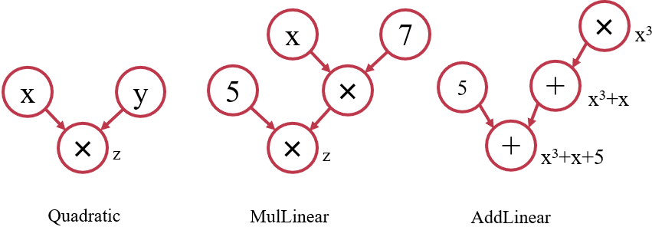
Algorithm Design: Tile Selection
Main Steps: Partitioning data flow graphs using customized tile types
Customized Tile Types:
Quadratic
MulLinear
AddLinear
Three Considerations:
Temporarily deferring the constraint merging step.
Utilizing the paradigm based on unmerged constraints as the fundamental approach.
Implementing a relatively straightforward algorithm for tile selection.

Slide 11
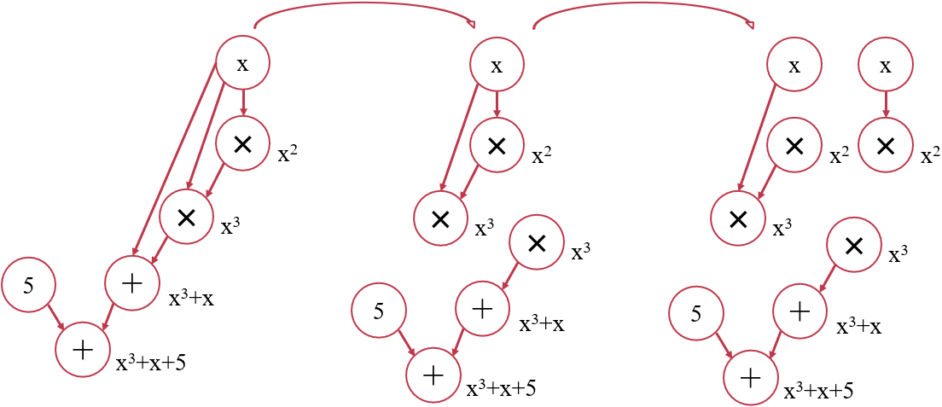
Algorithm Design: Tile Selection
The procedure of tile selection:

Slide 12
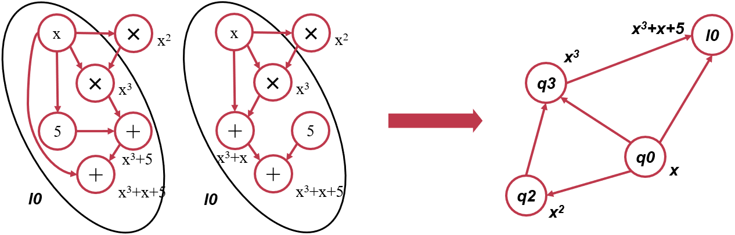
Algorithm Design: RNode Graph Abstraction
Main Steps: Abstracting linear tiles as a single large node and reconfiguring the associated edges.
The type of edges after abstraction:
Abstract Node to Abstract Node: Both abstracted nodes represent linear tiles that have common RNode.
Abstract Node to RNode: RNode is present in the linear tile represented by the abstracted node.
RNode to RNode: Maintaining consistency with the original data flow graph before abstraction.

Slide 13
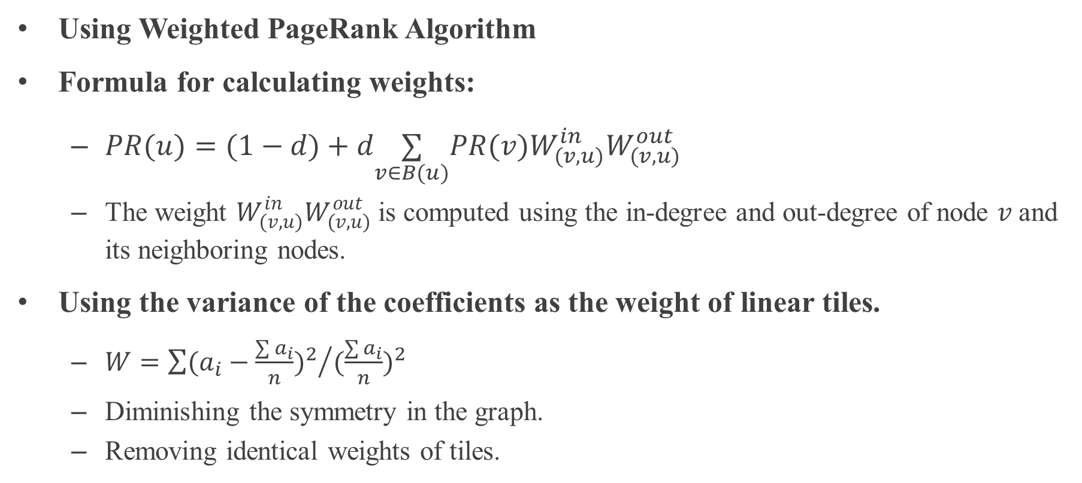
Algorithm Design: Tile Weight Calculation
Using Weighted PageRank Algorithm
Formula for calculating weights:
$PR(u)=(1−d)+d\underset{v∈B(u)}{∑}PR(v)W_{(v,u)}^{in}W_{(v,u)}^{out}$
The weight $W_{(v,u)}^{in}W_{(v,u)}^{out}$ is computed using the in-degree and out-degree of node 𝑣 and its neighboring nodes.
Using the variance of the coefficients as the weight of linear tiles.
$W={\sum{{(a_{i}−\frac{\sum{a_{i}}}{n})}^{2}}}/{{(\frac{\sum{a_{i}}}{n})}^{2}}$
Diminishing the symmetry in the graph.
Removing identical weights of tiles.

Slide 14
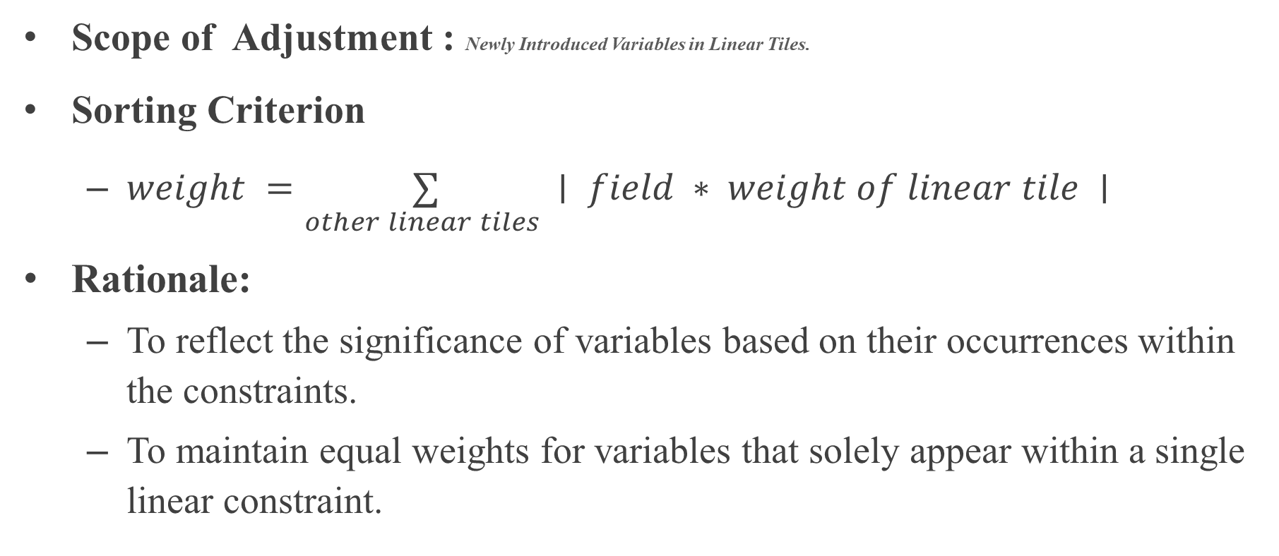
Algorithm Design: Linear Constraint Adjustment
Scope of Adjustment : Newly Introduced Variables in Linear Tiles.
Sorting Criterion
$weight =\underset{other linear tiles }{∑}∣ field ∗ weight of linear tile ∣$
Rationale:
To reflect the significance of variables based on their occurrences within the constraints.
To maintain equal weights for variables that solely appear within a single linear constraint.

Slide 15
evaluation

Slide 16
Evaluation
Benchmark Design
Benchmark Classification: According to summarized rules for generating equivalent R1CS
Separated Generation: Within each category
Experiment Result Evaluation
Developing benchmark constraint sets
Constructing equivalent constraint sets
Performing algorithm testing
Reasons for Generating Equivalent R1CS Constraints | Number of Groups | Successfully Generated Groups | Pass Rate
Replacement of variable order. | 55 | 55 | 100%
Reordering of constraint sequences. | 21 | 21 | 100%
Introduction of multiple new variables in a single linear constraint. | 15 | 15 | 100%
Introduction of multiple new variables with usage in multiple linear constraints. | 15 | 15 | 100%
Merging and splitting of constraints. | 6 | 6 | 100%

Slide 17
Conclusion

Slide 18
Conclusion: Contribution
Introducing the formal paradigm of R1CS constraint sets and designing an algorithm for generating paradigm sets.
Summarizing the patterns in generating equivalent R1CS constraint sets.
Designing benchmark for equivalent R1CS constraint sets.
Tile Selection
Tile Weight Calculation
R1CS
Generate RNode Graph
Graph Abstraction
Normalized R1CS

Slide 19
Conclusion: Future Work
Merging Rules for Constraints
More Complex Tile Forms
Matrices with a Higher Degree of Density
More comprehensive test sets
More Comprehensive Categorization
Additional and Larger-scale Illustrations.
More efficient algorithmic workflow
Improving the Parallelism of the Algorithm.
Reducing Algorithm Memory Consumption.

Slide 20
Thank You

