Slide 1

ABC Solutions Group
Delivering Tailored Solutions for your Needs

Slide 2

About Us
ABC Solutions Group is a leading provider of customized business solutions, offering expertise across a wide range of industries.

Slide 3

Our Services
Comprehensive Services Tailored for You
Consulting Services: Strategic planning, market analysis, and operational improvement.
Technology Solutions: Custom software development, IT support, and systems integration.
Project Management: End-to-end project oversight ensuring timely delivery and quality.

Slide 4

Why Choose Us
Proven track record of successful projects
Expert team with industry-specific knowledge
Flexible and scalable solutions
Commitment to client satisfaction Visual: Testimonial quotes or key metrics

Slide 5
Pricing Structure
Transparent and Flexible Pricing
Consulting Services: Starting at $5,000 per project
Technology Solutions: Tailored pricing based on project scope
Project Management: $100/hour or fixed packages available
Training & Support: $500 per session or customized plans Note: All pricing includes a detailed project proposal. Visual: Table or chart summarizing pricing tiers

Slide 6

Project Timeline
Initial Consultation: 1 week
Proposal and Planning: 2 weeks
Implementation Phase: 4-12 weeks (depending on project size)
Review and Handover: 1-2 weeks
Post-Project Support: Ongoing Visual: Timeline graphic with milestones

Slide 7
Success Stories
Proven Results
Achieved 30% cost reduction through streamlined operations
Increased revenue by 50% with new technology integration
Successfully launched a new product with our project management support
C
Client 1
Client 2
Client 3

Slide 8

Contact Us
Let’s Work Together
Email: contact@ABCsolutionsgroup.com
Phone: (123) 456-7890
Address: 123 Lane, Innovation City, ST 12345
Website: www. abcsolutionsgroup.com Visual: Contact form graphic or QR code leading to website

Slide 9

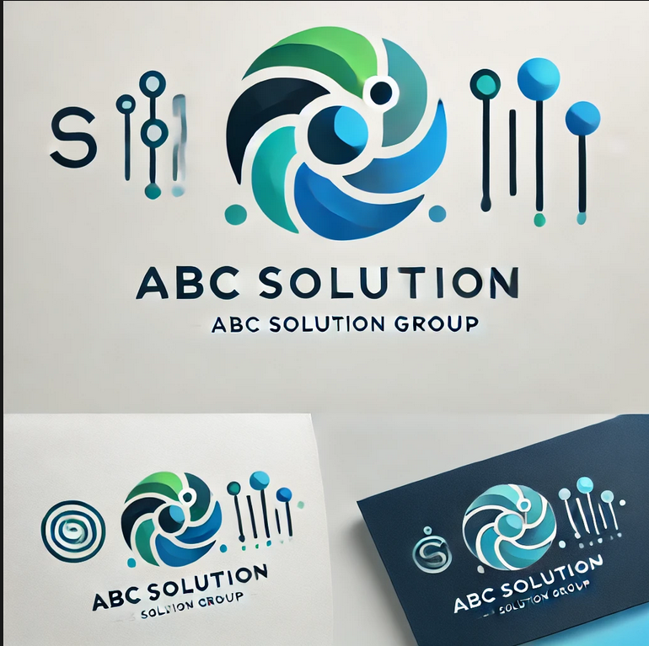
Thank You
Thank You for Your Time We look forward to the opportunity to partner with you and drive your business forward

