Slide 1
Basics in R
(part 2)
Lokesh

Slide 2
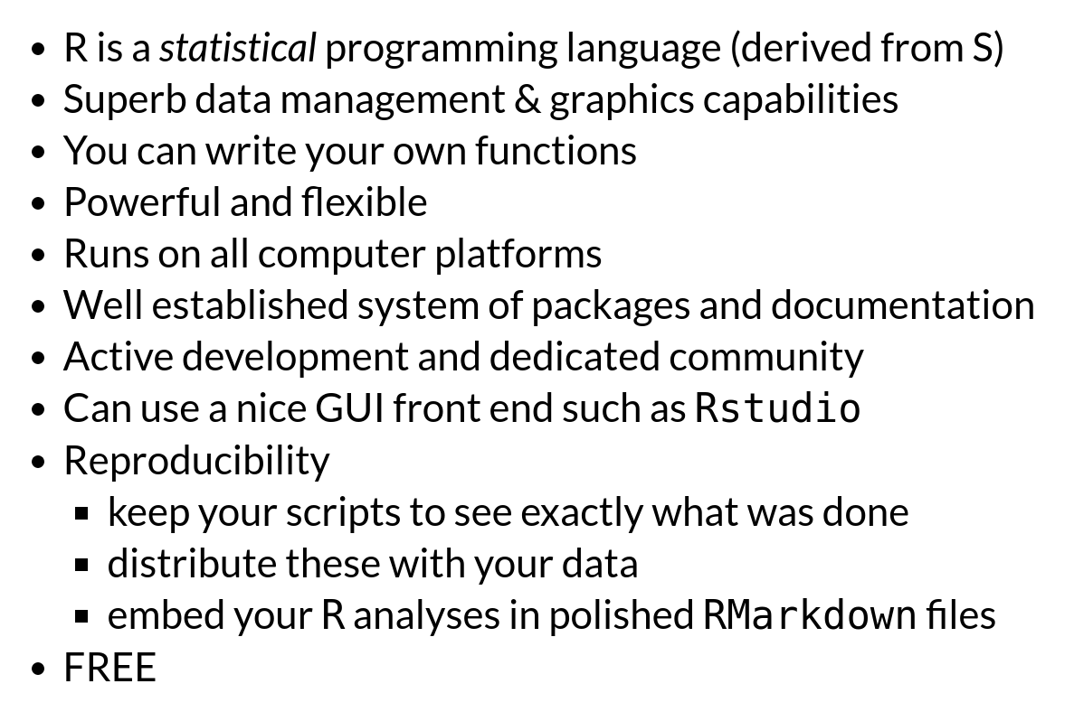
Why use R?

Slide 3
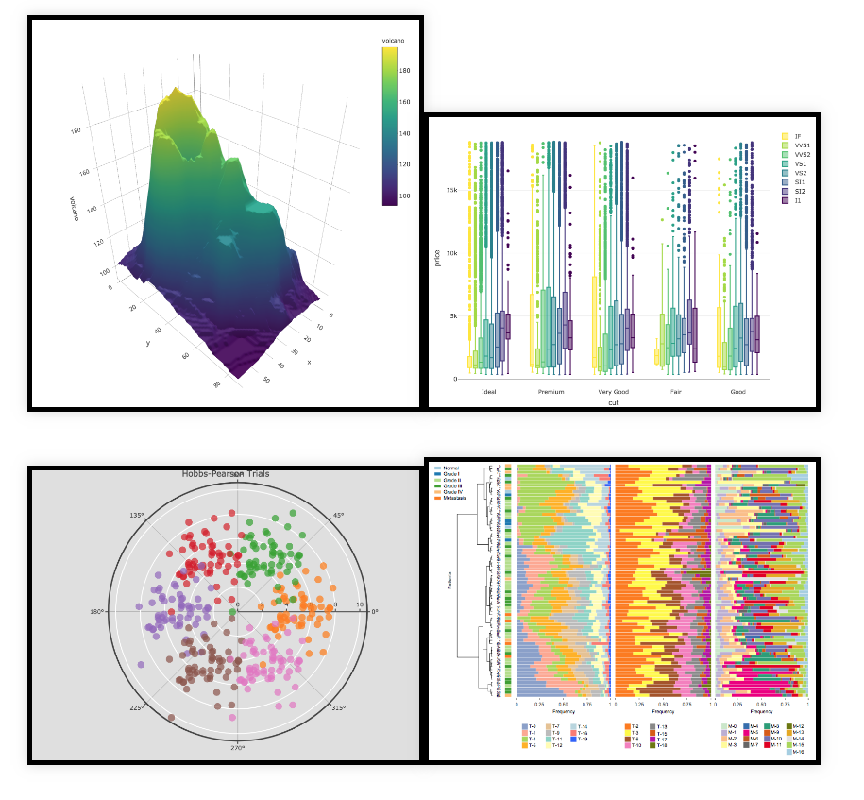
Why use R?

Slide 4
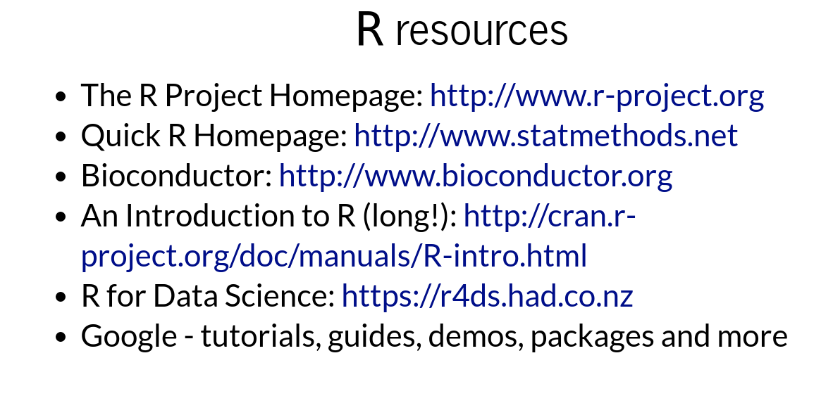

Slide 5
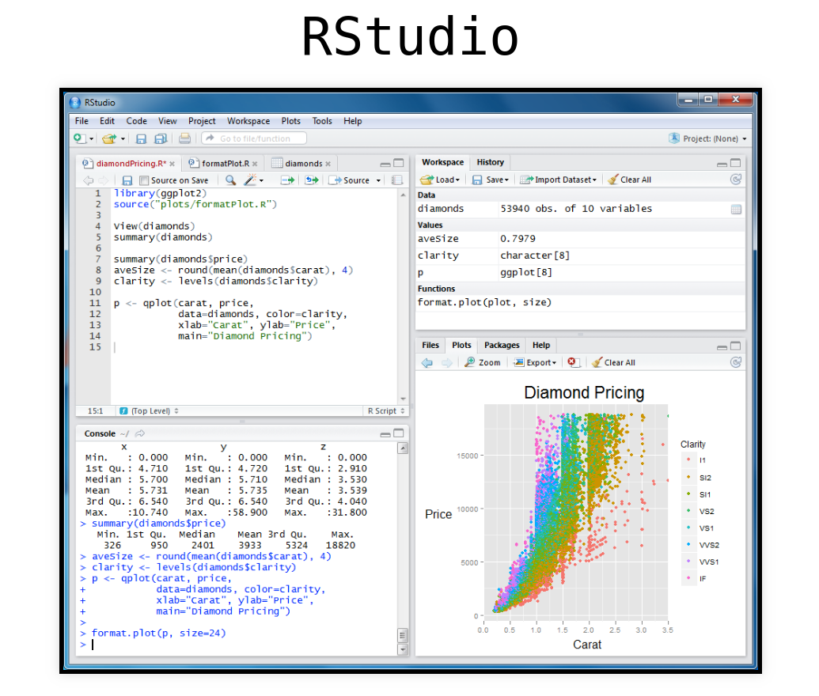

Slide 6
Rstudio Demo
CRAN and Bioconductor

Slide 7

? and ??

Slide 8
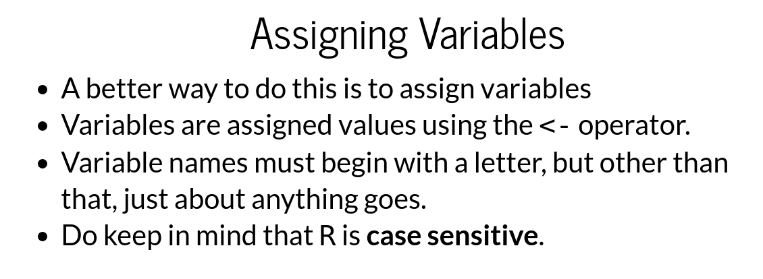

Slide 9
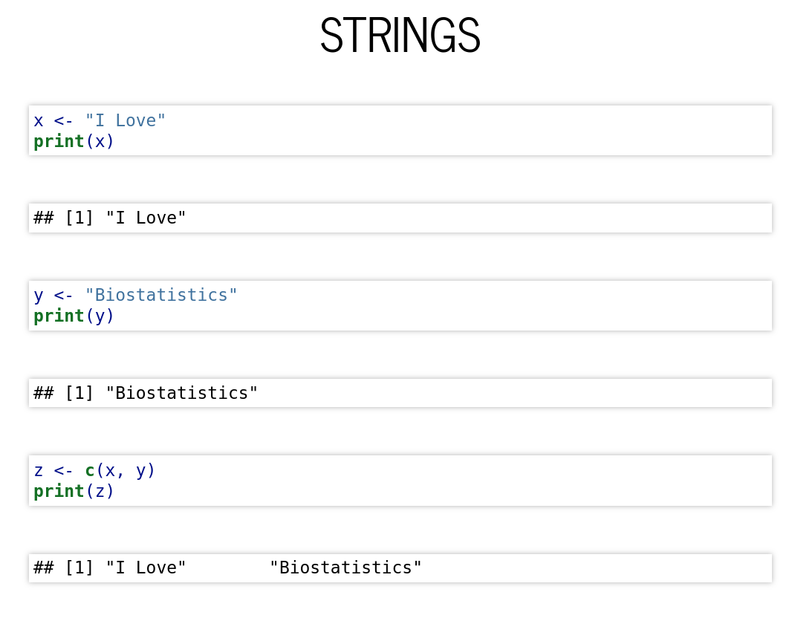

Slide 10
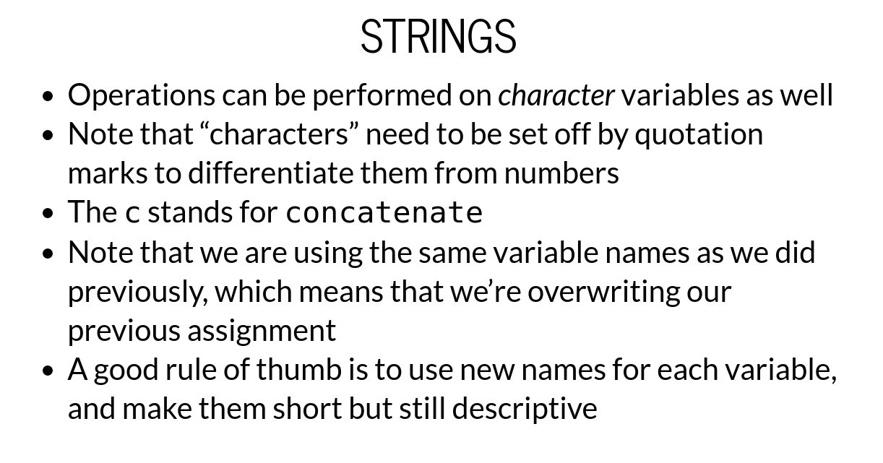

Slide 11
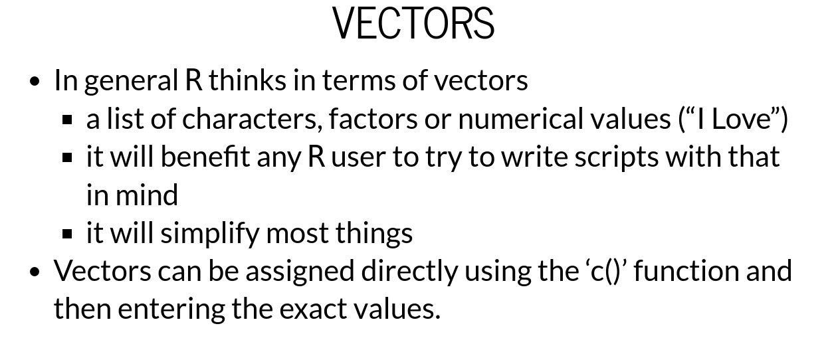

Slide 12
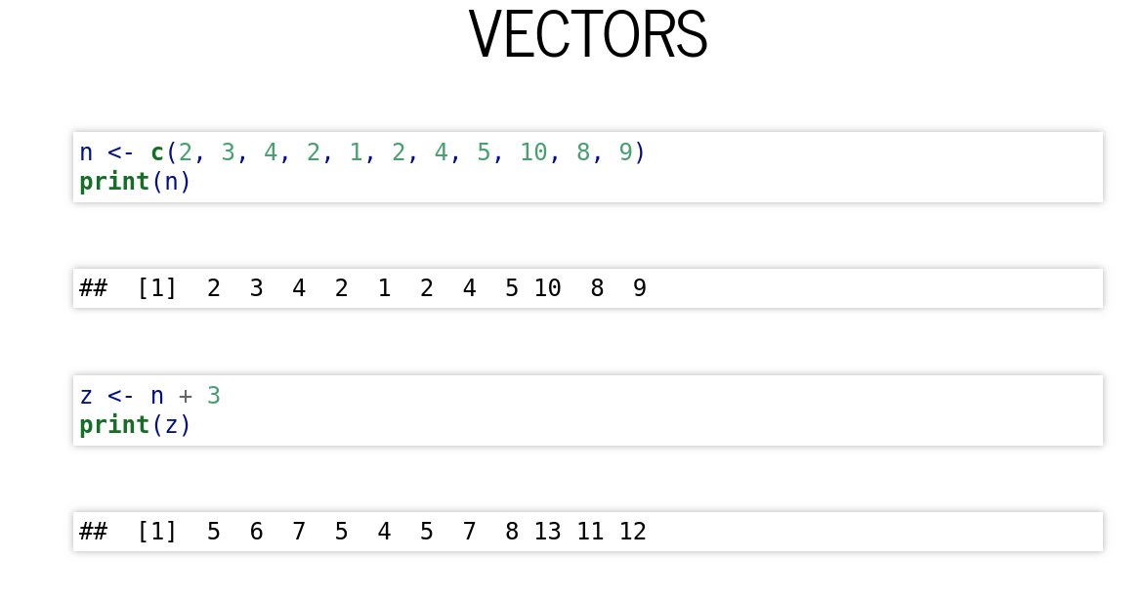

Slide 13
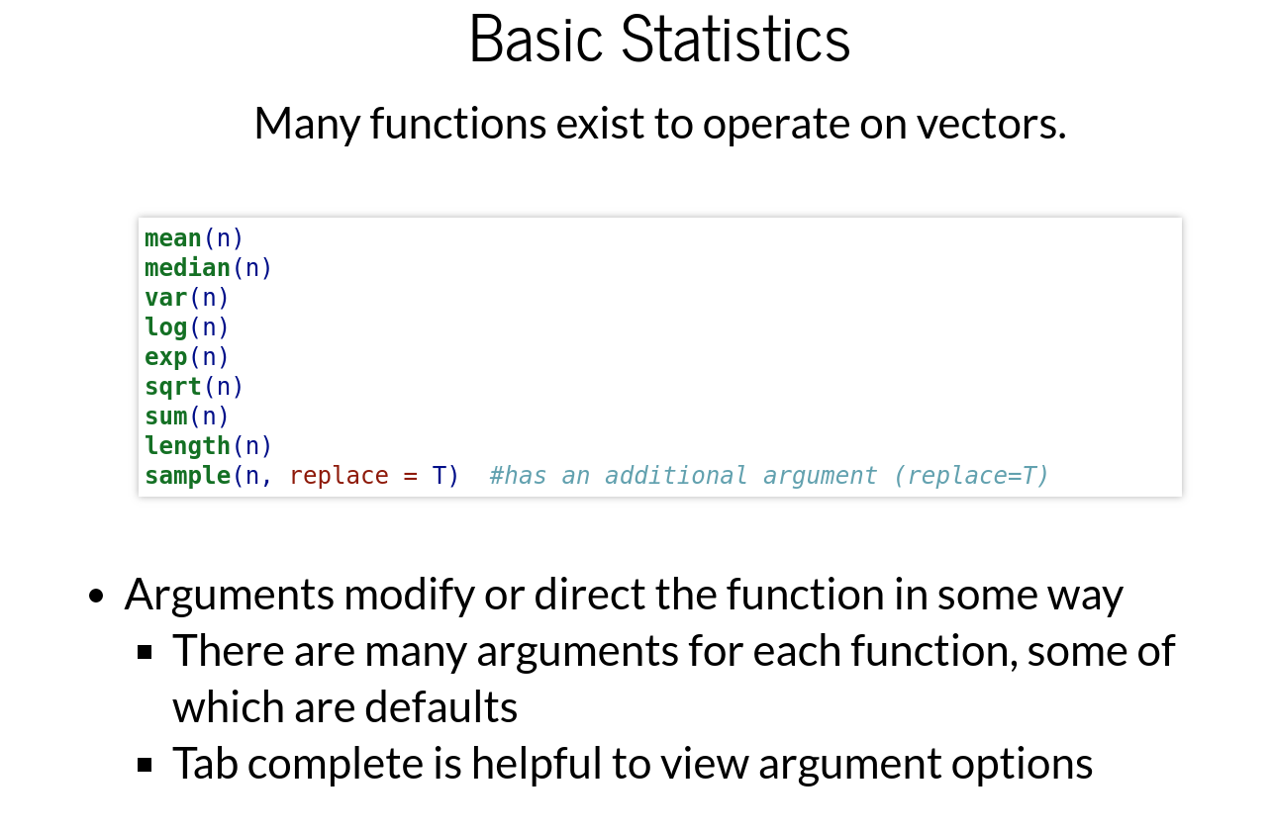

Slide 14
Session II

Slide 15
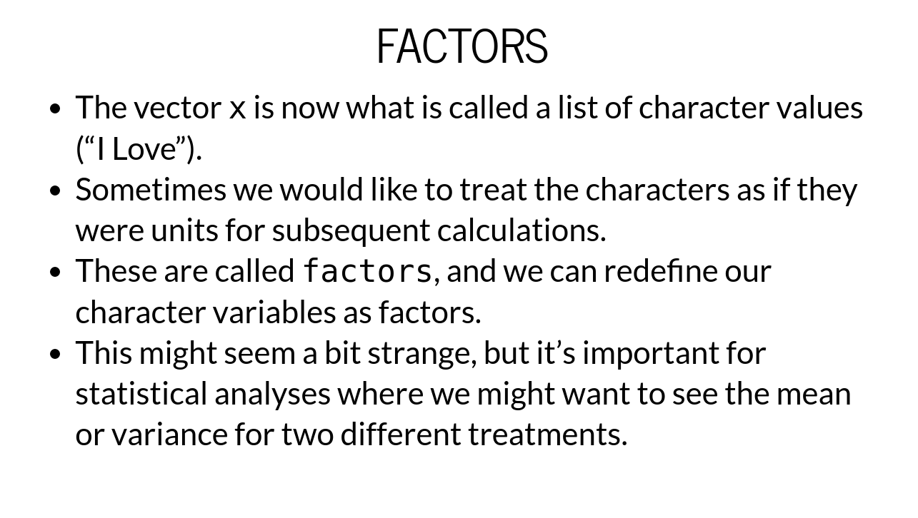

Slide 16
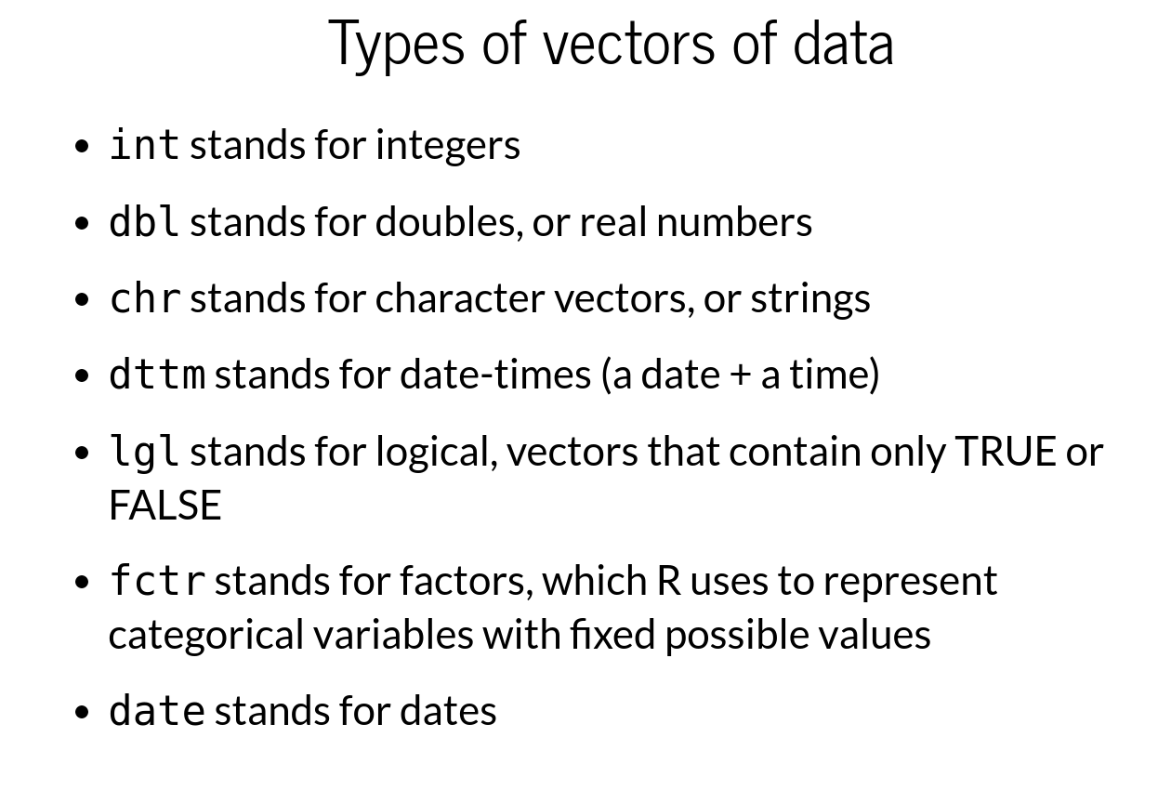

Slide 17
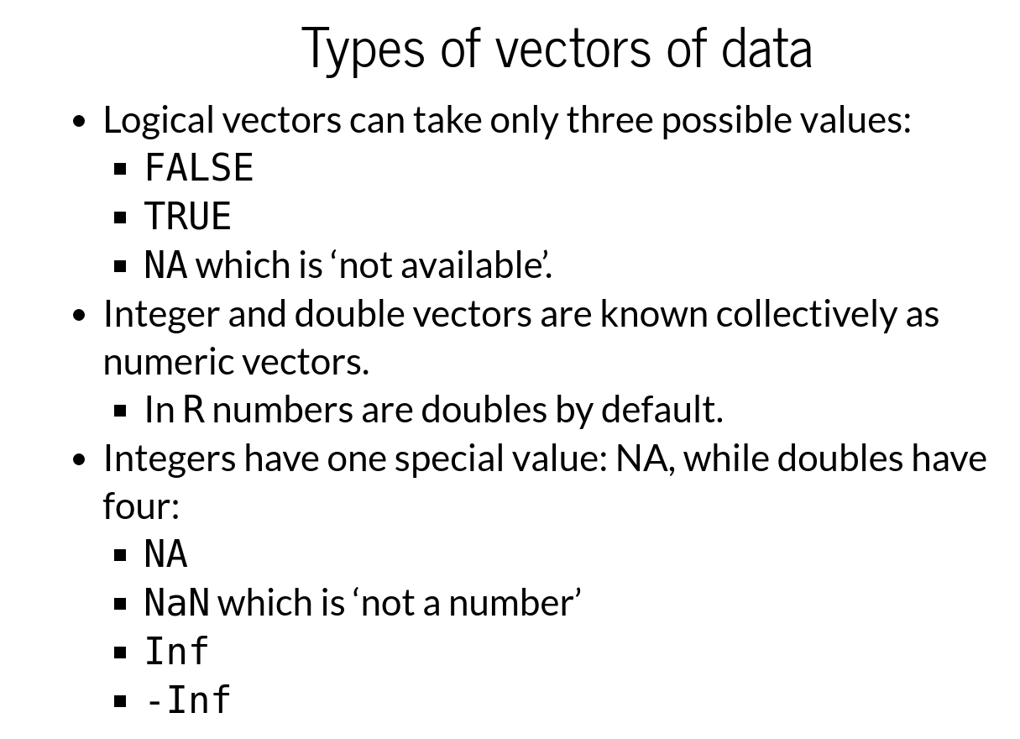

Slide 18
Session III

Slide 19
Some R demo
Data.frames
Lists
Matrices

