Slide 1
Typescript
Course: Understanding TypeScript | Udemy
GitHub - mschwarzmueller/understanding-typescript-resources: Code repository for my "Understanding TypeScript" (https://acad.link/typescript) course.

Slide 2
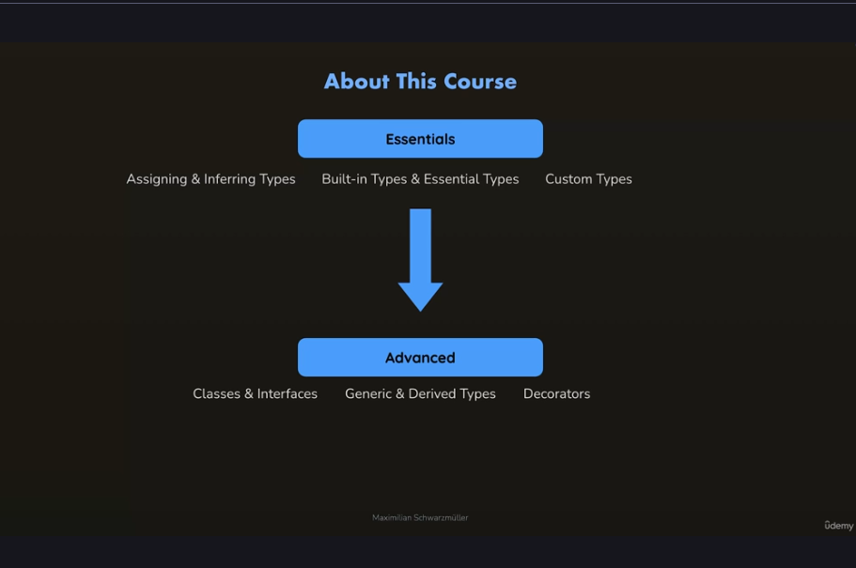

Slide 3
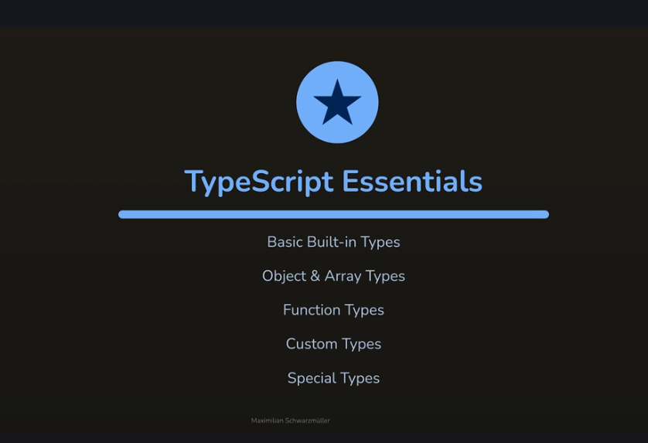

Slide 4
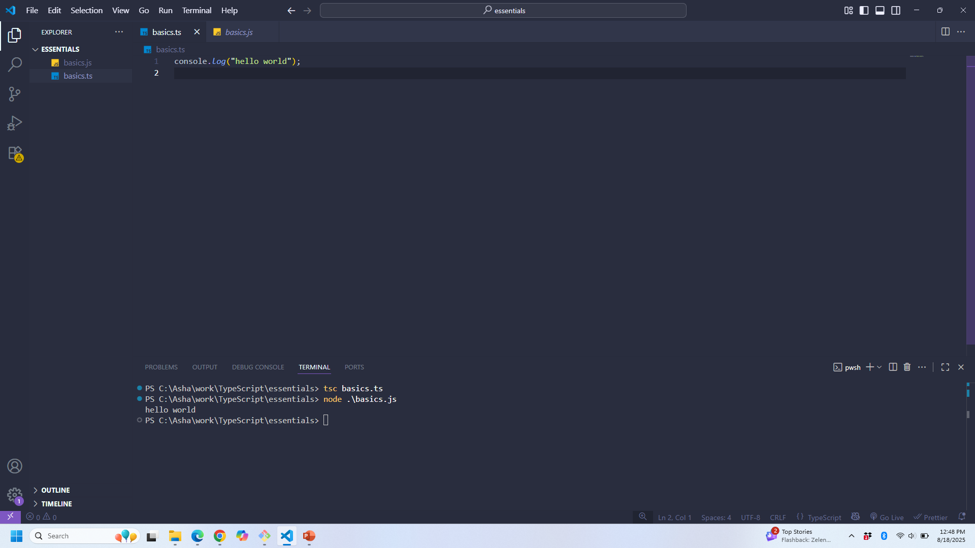
Basic ts file compiling

Slide 5
Error fixing in vs code
let me: string = "asha";
console.log(me);
Gives an error Cannot redeclare block-scoped variable 'me’
To fix that, add export {} at the end of ts file
JS also has types, eg: typeof(name) gives string. But just that it does not have explicit type assignments like in TS

Slide 6
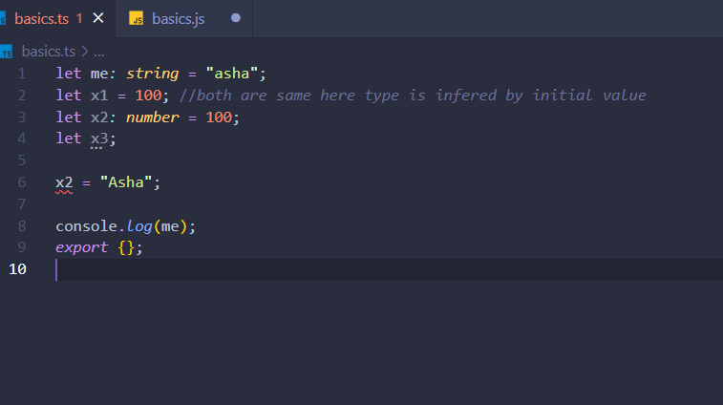
Infered type

Slide 7
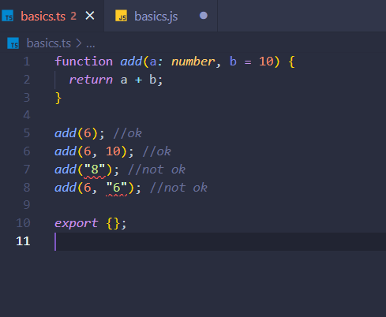
Functions and ts

Slide 8
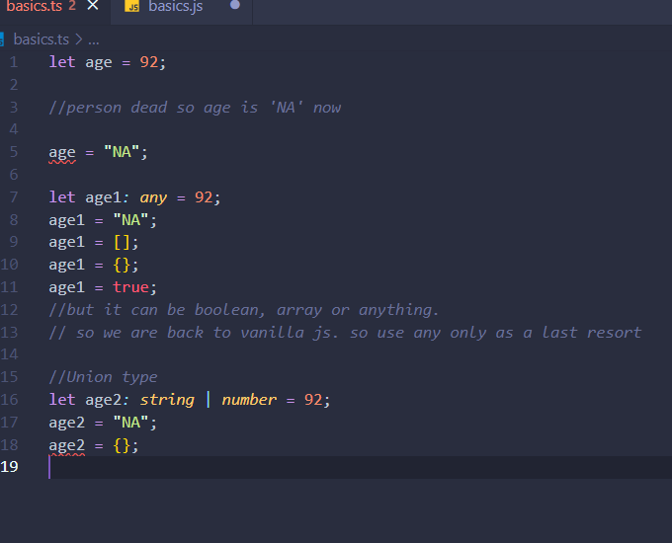
flexibility
Use “any” as a type
Union type: use or operator to specify the types you want
Be as specific as you possibly can

Slide 9
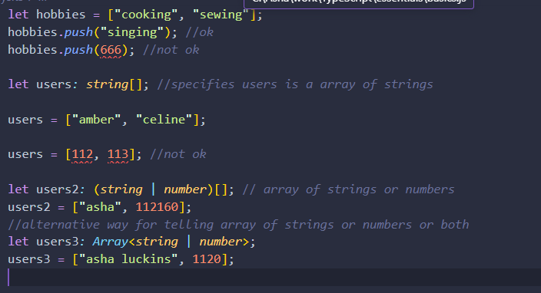
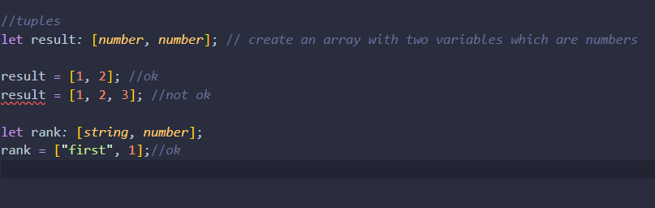
Arrays and types, tuples

Slide 10
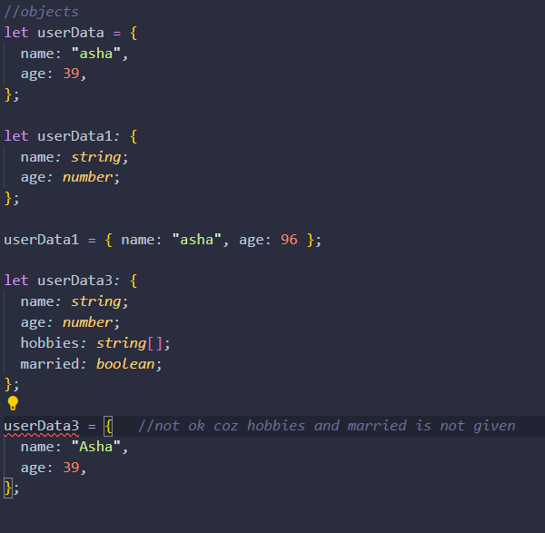
Objects
Can be very specific. Can have object inside object

Slide 11
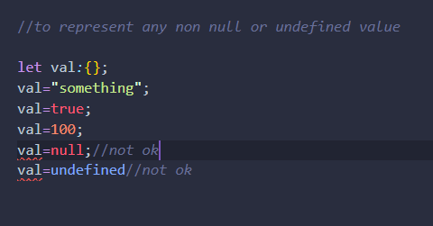
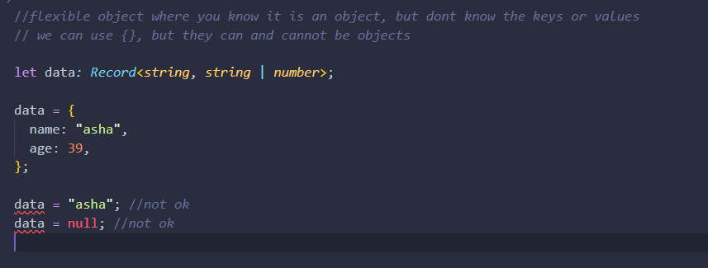
Type for representing any non null/undefined value {}
Flexible object

Slide 12
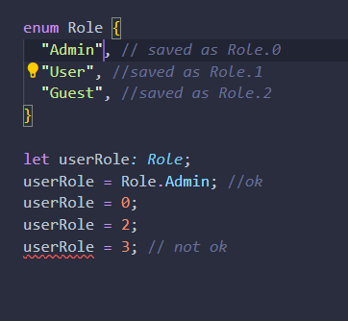
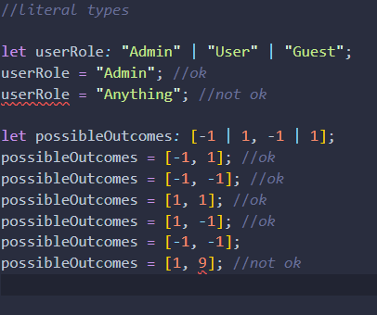
Enums-select the value from a list of allowed values
Literal types

Slide 13
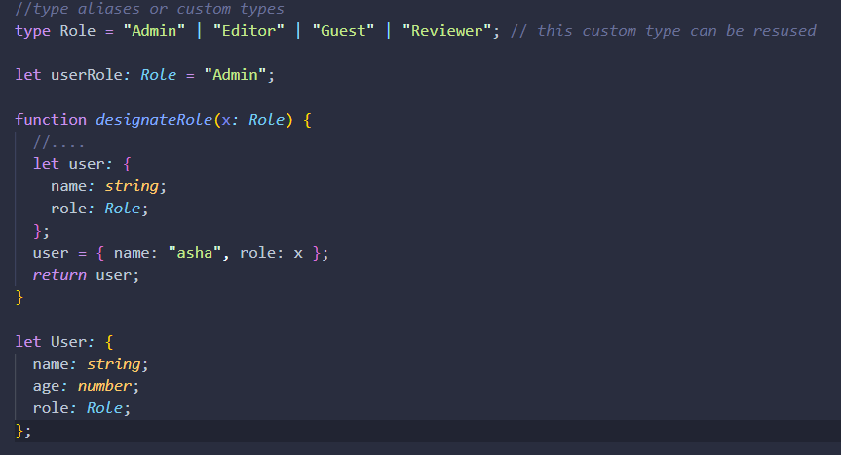
Type alias / custom types

Slide 14
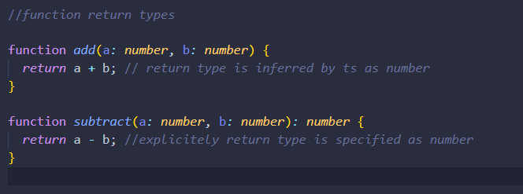
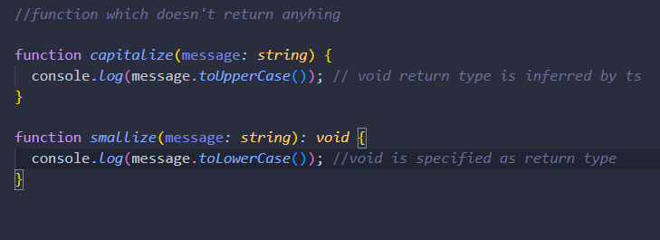
Setting Function return types
Void as return type when funcs don’t return any value

Slide 15
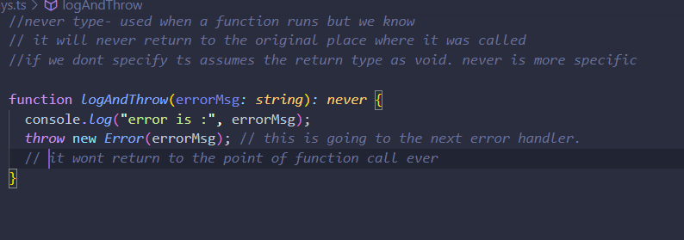
Never type

Slide 16
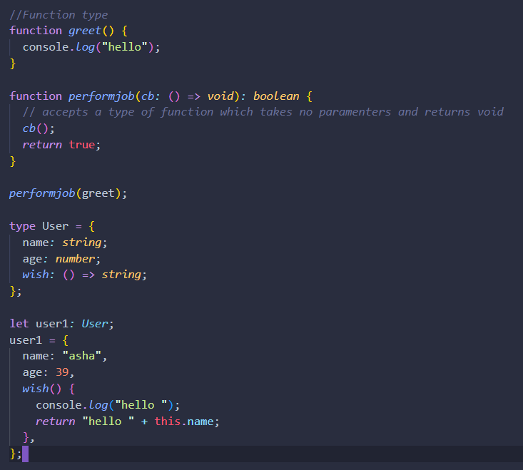
Function type
Can be used in situation where where there is call back function is an argument
()=>string
This means, a function type which accepts nothing and returns a string
(num:number)=>string
Accepts one number argument and returns a string

Slide 17
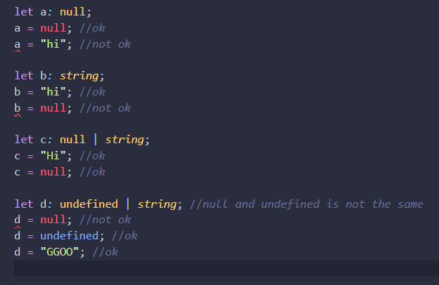
Null and undefined type

Slide 18
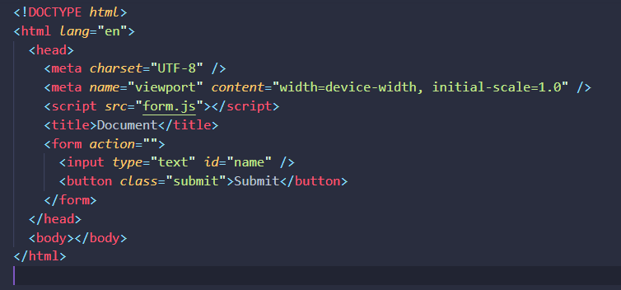
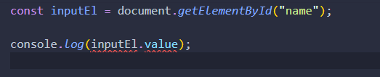
Imagine a form with ts

Slide 19


Forced not null/ optional chaining
They are showing the error coz the inputEl may be null and we are asking for null.value. In in a general application, we need to have if clauses to avoid those errors(which is the correct practice)
But if it is a small application and either (i) we know it is not null or (ii) we don’t mind a runtime error, we can remove that error by adding a ! at the end of the statement
Or give a ? Where we access it

Slide 20
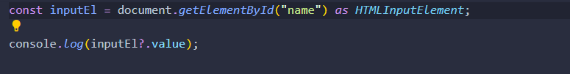
Typecasting (as)
Now also there is an error, that is coz, that ts knows that this is an htmlelement. It does not know if it will have value property(eg p or span don’t have values
So we typecast that as htmlInputElement
Now all errors are gone

Slide 21
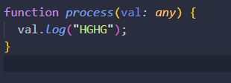

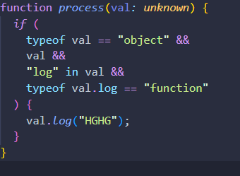
Unknown type
In a function, sometimes we don’t know what kind of argument you have, so we can use any. But you are back to vanilla js. Where there is possibility of many errors. In the eg, val may not have a log function.It may not be an object. With unknown it shows the error
To keep it ts, we can use unknown , then if you don’t do many checks, it will show an error

Slide 22
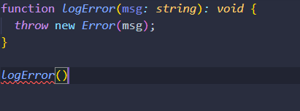
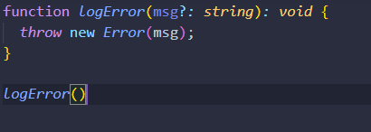
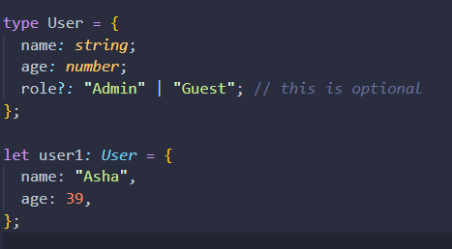
Optional type (?)
Add a ? After variable to show that the value of the variable is optional

Slide 23
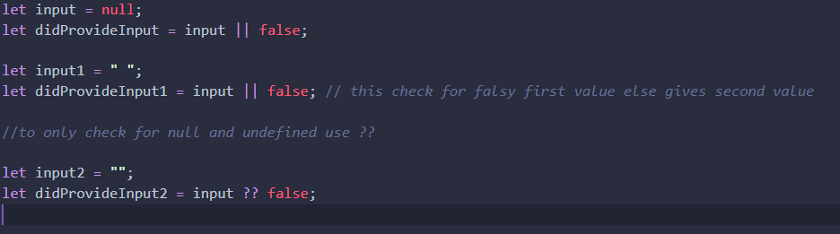
Nullish coalescing (??)

Slide 24
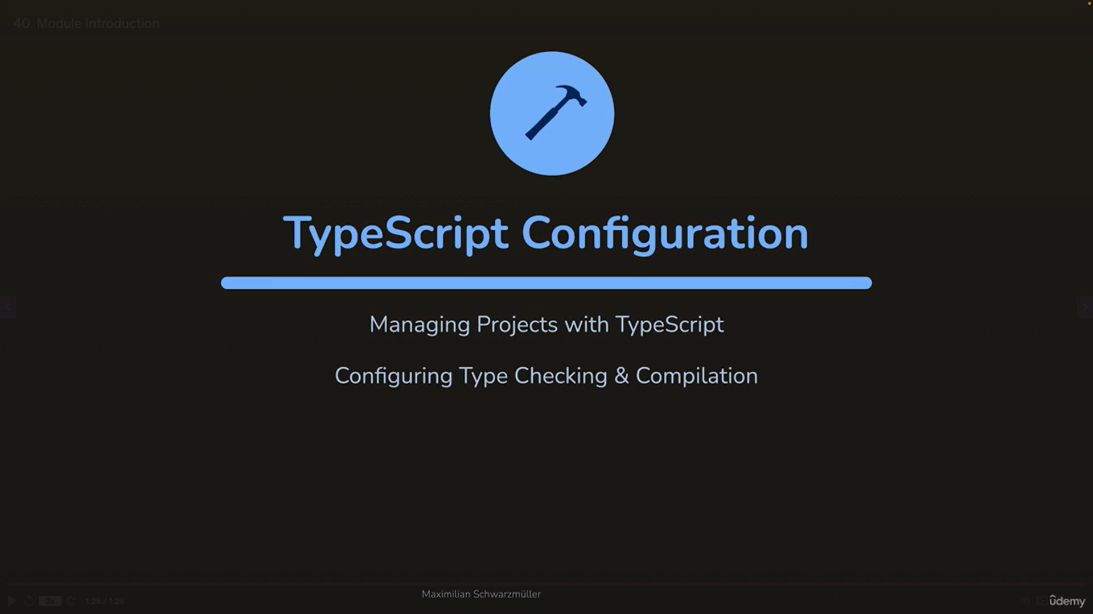
Section 3: TS compiler config

Slide 25
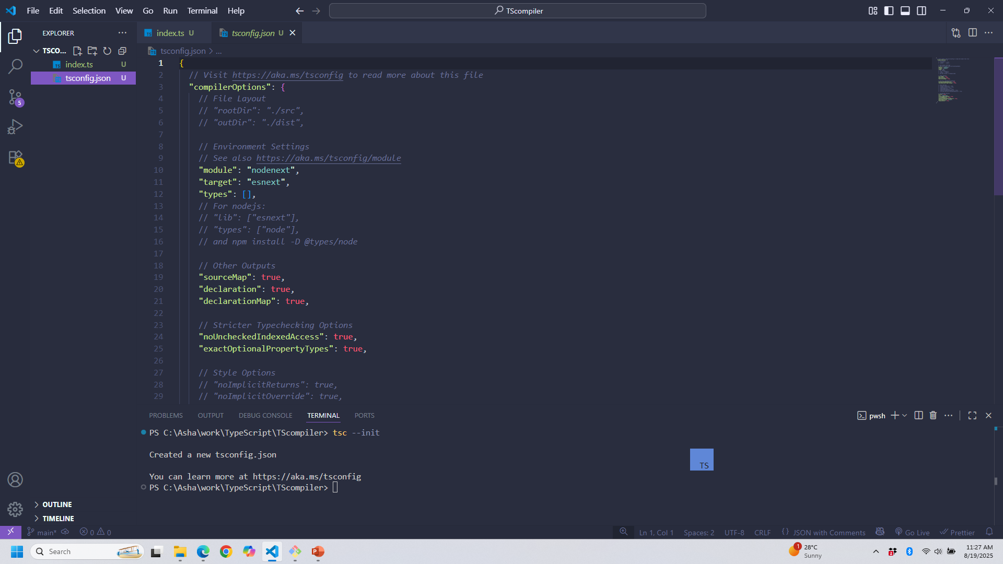
To create tsconfig.json
tsc --init
This file contains the config of which version of target js to use, additional libraries and many other things. You can read the docs for more info
To use the tsconfig file while compiling just type tsc and <Enter>

Slide 26
Tsconfig.json
{
"target": "ES2022", // Good for modern browsers or Node.js
"compilerOptions": {
"esModuleInterop": true, // Ensures ESM and CJS imports work together well
"skipLibCheck": true, // Ensures .d.ts files from 3rd libraries are not type-checked
"target": "es2022", // Sets a relatively modern ECMAScript version as compilation target
"allowJs": true, // Allows importing .js files into .ts (helpful when migrating projects)
"strict": true, // Ensures strict type checking (i.e., noImplicitAny etc)
"noUncheckedIndexedAccess": true, // Adds undefined as a value when accessing by index
// "noImplicitOverride": true, // Enable this when working with classes & inheritance
"noUnusedLocals": true, // to avoid unused variables
"module": "NodeNext", // Supports both ESM & CJS modules / imports
"outDir": "dist", // Store compiled files in "dist" folder
"sourceMap": true, // Enables source maps for easier debugging
"lib": ["es2022", "dom", "dom.iterable"] // Or without "dom" libs when building for Node
}

Slide 27
Ts compiler
Type tsc in the console and <Enter> for using tsconfig file
tsc –watchmode for automatically detecting change in a file and recompiling
Installing type packages
If it is a node project create package.json
npm init –y
In that give type as module
If the project is node or react, ts doesn’t know the types and it may give errors. For rectifying such errors
npm install @types/node --save-dev
Also in the tsconfig,->compiler options-> types:[“node”]

Slide 28
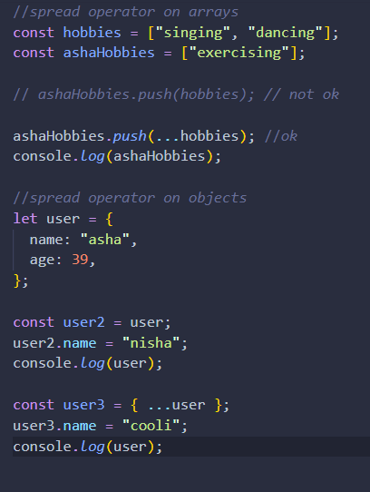
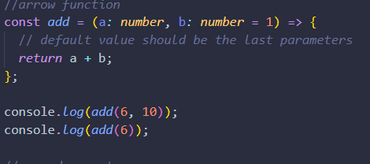
Section 5:Modern JS and TS
var is used in old js. It has block scope, so it may lead to errors. So try to use let and const instead
If you are giving default parameters, give them at the end
When you write obj1=obj2, you are merely copying the reference if obj2 to obj1. To copy the contents, use the spread operator

Slide 29
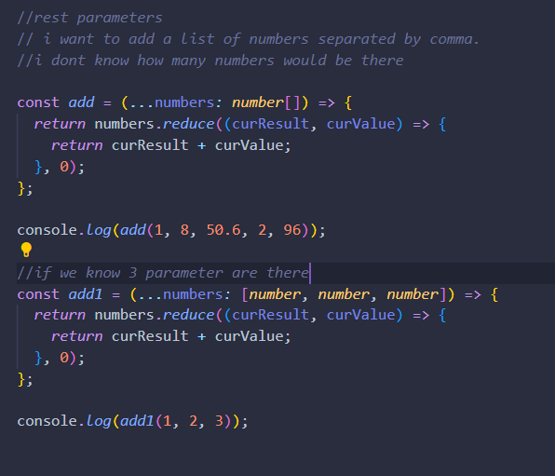
Rest parameters

Slide 30
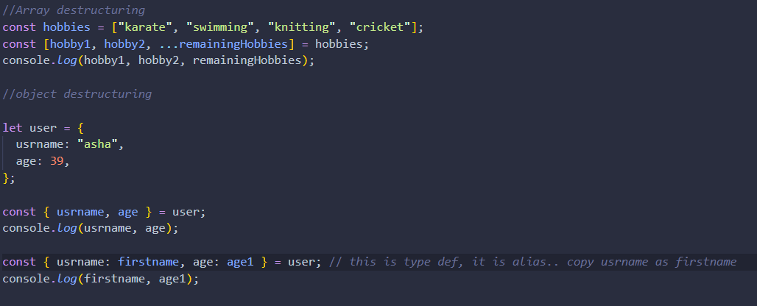
Array and object restructuring

Slide 31
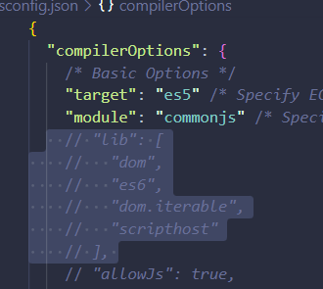
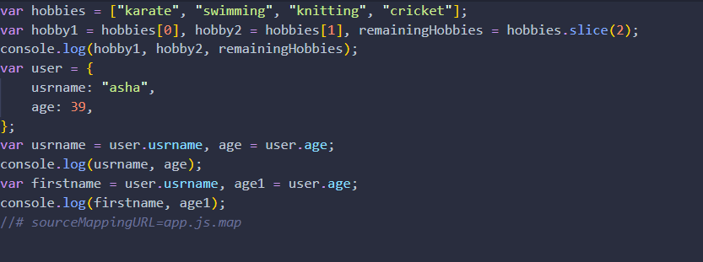
Convert TS to old js(es5 or lesser)
In the tsconfig change the target to es5
Now it will be generated in old js. The code will be longer

Slide 32
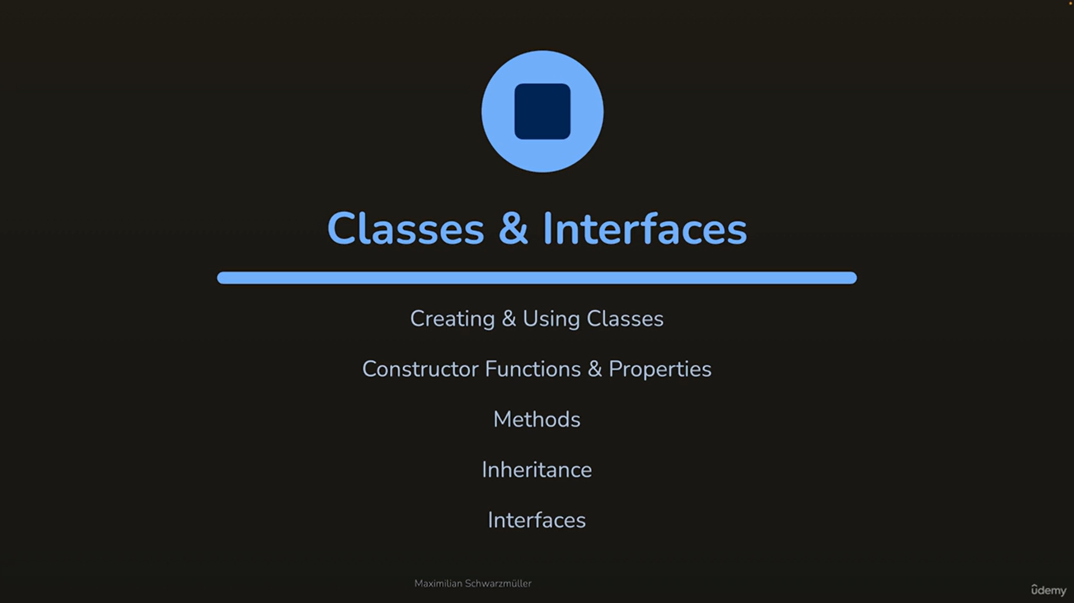
Section6: classes and interfaces
Interfaces are TS exclusive feature

Slide 33
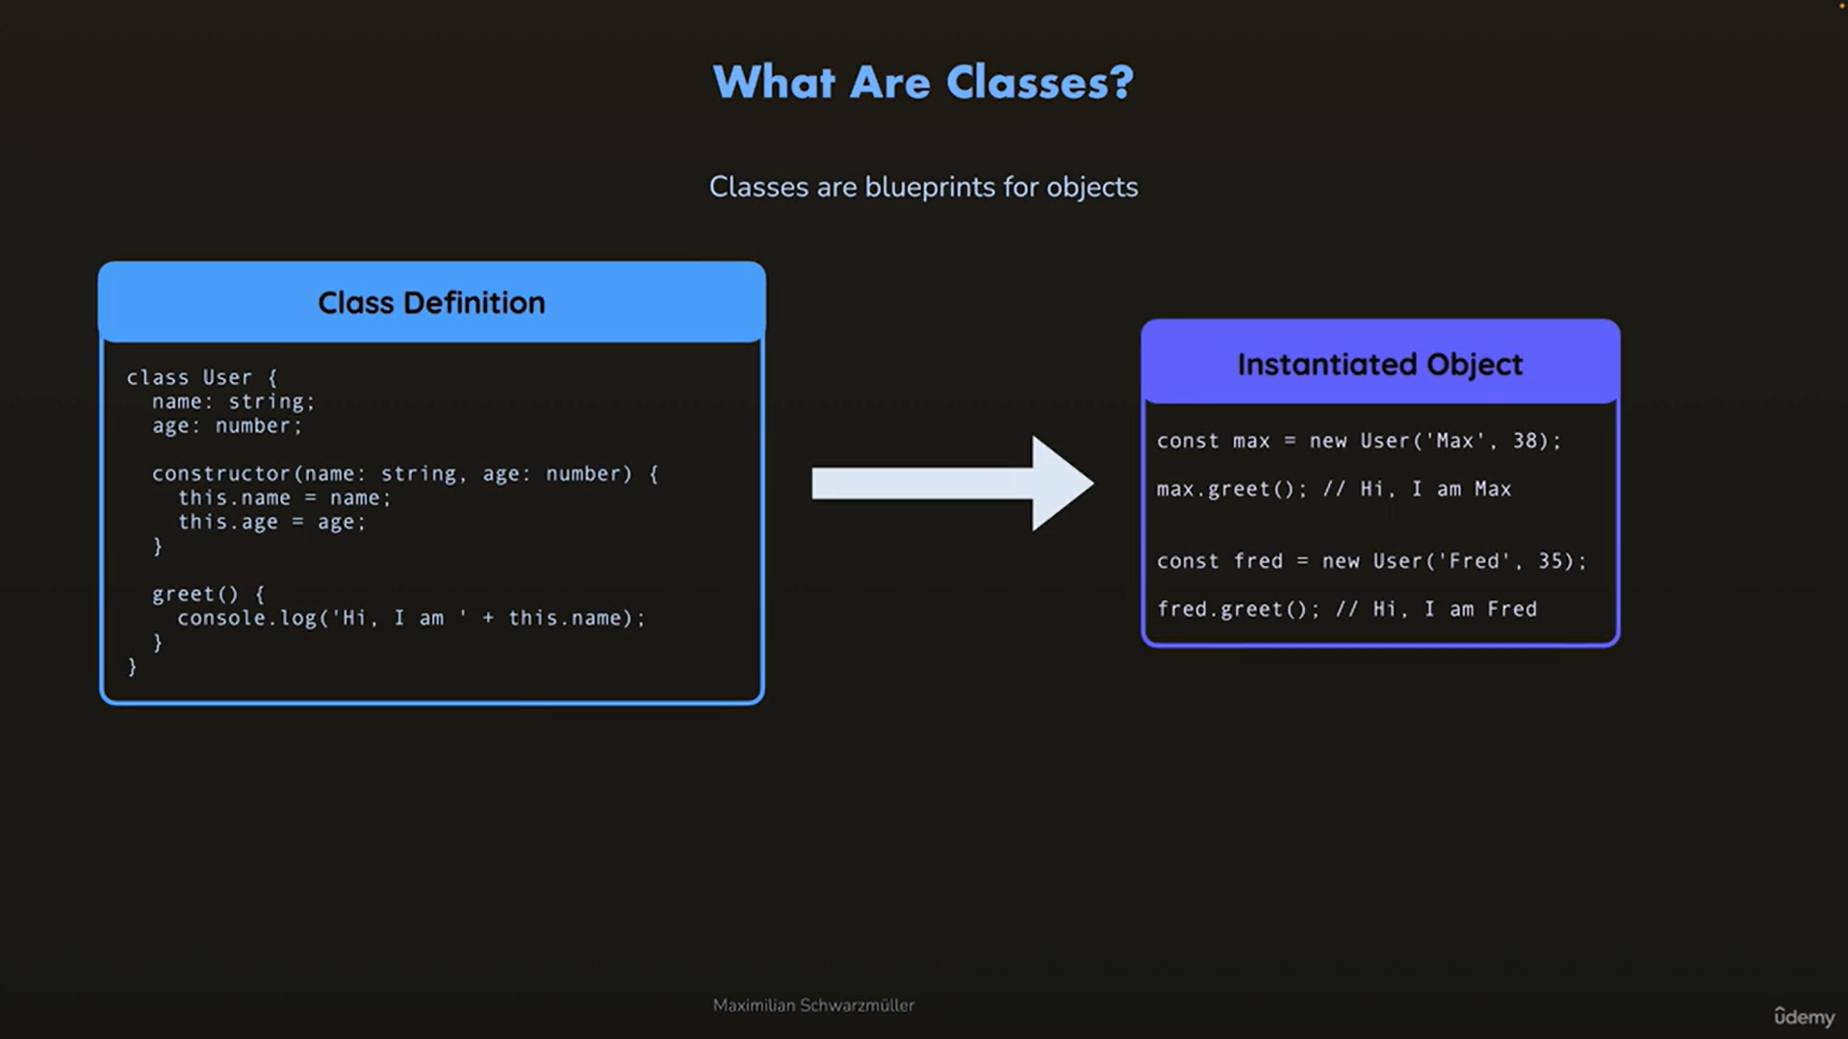
Classes

Slide 34
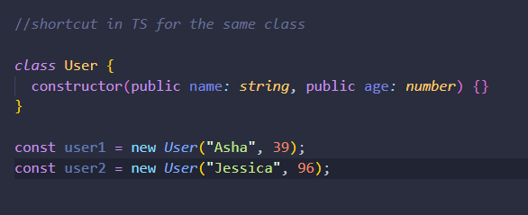
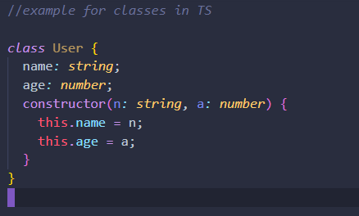
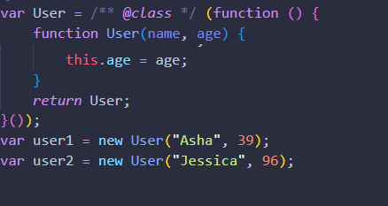
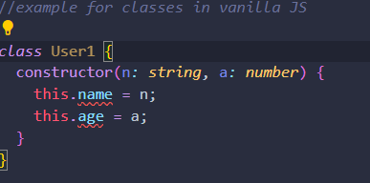
classes
Compiled as below

Slide 35
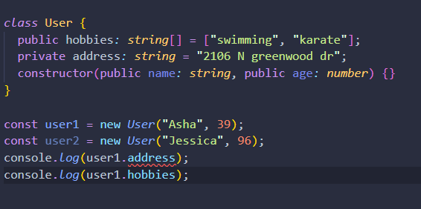
Public, private, protected and readonly
Same meaning as in C++;
Public variables are accessible to outside the class with . Operator
Private ones are not accessible outside the class
Protected is accessible only to classes which are inherited from this class
Readonly items are read only. You can’t modify them. But if they are an array, you can push items into it.

Slide 36
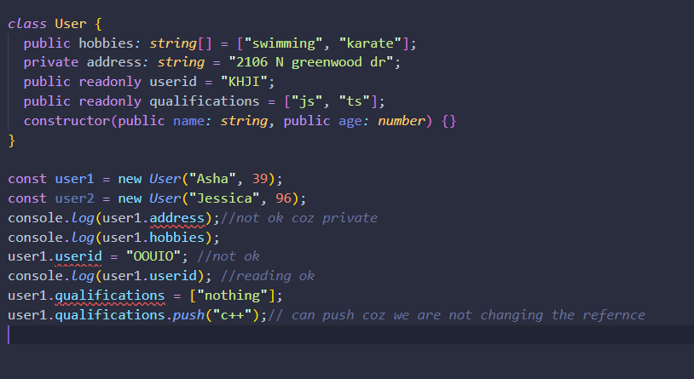
Example for public, private and readonly

Slide 37
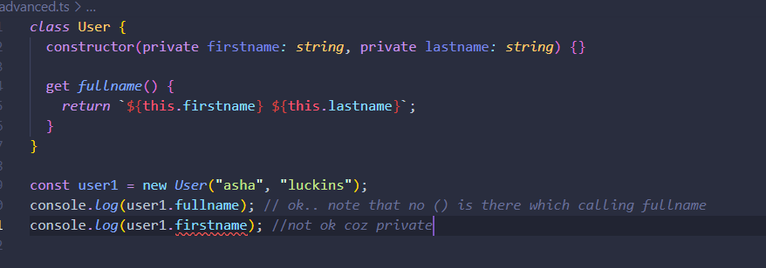
getters
Getters are like class functions(not class functions) which can return a derived value from class variables and functions

Slide 38
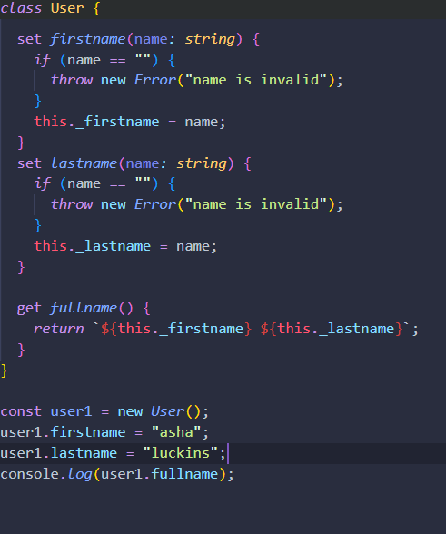
setters
If you want to validate the values before setting into the values inside a class, we can use set

Slide 39
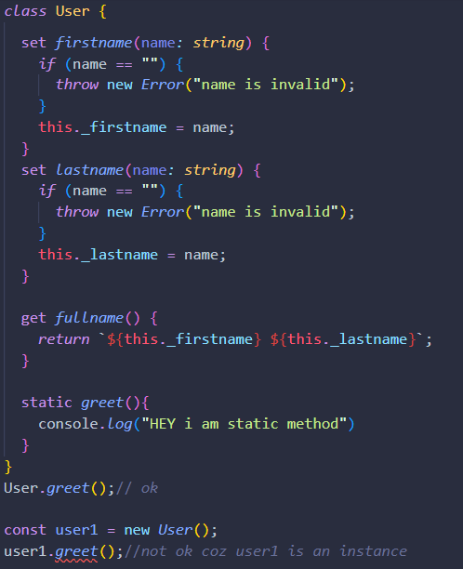
static
Cannot be used in an instance, but can be used with class

Slide 40
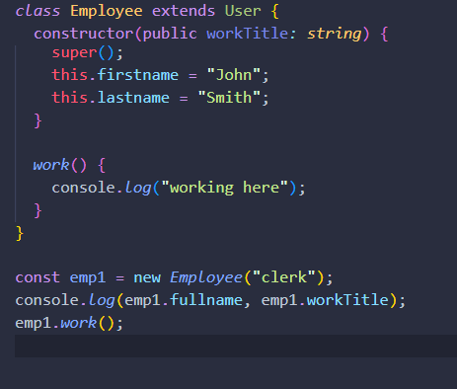
Inheritance (uses extends keyword)
You can access everything from the parent class
We have to have a contructor and call the super() for running parent constructor

Slide 41
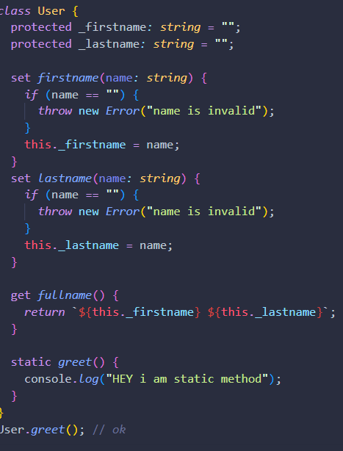
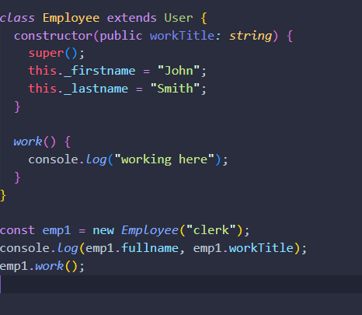
Using protected so that child class can also access the parent class variables

Slide 42

Abstract class
Abstract class is a base class which cannot be instantiated by itself.

Slide 43

interfaces
Interfaces are unique to TS
Interface is like a type for an object but with functions also
You don’t have to give values, implement functionality etc. it just needs the variable, function name and their types. If they are functions, they also needs the return type

Slide 44


Interface eg

Slide 45


Difference between type and interface
Interface supports declaration merging-> means at any point if we want to add more things in an interface, we can add at that point itself. It will be automatically merged.
With types, we have to go back to the type declaration and modify it
Interfaces can be used to define type of functions also
Interfaces can be used to force us and other developers working in the project to implement an interface

Slide 46

Implementing interface
This forces the class to have the items in the interface

Slide 47

Ensuring basetypes with interfaces

Slide 48

Interfaces can extend from other interfaces

