Slide 1


Yes Chef!
User:
Password:
Submit
SKIP

Slide 2

Loading….

Slide 3
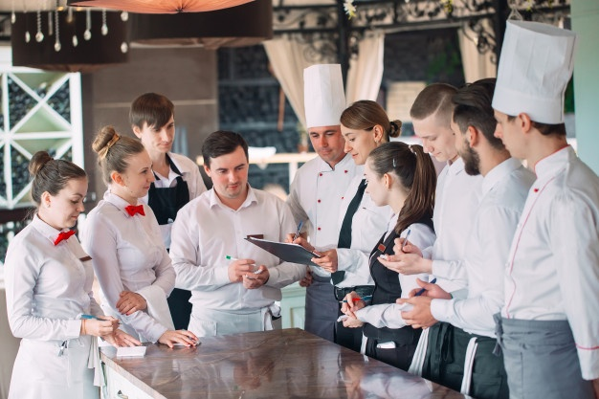
Dish Costing
Invoice Tracking
Cost Monitor
Ordering
Rostering
Recipe Book
Overview
Welcome…
Yes Chef! Is currently in development with Technodrome Inc, we hope you enjoy this interactive presentation.

Slide 4
Dish Costing
Invoice Tracking
Cost Monitor
Ordering
Rostering
Recipe Book
Overview
Dish Name
PRODUCT | PRICE | UNIT | QTY | COST
Brown Rice | 4.50 | Kg | 0.10 | $ 0.45
Chorizo | 12.84 | Kg | 0.10 | $ 1.28
Prawn | 21.50 | kg | 0.10 | $ 2.15
Fish | 18.90 | kg | 0.10 | $ 1.89
Calamari | 55.00 | kg | 0.10 | $ 5.50
seasoning | 1.00 | Each | 1.00 | $ 1.00
PORTIONS | 1
COST OF GOODS | $12.27
$ PER PORTION | 12.274
WASTAGE % | 5
COST INC WASTAGE | $12.89
SELLING PRICE | $28.64
SELLING PRICE INC GST | $31.50
FOOD COST % | 45%
$ 12.27
Save

Slide 5
Dish Costing
Invoice Tracking
Cost Monitor
Ordering
Rostering
Recipe Book
Overview
Dish Name – Saved to Recipe Book
Save

Slide 6
Dish Costing
Invoice Tracking
Cost Monitor
Ordering
Rostering
Recipe Book
Overview
Dish Name
PRODUCT | PRICE | UNIT | QTY | COST
Brown Rice | 4.50 | Kg | 0.10 | $ 0.45
Chorizo | 12.84 | Kg | 0.10 | $ 1.28
Prawn | 21.50 | kg | 0.10 | $ 2.15
Fish | 18.90 | kg | 0.10 | $ 1.89
Calamari | 55.00 | kg | 0.10 | $ 5.50
seasoning | 1.00 | Each | 1.00 | $ 1.00
PORTIONS | 1
COST OF GOODS | $12.27
$ PER PORTION | 12.274
WASTAGE % | 5
COST INC WASTAGE | $12.89
SELLING PRICE | $28.64
SELLING PRICE INC GST | $31.50
FOOD COST % | 45%
$ 12.27
Save

Slide 7
Dish Costing
Invoice Tracking
Cost Monitor
Ordering
Rostering
Recipe Book
Overview

Slide 8
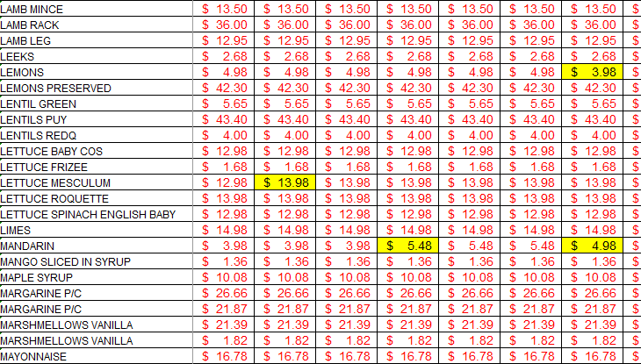
Dish Costing
Invoice Tracking
Cost Monitor
Ordering
Rostering
Recipe Book
Overview
Item
Cost Variance
Today
Week
Month
Year

Slide 9



Dish Costing
Invoice Tracking
Cost Monitor
Ordering
Rostering
Recipe Book
Overview
Dictate Order
Scan Order
Type Order

Slide 10
Dish Costing
Invoice Tracking
Cost Monitor
Ordering
Rostering
Recipe Book
Overview
DD/MM/YYY - DD/MM/YYY
Contacts

Slide 11
Dish Costing
Invoice Tracking
Cost Monitor
Ordering
Rostering
Recipe Book
Overview
Dressings & Sauce
Fish & Seafood
Beef
Chicken & Poultry
Customize this Button

Slide 12
Dish Costing
Invoice Tracking
Cost Monitor
Ordering
Rostering
Recipe Book
Overview
 |  | Food | Cost of
Day | Purchases | Revenue | Sales
1 | $ - | $ 3,722.81 | 0.0%
2 | $ 2,369.57 | $ 2,914.06 | 81.3%
3 | $ 1,227.49 | $ 2,503.84 | 49.0%
4 | $ 2,418.36 | $ 2,807.51 | 86.1%
5 | $ 2,152.77 | $ 2,204.78 | 97.6%
6 | $ 1,242.42 | $ 3,499.31 | 35.5%
7 | $ 825.96 | $ 4,156.19 | 19.9%
8 | $ - | $ 2,331.98 | 0.0%
9 | $ 2,343.81 | $ 3,108.96 | 75.4%
10 | $ 386.54 | $ 2,463.67 | 15.7%
11 | $ 1,660.48 | $ 2,477.14 | 67.0%
12 | $ 1,363.19 | $ 3,010.27 | 45.3%
13 | $ 2,124.06 | $ 3,930.02 | 54.0%
14 | $ 944.14 | $ 3,432.02 | 27.5%
15 | $ - | $ 1,542.35 | 0.0%
16 | $ -
17 | $ -
18 | $ -
19 | $ -
20 | $ -
21 | $ -
22 | $ -
23 | $ -
24 | $ -
25 | $ -
26 | $ -
27 | $ -
28 | $ -
29 | $ -
30 | $ -
31 | $ -
Day
Purchases
Food Revenue
Cost Of Sale
Month To Date
Purchases | $19,058.79
Revenue | $44,104.91
Opening Stock | $32,428.15
Closeing Stock | $30,695.68
Stock + Purchases | $51,486.94
COGS | $20,791.26
Budget | 45%
Under/(over) Spent | $ 788.42
Food Cost % | 43.21%
GP % (Without Stock) | 56.79%
GP Actual | $23,313.65
GP Actual % | 52.86%

Slide 13
Dish Costing
Invoice Tracking
Cost Monitor
Ordering
Rostering
Recipe Book
Overview
Dressings & Sauce
Fish & Seafood
Red wine Vinaigrette
Beef
Add Card
Chicken & Poultry
Customize this Button

Slide 14
Dish Costing
Invoice Tracking
Cost Monitor
Ordering
Rostering
Recipe Book
Overview
Dressings & Sauce
Red wine Vinaigrette
Fish & Seafood
Ingredients
UOM
QTY
Note
INGREDIENTS | UOM | QTY | NOTE
Shallots | Each | 1 | Chopped
Red Wine Vinegar | ML | 500
Sugar | CUP | 1
Peppercorn | TBSP | 1
Tarragon | Bunch | 1
Ginger | Grams | 30
Salt |  |  | Pinch
Vegetable Oil | ML | 1000
Vanilla Essence | ML | 5
Beef
Chicken & Poultry
Customize this Button
Method
METHOD
In a pot, bring Shallots, Red wine vintager, Sugar, Peppercorns, Tarragon, Ginger & Salt to the boil, Reduce
Until Syrup like
Whisk in Veg oil and vanilla.

