Slide 1
Unidata Python Workshop Overview (Unidata, python)
20 July 2015

Slide 2
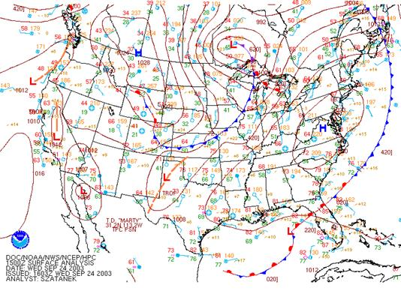
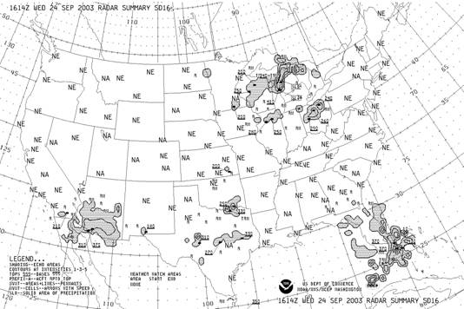
Unidata: Core Activities
Facilitate access to (real-time) data by the University research and education community
Support the community in their use of the data
Help build, represent, and advocate on behalf of the community

Slide 3
Unidata: Core Activities
Facilitate access to (real-time) data by the University research and education community
Support the community in their use of the data
Help build, represent, and advocate on behalf of the community
Develop open source tools and infrastructure for data access, analysis, visualization, and data management
Advance metadata standards for the earth science community
Support users of our technologies

Slide 4
Unidata – What we provide
Real-time data streams over IDD/LDM
Radar, satellite, model forecasts, station, etc.
Visualization and analysis packages
IDV, GEMPAK, McIDAS, AWIPS-II
Rolling archive of real-time data
thredds.ucar.edu
NetCDF data format and libraries

Slide 5
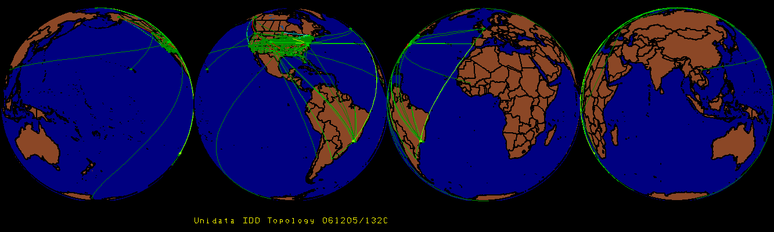
Unidata: Facilitate access to real-time data
IDD: Real-Time Data Distribution
Over 200 sites. Approx 15 GB/hour
Unidata’s LDM
Protocol and client/server software
Event-driven data distribution
Supports subscription to subsets of data feeds

Slide 6
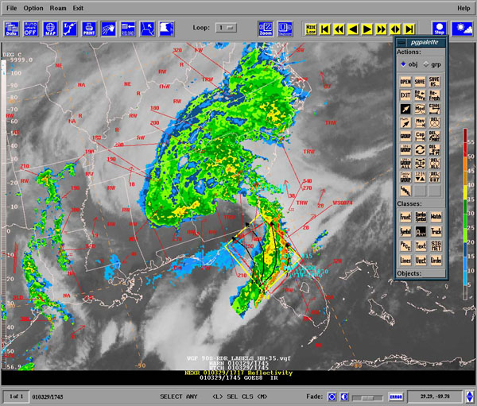
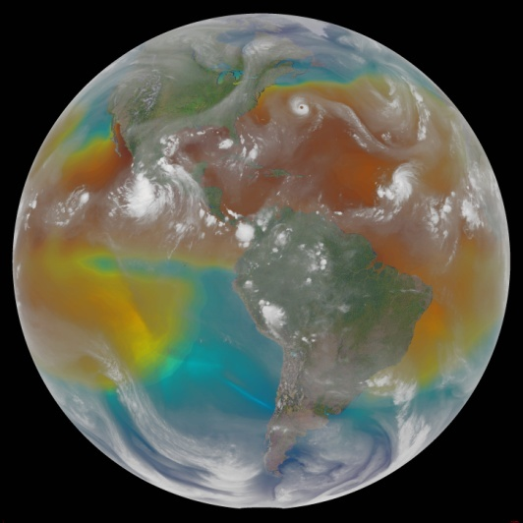
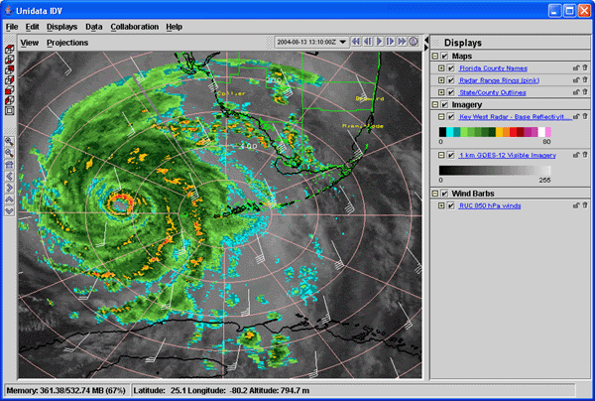
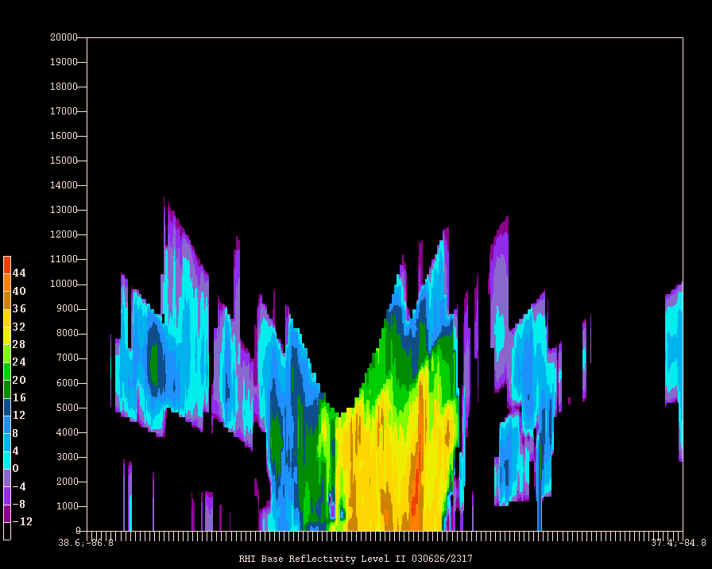
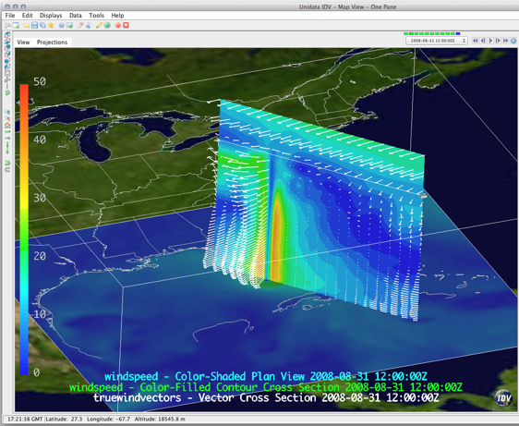
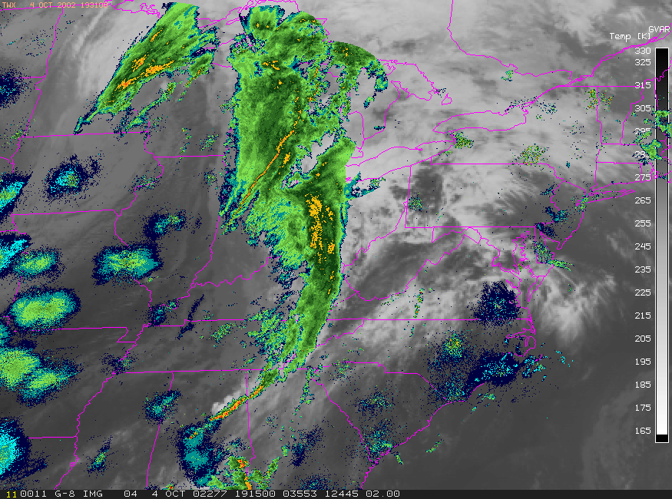
Visualizing and Analyzing Data
GEMPAK
McIDAS-X
IDV

Slide 7
Access to Real-time Data
Unidata TDS: thredds.ucar.edu
Serves the last month or so of IDD/LDM data streams
Services:
OPeNDAP
NCSS
OGC WCS and WMS
Unidata ADDE server: adde.ucar.edu
Service: McIDAS ADDE

Slide 8
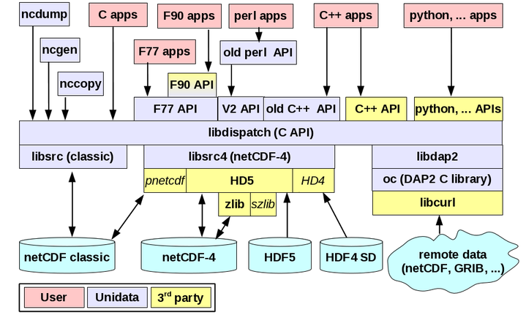
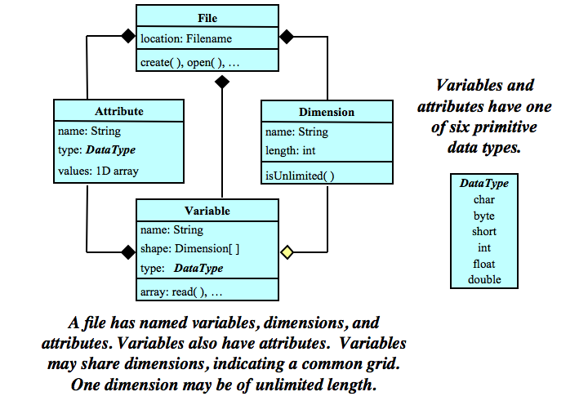
netCDF
Array-oriented scientific data:
Interface for access (C, Fortran, Java, etc.)
Machine-independent encoding format
Reference libraries (C and Java)
NetCDF Library Architecture
NetCDF Class Data Model

Slide 9
Unidata User Community
Support the community
User Workshops
Training Workshops
Mailing lists
For specific software packages
“community” email list – for Unidata community announcements
Represent and advocate for the community
More: http://www.unidata.ucar.edu/

Slide 10
Why Unidata and Python?
Embraced by the earth science community
Language popularity measured by search hits on AMS web site
Requests from Unidata community for Python support
Year | Python | Java | Fortran
2010 | 2 | 7 | 2
2011 | 19 | 2 | 4
2012 | 57 | 9 | 2
2013 | 60 | 12 | 9
2014 | 60 | 7 | 5
2015 | 65 | 6 | 11

Slide 11
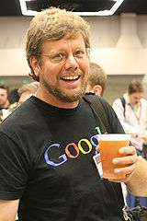
What is Python?
General purpose, high-level language invented by Guido van Rossum.
Multiple paradigms
scripting
object-oriented
imperative
functional
"Python is executable pseudocode"

Slide 12
Unidata and Python
"I have used a combination of Perl, Fortran, NCL, Matlab, R and others for routine research, but found out this general-purpose language, Python, can handle almost all in an efficient way from requesting data from remote online sites to statistics, graphics." - UCAR Scientist
Avenue for exploring, and leveraging netCDF and THREDDS Data Server technologies.
Embraced by earth science community for analysis and exploration (see table).
Publication quality graphics and visualization which are improving all the time.

Slide 13
Python Editor
Today, we will be using the jupyter notebook. It is good for presentations and sharing finished code. It is not so good for code development. Here are some Python IDEs:
Spyder (Scientific Python Developement EnviRonment)
Emacs jupyter Notebook
Enthought Canopy Editor
Wakari, a hosted Python data analysis environment
PyCharm
Python Tools for Visual Studio

Slide 14
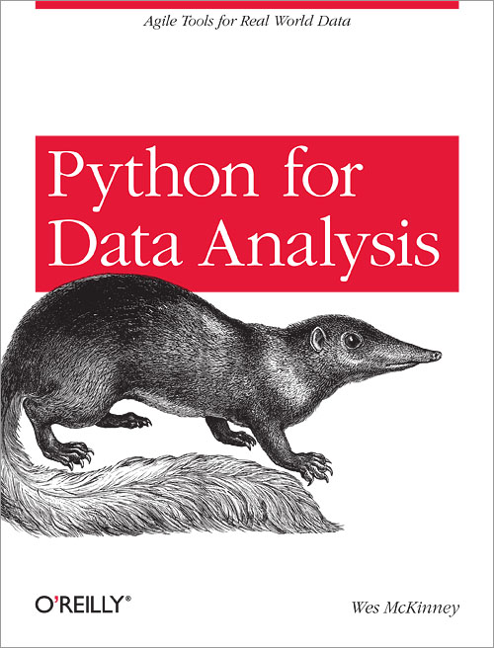
Python Background material
A Hands-On Introduction to Using Python in the Atmospheric and Oceanic Sciences
Lectures on scientific computing with Python
Why Python is the Next Wave in Earth Sciences Computing
Oceanographic Anaylsis with Python - Rich Signell
Python Scientific Lecture Notes

Slide 15
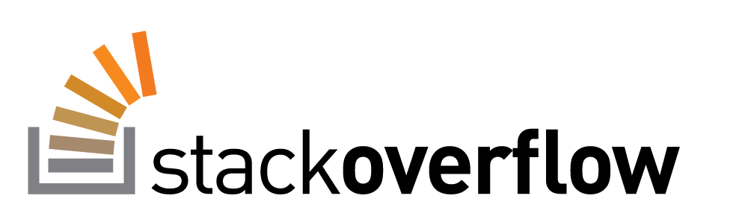
Where to ask for Help
Tag your questions with python, netcdf, thredds, etc.

Slide 16
Let’s Get Started Today We Will …
Software Carpentry for Science
Jupyter Notebook
Numpy with matplotlib
Read and write netCDF files
Geoscience Visualization with matplotlib and cartopy
And lots more …

