Slide 1
Introduction to Jupyter Notebook
Ward Fisher
Unidata Python Workshop
July 2015

Slide 2
Overview
Brief overview of Jupyter Notebook
What is it?
How do you use it?
Examples of basic Jupyter Notebook Usage.
Discuss some Advanced Jupyter Notebook Uses.

Slide 3
Overview
We will not be going too in-depth with what you can do in regards to using Jupyter Notebooks for actual science.
You will be seeing that throughout the rest of the workshop.

Slide 4
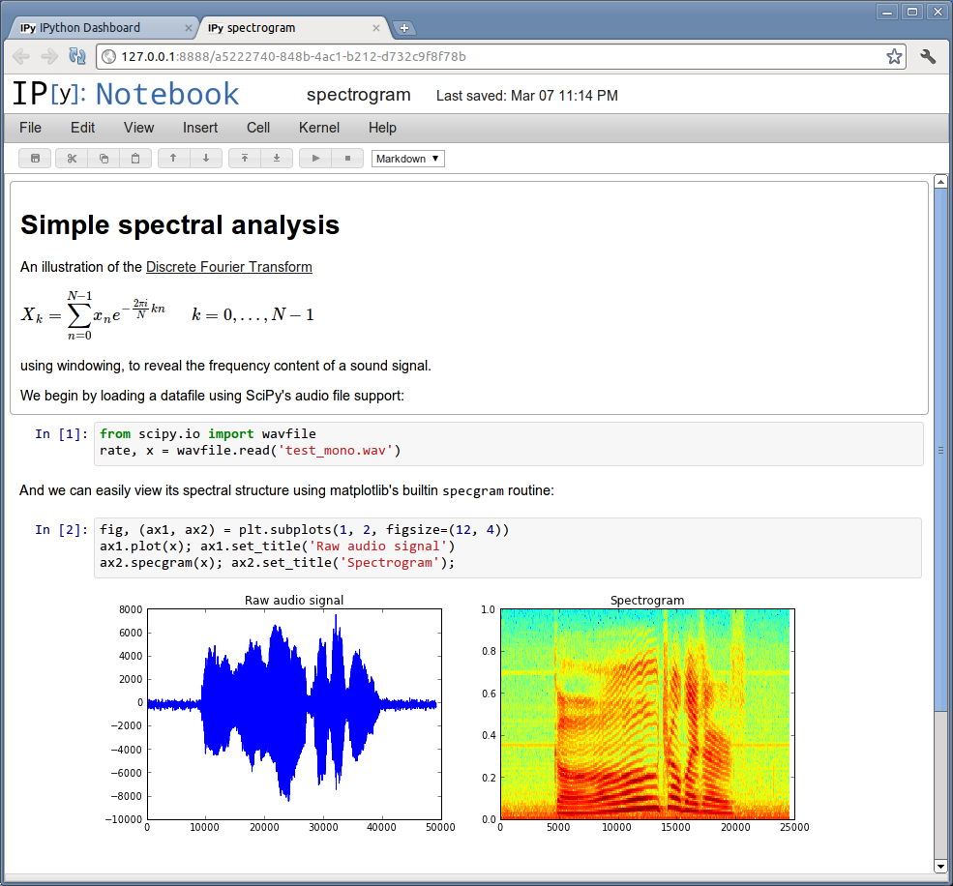
Remember IPython Notebook?
“The IPython Notebook is a web-based interactive computational environment where you can combine code execution, text, mathematics, plots and rich media into a single document”
http://ipython.org/notebook.html

Slide 5
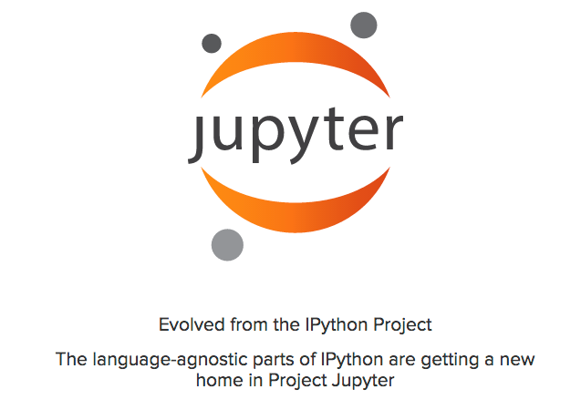
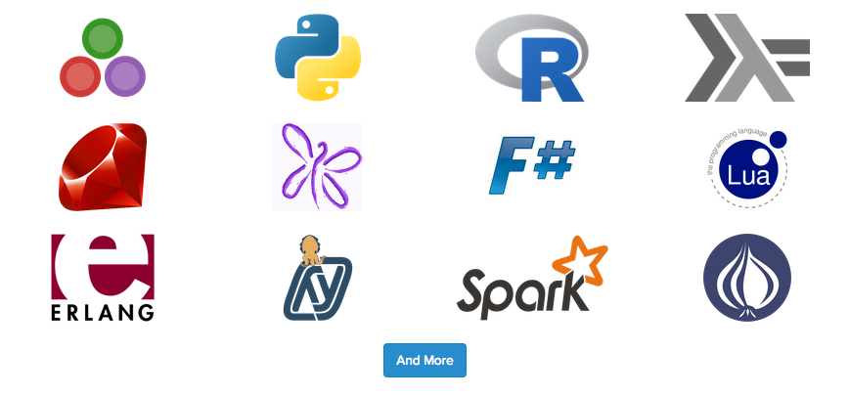
What is Jupyter Notebook?
(…) the language-agnostic parts of the project: the notebook format, message protocol, qtconsole, notebook web application, etc. will move to new projects under the name Jupyter.
IPython itself will return to being focused on interactive Python, part of which will be providing a Python kernel for Jupyter. IPython 3.0 contains some indications of the project transition, including the logo in the notebook web UI being that of Jupyter.
Notes:
Talk about the different kernels it can run now.

Slide 6
What is Jupyter Notebook?
Jupyter Notebooks has two components:
The Jupyter Notebook server
Individual Notebooks (.ipynb)

Slide 7
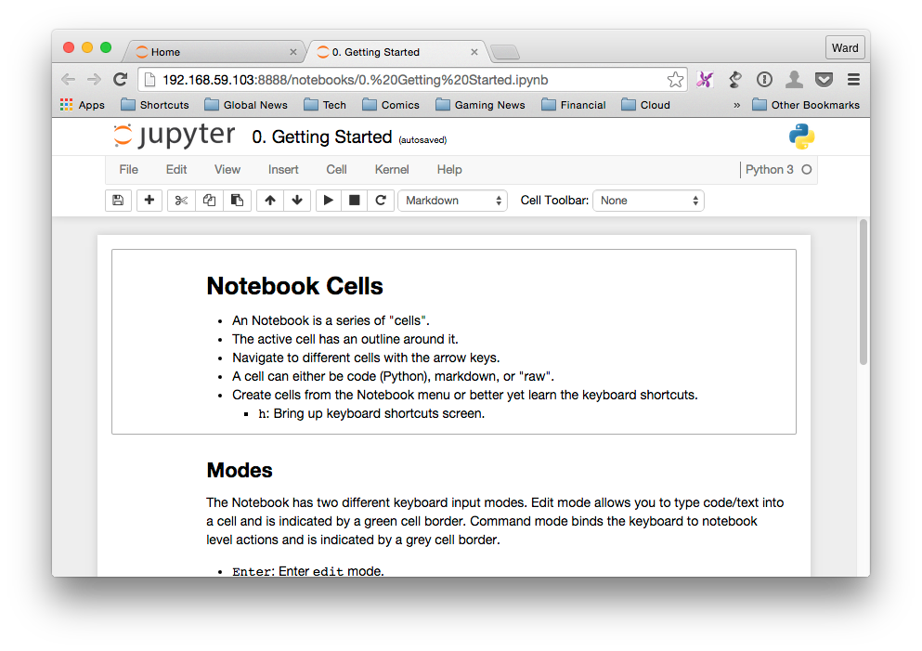
Jupyter Notebooks
An Jupyter Notebook is a collection of cells.
Markdown
Code
“Raw” - Raw cells are left ‘as is’ and are not processed.

Slide 8
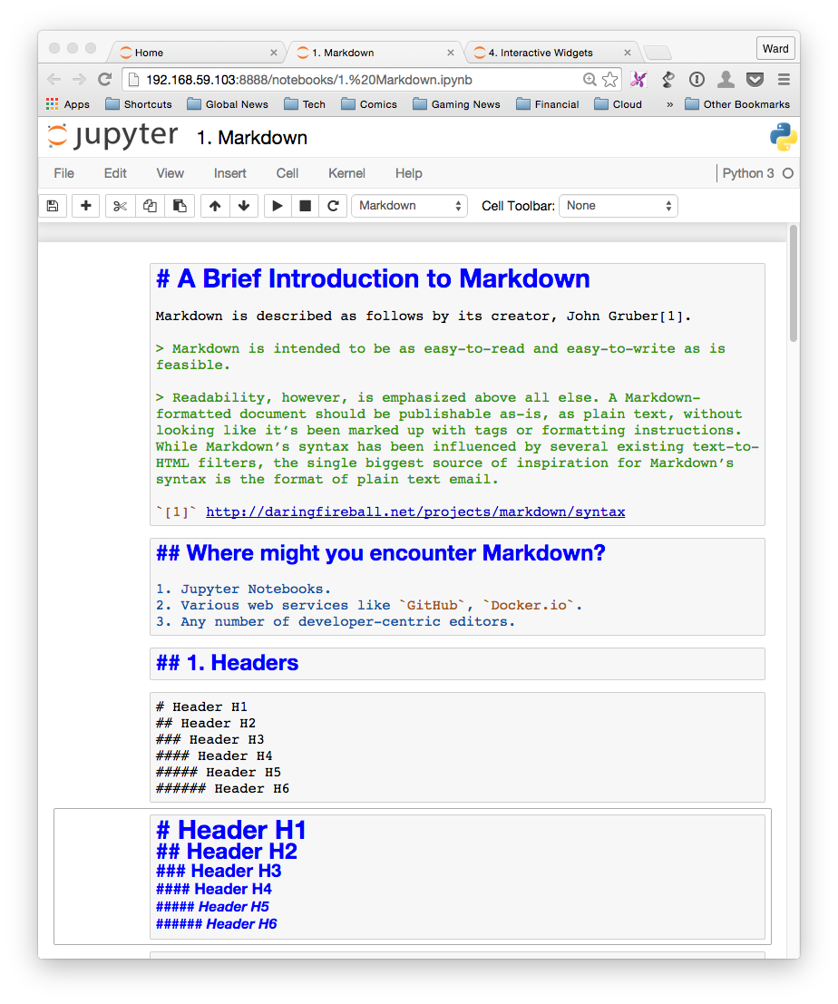
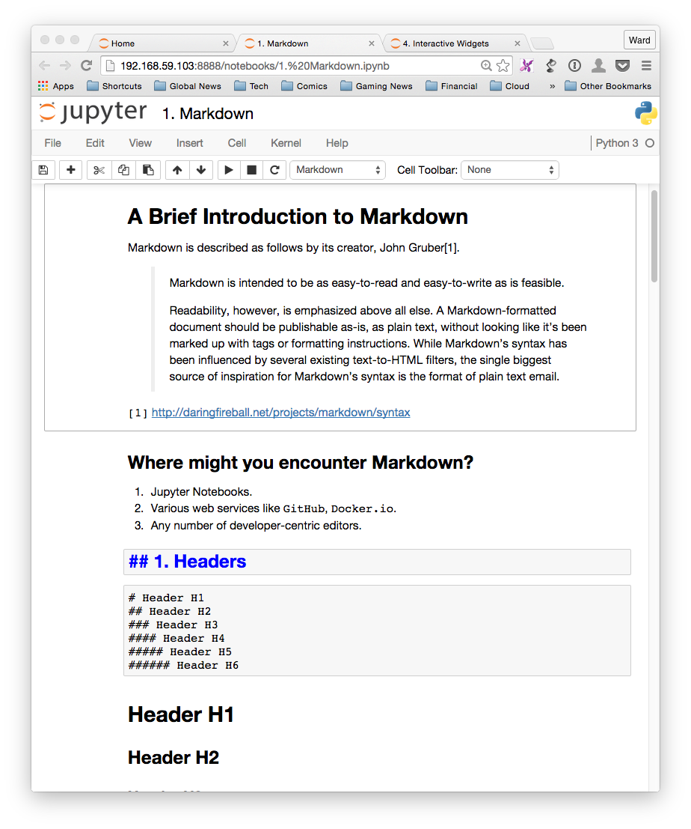
Markdown Cells
Notes:
We’ll talk a bit about markdown in the notebooks.

Slide 9
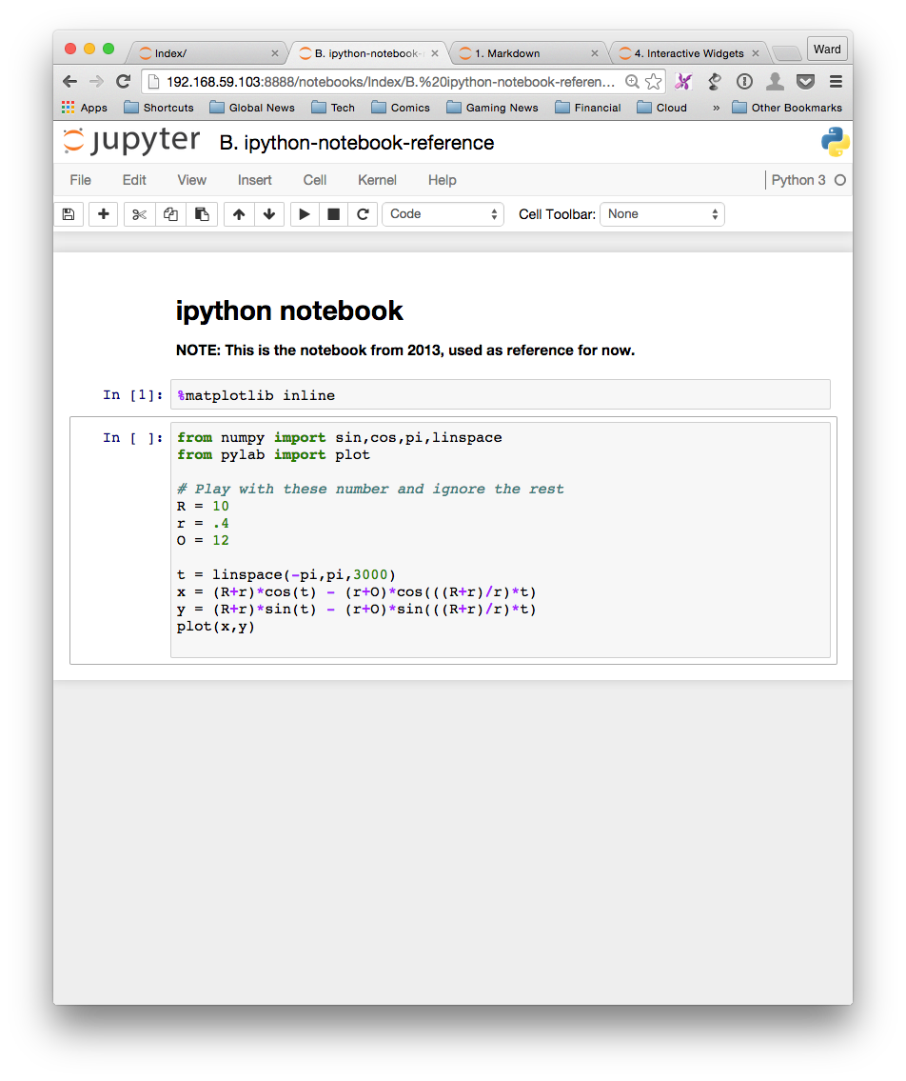
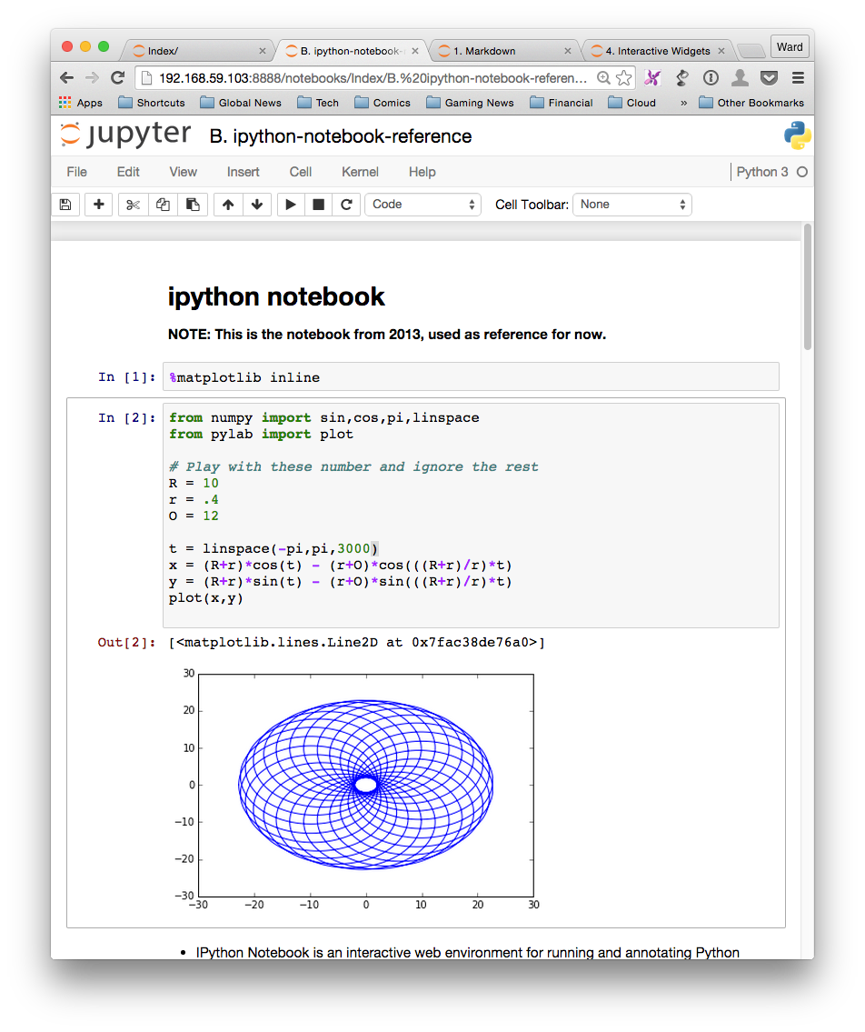
Python Cells

Slide 10
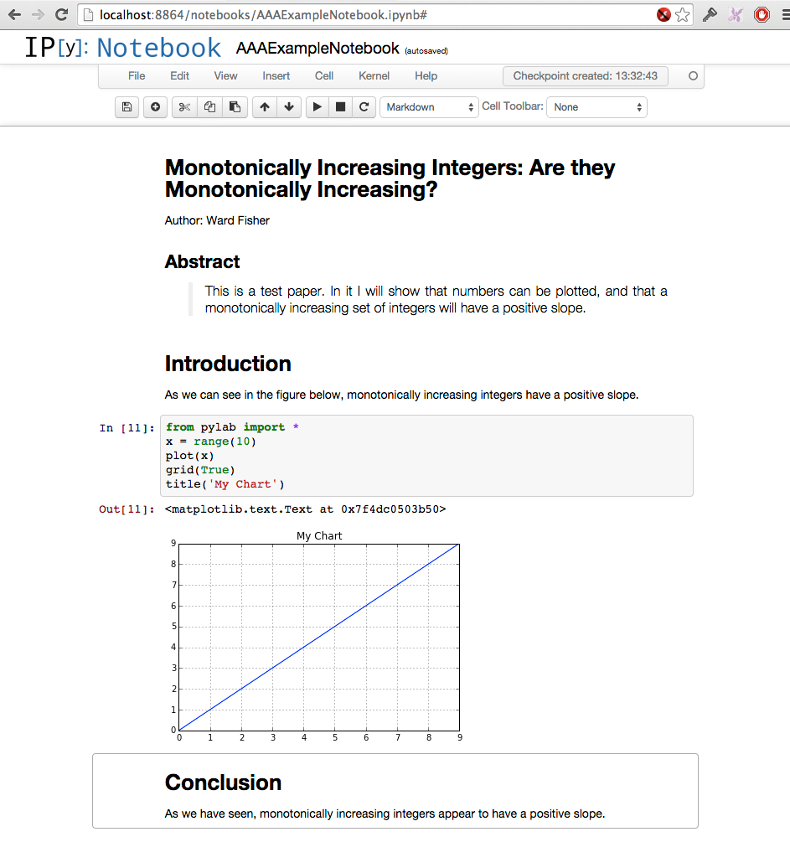
What does this get you?
A sharable document with embedded, reproducible experimental data analysis.

Slide 11
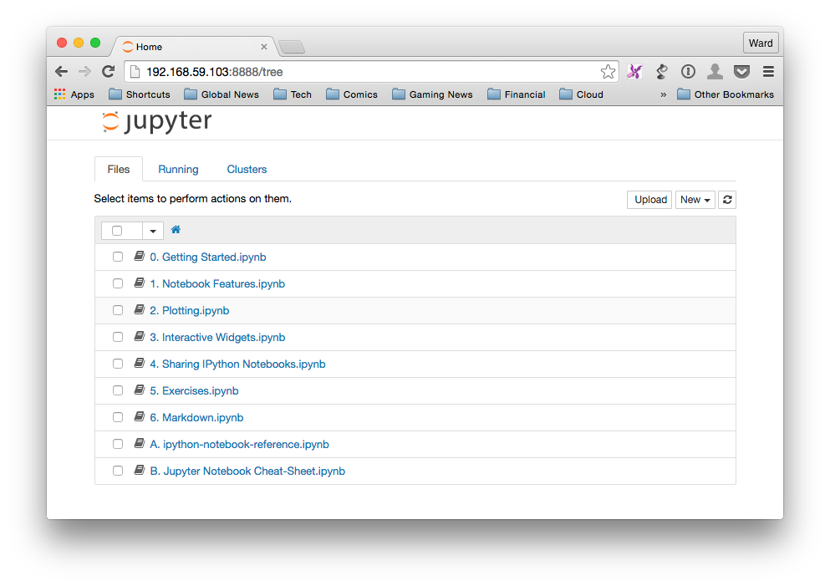
Jupyter Notebook Server
The Jupyter Notebook Server acts as a dashboard for a collection of individual notebooks.

Slide 12
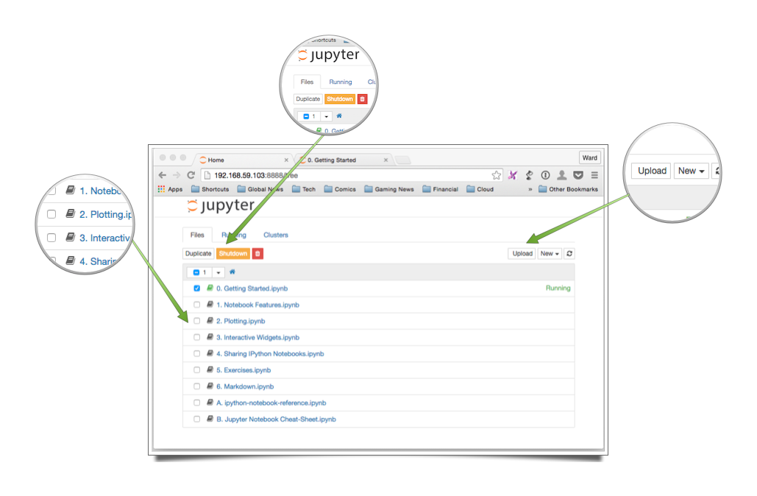
Jupyter Notebook Server

Slide 13
Installing Jupyter Notebook
The easiest way to install Jupyter notebook is with a package manager like “Conda”
Maintained by Continuum Analytics
http://continuum.io/downloads

Slide 14
Installing Jupyter Notebook
Once Anaconda is installed, you can use the ‘conda’ command to install jupyter notebook (and other packages).
$ conda install ipython ipython-notebook
Notes:
Jupyter is taking over for IPython, but for now you just install ipython

Slide 15
Launching Jupyter Notebook
Jupyter Notebook is launched via the command line.
$ ipython notebook

Slide 16
Launching Jupyter Notebook
Jupyter Notebook is launched via the command line.
$ ipython notebook [options]
There are a number of command line options for advanced usage.

Slide 17
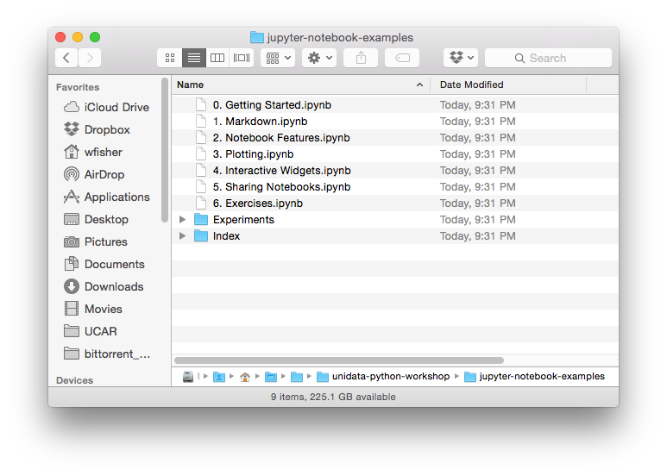
Running Jupyter Notebook Server
Notebooks are arranged in a directory.
You launch Jupyter Notebook from the root of this directory structure.

Slide 18
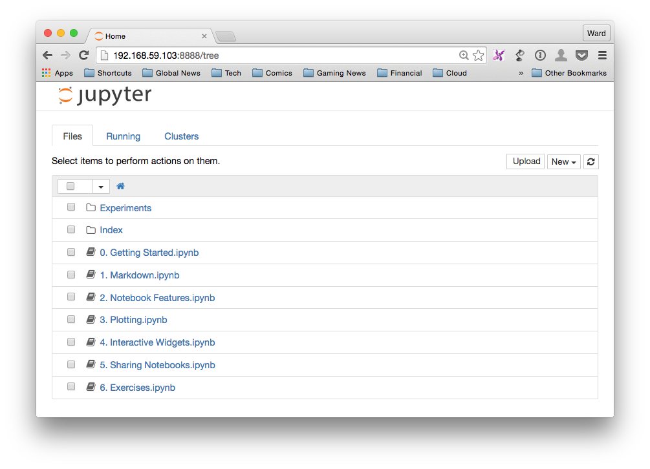
Running Jupyter Notebook Server
Notes:
So what? What’s this get you? Well, we’ll see. Next, jumping into examples.

Slide 19
Working in Jupyter Notebook
Switching to the Browser.

