Slide 1
Unidata Python Workshop Overview (Unidata, python, data)
21 October 2014

Slide 2
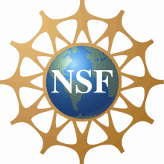
Unidata – Who are we?
Funded primarily by the U.S. National Science Foundation
Mission:
To provide data, tools, and community leadership for improving Earth-system education and research
At the Unidata Program Center, we
Provide access to data (via push and pull systems)
Develop open source tools and infrastructure for data access, analysis, visualization, and data management
Advance metadata standards for the Earth system science community
Support users of our technologies: faculty, students, and researchers
Help to build, represent, and advocate on behalf of our community
Notes:
Although the main focus of our work is on providing real-time data, Unidata develops tools, middleware, and services that contribute to broader cyberinfrastructure needs of the community.

Slide 3
Unidata – What we provide
Real-time data streams over IDD/LDM
Radar, satellite, model forecasts, station, etc.
Visualization and analysis packages
IDV, GEMPAK, McIDAS, AWIPS-II
Rolling archive of real-time data
thredds.ucar.edu
NetCDF data format and libraries

Slide 4
Real-time Data Streams
IDD Real-time Data Flow
30 data feeds provide radar, satellite, text bulletins, lightning, model forecasts, surface and upper air observations, …
LDM routinely handles 10 GB/hour input, with as many as 280,000 products/hour
Worldwide collaboration of over 250 institutions running LDM software
Unidata’s LDM
Protocol and client/server software
Event-driven data distribution
Supports subscription to subsets of data feeds

Slide 5
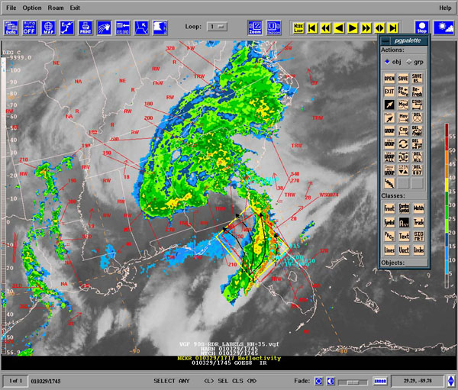
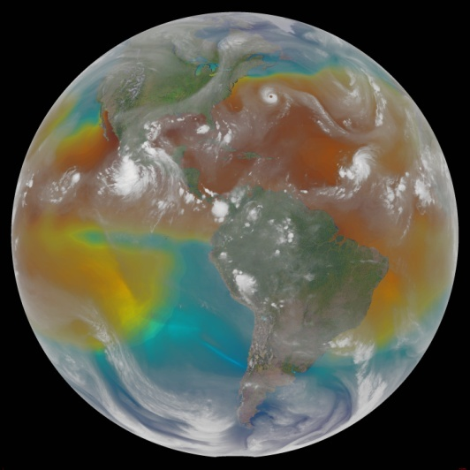
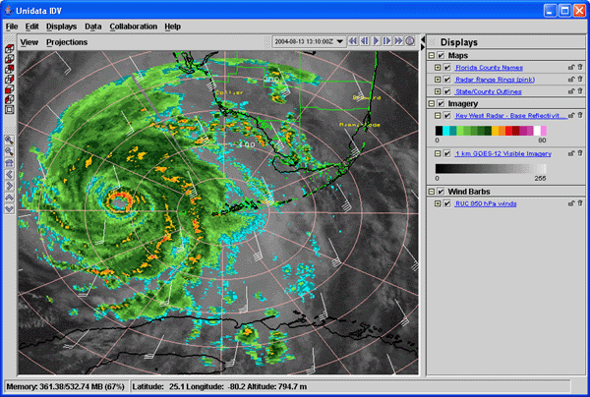
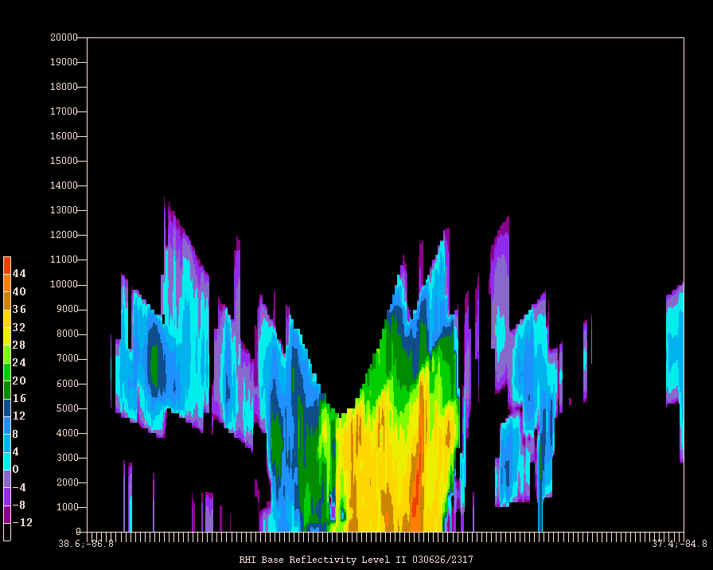
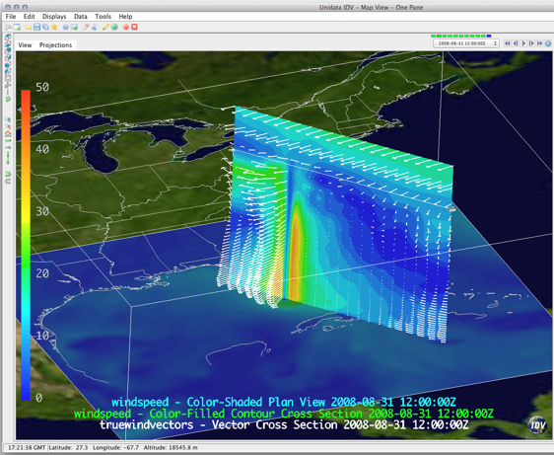
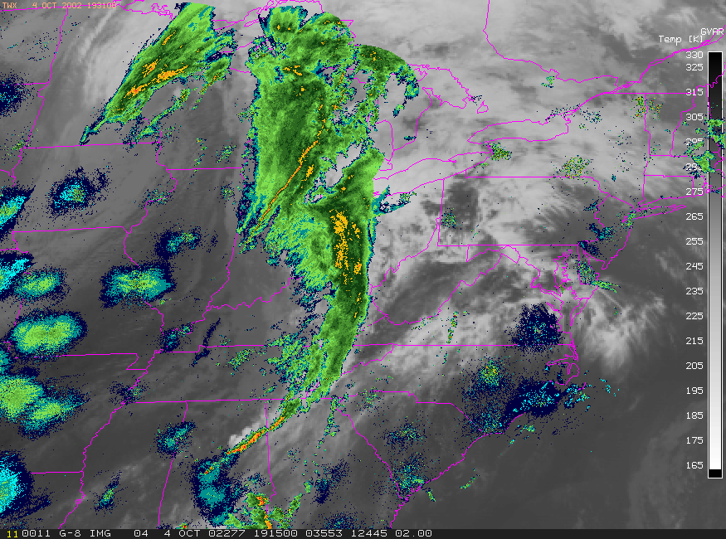
Visualizing and Analyzing Data
GEMPAK
McIDAS-X
IDV

Slide 6
Access to Real-time Data
Unidata TDS: thredds.ucar.edu
Serves the last month or so of IDD/LDM data streams
Services:
OPeNDAP
NCSS
OGC WCS and WMS
Unidata ADDE server: adde.ucar.edu
Service: McIDAS ADDE

Slide 7
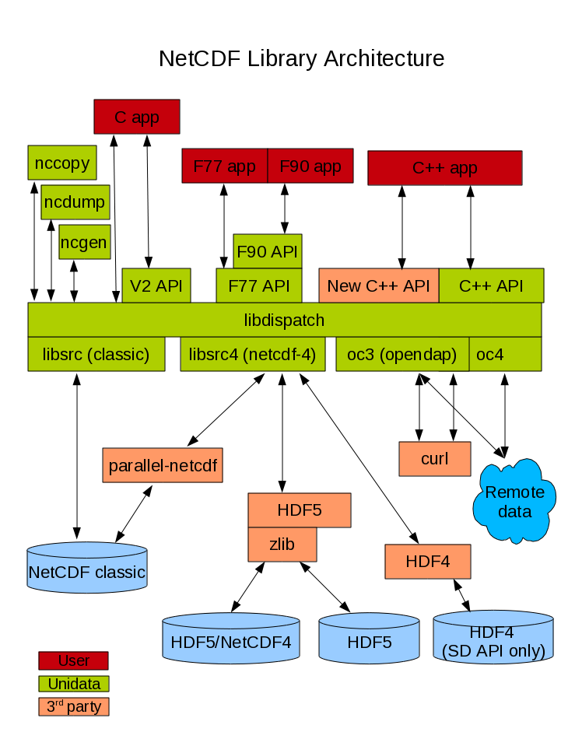
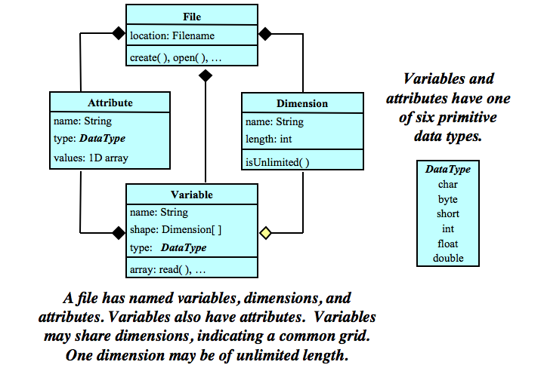
netCDF
Array-oriented scientific data:
Interface for access (C, Fortran, Java, etc.)
Machine-independent encoding format
Reference libraries (C and Java)

Slide 8
Unidata User Community
Support the community
User Workshops
Training Workshops
Mailing lists
For specific software packages
“community” email list – for Unidata community announcements
Represent and advocate for the community
More: http://www.unidata.ucar.edu/

Slide 9
Why Unidata and Python?
Embraced by the earth science community
Language popularity measured by search hits on AMS web site
Requests from Unidata community for Python support
Year | Python | Java | Fortran
2010 | 2 | 7 | 2
2011 | 19 | 2 | 4
2012 | 57 | 9 | 2
2013 | 60 | 12 | 9
2014 | 60 | 7 | 5

Slide 10
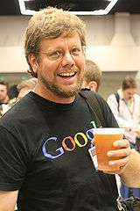
What is Python?
General purpose, high-level language invented by Guido van Rossum.
Multiple paradigms
scripting
object-oriented
imperative
functional
"Python is executable pseudocode"

Slide 11
Unidata and Python
"I have used a combination of Perl, Fortran, NCL, Matlab, R and others for routine research, but found out this general-purpose language, Python, can handle almost all in an efficient way from requesting data from remote online sites to statistics, graphics." - UCAR Scientist
Avenue for exploring, and leveraging netCDF and THREDDS Data Server technologies.
Embraced by earth science community for analysis and exploration (see table).
Publication quality graphics and visualization which are improving all the time.

Slide 12
Python Environment
Setting up a Python environment can be challenging. Some libraries require native dependencies. There are various solutions to this problem.
Use a commercial Python distribution with a package manager. Academic use is typically free. This is a good option for beginners but has limitations.
“Roll your own" Python library management strategy as you gain experience.
For various reasons the scientific Python world is still at Python 2.7.x so that is what we will be using.

Slide 13
Python Editor
Today, we will be using the ipython notebook. It is good for presentations and sharing finished code. It is not so good for code development. Here are some Python IDEs:
Python Tools for Visual Studio
Spyder (Scientific Python Developement EnviRonment)
Emacs Ipython Notebook
Enthought Canopy Editor
Wakari, a hosted Python data analysis environment

Slide 14
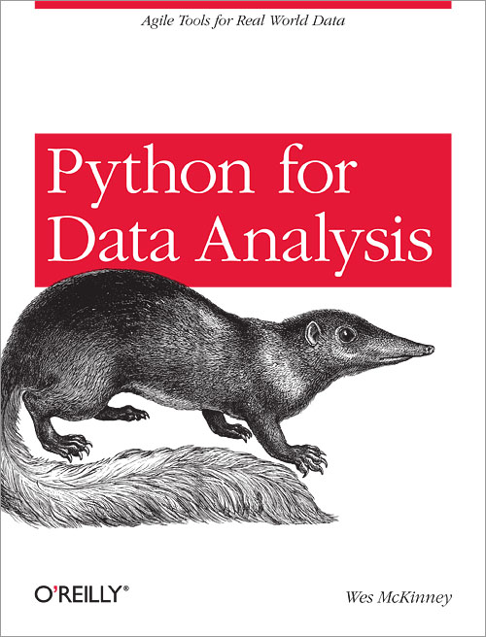
Python Background material
A Hands-On Introduction to Using Python in the Atmospheric and Oceanic Sciences
Lectures on scientific computing with Python
Why Python is the Next Wave in Earth Sciences Computing
Oceanographic Anaylsis with Python - Rich Signell
Python Scientific Lecture Notes
Enthought

Slide 15
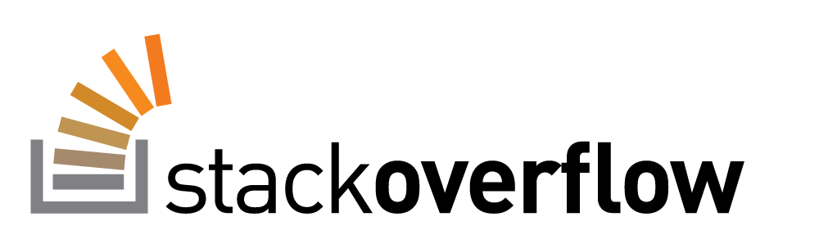
Where to ask for Help
Tag your questions with python, netcdf, thredds, etc.

Slide 16
Let’s Get Started Today We Will …
Read and write netCDF files
Use matplotlib to visualization geoscience data
Read model and station data from a TDS NCSS
Accessing data with PyDAP
Read Radar Level 2 data
Request maps from an OGC WMS server

